Slide 1
Introduction to Bootstrap-4
By Misbah Rahman

Slide 2
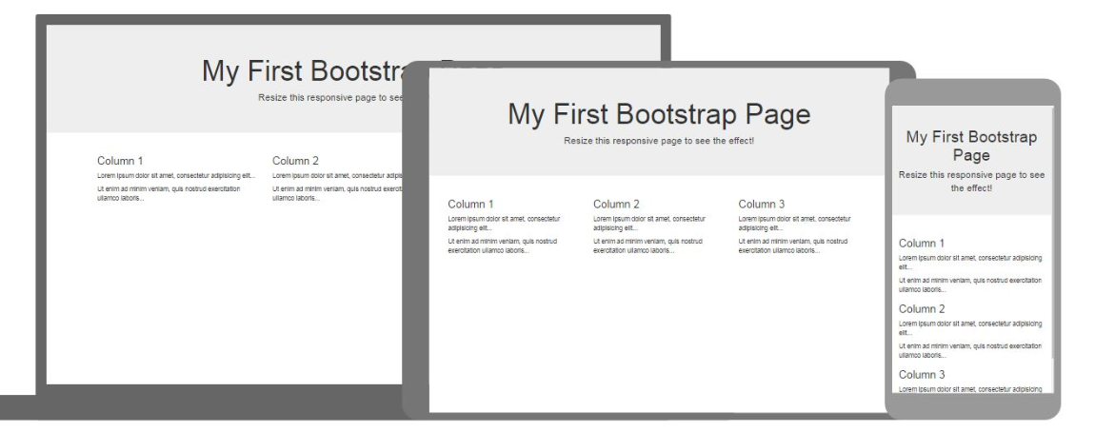
What is Bootstrap?
Bootstrap is the most popular CSS Framework for developing responsive and mobile-first websites.

Slide 3




Benefits of Bootstrap:
➔Bootstrap is Easy to Use: Bootstrap is very easy and quite simple to use for designing and development. Being a new framework there is a lot to learn from it. It can be used with CSS, LESS or SaaS etc.
➔Fast and Time-Saving Framework: Bootstrap is an agile framework which is quite faster than other frameworks. It saves time due to its standard ready-made coding blocks, responsiveness, and cross-browser capabilities
➔Bootstrap is totally Customizable: It is developer friendly and can be customized as per the project requirements. Common CSS, utilities, Javascript Components, and components can compose the appearance to create ease for developers.

Slide 4
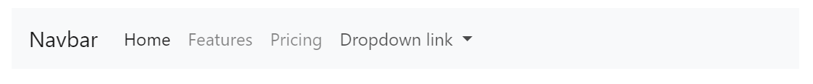
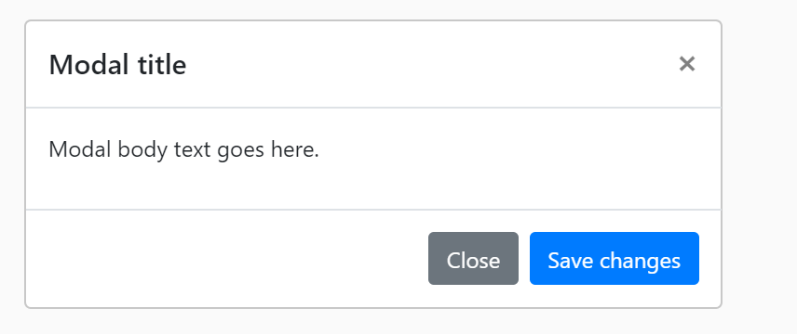
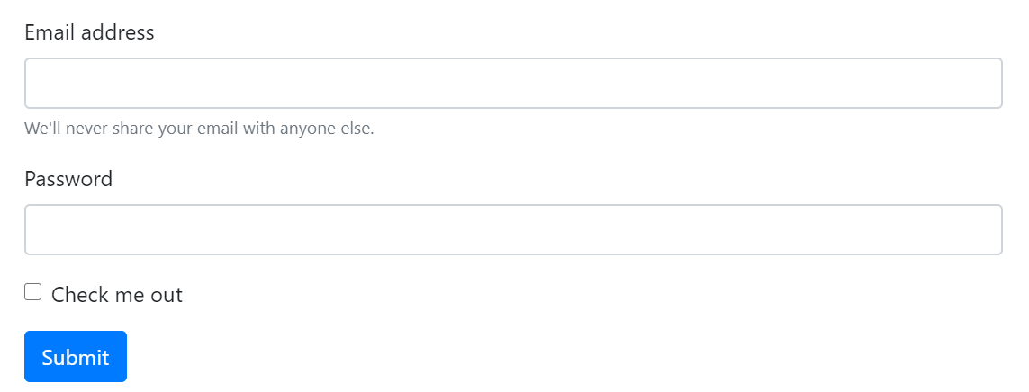
Major used Component of Botstrap:
➔ Navbar & navs
➔ Modal and List group
➔Form Object

