Slide 1
Digital Multimeter
Cameron McGary, Joel Castro

Slide 2
Why this project?
Experiment with output via LCD
Utilize the A/D conversion in the AVR
Try to create a usable device without being tied to a PC's serial/USB port

Slide 3
Components of this project
Amplifiers
Power Supply
LCD Screen
The ATMEGA88PA chip

Slide 4
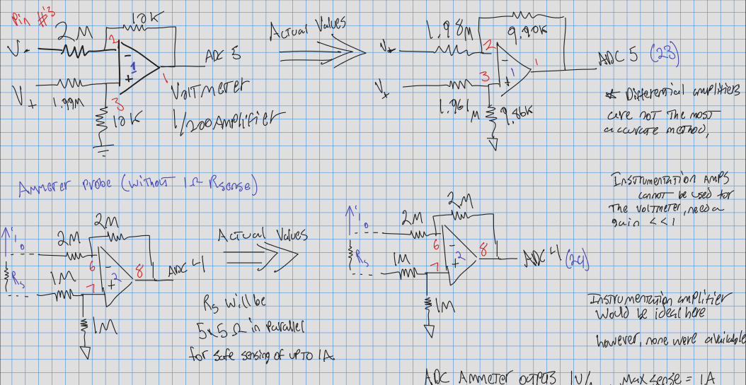
ADC Amplifiers
The ADC is limited to measuring ~1.1V or less.
In order to create a usable device, the probes must be able to measure more than this.

Slide 5
MDL-16166-LS
- Difficult initialization
- Limited number of pins on AVR
- Sharing pins temporarily
14 pin LCD
4/8bit setup
16:1 mux Display

Slide 6
AVR
28 Pins (enough)
6+ ADC
C Programmable
  AVR tool chain
Low power
Fast conversion
“Well known”

Slide 7
Power Supply

Slide 8
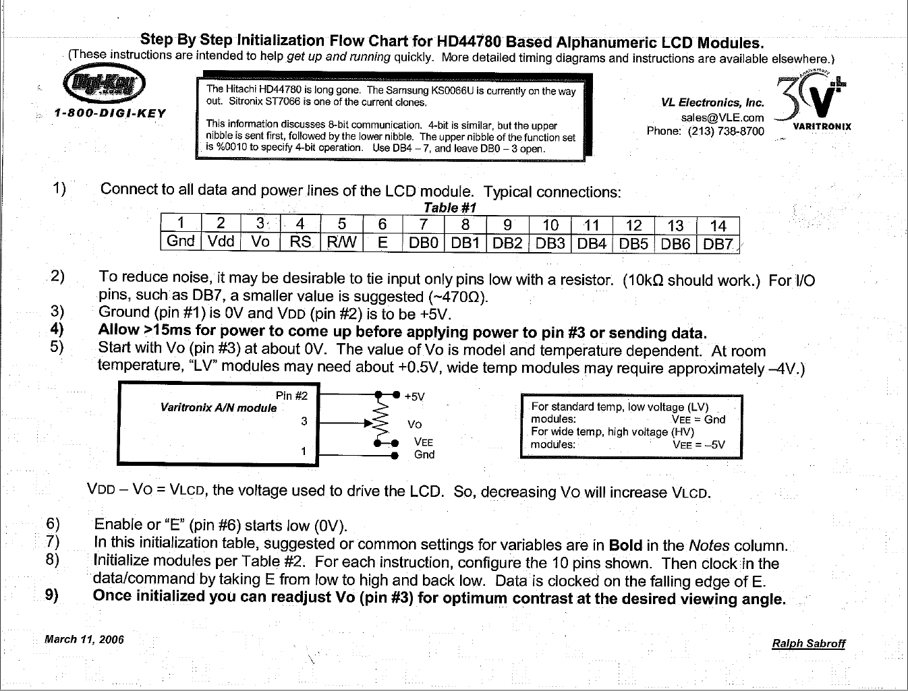
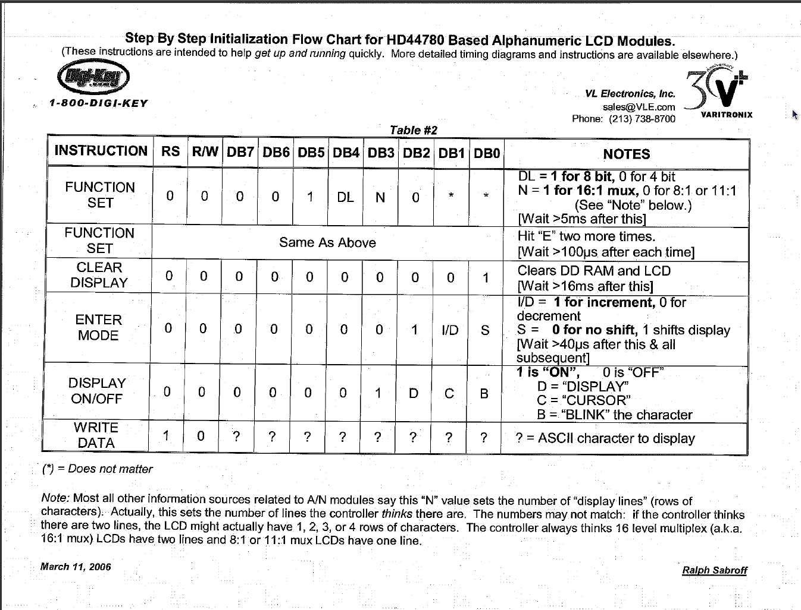
LCD Initialization
Difficult but straight- forward
Follow the steps!
Check you options.
Don't Forget Time Delays!
Don't connect to USART!

Slide 9
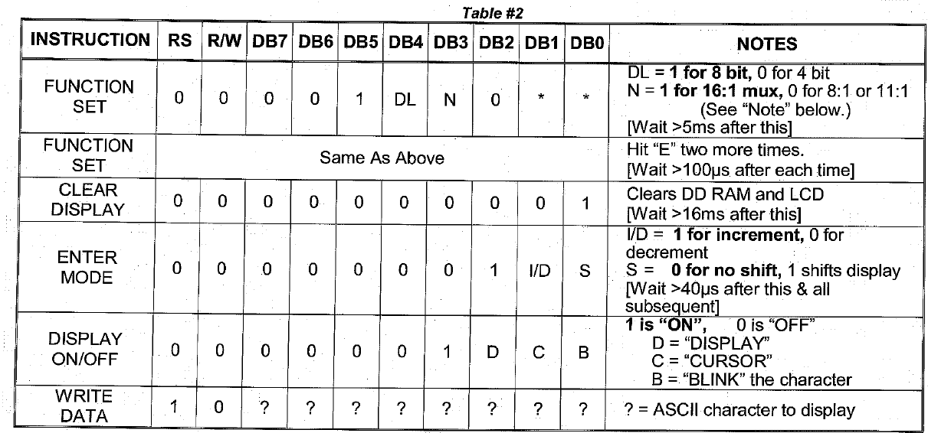
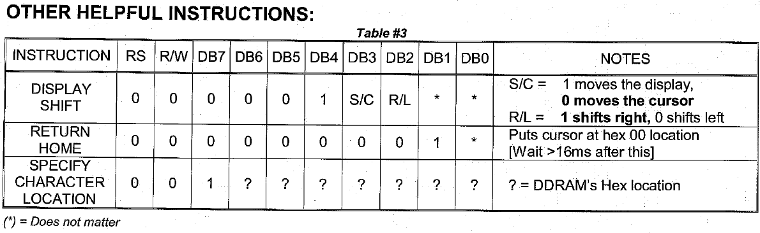
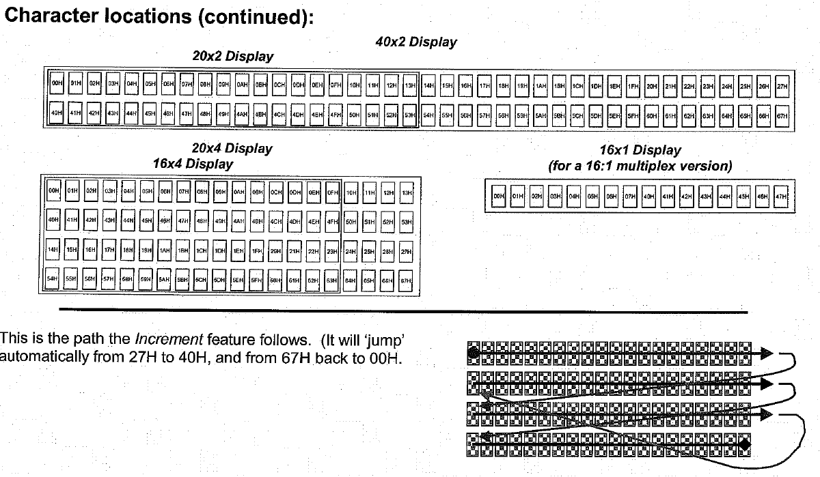
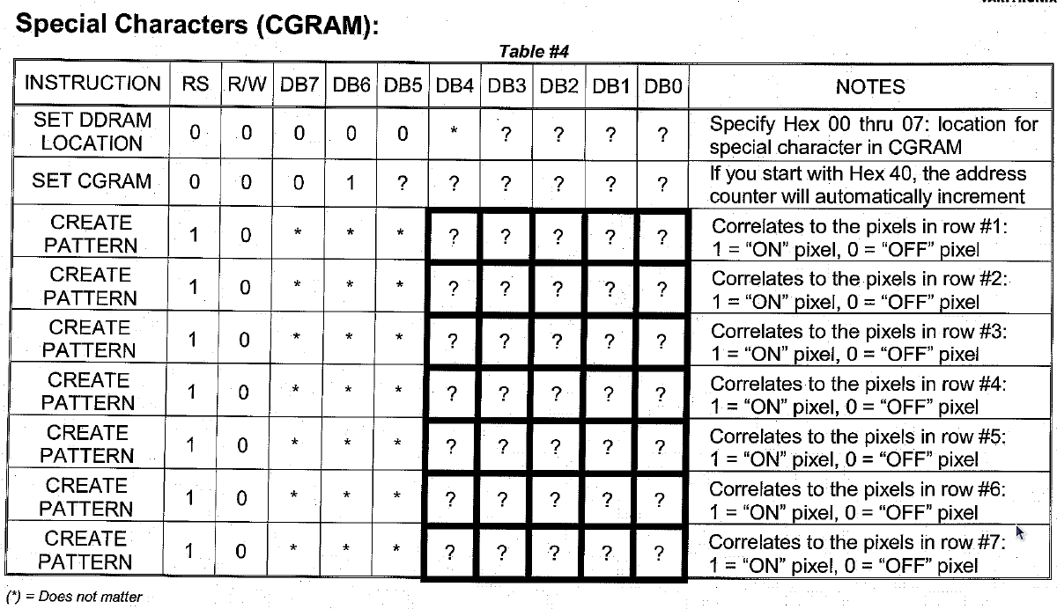
LCD Options
←most important part
←pretty useful
↓ for more complexity

Slide 10
More Information on LCD
Get the Varitronix LCD Initialization Instructions
Alternative instructions:
  http://courses.eece.maine.edu/ece177/
  16166 is a standard Hitatchi HD44780 LCD
  Other LCD's use same instructions
    Change mux setup
    LED backlight

Slide 11
Start Multimeter
Initialization

