Slide 1
CLUSTERING

Slide 2
LEARNING OBJECTIVES
COMMUNICATING RESULTS
Supervised vs unsupervised algorithms
Understand and apply k-means clustering
Density-based clustering: DBSCAN
Silhouette Metric

Slide 3
OPENING
UNSUPERVISED LEARNING

Slide 4
Unsupervised Learning
There are two main categories of machine learning: supervised learning and unsupervised learning.
Unsupervised learning:
Extracting structure from data
Example: segment grocery store shoppers into “clusters” that exhibit similar behaviors
Goal is “representation”

Slide 5
UNSUPERVISED LEARNING
So far all the algorithms we have used are supervised: each observation (row of data) came with one or more labels, either categorical variables (classes) or measurements (regression)
Unsupervised learning has a different goal: feature discovery
Clustering is a common and fundamental example of unsupervised learning
Clustering algorithms try to find meaningful groups within data

Slide 6
Unsupervised Learning
Unsupervised learning has some clear differences from supervised learning. With unsupervised learning:
There is no clear objective
There is no “right anwser” (hard to tell how well you are doing)
There is no response variable, just observations with features
Labeled data is not required

Slide 7
Unsupervised Learning
Unsupervised learning example: Coin clustering
Observations: Coins
Features: Size and mass
Response: There isn’t one (no hand-labeling required!)
Perform unsupervised learning
Cluster the coins based on “similarity”
You’re done!

Slide 8
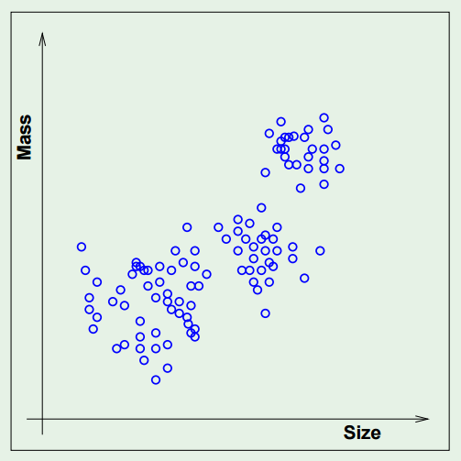
Unsupervised Learning

Slide 9
Unsupervised Learning
Common types of unsupervised learning:
Clustering: group “similar” data points together
Dimensionality Reduction: reduce the dimensionality of a dataset by extracting features that capture most of the variance in the data
Decision Trees
Principal Component Analysis

Slide 10
CLUSTERING
CLUSTERING

Slide 11
INTRO TO CLUSTERING
Clustering is the task of dividing the population (our data) into a number of groups such that data points within each group are more similar to its own group than other groups. Simply put – the goal is to segregate groups with similar traits into clusters. We’ll talk today about three different models.
Centroid Models - iterative clustering algorithms in which the notion of similarity is derived by the closeness of a data point to the centroid of the clusters. In these models, the no. of clusters required at the end have to be mentioned beforehand, which makes it important to have prior knowledge of the dataset. These models run iteratively to find the local optima.
Hierarchical Models - clustering algorithm that builds hierarchy of clusters. This algorithm starts with all the data points assigned to a cluster of their own. Then two nearest clusters are merged into the same cluster. In the end, this algorithm terminates when there is only a single cluster left.
Density Models: These models search the data space for areas of varied density of data points in the data space. It isolates various different density regions and assign the data points within these regions in the same cluster. Popular examples of density models are DBSCAN and OPTICS.

Slide 12
INTRO TO CLUSTERING
Clustering has a large no. of applications spread across various domains. Some of the most popular applications of clustering are:
OR
When your boss comes to you and says “Help me understand our customers better so we can better sell them things”
Since there’s no specific objective we aren’t looking for specific insights into a phenomena. So instead we can look for structures within our data without being tied to a specific objective.
Recommendation engines
Market segmentation
Social network analysis
Search result grouping
Medical imaging
Image segmentation
Anomaly detection
Clusters add new features to our data by grouping them together through similarity

Slide 13
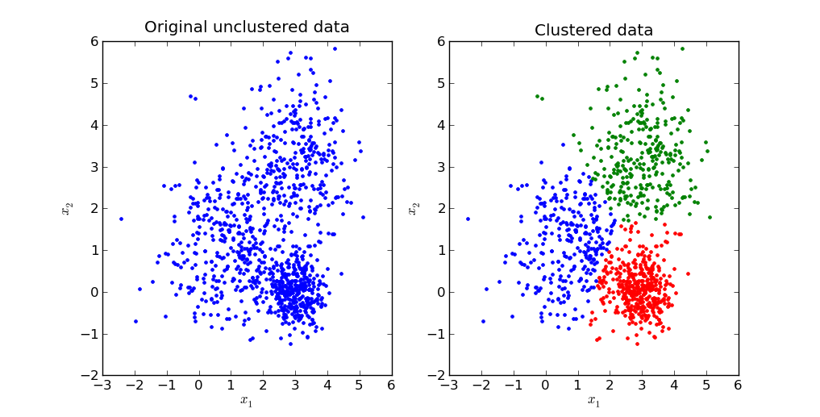
CLUSTERING: Centroids
Source: http://stackoverflow.com/questions/24645068/k-means-clustering-major-understanding-issue

Slide 14

ACTIVITY: KNOWLEDGE CHECK
ANSWER THE FOLLOWING QUESTIONS
Why might data often appear in centered clusters?
EXERCISE
DELIVERABLE
Answers to the above questions

Slide 15
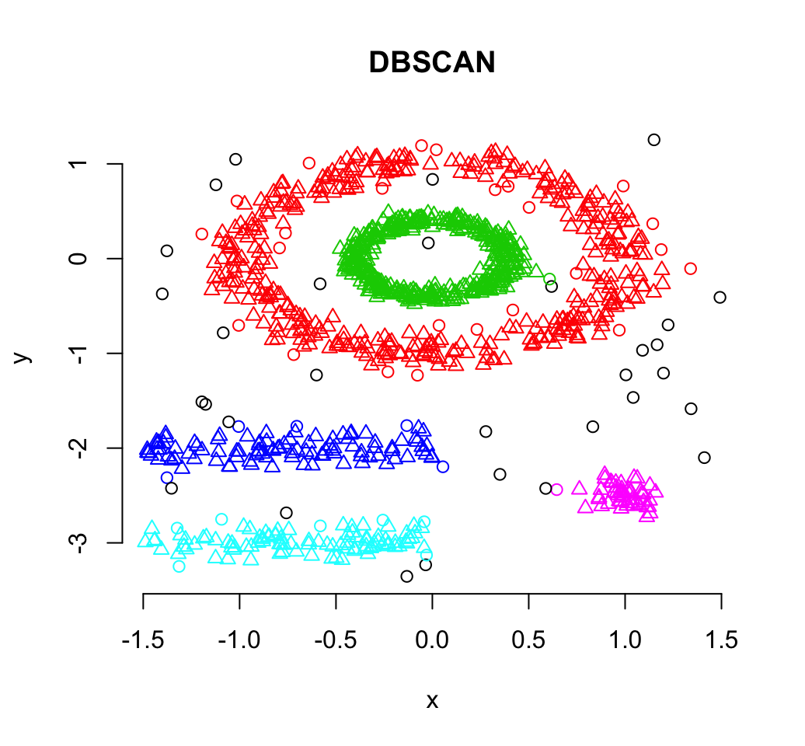
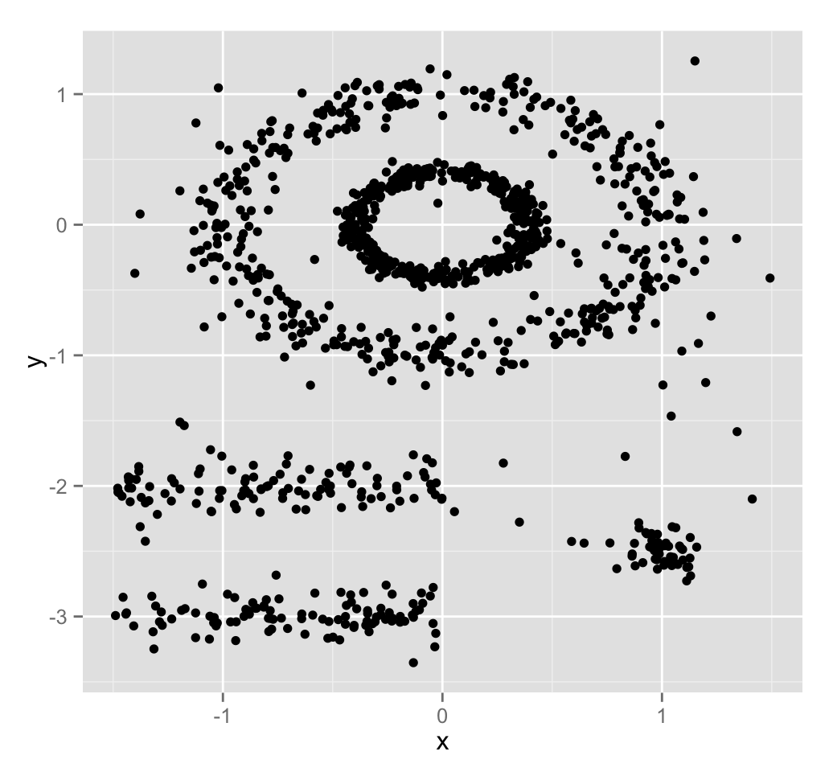
CLUSTERING: Density-Based
Source: http://www.sthda.com/english/wiki/dbscan-density-based-clustering-for-discovering-clusters-in-large-datasets-with-noise-unsupervised-machine-learning

Slide 16
ACTIVITY: KNOWLEDGE CHECK
ANSWER THE FOLLOWING QUESTIONS
Why might data often appear in density-based clusters?
EXERCISE
DELIVERABLE
Answers to the above questions

Slide 17
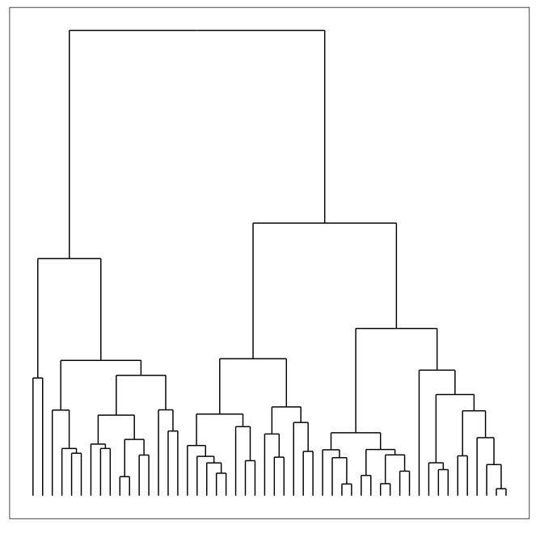
CLUSTERING: Hierarchical
Build hierarchies that form clusters
Based on classification trees (future lesson)

Slide 18
ACTIVITY: KNOWLEDGE CHECK
ANSWER THE FOLLOWING QUESTIONS
How is unsupervised learning different from classification?
EXERCISE
DELIVERABLE
Answers to the above questions

Slide 19
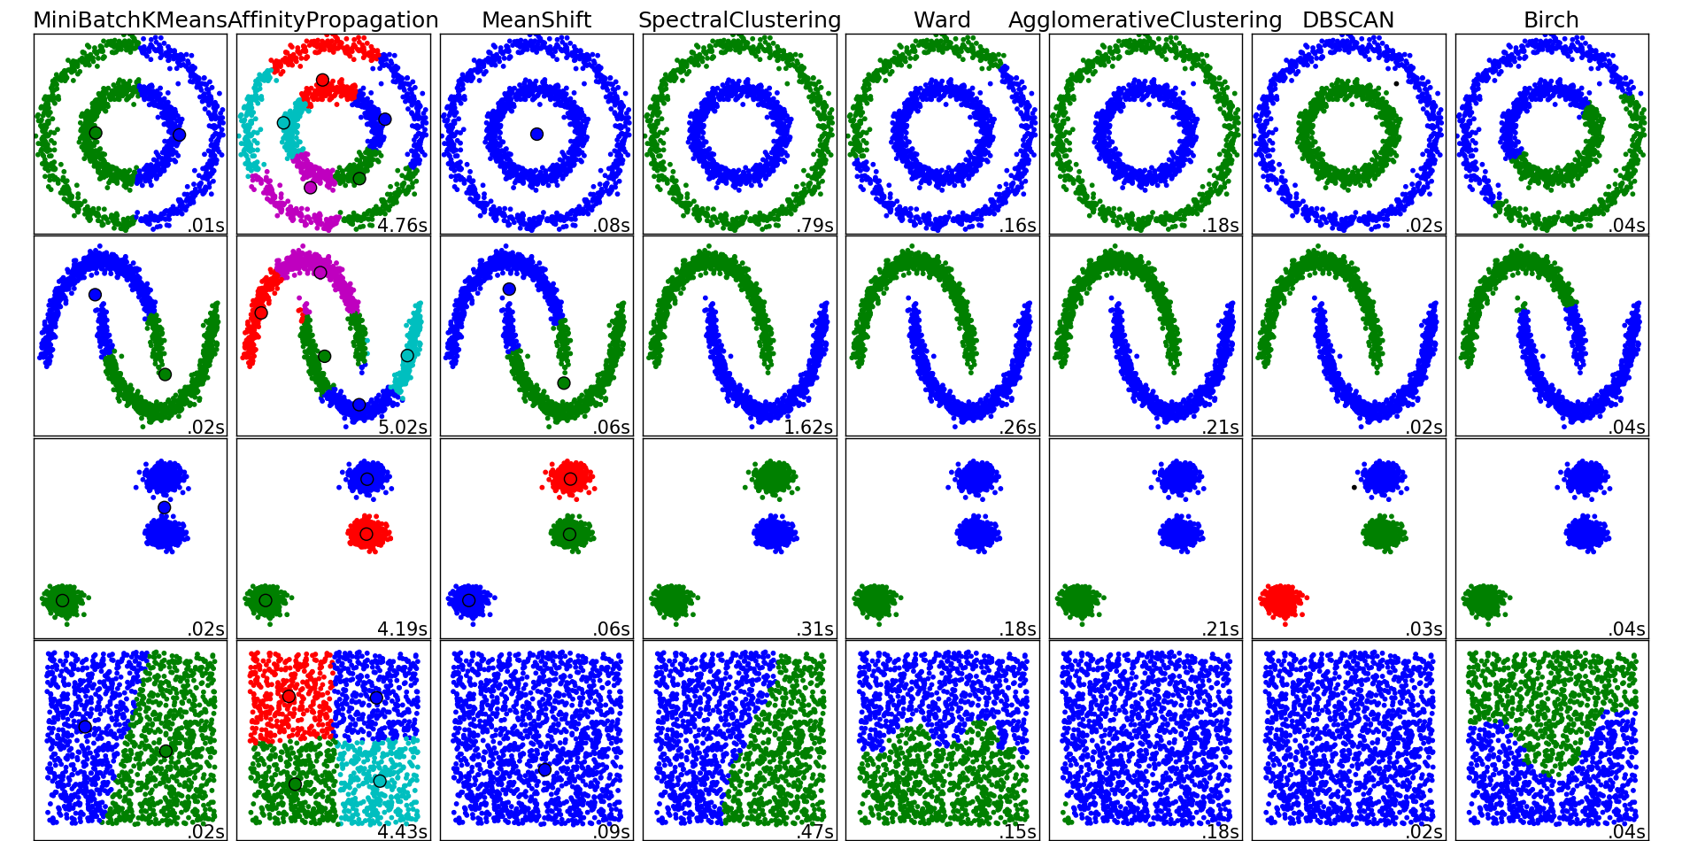
CLUSTERING
There are many clustering algorithms

Slide 20
ACTIVITY: KNOWLEDGE CHECK
ANSWER THE FOLLOWING QUESTIONS
Can you think of a real-world clustering application?
EXERCISE
DELIVERABLE
Answers to the above questions

Slide 21
ACTIVITY: KNOWLEDGE CHECK
ANSWERS
Recommendation Systems e.g. Netflix genres
Medical Imaging: differentiate tissues
Identifying market segments
Discover communities in social networks
Lots of applications for genomic sequences (homologous sequences, genotypes)
Earthquake epicenters
Fraud detection
EXERCISE

Slide 22
CLUSTERING
K-MEANS: CENTRIOD CLUSTERING

Slide 23
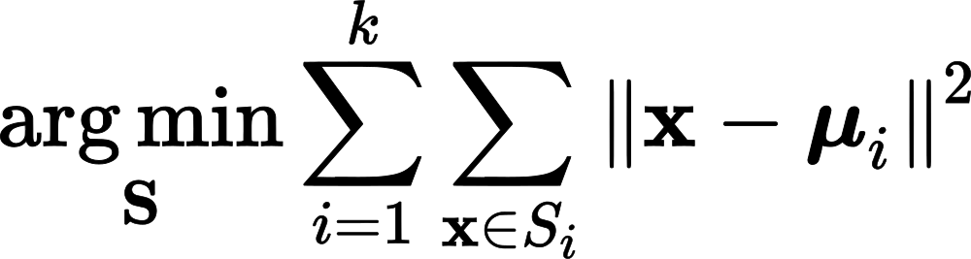
K-MEANS CLUSTERING
k-Means seeks to minimize the sum of squares about the means
Precisely, find k subsets S_1, … S_k of the data with means mu_1, …, mu_k that minimizes:

Slide 24
K-MEANS CLUSTERING
k-Means clustering is a popular centroid-based clustering algorithm
Basic idea: find k clusters in the data centrally located around various mean points
Awesome Demo

Slide 25
K-MEANS CLUSTERING
This is a computationally difficult problem to solve so we rely on heuristics
The “standard” heuristic is called “Lloyd’s Algorithm”:
Start with k initial mean values
Data points are then split up into a Voronoi diagram
Each point is assigned to the “closest” mean
Calculate new means based on centroids of points in the cluster
Repeat until clusters do not change

Slide 26
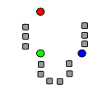
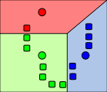
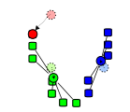
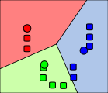
K-MEANS CLUSTERING
Start with initial k mean values
Data points are then split up into a Voronoi diagram
Calculate new means based on centroids

Slide 27
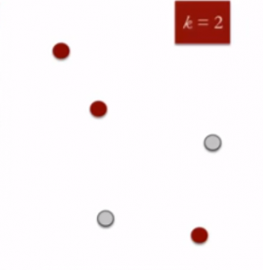
K-MEANS CLUSTERING
K means is an iterative clustering algorithm that aims to find local maxima in each iteration. This algorithm works in these 5 steps :
Specify the desired number of clusters K : Let us choose k=2 for these 5 data points in 2-D space.
Randomly assign each data point to a cluster : Let’s assign three points in cluster 1 shown using red color and two points in cluster 2 shown using grey color.

Slide 28
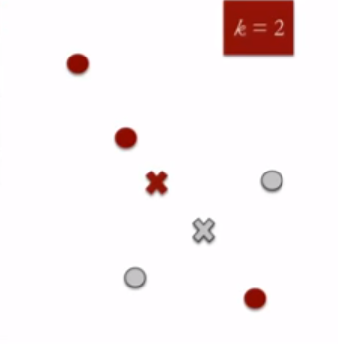
K-MEANS CLUSTERING
3. Compute cluster centroids : The centroid of data points in the red cluster is shown using red cross and those in grey cluster using grey cross.

Slide 29
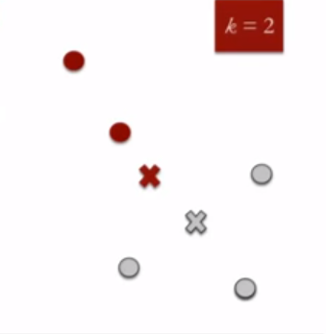
K-MEANS CLUSTERING
4. Re-assign each point to the closest cluster centroid : Note that only the data point at the bottom is assigned to the red cluster even though its closer to the centroid of grey cluster. Thus, we assign that data point into grey cluster

Slide 30
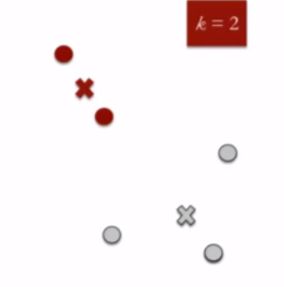
K-MEANS CLUSTERING
5. Re-compute cluster centroids : Now, re-computing the centroids for both the clusters.
6. Repeat steps 4 and 5 until no improvements are possible : Similarly, we’ll repeat the 4th and 5th steps until we’ll reach global optima. When there will be no further switching of data points between two clusters for two successive repeats. It will mark the termination of the algorithm if not explicitly mentioned.

Slide 31
ACTIVITY: KNOWLEDGE CHECK
ANSWER THE FOLLOWING QUESTIONS
How do we assign meaning to the clusters we find?
Do clusters always have meaning?
EXERCISE
DELIVERABLE
Answers to the above questions

Slide 32
K-MEANS CLUSTERING
Assumptions are important! k-Means assumes:
k is the correct number of clusters
the data is isotropically distributed (circular/spherical distribution)
the variance is the same for each variable
clusters are roughly the same size
Nice counterexamples / cases where assumptions are not met:
http://varianceexplained.org/r/kmeans-free-lunch/
Scikit-Learn Examples

Slide 33
CLUSTERING
DBSCAN: DENSITY BASED CLUSTERING

Slide 34
DBSCAN CLUSTERING
DBSCAN: Density-based spatial clustering of applications with noise (1996)
Main idea: Group together closely-packed points by identifying
Core points
Reachable points
Outliers (not reachable)

Slide 35
DBSCAN CLUSTERING
DBScan takes in two parameters:
min_samples the number of samples (or total weight) in a neighborhood for a point to be considered a core point. This includes the point itself.
Epsilon (eps) the local radius for expanding clusters. Think of it as a step size - DBSCAN never takes a step larger than this, but by doing multiple steps DBSCAN clusters can become much larger than eps.
Simply put
Eps: Maximum radius of the neighborhood.
MinPts: Minimum number of points in the Eps-neighborhood to make a determination

Slide 36
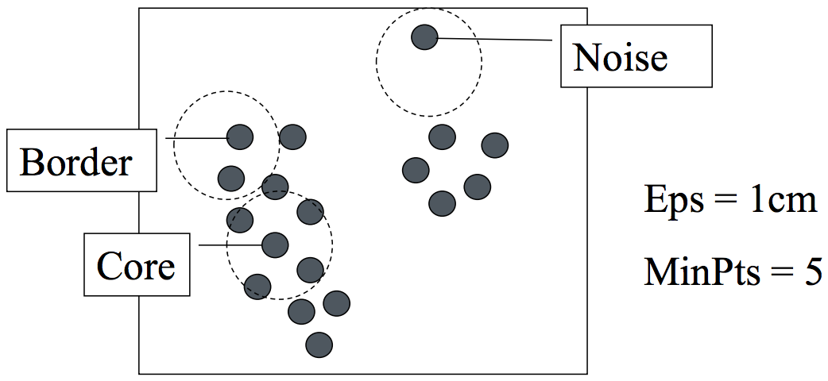
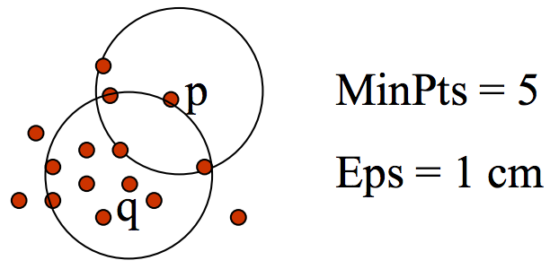
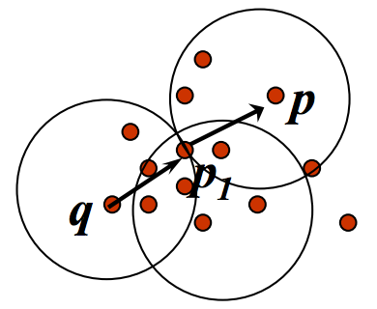
UNDERSTANDING TERMS
Terms
The Eps-neighborhood of a point: Point inside the circle
Outlier: Not in a cluster.
Core point: In a dense neighborhood
Border point: In cluster but neighborhood is not dense
Directly density-reachable: A point p is directly density-reachable from a point q
p is in the neighborhood and q is a core point
p doesn’t need to be a core point
Density-reachable: A point p is density-reachable from a point q w.r.t. Eps and MinPts if there is a chain of points p₁ … p_{n}, p₁ = q p_{n} = p such that p_{i+1} is directly density-reachable from p_{i}

Slide 37
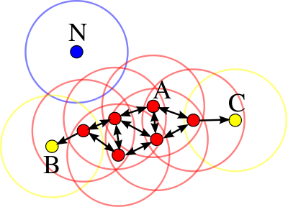
DBSCAN CLUSTERING
Core points: at least min_samples points within eps of the core point
Such points are directly reachable from the core point
Reachable: point q is reachable from p if there is a path of core points from p to q
Outlier: not reachable

Slide 38
DBSCAN CLUSTERING
A cluster is a collection of connected core and reachable points

Slide 39
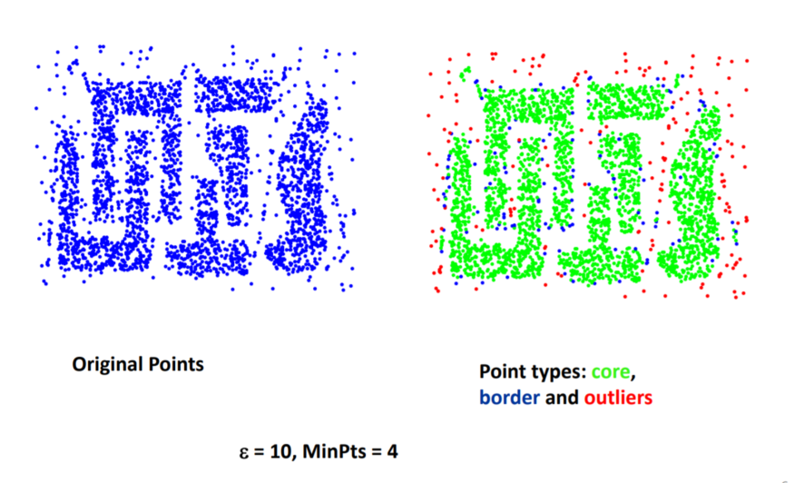
CLUSTERING: Density-Based
Another example:
Awesome Demo
Image Source

Slide 40
ACTIVITY: KNOWLEDGE CHECK
ANSWER THE FOLLOWING QUESTIONS
How does DBSCAN differ from k-means?
EXERCISE
DELIVERABLE
Answers to the above questions

Slide 41
DBSCAN CLUSTERING
DBSCAN advantages:
Can find arbitrarily-shaped clusters
Can handle clusters of different shapes and sizes
Resistant to Noise
Don’t have to specify number of clusters
Robust to outliers
DBSCAN disadvantages:
Doesn’t work well when clusters are of varying densities
hard to chose parameters that work for all clusters
Sensitive to parameter settings – Hard to determine the correct set of parameters

Slide 42
ACTIVITY: CLUSTERING USERS
ANSWER THE FOLLOWING QUESTIONS
How does DBSCAN differ from k-means?
EXERCISE
DELIVERABLE
Answers to the above questions

Slide 43
CLUSTERING
HIERARCHICAL CLUSTERING

Slide 44
CLUSTERING: Hierarchical
Build hierarchies that form clusters
Based on classification trees

Slide 45
HIERARCHICAL CLUSTERING
We’ll discuss the details once we cover decision trees. For now we can black box the model and fit with sklearn
from sklearn.cluster import AgglomerativeClustering
est = AgglomerativeClustering(n_clusters=4)
est.fit(X)
labels = est.labels_
Let’s try it out!

Slide 46
CLUSTERING
CLUSTERING METRICS

Slide 47
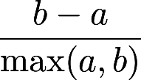
CLUSTERING METRICS
As usual we need a metric to evaluate model fit
For clustering we use a metric called the Silhouette Coefficient
a is the mean distance between a sample and all other points in the cluster
b is the mean distance between a sample and all other points in the nearest cluster
The Silhouette Coefficient is:
Ranges between 1 and -1
Average over all points to judge the cluster algorithm

Slide 48
CLUSTERING METRICS
from sklearn import metrics
from sklearn.cluster import KMeans
kmeans_model = KMeans(n_clusters=3, random_state=1).fit(X)
labels = kmeans_model.labels_
metrics.silhouette_score(X, labels, metric='euclidean')

Slide 49
CLUSTERING METRICS
There are a number of other metrics based on:
Mutual Information
Homogeneity
Adjusted Rand Index (when you know the labels on the training data)

Slide 50
PUTTING IT TOGETHER
CLUSTERING, CLASSIFICATION,
AND REGRESSION

Slide 51
ACTIVITY: KNOWLEDGE CHECK
ANSWER THE FOLLOWING QUESTIONS
How might we combine clustering and classification?
EXERCISE
DELIVERABLE
Answers to the above questions

Slide 52
CLUSTERING, CLASSIFICATION, AND REGRESSION
We can use clustering to discover new features and then use those features for either classification or regression
For classification, we could use e.g. k-NN to classify new points into the discovered clusters
For regression, we could use a dummy variable for the clusters as a variable in our regression

Slide 53
CONCLUSION
TOPIC REVIEW

Slide 54
REVIEW AND NEXT STEPS
Clustering is used to discover features, e.g. segment users or assign labels (such as species)
Clustering may be the goal (user marketing) or a step in a data science pipeline

Slide 55
LESSON
Q & A

Slide 56
LESSON
EXIT TICKET
DON’T FORGET TO FILL OUT YOUR EXIT TICKET

