Slide 1

Web Apps with Symfony3

Slide 2
Level Entry
Basic GIT
PHP
  Composer (Optional)
  POO
Huevos

Slide 3
What will you learn
(Hopefully)
Install Symfony 3.2
Create entities with repositories and relationships
Use FOSUserBundle for user creation
Symfony routing basic usage
Create RESTFul API with FOSRest
Form creations
CSRF tokens
Validations
Protect API with
  Symfony Firewall
    Basic Authentication
    ApiKey based authentication
CORS settings
Documentate API with NelmioAPIDocBundle

Slide 4
Next courses (API)
Monolog usage
Create services
Symfony migrations
Configure ROLES HIERARCHY
Security Providers
Symfony Firewalls
Symfony Access Control List (ACL)
GedmoTree for Categories (Taxonomies)
Create Event Listeners
CreateQueryBuilder usage
Easy joins with createQueryBuilder
VirtualProperty for FOSRestBundle
Create slugs for entities
Versioning entities
Retrieve entities versions
SoftDeletableFilter
Trace changes by IP
WebProfiler toolbar
Blackfire introduction

Slide 5
Next courses (WebClient)
JQuery client
Login form firewall
Symfony Voters Security System
Twig & Twig extensions ( functions & filters )
Extend FOSUserBundle views and controllers
Advanced routing system
Translate static text with LexikTranslationBundle
Select user language using EventListener
FOSJSRouteBundle usage
Build menus with KnpMenuBuilder
Upload files with VichUploaderBundle
Jshrink usage
Templates using jQuery tmpl plugin

Slide 6
Let’s start easy

Slide 7
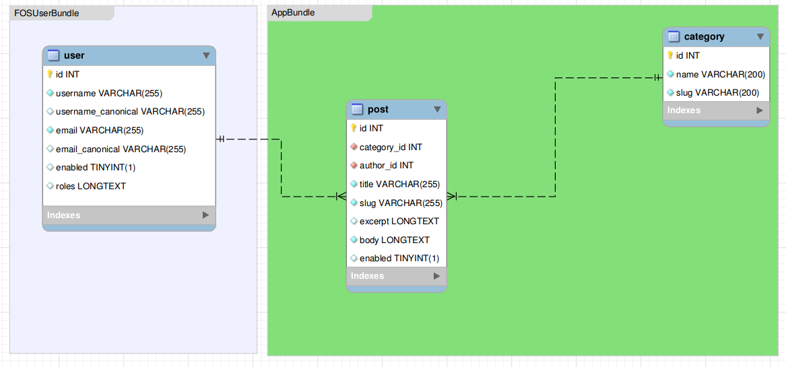
Model

Slide 8
symfony.com

