Slide 1

Yoga Clusters in NYC

Slide 2

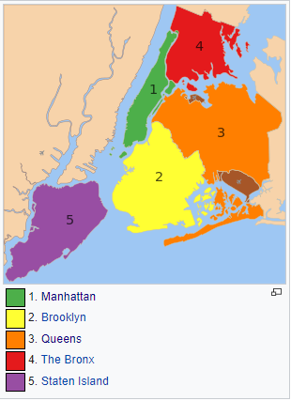
Yoga Clusters in NYC - Overview

Slide 3
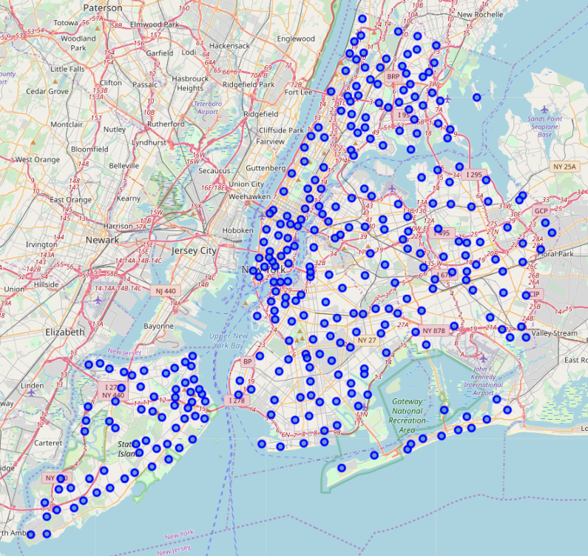
Yoga Clusters in NYC - Neighborhoods

Slide 4
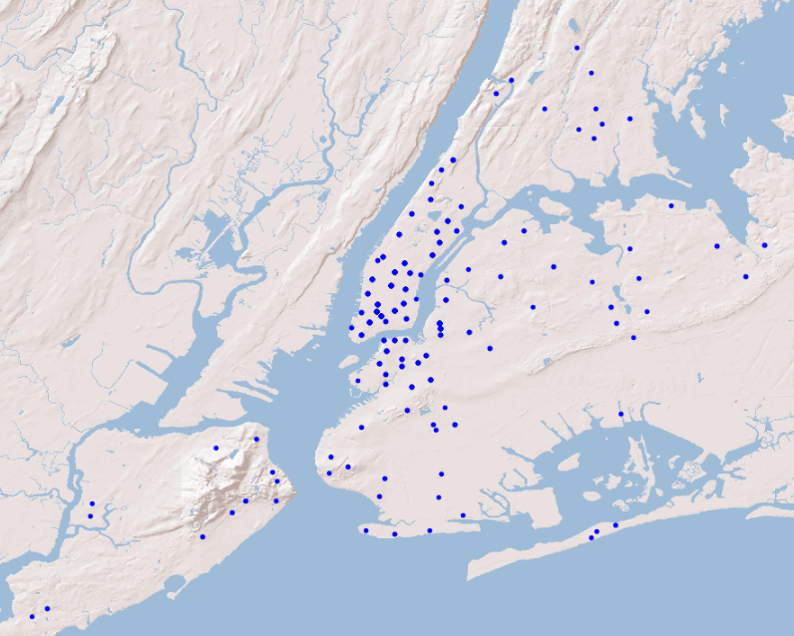
Yoga Clusters in NYC – Studio Locations

Slide 5
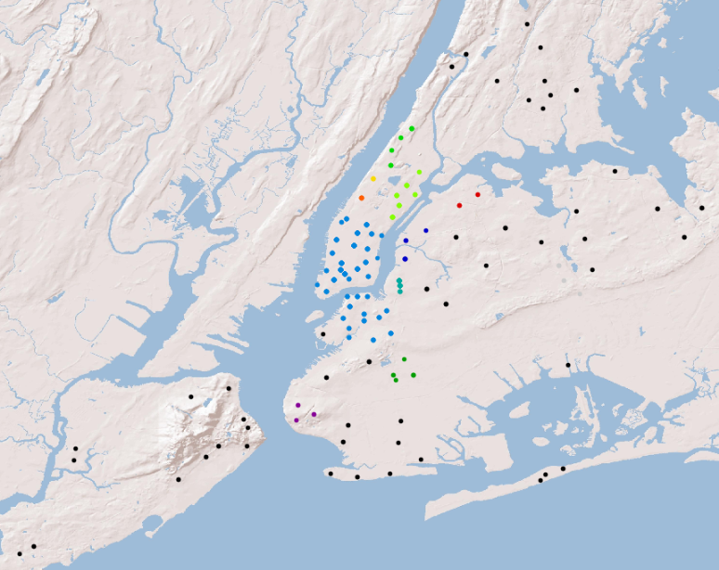
Yoga Clusters in NYC – Studio Clusters

Slide 6
Yoga Clusters in NYC – Studio Clusters

Slide 7
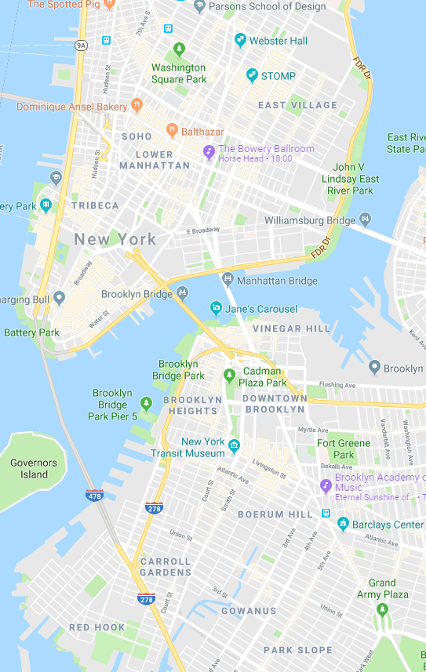
Yoga Clusters in NYC – Yoga Epicentre

