Slide 1
WebWorks Build Script
Ant Script with Lint Checking and Optimization

Slide 2
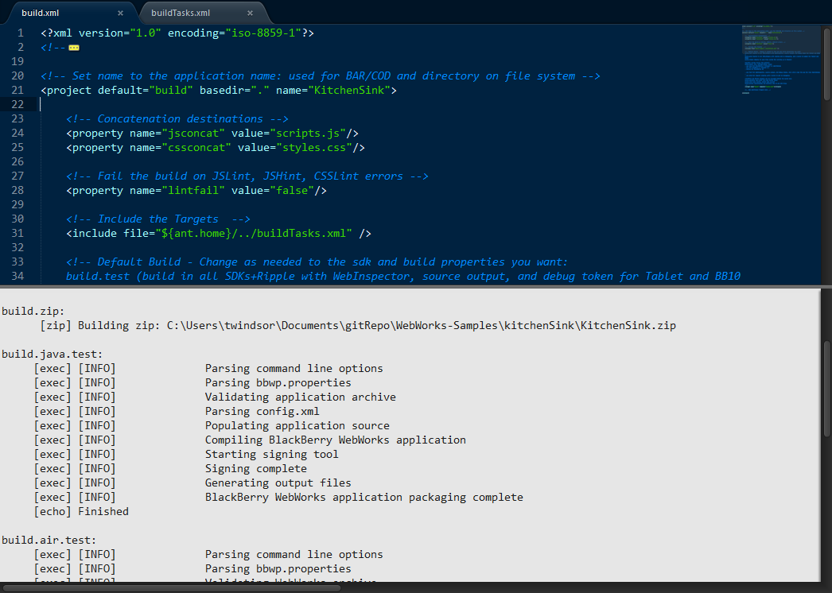
WebWorks Build Script
Ant based
JSLint, JSHint, CSSLint
YUICompressor
Build at once for BlackBerry OS, PlayBook and BlackBerry 10
Deploy to local webroot for Ripple emulator
Create and deploy debug tokens
Integrate with IDE’s

Slide 3
Three Main Parts
Main Script, your settings and tools in one central place
buildTasks.xml
buildTasks.properties
build.xml gets copied to your project
edit the project name
configure your build preferences
→ Main Script and Tools in one central place
→ buildTasks.xml (no edits required)
→ buildTasks.properties (one-time edits)
→ Drop build.xml into your project to enable building
→ Set a few properties to customize the build

Slide 4
Project Build Options
do.build.ripple copies project files to RippleSites folder for emulation testing
use.java.sdk packages using Java WebWorks SDK
use.tablet.sdk packages using Tablet OS WebWorks SDK
use.bb10.sdk packages using BB10 WebWorks SDK
use.[java | tablet | bb10].device deploys to device if true, simulator if false
do.[java | tablet | bb10].build.type = [debug, beta, release]
- debug for WebInspector, source output, and debug tokens; signs Java Smartphones apps
- release for regular signing with a build id and no debugging.
- beta for regular signing with a build id and WebInspector turned on
optimize runs both lint and minify tasks
lint runs jslint, jshint and csslint
minify concatenates and minifies the JS and CSS files

Slide 5
Common Repetitive Tasks
createDebugToken.[tablet | bb10] creates a new debug token
deployDebugToken.[tablet | bb10] deploys debug token to device
setDebugToken.tablet moves debug token to ${user.home}, you still must modify bbwp.properties

Slide 6
buildTasks.properties
file.excludes = build/ bin/ .externalToolBuilders/ *.md *.zip .project build.xml .iml .idea
sign.pw = your signing key password
ant.home = C:/BB10-WebWorks-Community-Samples-Fork-RodNolan/Ant-Build-Script/tools/apache-ant-1.8.2
ripple.basedir = C:/Users/Rod Nolan/RippleSites
wwsdk.bb10.dir = C:/Program Files (x86)/Research In Motion/BlackBerry 10 WebWorks SDK 1.0.2.9
wwsdk.java.dir = C:/Program Files (x86)/Research In Motion/BlackBerry WebWorks SDK 2.3.1.5
wwsdk.tablet.dir = C:/Program Files (x86)/Research In Motion/BlackBerry WebWorks SDK for TabletOS 2.2.0.5
bb10.pw = your bb10 device password
bb10.pin = 29D9394F
bb10.ip.device = 10.0.1.14
bb10.ip.sim = 192.168.18.132
tablet.pw = your tablet password
tablet.pin = 5020022E
tablet.ip.device = 10.0.1.15
tablet.ip.sim = 192.168.18.133
java.device.pw = your smartphone password
jsconcat = scripts.js
cssconcat = styles.css
lintfail = false

Slide 7
Get it from Github
→ https://github.com/rodnolan/BB10-WebWorks-Community-Samples
Setup windows environment
Edit buildTasks.properties to match your environment (one time only)
Copy build.xml to your project; edit project name and set build prefs
→ %ANT_HOME% = <installation path>\apache-ant-1.8.2
→ %PATH% = %PATH%;%ANT_HOME%\bin

