Slide 1
Competitors Intelligence

Slide 2
Competitor’s tracking
In order to understand our position in each market, we have been tracking some key metrics to understand the position of our competitors and capture the signals they were sending to the market to position ourselves in a more competitive place.
As mentioned before, understanding our competitors strategy is not directly possible as all the information for this kind of analysis is not directly accessible. For this reason we looked at the available metrics as proxies to get a good insight on about the market and our stand in it.
Relative Quality (P1 & P2)
Relative Price (Per Product & Country)
Sales Revenue (P1 & P2)
Market Share (Per Product & Country)
* This tool only tracks behavior after Period 60.

Slide 3
Quality

Slide 4
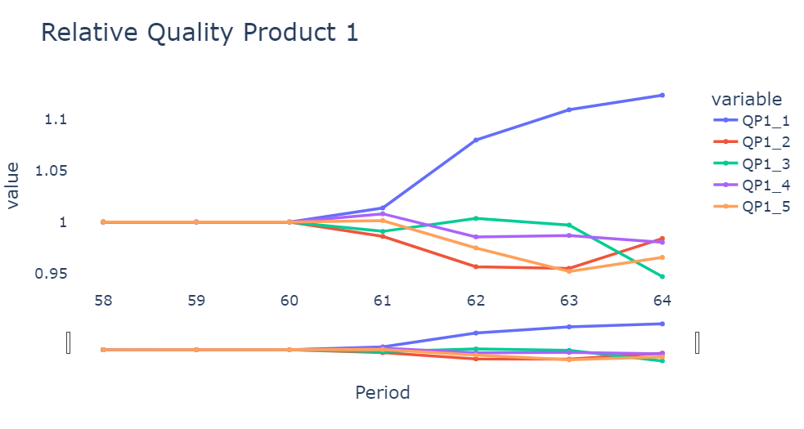
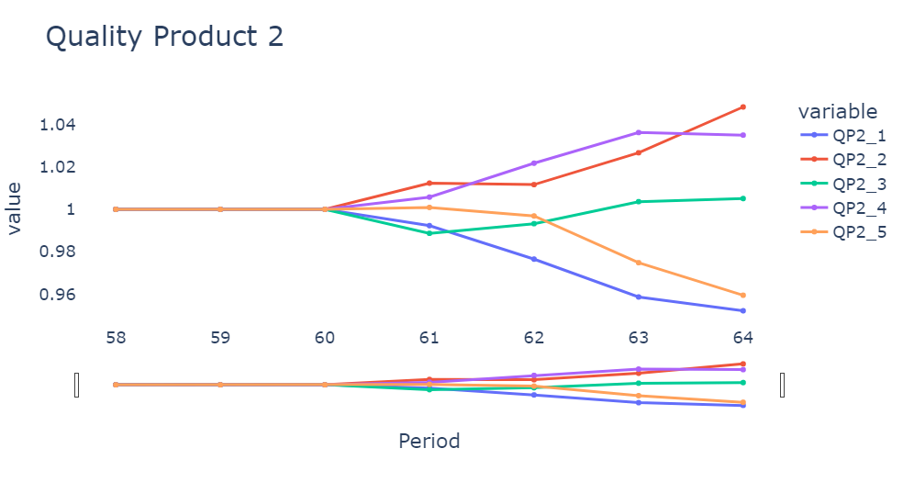
Relative Quality Highlights (Product 1 & 2)
Notes:
It is possible to notice that Company 1 is sending a signal about their strategy on Product 1 as they are competing for Product 1 in the Markets where quality (and greens) is the strongest indicator of market share. On the other hand we see the opposite behavior in regards of Product 2, where their investment on Quality as been one of the lowest during these 4 quarters.
Company 4 is also sending a strong signal but in their case this is about Product 2, where they want to position themselves as the quality leaders and dominate on the European market (which align with their relocation of the Product 2 Factory from the US to Germany).
We will keep track of Company 3 as it has been moving their Relative Quality Downwards at the same time that they have been increasing their Relative Price for Product 1.

Slide 5
Price

Slide 6
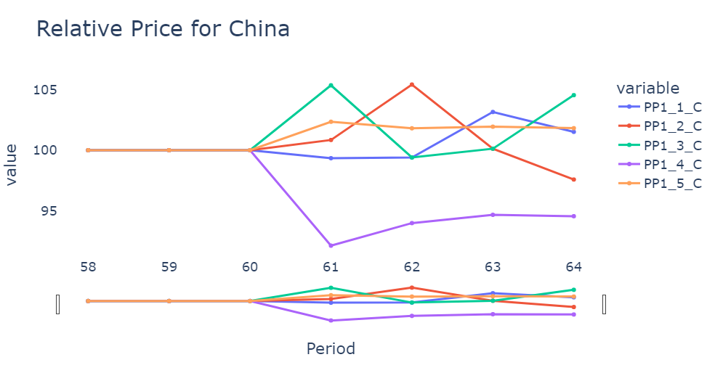
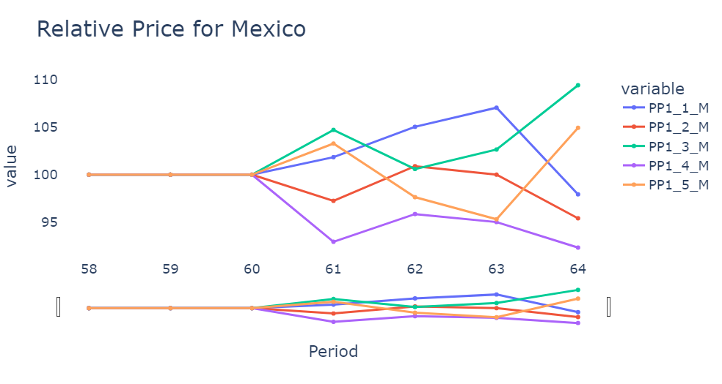
Relative Price Highlights (Product 1)
Notes:
Company 3 is the one with the highest Relative Price in China and Mexico and also the one with the lowest Relative Quality signaling their exit of the noted 2 markets.
Something similar is noticeable for Company 5 but in a more moderate way, as there are the second highest in Relative Price and the Second lowest in Relative Quality which for Product 1 are the factors that carry most weight.

Slide 7
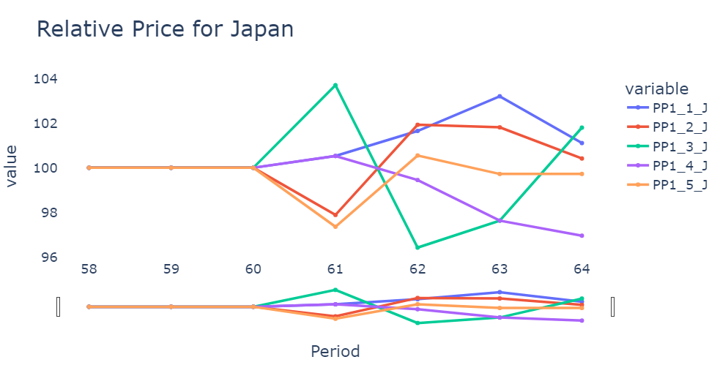
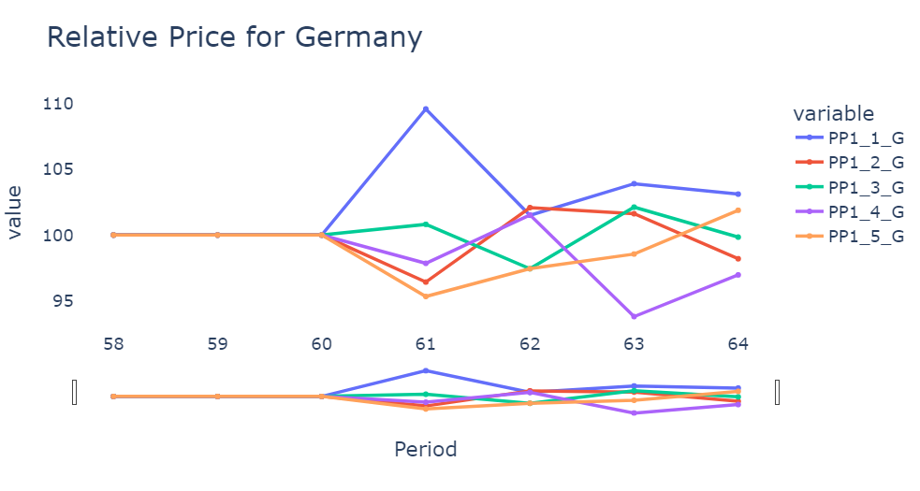
Relative Price Highlights (Product 1) continuation
Notes:
As Company 1 has the highest Relative Quality they are increasing their Relative Price positing themselves as potentials leaders of this market for the premium markets (Germany & Japan). It is important to notice that the Product 1 Market is way more sensitive to Price than Quality, but Quality is the second best predictor.

Slide 8
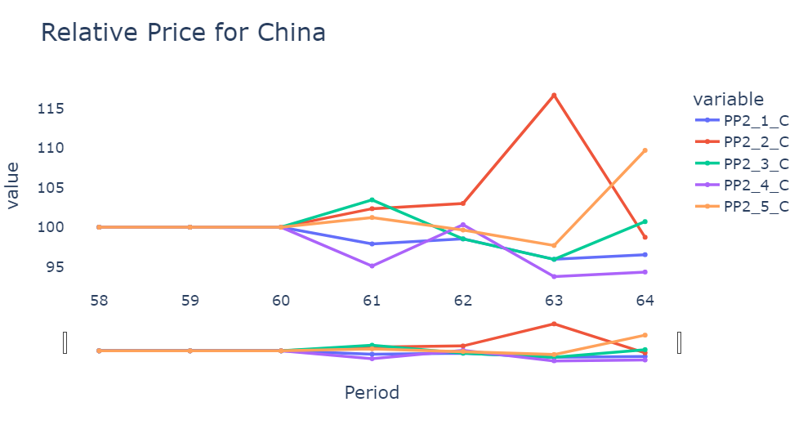
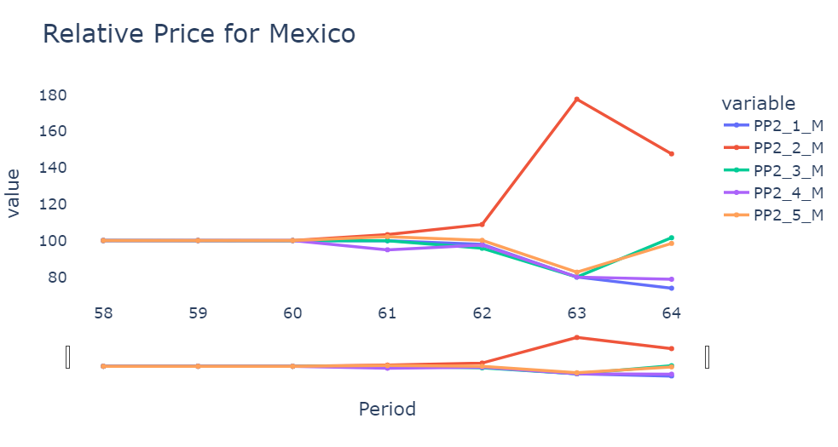
Relative Price Highlights (Product 2)
Notes:
Company 2 is signaling their exit for the Product 2 Mexico market as their increase their Relative Price substantially. Product 2 is sensitive to Quality and Greens for most markets except China and Mexico where Relative Price carries a heavy weight as well.
Company 5 is signaling their exit for the Product 2 China markets as they have the second lowest Relative Quality and Highest Relative Price. Even though we do not have a clear picture of their position on Greens, these combination of Low Quality and High price will yield very low results at least on Market share.

Slide 9
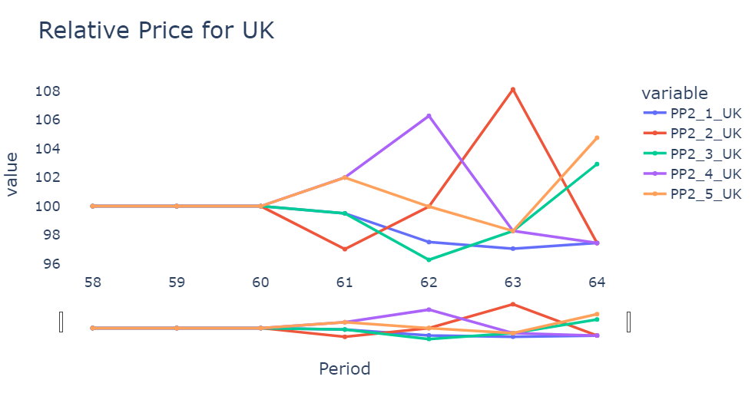
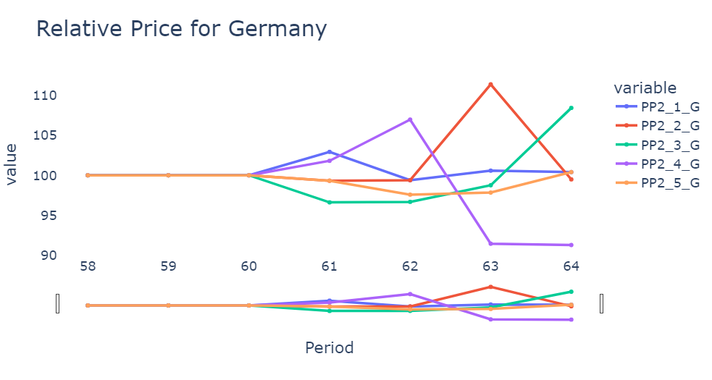
Relative Price Highlights (Product 2) continuation
Notes:
Company 2 is giving indications that is after the Premium European market for Product 2. They moved their Factory for Product 2 from the US to Germany as mentioned before and have been investing heavily in Quality and very likely on Green as well. The combination of High Quality and lower Relative Price is very likely position Company 2 as of the leaders for Product 2 for Premium markets and potentially for the US market as their lower the Relative Price for Product 2 this past quarter.
Another signal that is possible to see for Company 2 is that they relay on the delay on the effects on Increase in Quality. When investing in Quality they keep their Relative Price and after that quarter increase their Price substantially as their Perception of High Quality Products has been noticed by the market. This strategy has position Company 2 as one of the leaders on the Market.

Slide 10
Sales

Slide 11
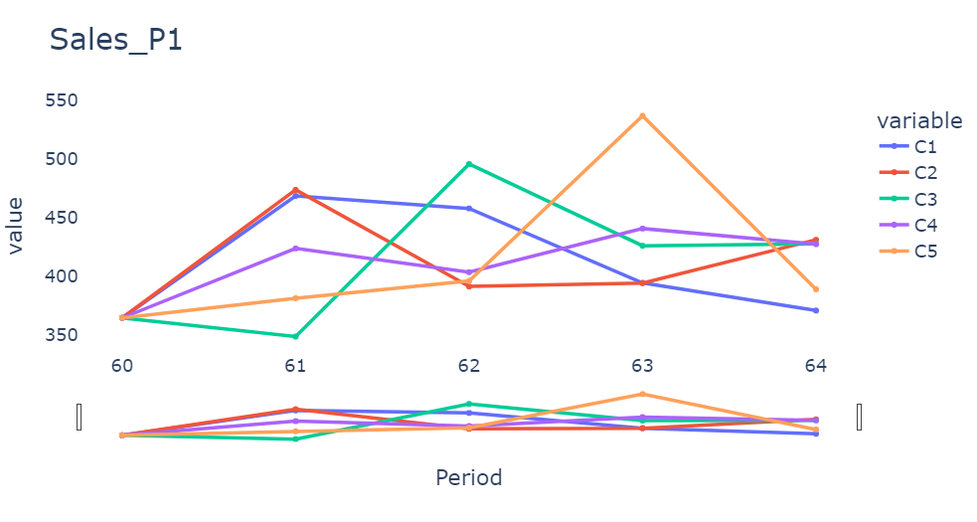
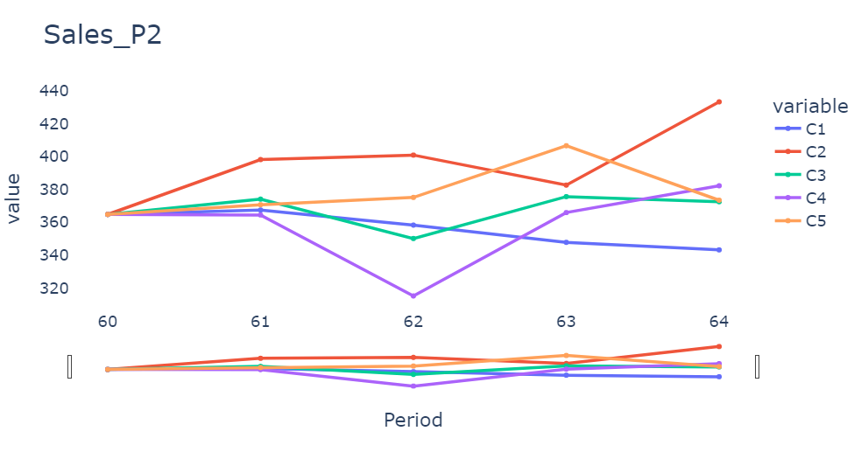
Sales in Units (Product 1 & 2)
Notes:
For Product 1 we can notice the loss in Market share for Company 5 as their strategy the last quarter did not yield the best results compared to previous quarter.
As right now per product sales Company 2 is leading on Product 2, which is reflected also in Sales Revenue (see graph below) as Product 2 have a higher Contribution to Margins than Product 1 for all the 6 markets.

Slide 12
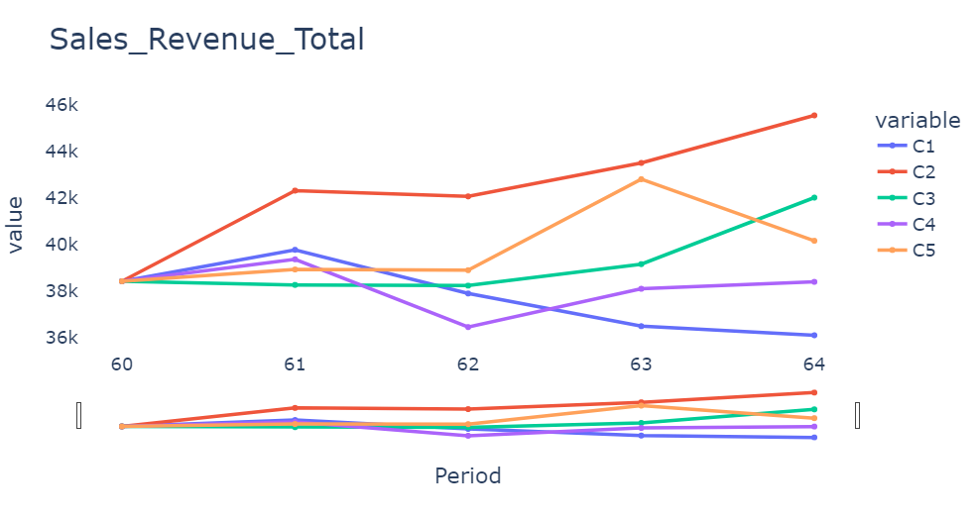
Sales Revenue Highlights (Product 1 & 2) continuation
Notes:
In a global scale the strategy of Company 2 and 3 have yield great results as both of them have been increasing almost a constant rates their Sales Revenues for both Products, by not only increasing quality and decreasing price in some markets but also exiting markets where they cannot compete.

Slide 13
Market Share

Slide 14
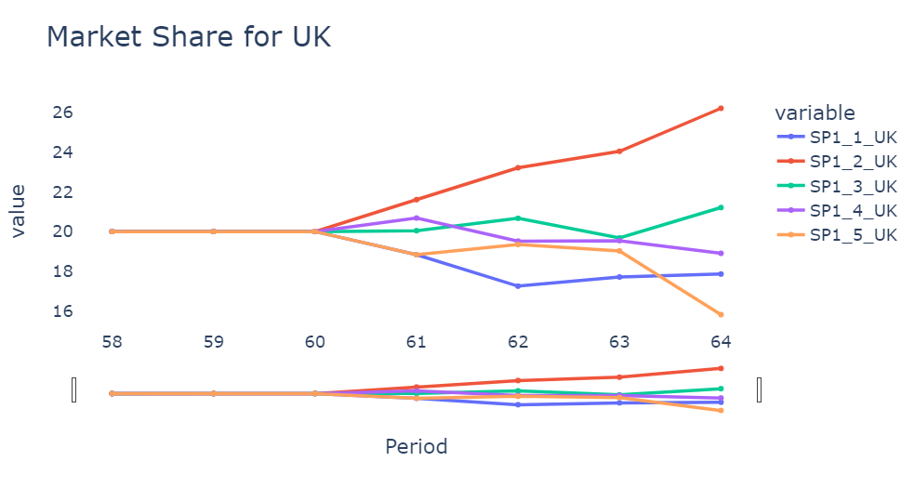
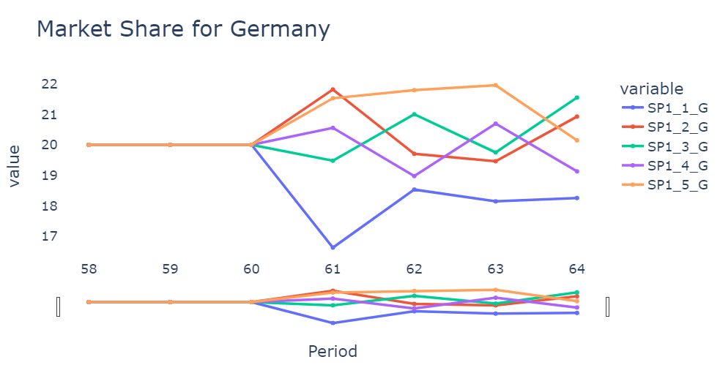
Market Share Highlights (Product 1)
Notes:
Company 2 is the leader for the UK market and seems to be moving in the same direction for the German market. This behavior is seen as well in the US and Chinese markets for Company 2 where they are leading.
Company 5 have been steadily increasing their footprint in Japan where they are the leaders in Market share.

Slide 15
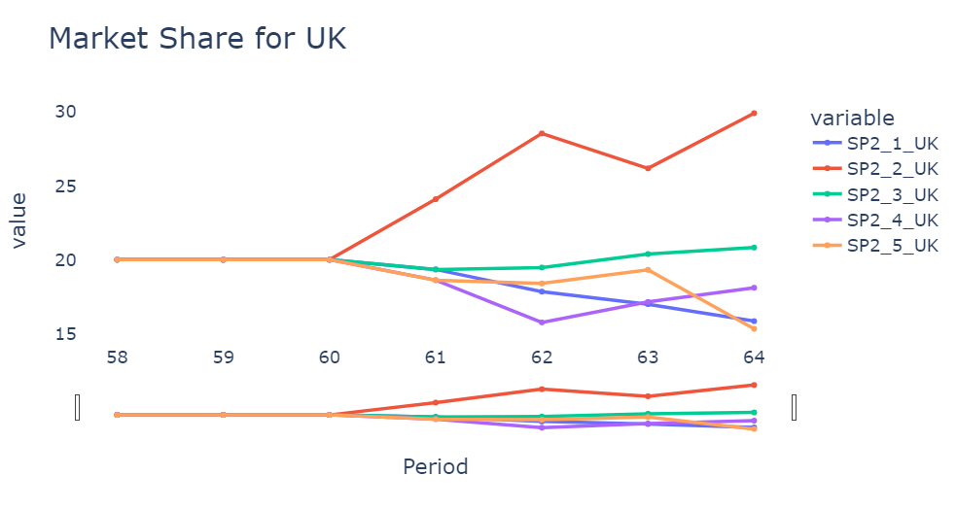
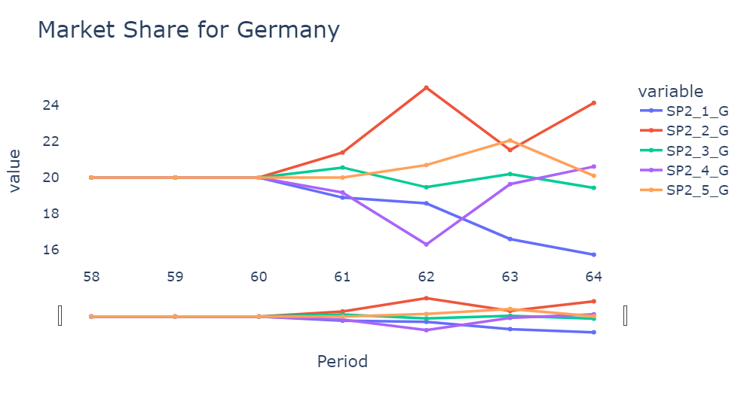
Market Share Highlights (Product 2)
Notes:
Company 2 has been sending signals of their dominance on the European market for Product 2. (High quality, very likely high greens and their relocation for their Product 2 factory from the US to Germany).
Company 2 and Company 5 have been fighting for the 1st place for the US & Japan markets since 3 quarters ago.
At the same time both companies have signaling their exit from the Mexico and China markets as they seem concentrated in the Premium markets.

