Slide 1
Probability and Statistics
Ben Moseley
moseleyb@Andrew.cmu.edu
canvas.cmu.edu
Module 1

Slide 2

Modules on Canvas
Start Reviewing on weekend prior to session
Arranged in sequential units
Watch a video
Read a short section of book or notes
Try the suggested exercises from the problem set;
Additional practice problems are available; check against the solutions that are provided
Take First Quiz on module by Monday noon
Ideally before class
First quiz due Wednesday and Monday thereafter
Class on Monday
Complete Second Quiz on module by following Friday.
Due

Slide 3
Jaggia & Kelly Text
Clear concise presentation
Answers to even number problems, videos
Online version
Downloadable to mobiles
Problem videos and answers to even-numbered exercises

Slide 4
Assignments
One homework assignment per module
Work out the easy and moderate parts of the problems after going through the appropriate unit
Use Piazza and class to clarify concepts related to the more challenging parts of the problem set

Slide 5
Quizzes
Two quizzes per module
The first quiz tests basic ideas in the module and the easy part of the HW problems
The second quiz tests the more challenging aspects of the HW problems as well as general proficiency with the module

Slide 6
Grading
Quizzes
6 X 3% per first quiz (18%)
6 X 7% per second quiz (42%)
Final exam (40%)

Slide 7
Learning Strategy
Watch videos
Read text sections (optional)
Try homework problems related to the unit as soon as you learn it
Work out suggested exercises (optional)
Post or check discussions for clarifying confusions
Check filled slides of online classes
Allocate time and stay in sync!

Slide 8
Pictour of course

Slide 9
Module 1 Learning Objectives
Define probability model and rules
Describe conditional probability and statistical independence
State and apply Bayes’ theorem
Define discrete random variables and their properties
Mean, variance, correlation. Apply to portfolio selection
Describe the Binomial and Poisson distributions, and where they arise

Slide 10
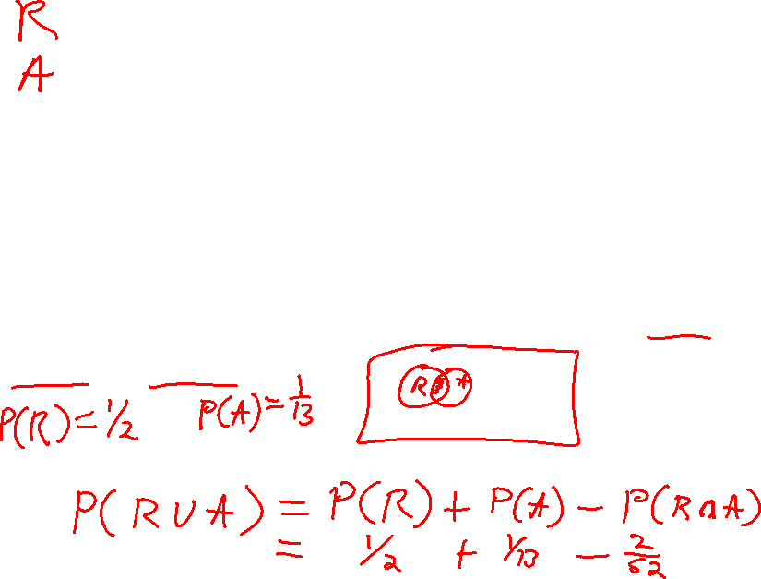
Example
Pick a random card from
a standard deck of 52 cards.
What is the probability that you draw a red card or an ace?

Slide 11
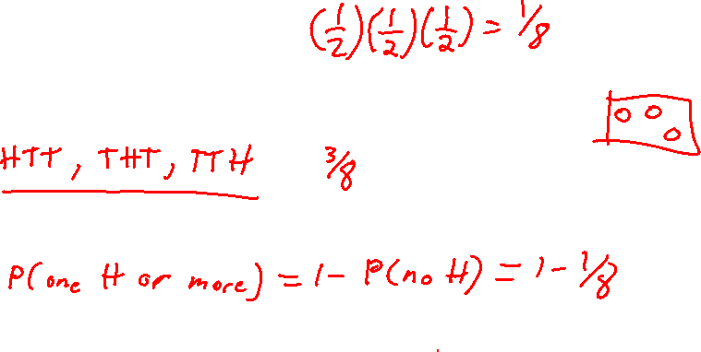
Example
Toss a fair coin three times
Probability of HTT?
Probability of exactly one H?
Probability of at least one H?

Slide 12

Example
A drilling company has estimated a 40% chance of striking oil for a new well.
A seismic test is performed for more information. Historically, 60% of successful wells have had positive seismic tests, and 20% of unsuccessful wells have had positive tests.
Given that the results of the seismic test were positive, what is the probability that the new well will be successful?

Slide 13

Bayes’ Theorem example
Let S = successful well
U = unsuccessful well
P(S) = .4 , P(U) = .6 (prior probabilities)
Define the positive result of the seismic test as event PT
Conditional probabilities:
P(PT|S) = .6 P(PT|U) = .2
Goal is to find P(S|PT)

Slide 14
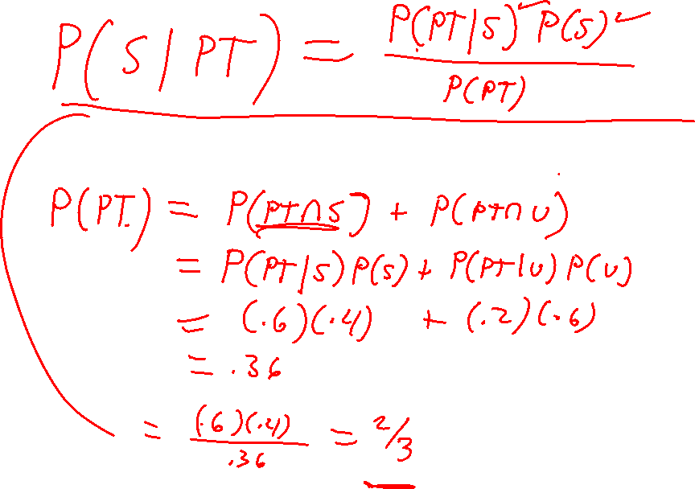

Slide 15
Random variables
Random Variable: Represents a possible numerical value from a random experiment
Which of the following are random variables?
The roll of a die
Demand for oil in 2020
The winner of the presidential elections in November
Random
Variables
Discrete
Random Variable
Continuous
Random Variable

Slide 16
Distributions of a random variable
Discrete random variable X
Probability distribution function (pdf):
P(x) = P(X = x) for each value x that X can take
Cumulative distribution function (cdf):
F(x) = P(X ≤ x)

Slide 17
Example of Distribution Functions
Value | Proba | CumProba
0 | 0 | 0
1 | 0.0625 | 0.0625
2 | 0.125 | 0.1875
3 | 0.125 | 0.3125
4 | 0.1875 | 0.5
5 | 0 | 0.5
6 | 0.125 | 0.625
7 | 0 | 0.625
8 | 0.125 | 0.75
9 | 0.0625 | 0.8125
10 | 0 | 0.8125
11 | 0 | 0.8125
12 | 0.125 | 0.9375
13 | 0 | 0.9375
14 | 0 | 0.9375
15 | 0 | 0.9375
16 | 0.0625 | 1

Slide 18
Expected Value
Expected Value (or mean) of a discrete
random variable (Weighted Average)
Example: Toss 2 coins, x P(x)
X = # of heads, 0 0.25
compute expected value of X: 1 0.5
E(X) = (0 x .25) + (1 x .50) + (2 x .25) = 1.0 2 0.25

Slide 19
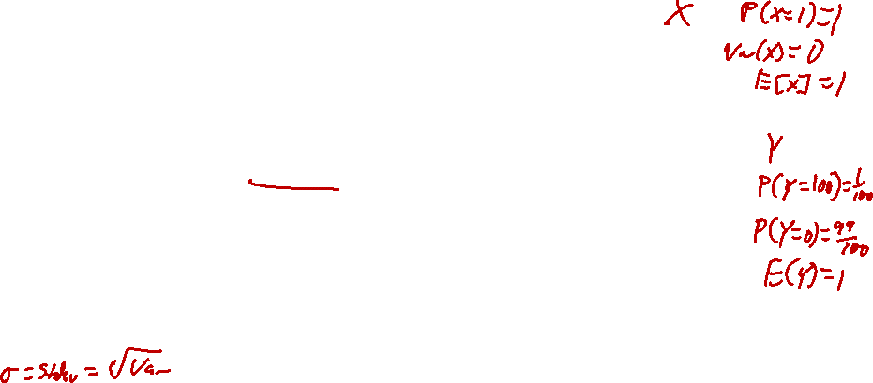
Variance and Standard Deviation
Variance of a discrete random variable X
Standard Deviation of a discrete random variable X
Measures dispersion, or risk.

Slide 20
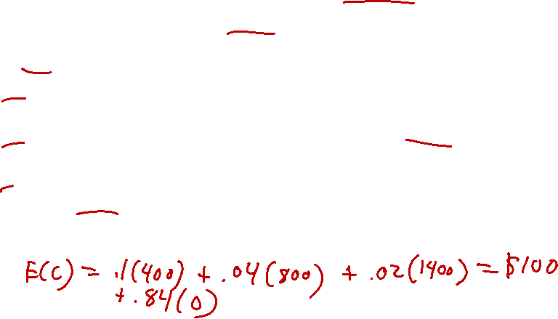
Text Chapter 5.2 Exercise 23
You are considering buying insurance for your new laptop computer, which you bought for $1,500. The insurance premium for 3 years is $90. Over the 3-year period, there is
an 10% chance that your laptop will require work worth $400,
a 4% chance it will require work worth $800, and
a 2% chance it will completely break down with a scrap value of $100.
Should you buy the insurance?

Slide 21
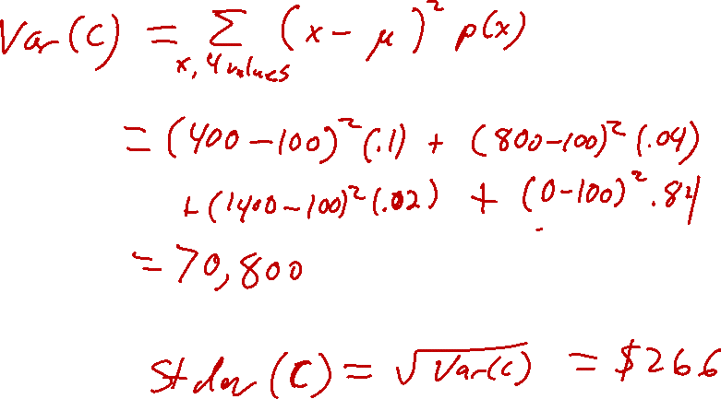
Text Chapter 5.2 Exercise 23
Compute the standard deviation of the repair costs

Slide 22

First result: Expectations add
E(X + Y) = E(X) + E(Y)
Additional points:
Also holds for sum of more than two random variables ⇒ E(X + Y + Z) = E(X) + E(Y) + E(Z)
E(a×X + b×Y) = a×E(X) + b×E(Y)
Implication for portfolio of A and B stock:
Since the return on the portfolio is w₁×X + w₂×Y,
the expected return on the portfolio is
E(w₁×X + w₂×Y) = w₁×E(X) + w₂×E(Y)

Slide 23

Second result: Variances do not usually add
General relationship:
var(X + Y) = var(X) + var(Y) + 2×cov(X,Y)
covariance between X and Y
Relationship for portfolio example:
var(w₁×X + w₂×Y) = w₁²×var(X) + w₂²×var(Y) + 2w₁w₂×cov(X,Y)

Slide 24

Covariance
Let X and Y be random variables with means μ_{X} and μ_{Y}
The expected value of (X - μ_{X})(Y - μ_{Y}) is called the covariance between X and Y
For discrete random variables
where P(x, y) = P(X=x, Y=y) denotes the joint probability.

Slide 25
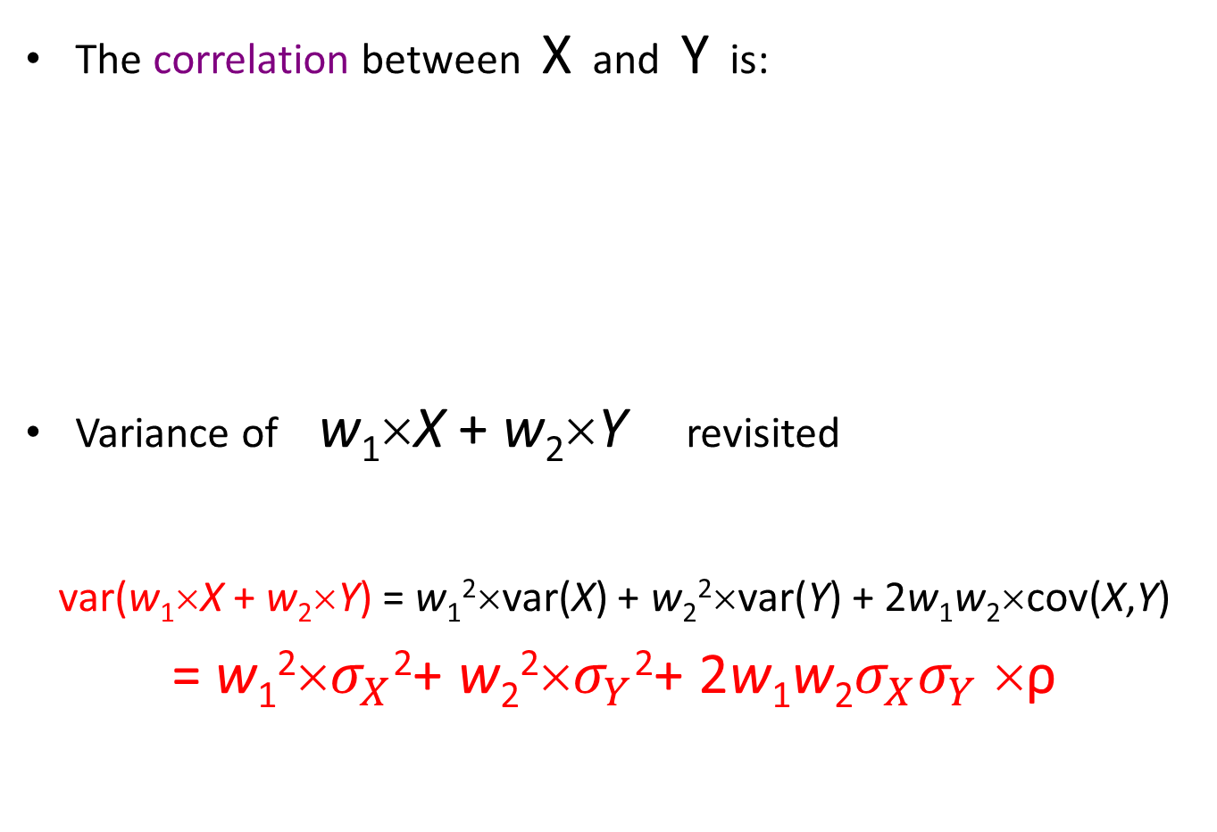

Correlation
The correlation between X and Y is:
Variance of w₁×X + w₂×Y revisited
var(w₁×X + w₂×Y) = w₁²×var(X) + w₂²×var(Y) + 2w₁w₂×cov(X,Y)
= w₁²×$σ_{X}$²+ w₂²×$σ_{Y}$²+ 2w₁w₂$σ_{X}σ_{Y}$ ×ρ

Slide 26

Text Chapter 5.3 Exercise 32
A fund manager is considering 2 mutual funds for investment.
The correlation between the stock and the bond funds is 20%.
What is the expected return and the standard deviation for a portfolio invested 60% in the stock fund and 40% in the bond fund?
 | Expected Return | Standard Deviation
Stock Fund | 14% | 26%
Bond Fund | 8% | 14%

Slide 27
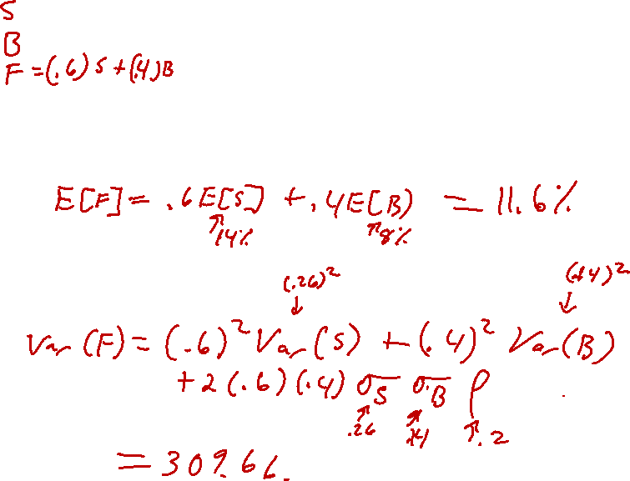
Ch 5.3, Ex 32
Portfolio with 60% in stock fund and 40% in bond fund: compute mean and variance

