Slide 1
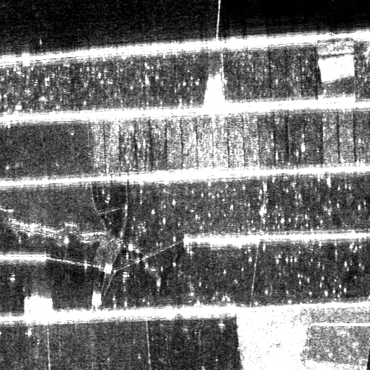
1
2
3
4
5
6
7
8
9
10
11
12
13
14
15
16
17
18
19
20
21
22
23
24
25
26
27
28
29
30
31
32
33
34
35
36
37
38
39
40
41
42
43
44
45
46
47
48
49
50
51
52
53
54
55
56
57
58
59
60
61
62
63
64
Vetor de pontos-sementes:
pontos = [5, 9, 10, 11, 12, 17, 18, 19, 20, 21, 22, 23, 30, 31, 32, 41, 42, 45, 46, 47, 48]
Matriz após a fragmentação e poda:
pontosF = [9, 10, 11, 12, 0, 0, 0;
17, 18, 19, 20, 21, 22, 23;
45, 46, 47, 48, 0, 0, 0]

