Slide 1



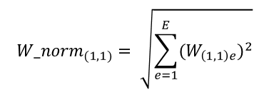



$${W_norm}_{(1,1)}= \sqrt{\sum_{e=1}^{E}{{{(W}_{\left(1,1\right)e})}^{2}}}$$
$$W_{E}$$
.
.
$$W_{5}$$
.
$$W_{4}$$
$$W_{3}$$
$$W_{2}$$
$$W_{1}$$

