Slide 1


Sensor Network-hw2
Dong Hyeon Lee

Slide 2
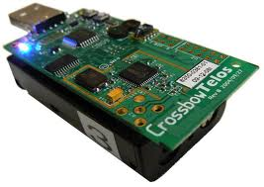
idea
Broadcast to all other telosb

Slide 3
idea
Cache 1 | Cache 2
Ip address | Ip address
Cache_count (over 2(>=3), delete this data) | Cache_count
Wait for 0.9 seconds…(to notify other telosb’s broadcast)
If telosb received broadcast, remember it(ip address)!(cache!)

Slide 4
idea
If telosb received message , which is same with cache 1 ip, then clear the cache_count of cache 1(same with cache 2)
If telosb didn’t received message for 1 loop, cache_count++
If count is over 2(>=3) , delete cache , num_of_telosb--.
(for preventing flickering – act like shield)

Slide 5
idea
If count = 0 , turn on 1 lights(blue)
If count = 1, turn on 2 lights(blue, green)
If count = 2, turn on 3 lights(blue, green, red)

Slide 6



Thank you!

