Slide 1


Perceiving QUIC : Do Users Notice or Even Care?
Jan Ruth, Konrad Wolsing, Klaus Wehrle
CoNext’ 19: proceedings of the 15th international conference on emerging networking experiments and technologies
Dong Hyeon Lee
Chung-Ang University
enjoying1018@naver.com
July. 8th 2021

Slide 2
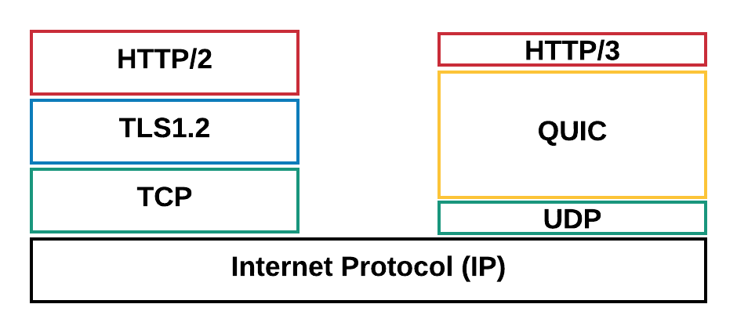
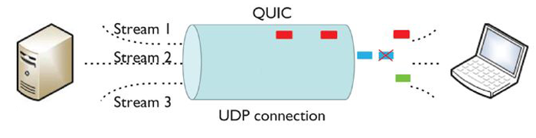
QUIC!

Slide 3
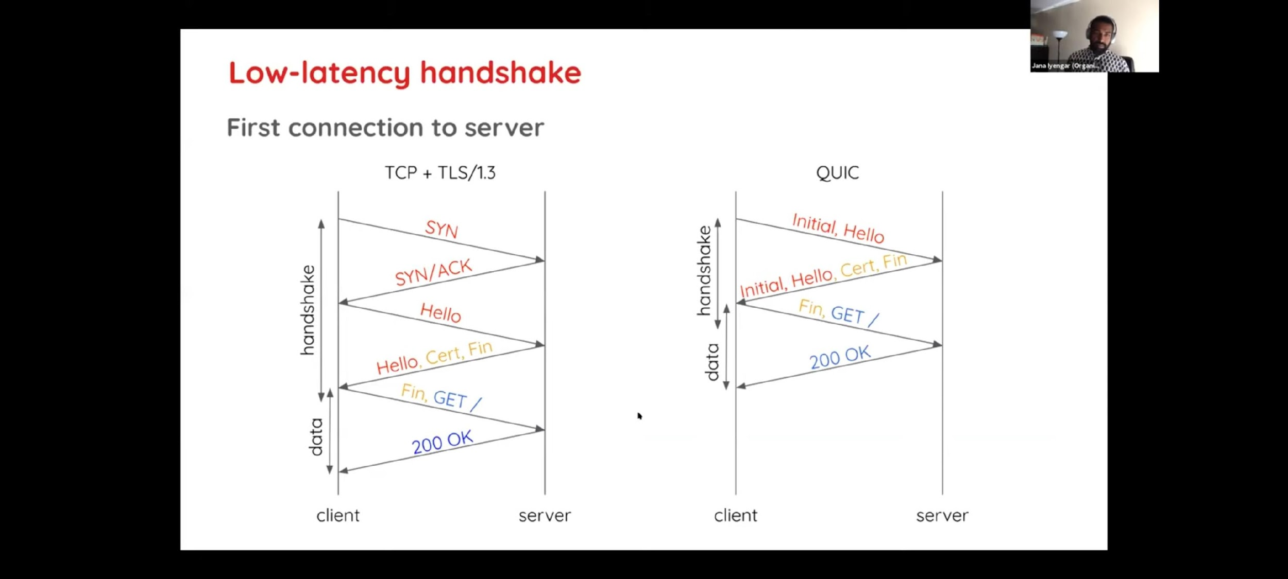
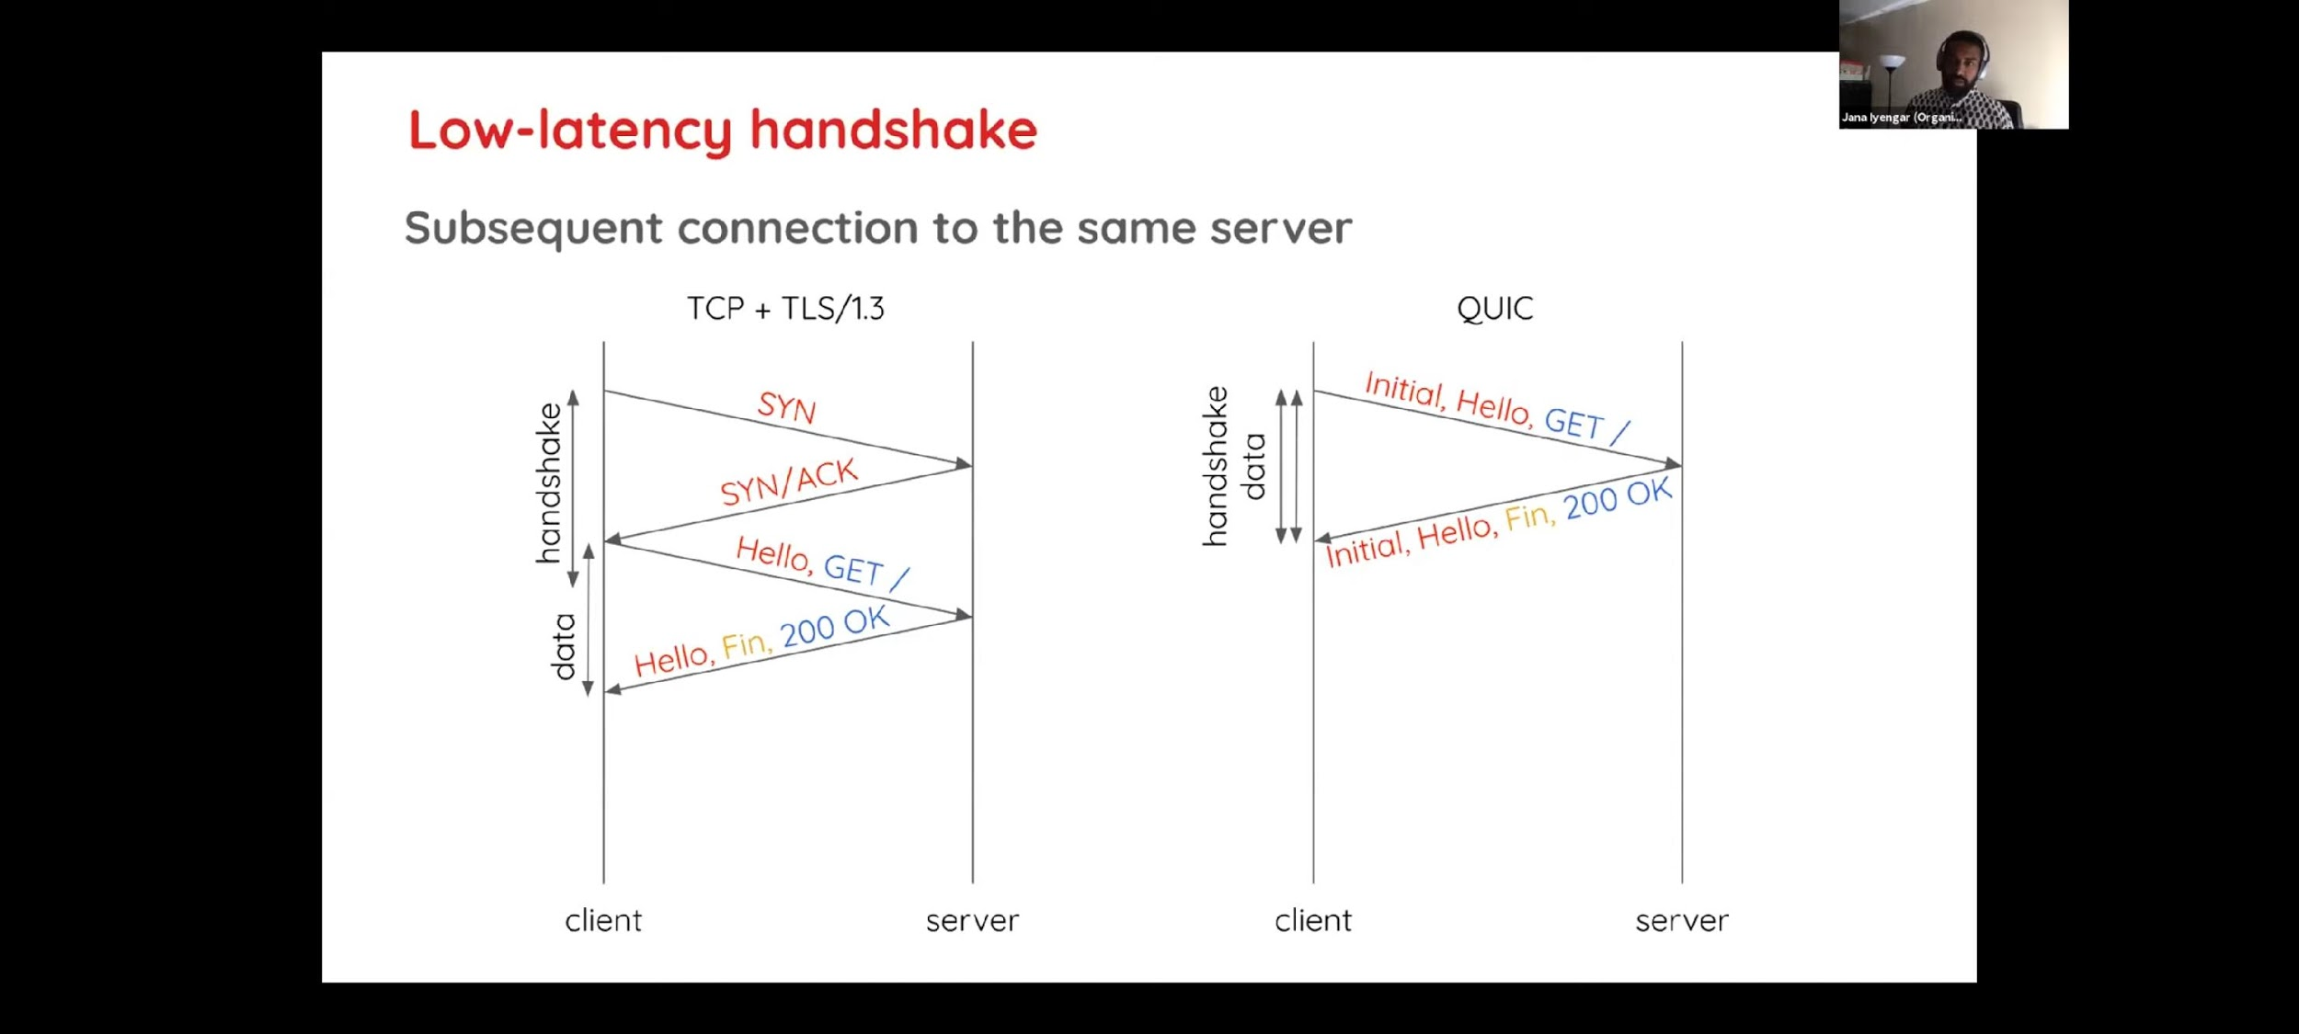
Benefits of QUIC!(performance)
Save 1 RTT!

Slide 4
Many Studies…
Many Studies says : QUIC is great!
However, there is some blind spot in past experiments…
Many studies utilize the PLT(Page Load Time) to measure performance.
-> PLT does not correlate well with human-perceived performance.
QUIC is too optimized in the past experiments!
🡺In this Study, we measure QoE!
: do humans even notice a difference, and if so, how much of a difference does it make?

Slide 5
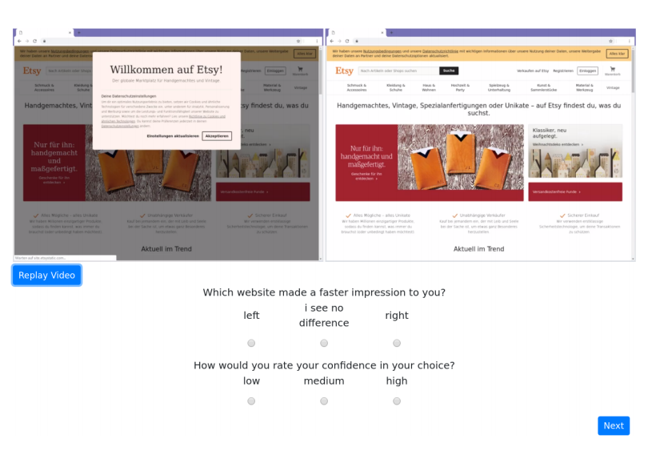
Study 1 (A/B test): Do Users Notice?

Slide 6
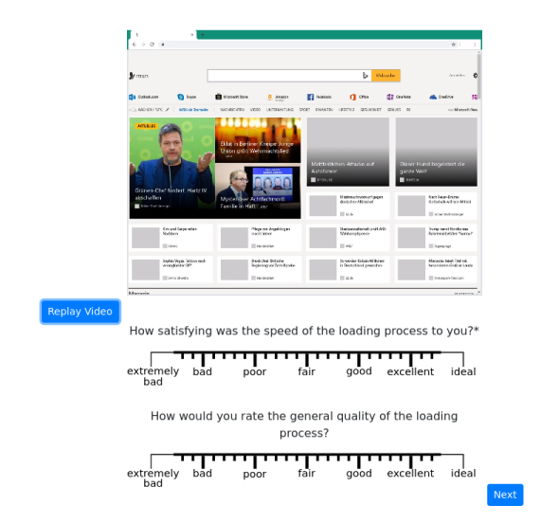
Study 2 (Rating): Do Users Care?

Slide 7
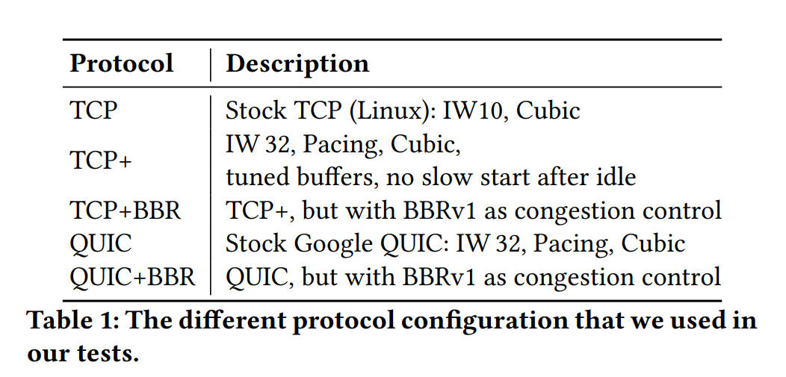
Settings(1)
Use self-hosted server
- enabling control experiments. = we can make tuned protocols.
- choose website , and replicate them.

Slide 8
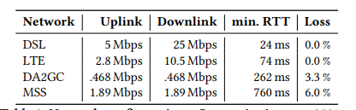
Settings(2)
- Various networks to simulate good/bad environment
How participants feel with different network(with same protocol)?
Extra Settings:
- informing the participants on the study goals and its procedure -> reduce noise
- rendered a Web browser
- No violence contents

Slide 9
Participants : Three Groups
Group1: Lab Study
28 videos for A/B study
(rating study) 27 videos = 11 in the work + 11 in the free time + 5 in the plane
Used for control data
Group2: Microworker
26 videos for A/B study
(rating study) 27 videos = 11 in the work + 11 in the free time + 5 in the plane
Group3: Internet(advertisement)
14 videos for A/B study
(rating study) 15 videos = 6 in the work + 6 in the free time + 3 in the plane

Slide 10
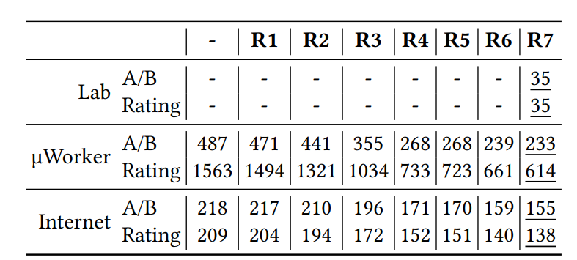
Filter Invalid Response
R1: A video in the study has not been played.
R2: A video has stalled.
R3: window not in the foreground over 10sec.
R4: A vote was placed before the FVC.
R5: A study took longer than 25 min or a question took longer than 2 min.
R6: A randomly placed control video was answered wrong.
R7: A control question was answered wrong.

Slide 11
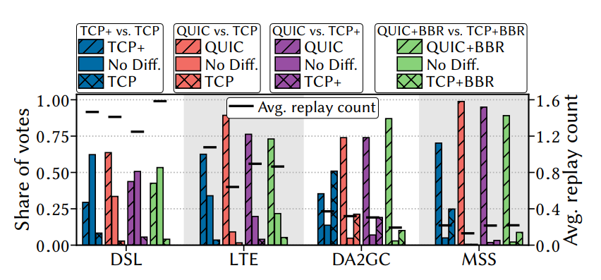
Results: Study1 – Do Users Notice a difference?
the agreement for observing a difference rises when the networks become slower.
Fast network-> hard to recognize difference-> more replays
in networks with high bandwidths, perceiving a difference seems to be more challenging

Slide 12
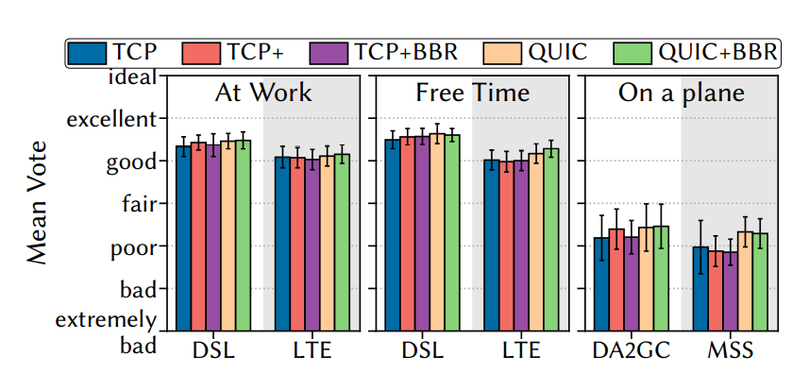
Results: Study2 – Do Users Care?
There is not big difference …
Slower network🡪 bigger difference

Slide 13
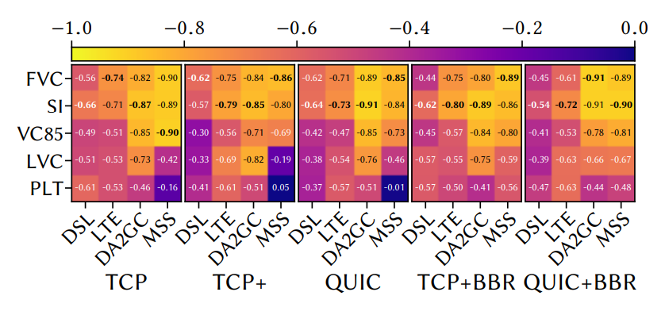
Compare with Technical Metrics.
Best correlation: SI(Speed Index)
Worst correlation: PLT(Page Load Time)

Slide 14
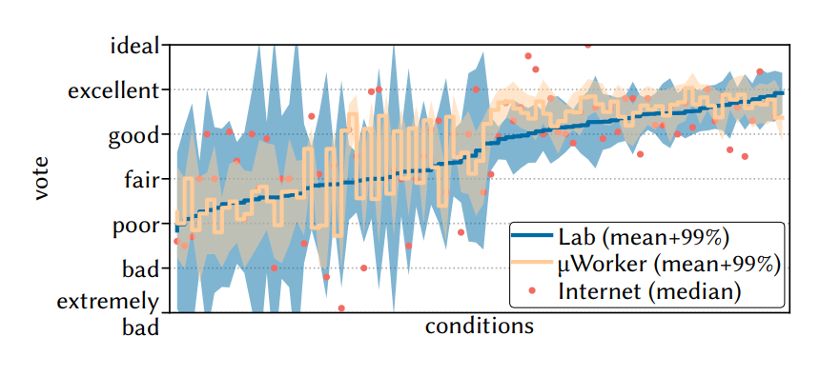
Discussion
Can I believe this report?
1) Filtering Rules
2) “Internet” group is not reliable

Slide 15



Thank you!

