Slide 1


Pluginizing QUIC
Quentin De Coninck, Francois Michel, Maxime Piraux, Florentine Rochet, Thomas Given-Wilson, Axel Legay, Olivier Pereira, Olivier Bonaventure
SIGCOMM 19’: Proceedings of the ACM Special Interest Group on Data Communication
Dong Hyeon Lee
Chung-Ang University
enjoying1018@naver.com
July. 22nd 2021

Slide 2


Application requirements evolve over time…
Protocol have to evolve
But, need too much time to deploy standardized extensions.

Slide 3


Revisit the extensibility of transport protocol
QUIC
A
QUIC
A
B
Achieve high extensibility!

Slide 4
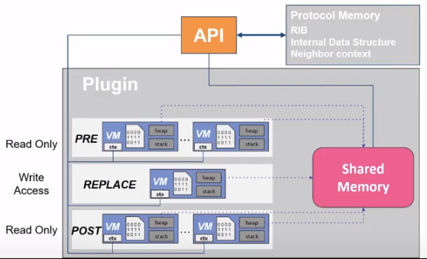
Structure of plugin(1)
Plugin= pluglets + *manifest form

Slide 5
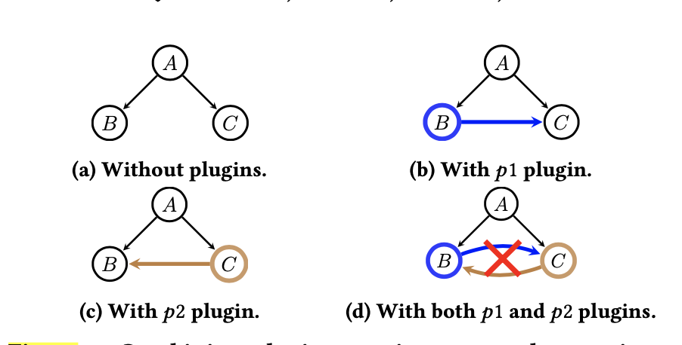
Structure of plugin(2) – virtual machine
PQUIC executes plugins inside a lightweight virtual machine(extend of EBPF VM)
Make plugins run any hardware, operating system
Check invalid grammer
Check memory saftety
Monitors the correct operation of the pluglets
Separate memory space for each pluglet

Slide 6
Structure of plugin(3) – virtual machine
A(){
B();
C();
}
B(){
WORK;
C(); // p1 plugin
}
C(){
WORK;
B(); //p2 plugin
}

Slide 7
Structure of plugin(4) – anchor
3 types of anchor: pre, post, replace
Replace: override the default behavior
Pre(read only)
: attatch the plugin(pluglet) just before the protocol operation invocation
Post(read only)
:attach the plugin(pluglet) just after the protocol operation invocation

Slide 8
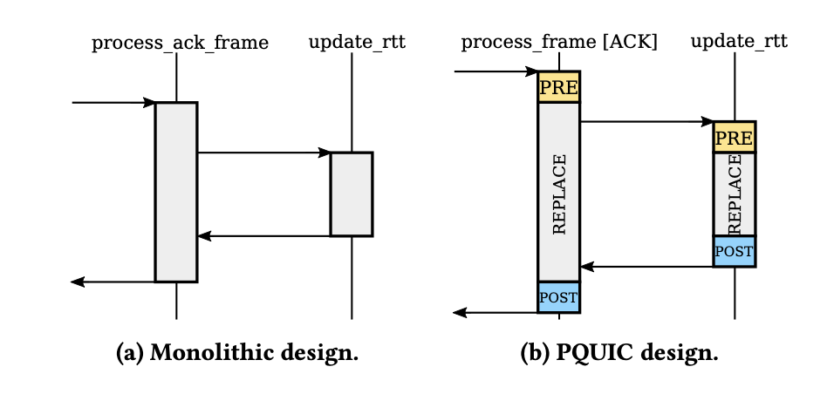
Structure of plugin(5)-API
API: revealing the insertion points and the interface between PQUIC and the pluglets
Revealing the insertion points:
FUNCTION alpha
-> A-B -> A-PRE B –REPLACE B – POST B
PQUIC include 72 protocol operations
(handling of the QUIC frames, internal processing of QUIC, QUIC packet management, events in the connection workflow)
Extra: plugin cache – no compile time

Slide 9
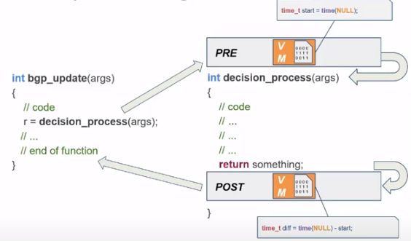
Structure of plugin(6)-example

Slide 10
Exchange plugin – client doesn’t have plugin
Client hello
Server hello: I want monitoring! Do you have?
Request monitoring plugin
Give monitoring plugin(bytecode)

Slide 11
Exchange plugin(2)- client have plugin
Client hello
Server hello: I want monitoring! Do you have?
Stream, Stat(info about client)
Stream

Slide 12
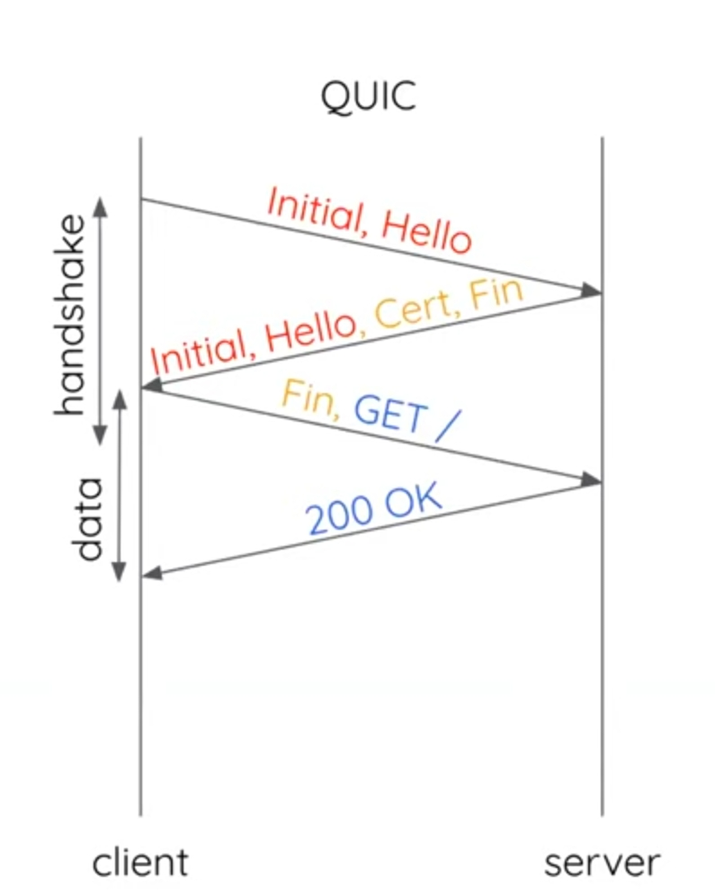
Exchange plugin(3)
PQUIC need same RTT

Slide 13
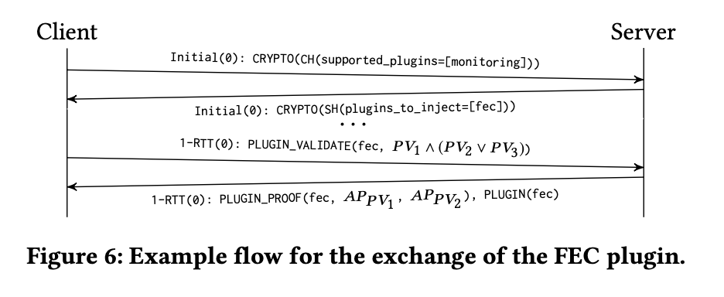
Plugin authentication(1)

Slide 14
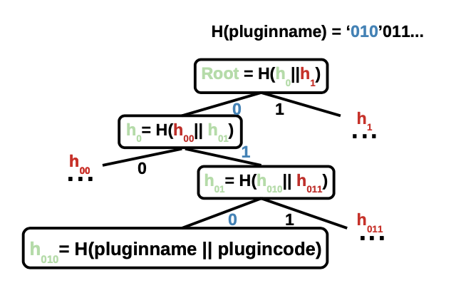
Plugin authentication(2)
Pv’n merkle tree

Slide 15
Application of pquic (1): add monitoring
Ex . Received out- of –order, bytes/packets sent/received

Slide 16
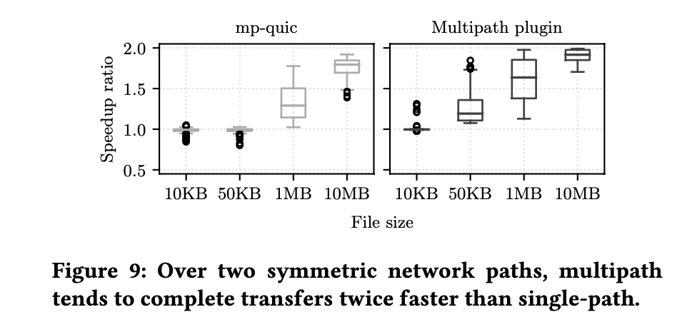
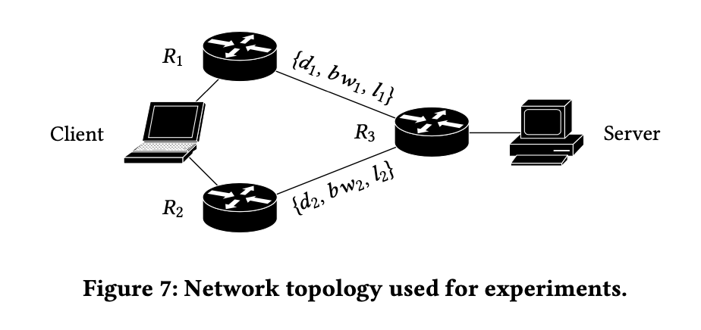
Application of pquic (2):multipath quic
-packets are scheduled in a round-robin manner between available paths
-new ACK: include path id(where does it come from?)

Slide 17
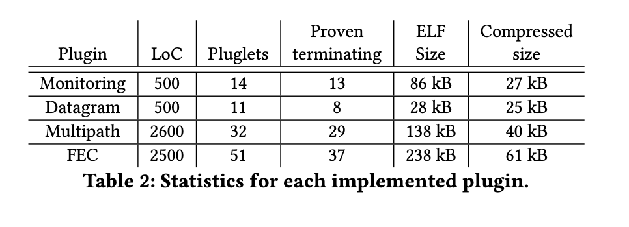
Application of pquic (3)

Slide 18
Discussion
Very new paradigm -> surprise to me
The research history is long + many reference
Give More Flexibility to protocol

Slide 19



Thank you!

