Slide 1
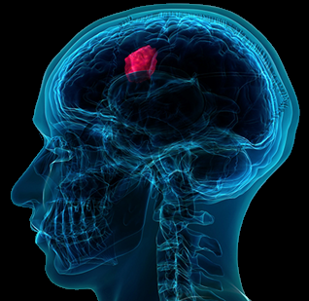

PAPER ID: 201
3D U-NET: FULLY CONVOLUTIONAL NEURAL NETWORK FOR
AUTOMATIC BRAIN TUMOR SEGMENTATION

Slide 2
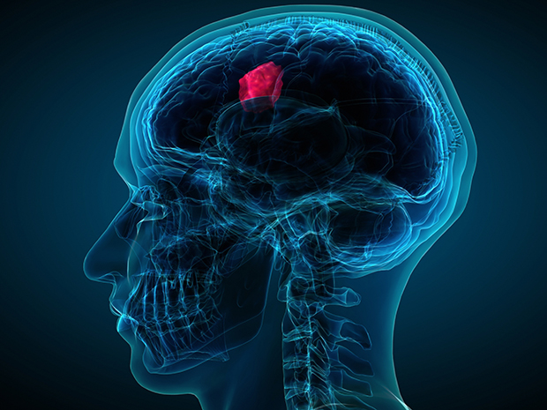
AUTHORS
Syed Fahim Ahmed
Fairuz Shezuti Rahman
Tasmia Tabassum Arony
Md. Tariqul Islam Bhuiyan
PRESENTED BY
Fairuz Shezuti Rahman

Slide 3
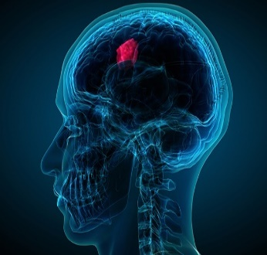
Overview
Introduction
Conclusion
Result & Discussion
Methodology
Literature Review

Slide 4

Introduction
Brain tumor, one of the most vulnerable diseases of the world
2 types of tumor depending on threat level
Using MRI images for tumor detection
Used 3D U-Net for tumor segmentation
Localization of tumor area

Slide 5

Motivation
Increasing number of patients
Time consumption in case of tumor detection
Development of tumor diagnosis
Increment of computer aided researches
Lot to improve in field of accurate classification

Slide 6

Related Works

Slide 7
Related Works
Convolutional Neural Network (CNN) Based Approach
U-net Based Approach
Different Neural Network Based Methods
Clustering Techniques
Other Machine Learning Algorithms Based Approach
Digital Image Processing Based Methods
4

Slide 8
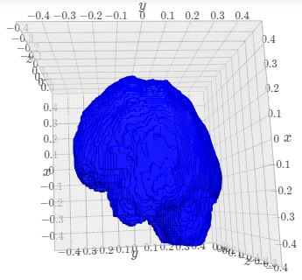
Used Dataset
Brats 2015
220 Patients Data of HGG and 54 Patients Data of LGG for training
110 Patients Data of both HGG and LGG for testing
4 types of data: Flair, t1, t1c, t2
Figure: 3D View of Brain

Slide 9
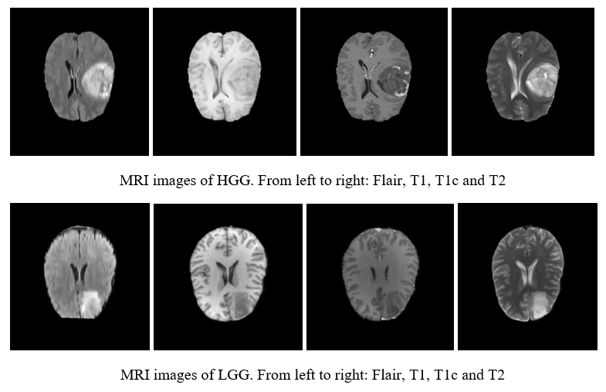
Used Dataset (cont.)
Figure: Dataset of BRATS 2015
6

Slide 10

Methodology

Slide 11
Methodology
Input MRI Image
Standardization
Data Augmentation
3D U-net
Segmentation
Image Re-sizing
Figure: Flowchart of Tumor Segmentation

Slide 12
Methodology (cont.)
Pre-processing
Image Re-sizing
Makes model more efficient in terms of time consumption
Original size image of 240×240×155 converted into 32×32×32
Data reduced from 2.87GB instead of 782GB

Slide 13
Methodology (cont.)
Pre-processing
Image augmentation
Methods | Range
Flip horizontally | 50% probability
Flip vertically | 50% probability
Rotation | ±20°
Shift | 10% on both horizontal and vertical direction
Shear | 20% on horizontal direction
Zoom | ±10%
Brightness | γ = 0.8 ~ 1.2
Table: Applied Data Augmentation Methods

Slide 14
Methodology (cont.)
Semantic Segmentation
Partitioning image into different regions
Grouping each pixel of the image based on specific characteristics
Level every pixel of a picture with a corresponding class
Maintains encoder/decoder structure

Slide 15
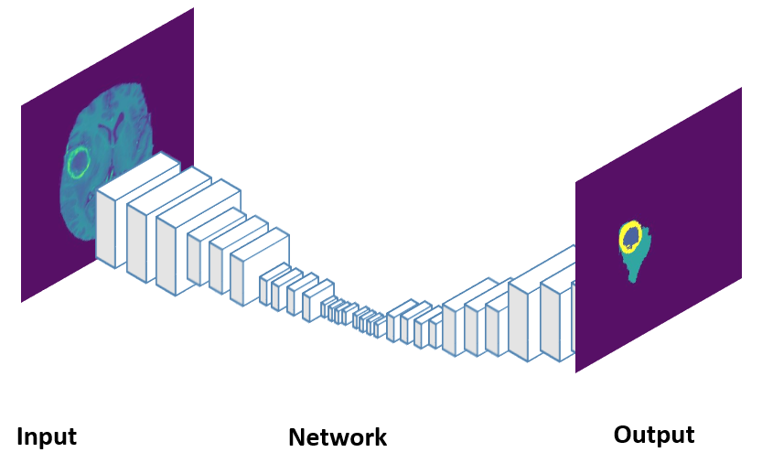
Methodology (cont.)
Semantic Segmentation
Figure: Semantic Segmentation

Slide 16
Methodology (cont.)
3D U-net
An architecture of Semantic Segmentation which combines encoding and decoding
Two path architecture
First path- Construction path which is encoder part
Second path- Symmetric expanding path which is decoder part

Slide 17
Methodology (cont.)
3D U-net
Convolution Operation
Max Pooling Operation
Up-sampling Operation
Transposed Convolution Operation
Activation Function

Slide 18
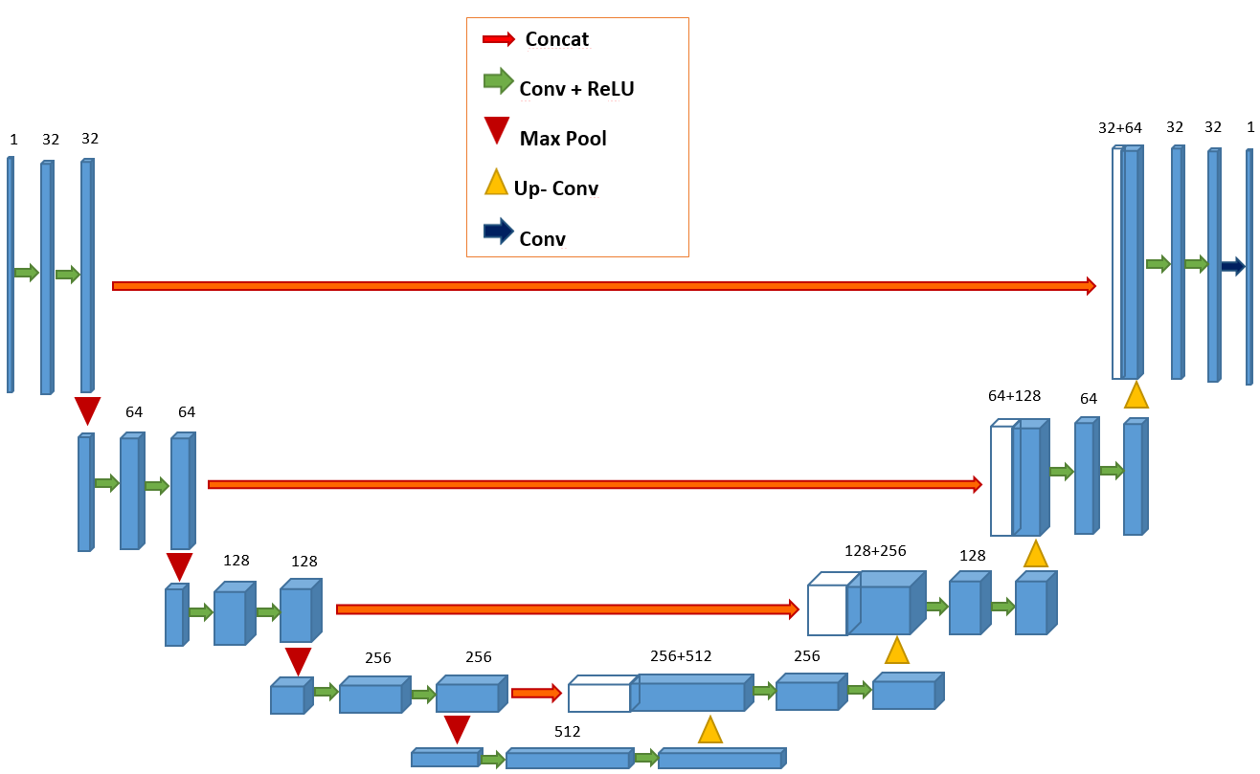
Methodology(cont.)
Figure: U-net Architecture of Our Model

Slide 19

Result & Discussion

Slide 20
Result & Discussion
Performance of the Model
Data Type | Accuracy | Loss Function
Training Data | 93.08% | 21%
Validation Testing | 92.09% | 19%
Table: Accuracy & Loss Function value for Tumor Segmentation

Slide 21
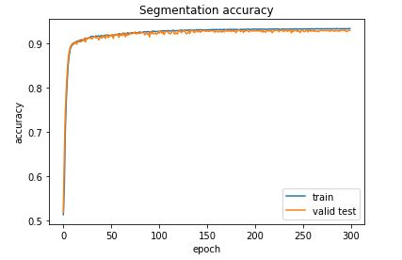
Result & Discussion
Accuracy of Tumor Segmentation
Figure: Accuracy Graph for Tumor Segmentation

Slide 22
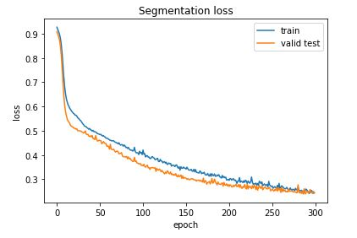
Result & Discussion
Loss Function of Tumor Segmentation
Figure: Loss Function Graph for Tumor Segmentation

Slide 23
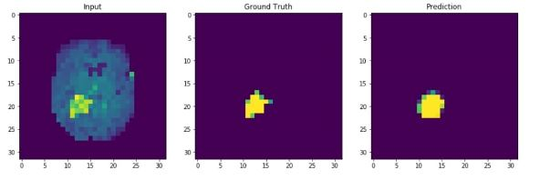
Result & Discussion
Segmentation Result for BRATS 2015
Five-fold Cross Validation Result
Figure: Segmentation for Flair MRI for Patients-1
18
23
23

Slide 24
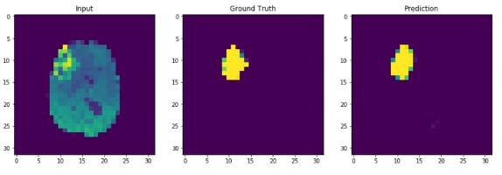
Result & Discussion
Segmentation Result for BRATS 2015
Five-fold Cross Validation Result
Figure: Segmentation for Flair MRI for Patients-2
19
24
24

Slide 25
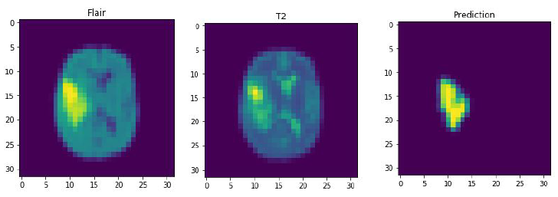
Result & Discussion
Segmentation Result for BRATS 2015
Testing Result
Figure: Segmentation of Testing Data
20
25
25

Slide 26
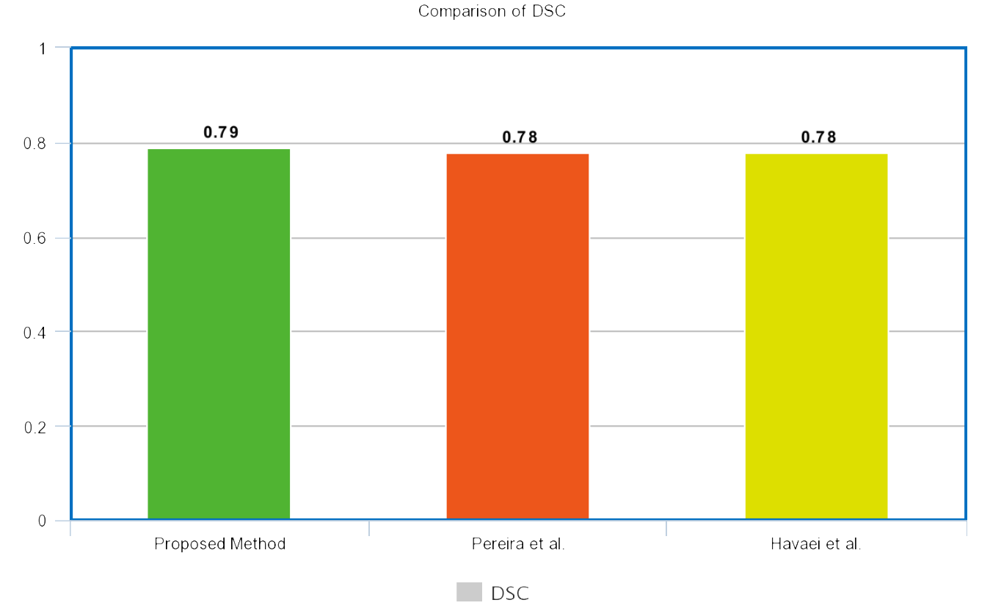
Result & Discussion
Comparison of DSC
Figure: Comparison of methods in respect of DSC
21
26
26

Slide 27
Result & Discussion
Comparison of Efficiency
Method | Data | Time
Proposed Method | BRATS 2015 | Less than 1sec
Hao Dong et al. | BRATS 2015 | 2 ~ 3sec
Sergio Pereira et al. | BRATS 2015 | 8min
Mohammad Havaei et al. | BRATS 2015 | 25sec ~ 3min
Table: Comparison of methods in respect of DSC
22
27
27

Slide 28
Conclusion
Segmented MRI images
Barred down the training time
Decremented computation time
Surgical planning and patient welfare
Using separate independent testing dataset
Evaluating results on higher GPU
More images for training

Slide 29


Slide 30


