Slide 1
E-News
Stay updated 24/7

Slide 2
Presented By-
Fairuz Shezuti Rahman
ID - 15.01.04.098
Sofia Neherin
ID - 15.01.04.107

Slide 3
What is E-News
It is an android based news portal app.
User can find any information based on his interest.
They can find important news portals in the home page.
It is beneficial for the users who want all the news in one app.

Slide 4
FEATURES
User friendly
Individual accounts with login, logout
News updates
Weather updates
Splash screen
Navigation bar
Toolbar

Slide 5
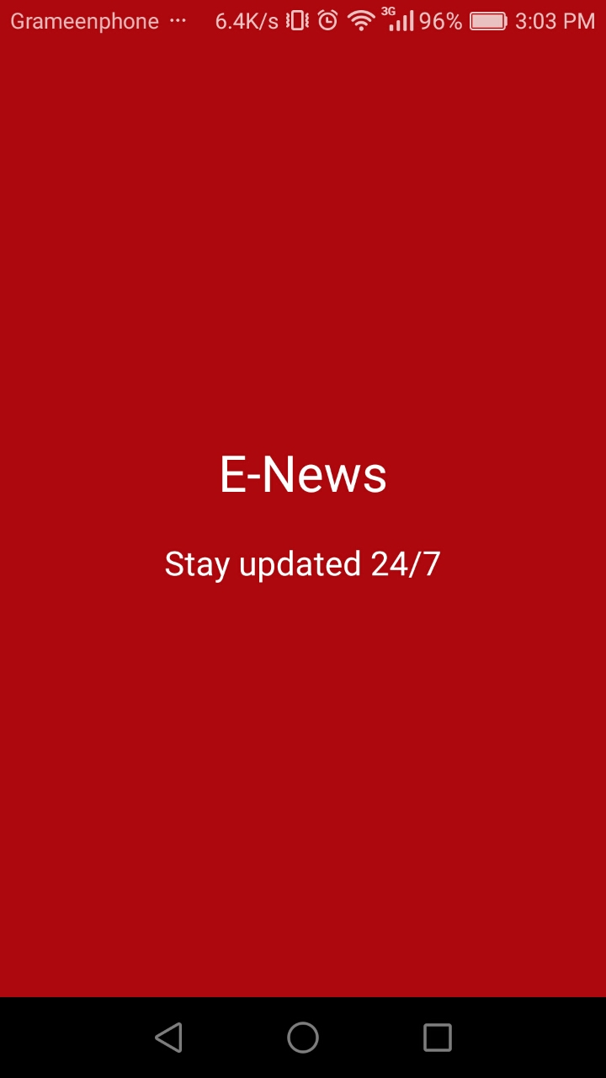
Splash screen
A splash screen will appear when the app is launched.
It shows title and subtitle name of the app.

Slide 6
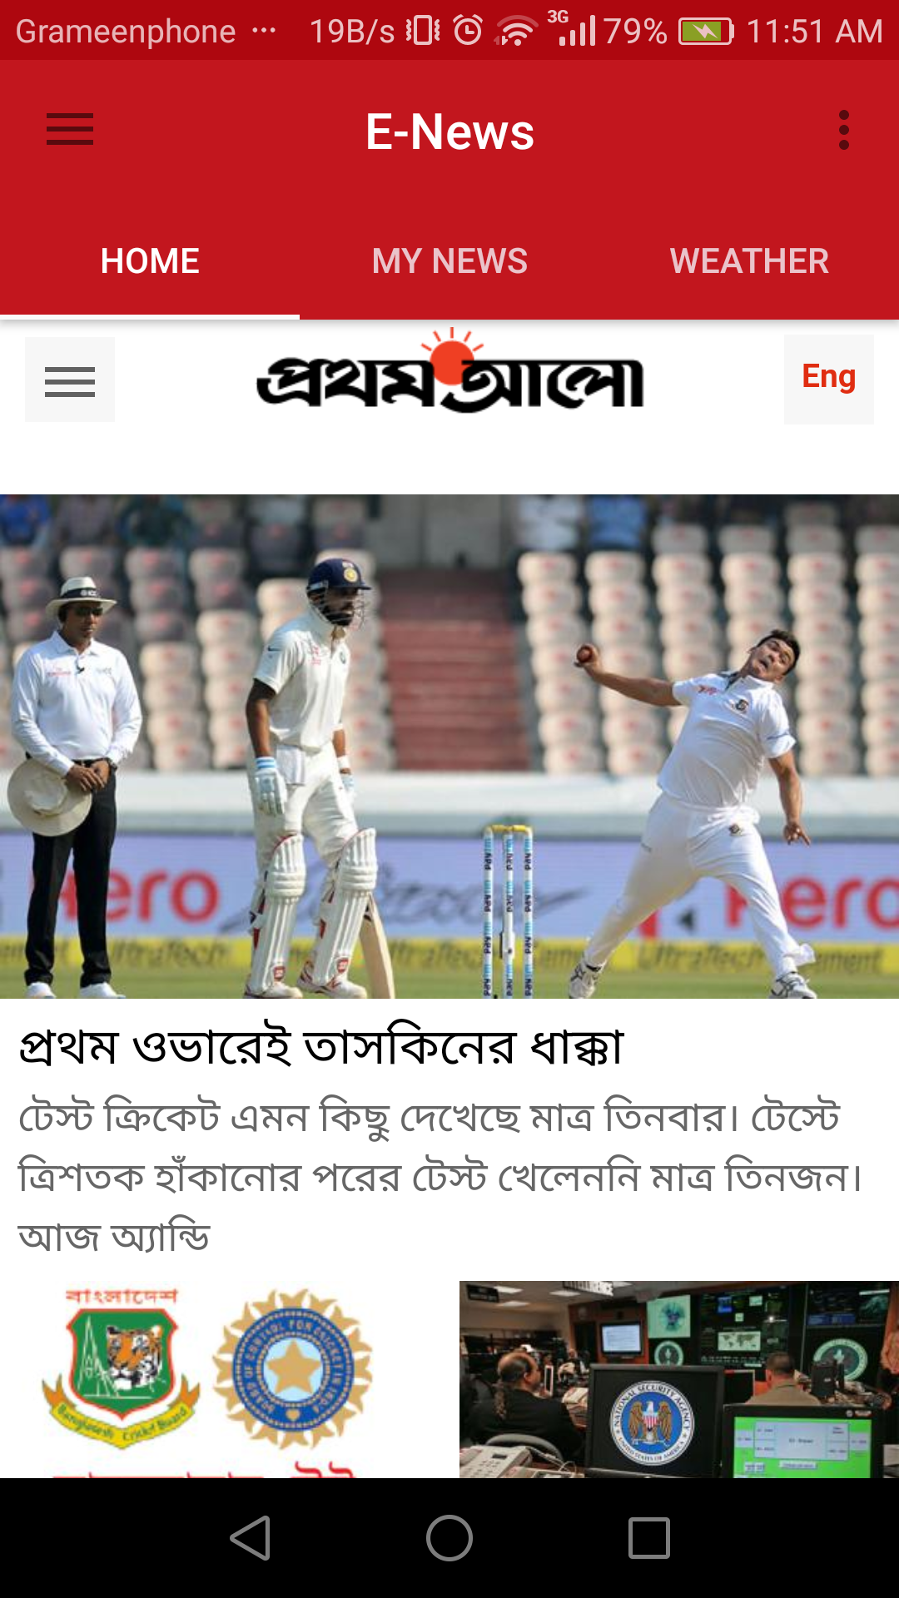
Home page
Shows most recent news from news portals.

Slide 7
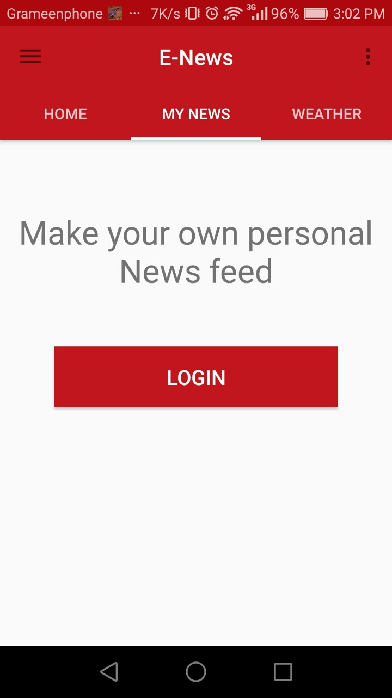
my news
For creating own personal news there is a login button.

Slide 8
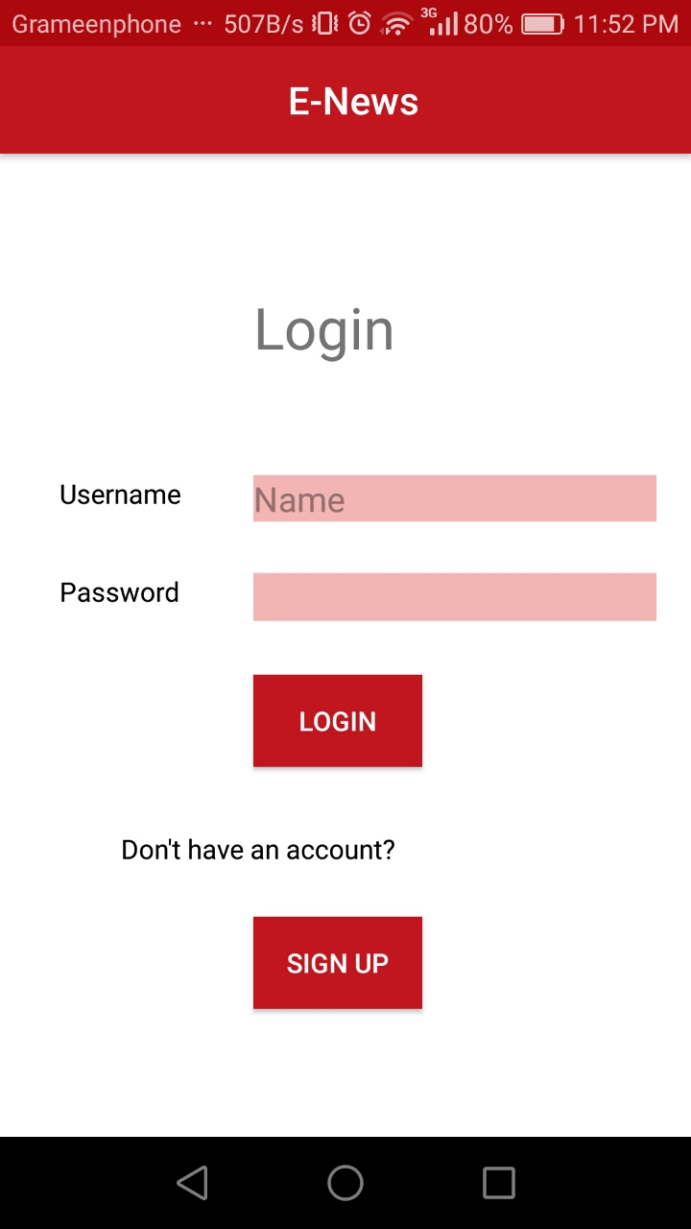
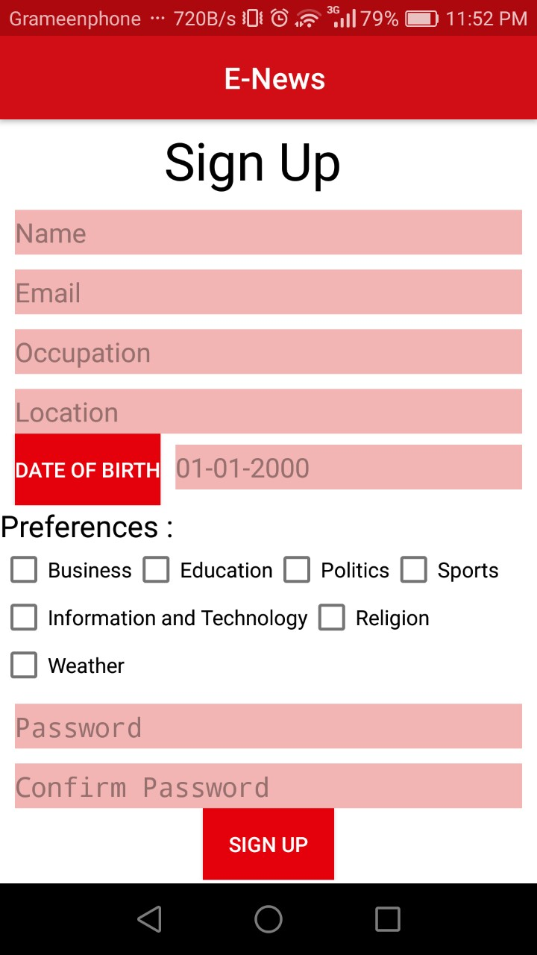
Login & sign up
User can log in and see their personal interested news.
If user doesn’t have an account they can open simply with sign up.

Slide 9
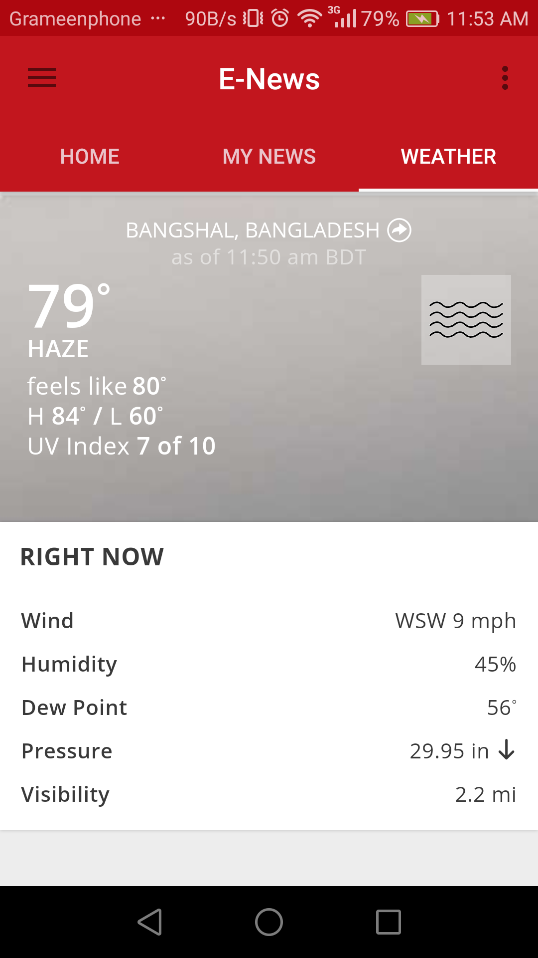
Weather update
Show weather update of user’s location.
Also can search weather for a desired location.

Slide 10
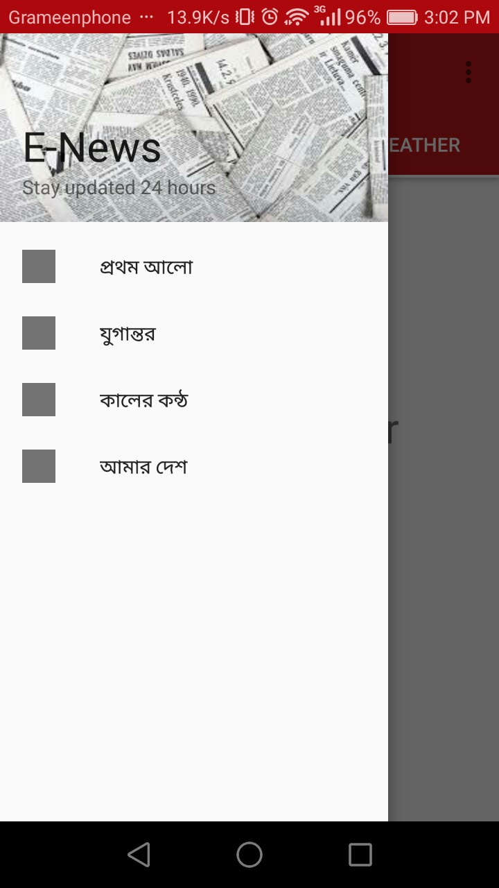
Navigation Drawer
Have navigation header and also have top news portal name.

Slide 11
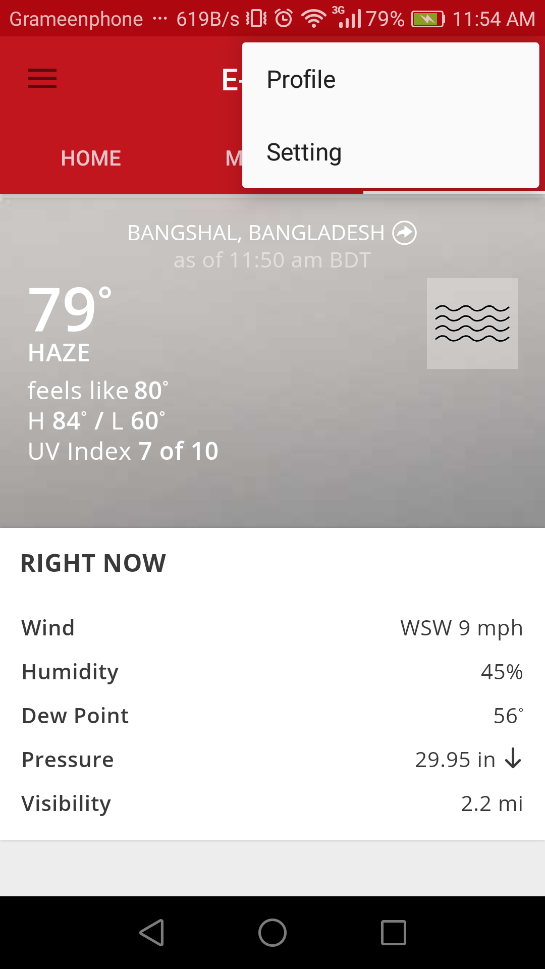
Tool bar
User can find their profile.
Go to settings of the app.

Slide 12
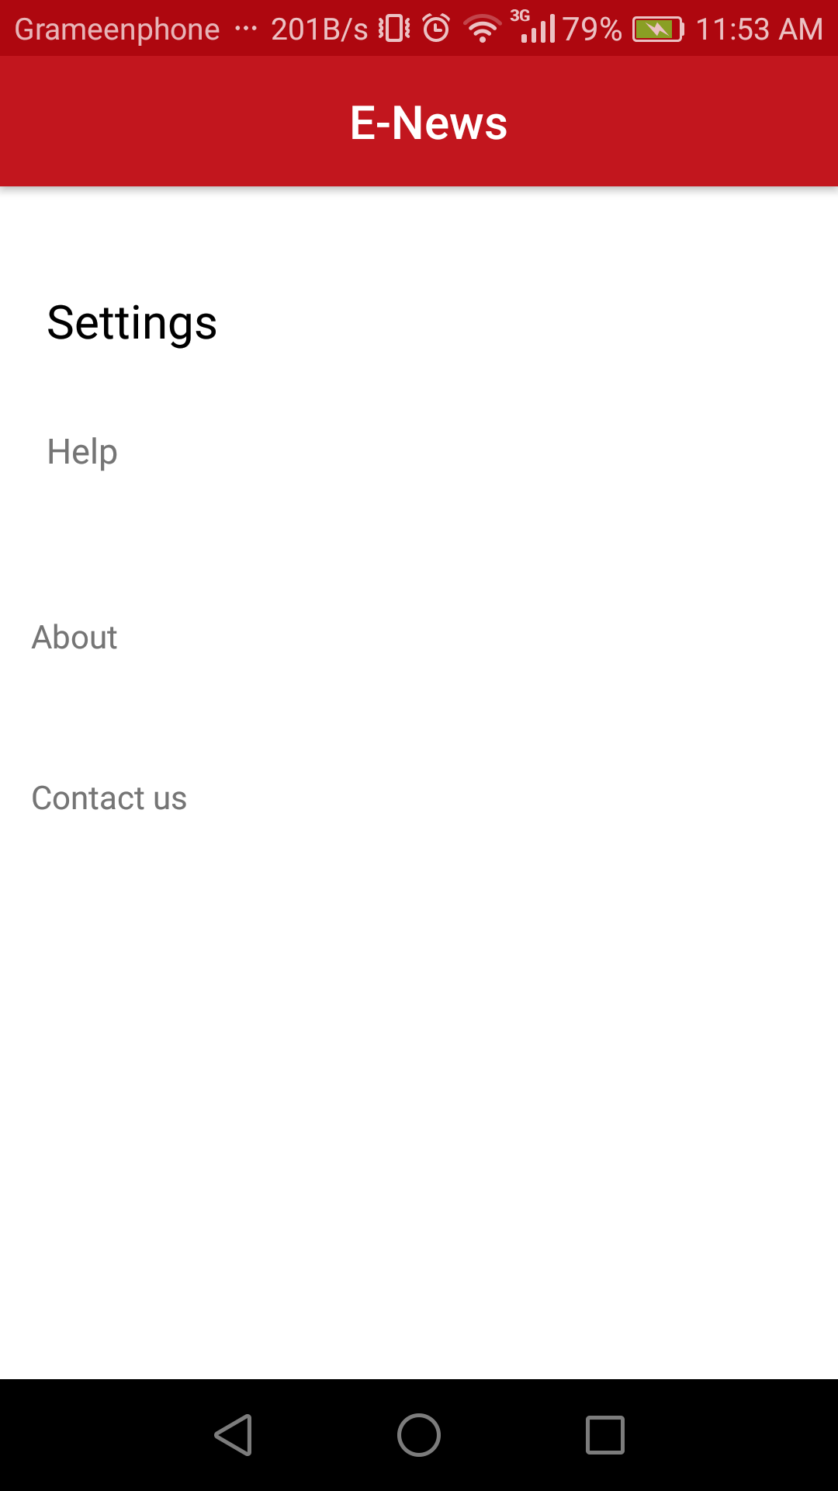
Settings
Help
About
Contact Us

Slide 13
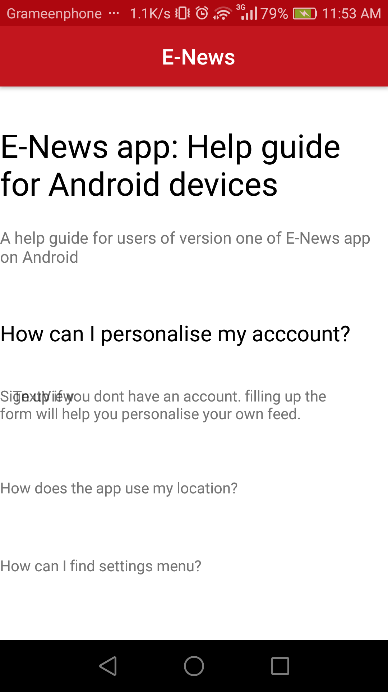
Help
Help is provided here.
How to use it is told here.

Slide 14
Tools we have used
IDE – Android Studio
Language - Java
Database - SQLite

Slide 15
Thank you!!!
Any Question?

