Slide 1
Binocular Stereopsis
How multiple views enable one to reconstruct depth in the world
Jitendra Malik
UC Berkeley

Slide 2
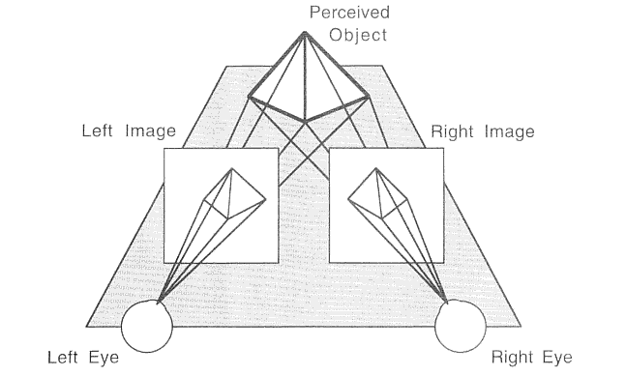
Binocular Stereopsis

Slide 3
Various camera configurations
Single point of fixation where optical axes intersect
Optical axes parallel (fixation at infinity)
General case

Slide 4
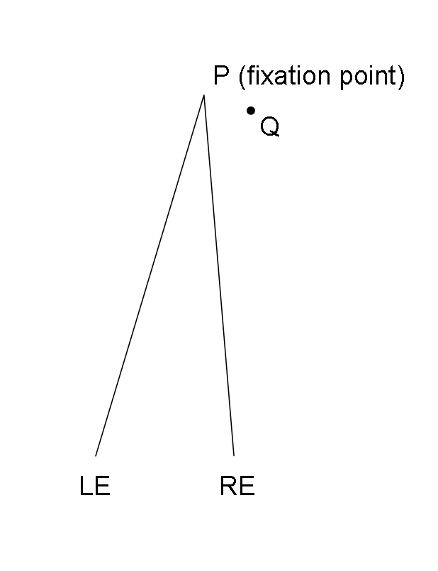
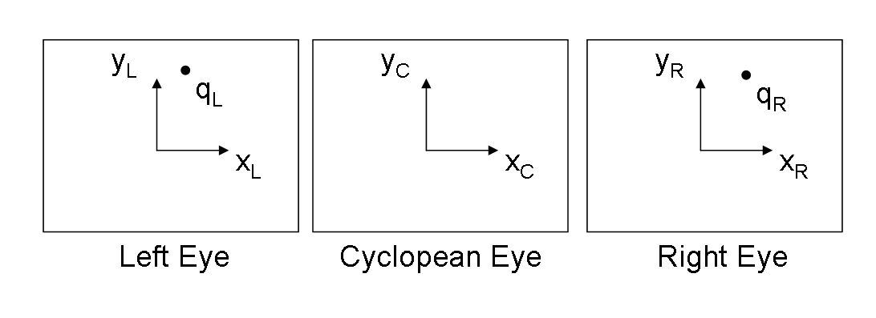
Disparity for a fixating binocular system

Slide 5
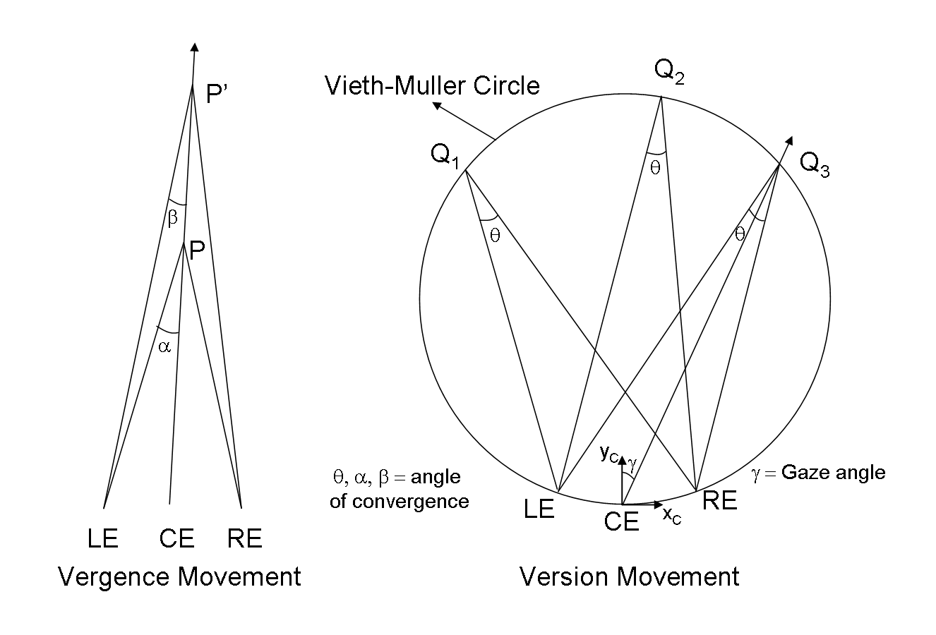
The two basic binocular eye movements

Slide 6
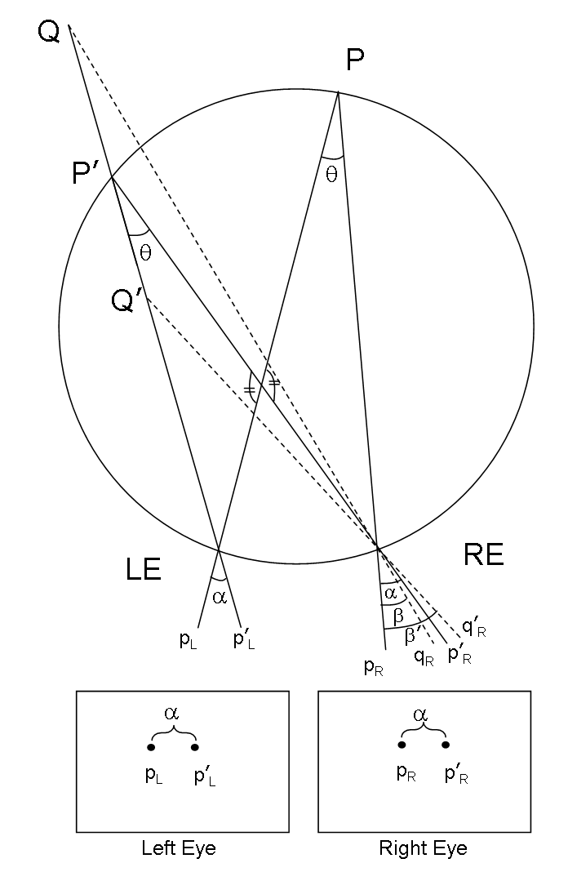
Disparity is zero on Vieth-Muller circle

Slide 7
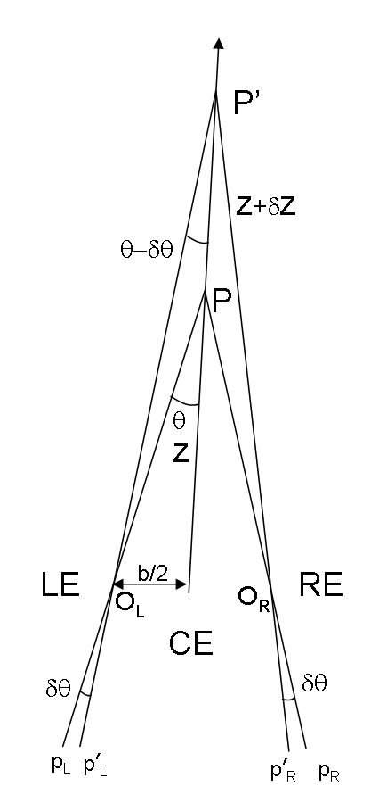
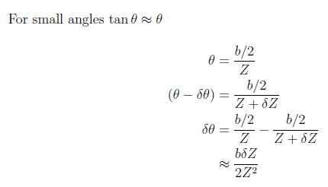
Relation between disparity and depth

Slide 8
Various camera configurations
Single point of fixation where optical axes intersect
Optical axes parallel (fixation at infinity)
General case

Slide 9
Parallel Optical Axes (fixation at infinity)

Slide 10
Parallel Optical Axes (fixation at infinity)

Slide 11
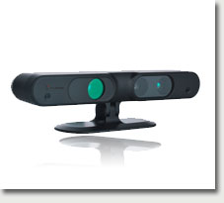
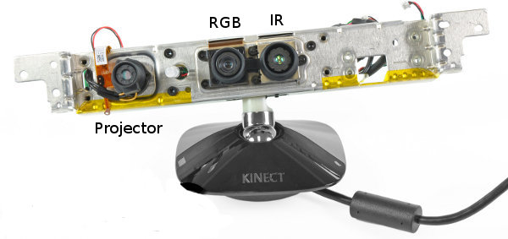
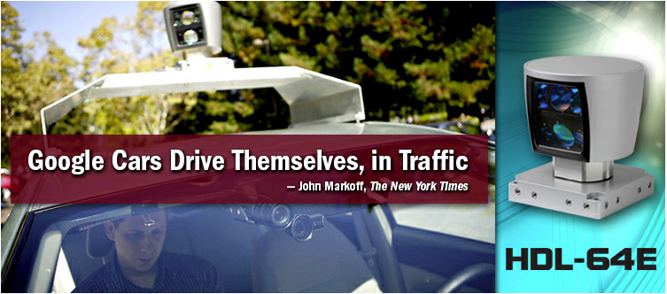
Range Sensors
primesense sensor (used in Kinect)
Velodyne LIDAR Sensor
http://www.primesense.com/, http://www.ifixit.com/,
http://mirror.umd.edu/roswiki/kinect_calibration(2f)technical.html
http://velodynelidar.com/lidar/lidar.aspx

Slide 12
Depth from Triangulation
Camera 1
Camera 2
Camera
Projector
Passive Stereopsis
Active Stereopsis
Active sensing simplifies the problem of estimating point correspondences

Slide 13
Recall the formula for disparity with parallel optical axes…

Slide 14
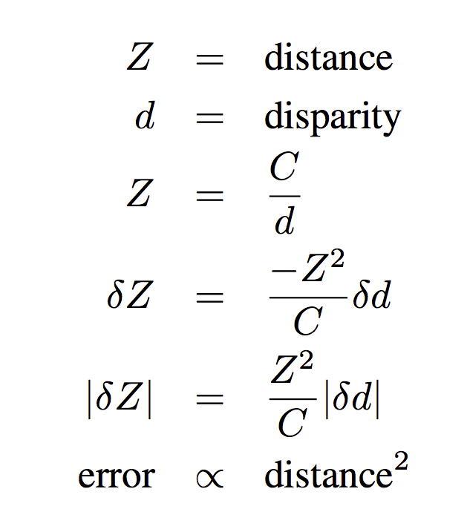
error(distance) – Kinect type sensor
Error in distance estimate increases quadratically with the distance

Slide 15
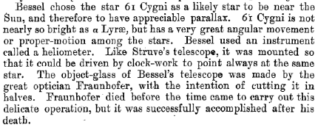
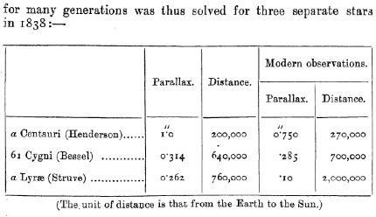
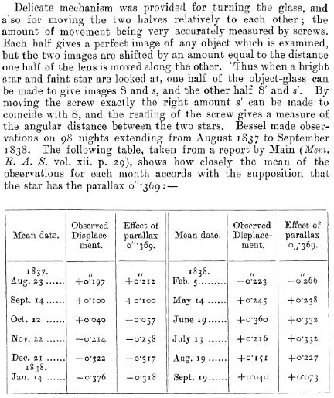
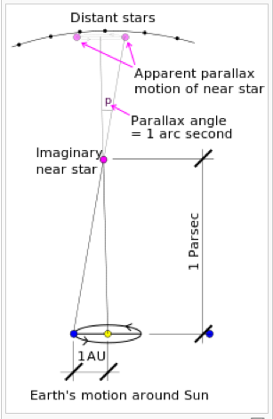

Slide 16
Various camera configurations
Single point of fixation where optical axes intersect
Optical axes parallel (fixation at infinity)
General case

