Slide 1
Markov Random Fields in Vision
Many slides drawn from presentations by Simon Prince/UCL and Kevin Wayne/Princeton

Slide 2
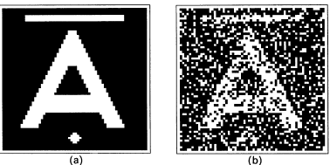


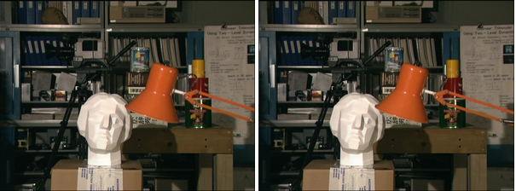
Image Denoising
Foreground Extraction
Stereo Disparity

Slide 3
Why study MRFs?
Image denoising is based on modeling what kinds of images are more probable
Foreground extraction is based on modeling what spatial distribution of foreground pixels is more probable
Stereo disparity estimation is based on modeling what kinds of disparity fields are more probable

Slide 4
Modeling the joint probability distribution
Associate a random variable with each pixel

Slide 5
Conditional independence assumptions necessary for tractability
Directed graphical models (a.k.a Bayes nets, Belief networks)

Slide 6
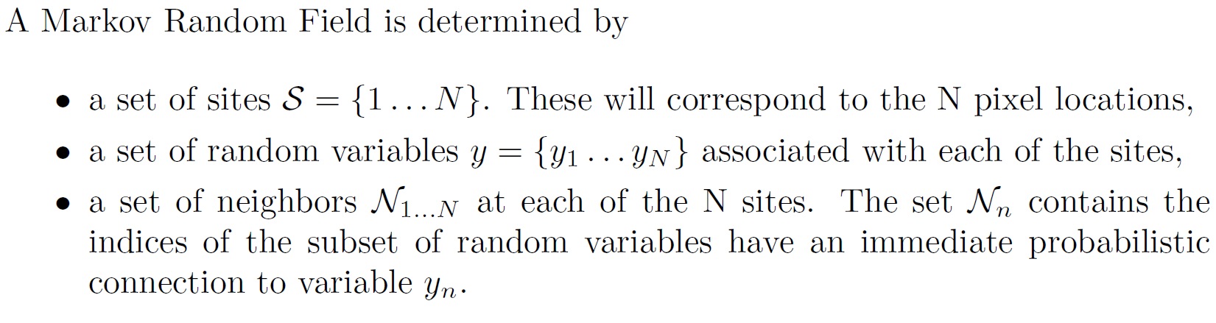
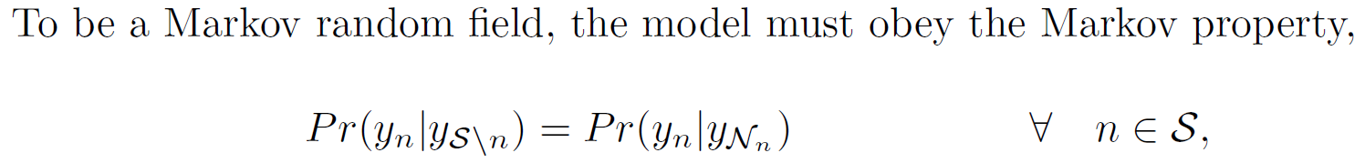
MRF Definition

Slide 7
Example: Image with 4-connected pixels

Slide 8
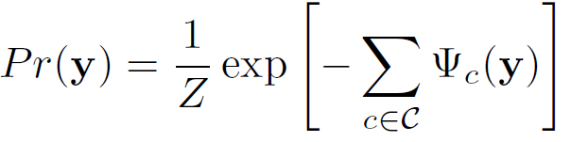
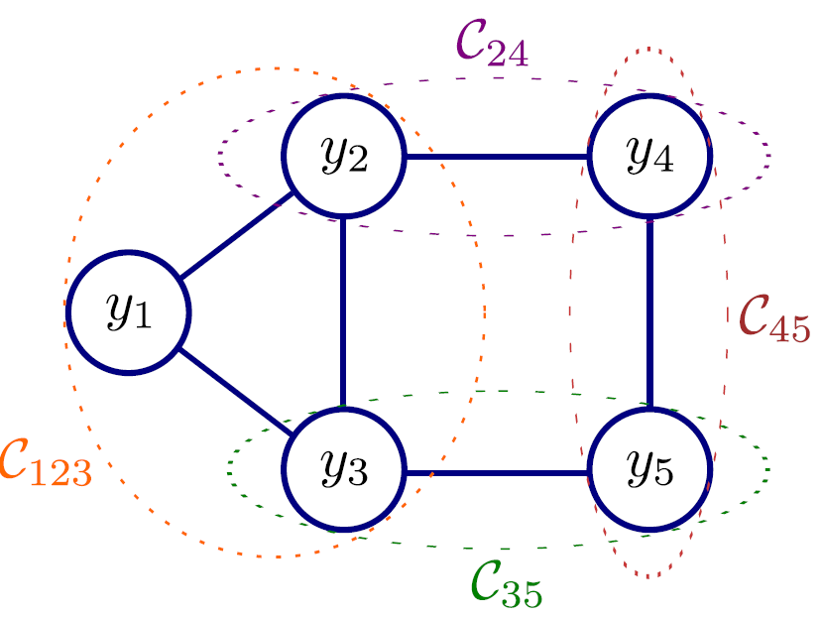
Hammersley Clifford Theorem
Any positive distribution that obeys the Markov property
can be written in the form
Where the c terms are maximal cliques
Cliques = subsets of variables that all connect to each other.
Maximal = cannot add any more variables and still be a clique

Slide 9
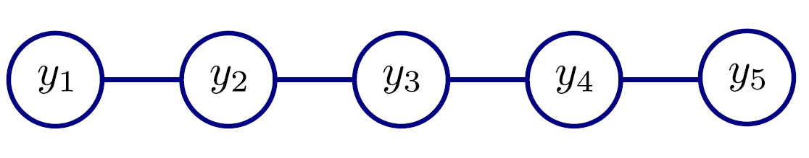
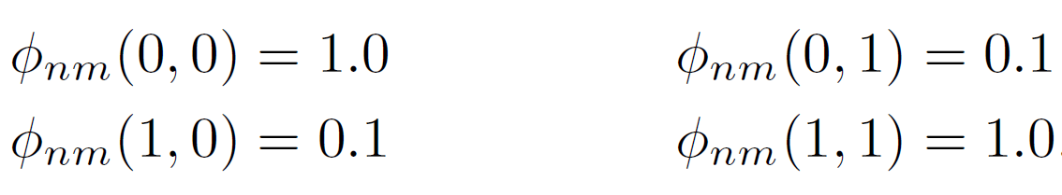
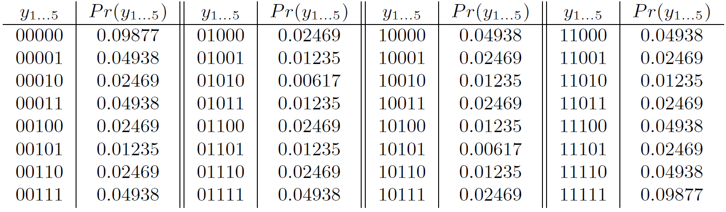
MRF on a line which favors smoothness
Consider the case where variables are binary, so functions return 4 different values depending on the combination of neighbours. Let’s choose

Slide 10
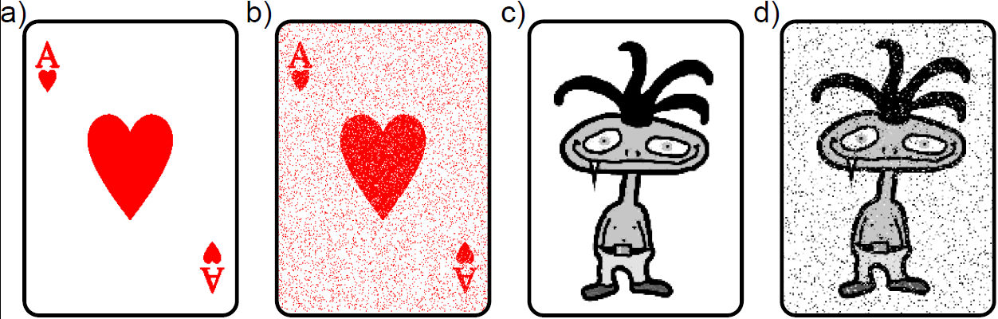
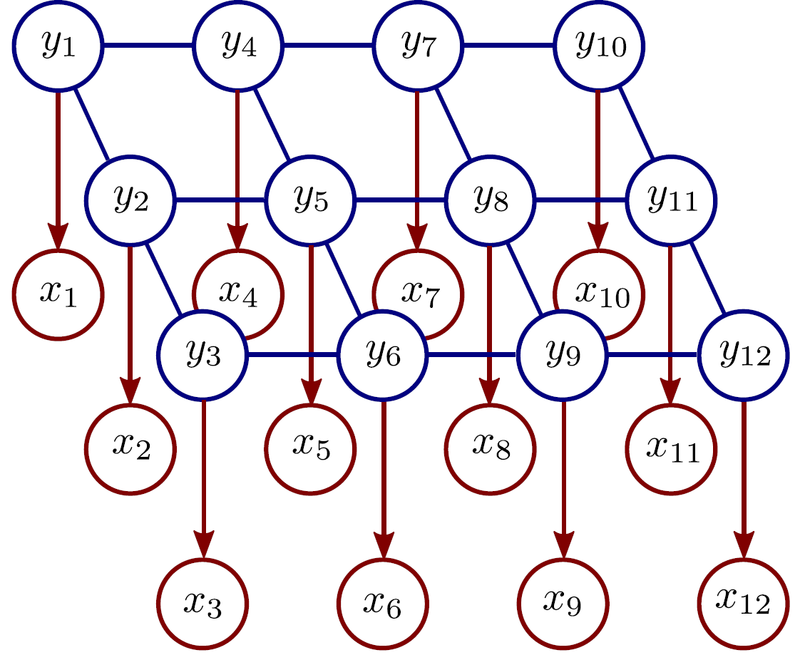
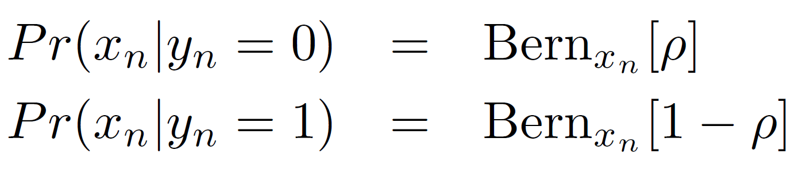
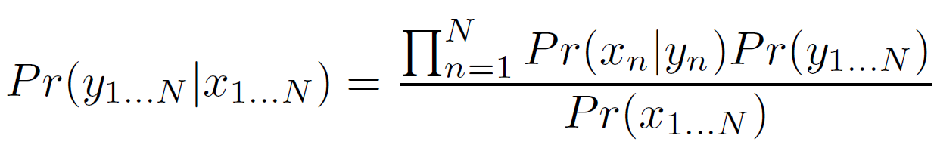
Denoising with MRFs
MRF Prior (pairwise cliques)
Original image, y
Likelihoods
Observed image, x
Inference via Bayes’ rule:

Slide 11
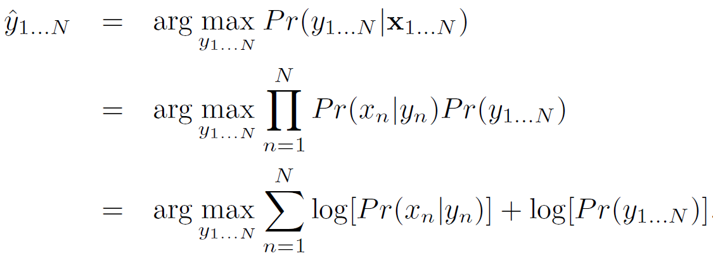
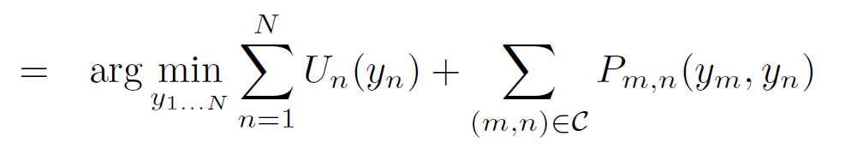
MAP Inference
Unary terms
(compatibility of data with label y)
Pairwise terms
(compatibility of neighboring labels)

Slide 12
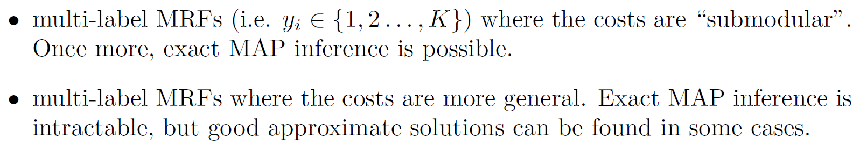
Graph Cuts Overview
Graph cuts used to optimise this cost function:
Unary terms
(compatibility of data with label y)
Pairwise terms
(compatibility of neighboring labels)
Three main cases:

Slide 13
Graph Cuts Overview
Graph cuts used to optimise this cost function:
Unary terms
(compatibility of data with label y)
Pairwise terms
(compatibility of neighboring labels)
Approach:
Convert minimization into the form of a standard CS problem,
MAXIMUM FLOW or MINIMUM CUT ON A GRAPH
Low order polynomial methods for solving this problem are known

Slide 14


Chapter 7 Network Flow
Slides by Kevin Wayne. Copyright © 2005 Pearson-Addison Wesley. All rights reserved.

Slide 15
Minimum Cut Problem
Flow network.
Abstraction for material flowing through the edges.
G = (V, E) = directed graph, no parallel edges.
Two distinguished nodes: s = source, t = sink.
c(e) = capacity of edge e.
2
9
5
10
4
15
15
10
source
s
5
3
8
6
10
t
sink
4
6
15
10
capacity
15
4
30
7
Notes:
source = where material originates, sink = where material goes.
We use cut to mean s-t cut.

Slide 16
Cuts
Def. An s-t cut is a partition (A, B) of V with s ∈ A and t ∈ B.
Def. The capacity of a cut (A, B) is:
2
9
5
10
4
15
15
10
s
5
3
8
6
10
t
A
4
6
15
10
15
Capacity = 10 + 5 + 15 = 30
4
30
7

Slide 17
Cuts
Def. An s-t cut is a partition (A, B) of V with s ∈ A and t ∈ B.
Def. The capacity of a cut (A, B) is:
2
9
5
10
4
15
15
10
s
5
3
8
6
10
t
A
4
15
15
6
10
Capacity = 9 + 15 + 8 + 30 = 62
4
30
7
Notes:
7->3 not counted

Slide 18
Minimum Cut Problem
Min s-t cut problem. Find an s-t cut of minimum capacity.
2
9
5
10
4
15
15
10
s
5
3
8
6
10
t
A
4
6
15
10
15
Capacity = 10 + 8 + 10 = 28
4
30
7

Slide 19
Flows
Def. An s-t flow is a function that satisfies:
For each e ∈ E: (capacity)
For each v ∈ V – {s, t}: (conservation)
Def. The value of a flow f is:
0
2
9
5
4
0
0
10
4
4
15
15
0
10
0
4
4
s
5
3
8
6
10
t
0
0
capacity
4
0
6
15
0
10
15
flow
0
0
Value = 4
4
30
7
Notes:
source = where material originates, sink = where material goes
flow conservation = otherwise warehouse overfills or oil pipe bursts
flow conservation is analogous to Kirchoff's law
* flow: abstract entity generated at source, transmitted across edges, absorbed at sink
* assume no arcs enter s or leave t (makes a little cleaner, no loss of generality)

Slide 20
Flows
Def. An s-t flow is a function that satisfies:
For each e ∈ E: (capacity)
For each v ∈ V – {s, t}: (conservation)
Def. The value of a flow f is:
6
2
9
5
10
0
6
10
4
4
15
15
0
10
3
8
8
s
5
3
8
6
10
t
1
10
capacity
4
0
6
15
0
10
15
flow
11
11
Value = 24
4
30
7

Slide 21
Maximum Flow Problem
Max flow problem. Find s-t flow of maximum value.
9
2
9
5
10
1
9
10
4
0
15
15
0
10
4
8
9
s
5
3
8
6
10
t
4
10
capacity
4
0
6
15
0
10
15
flow
14
14
Value = 28
4
30
7
Notes:
Equalize inflow and outflow at every intermediate node.
Maximize flow sent from s to t.

Slide 22
Flows and Cuts
Flow value lemma. Let f be any flow, and let (A, B) be any s-t cut. Then, the net flow sent across the cut is equal to the amount leaving s.
6
2
9
5
10
0
6
10
4
4
15
15
0
10
3
8
8
s
5
3
8
6
10
t
A
1
10
4
0
6
15
0
10
15
11
11
Value = 24
4
30
7

Slide 23
Flows and Cuts
Flow value lemma. Let f be any flow, and let (A, B) be any s-t cut. Then, the net flow sent across the cut is equal to the amount leaving s.
6
2
9
5
10
0
6
10
4
4
15
15
0
10
3
8
8
s
5
3
8
6
10
t
A
1
10
4
0
6
15
0
10
15
11
11
Value = 6 + 0 + 8 - 1 + 11 = 24
4
30
7
Notes:
total amount of flow that leaves S minus amount flow that "swirls" back

Slide 24
Flows and Cuts
Flow value lemma. Let f be any flow, and let (A, B) be any s-t cut. Then, the net flow sent across the cut is equal to the amount leaving s.
6
2
9
5
10
0
6
10
4
4
15
15
0
10
3
8
8
s
5
3
8
6
10
t
A
1
10
4
0
6
15
0
10
15
11
11
Value = 10 - 4 + 8 - 0 + 10 = 24
4
30
7

Slide 25
Max-Flow Min-Cut Theorem
Max-flow min-cut theorem. [Ford-Fulkerson 1956] The value of the max flow is equal to the value of the min cut.
There are low order polynomial time algorithms known for determining these, and associated software is available

Slide 26
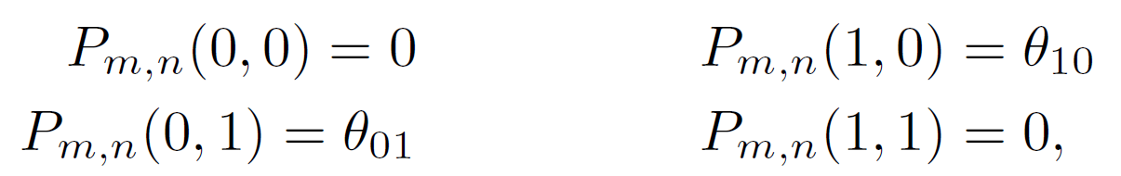
Graph Cuts: Binary MRF
Graph cuts used to optimise this cost function:
Unary terms
(compatability of data with label y)
Pairwise terms
(compatability of neighboring labels)
First work with binary case (i.e. True label y is 0 or 1)
Constrain pairwise costs so that they are “zero-diagonal”

Slide 27
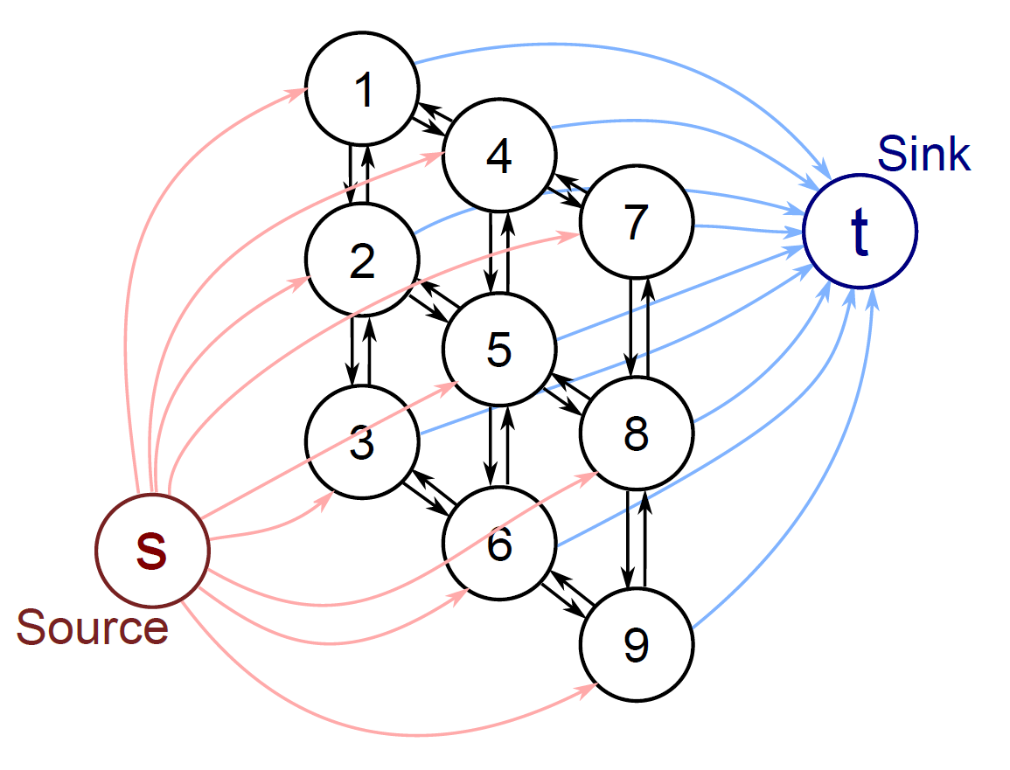
Graph Construction
One node per pixel (here a 3x3 image)
Edge from source to every pixel node
Edge from every pixel node to sink
Reciprocal edges between neighbours
Note that in the minimum cut EITHER the edge connecting to the source will be cut, OR the edge connecting to the sink, but NOT BOTH (unnecessary).
Which determines whether we give that pixel label 1 or label 0.
Now a 1 to 1 mapping between possible labelling and possible minimum cuts

Slide 28
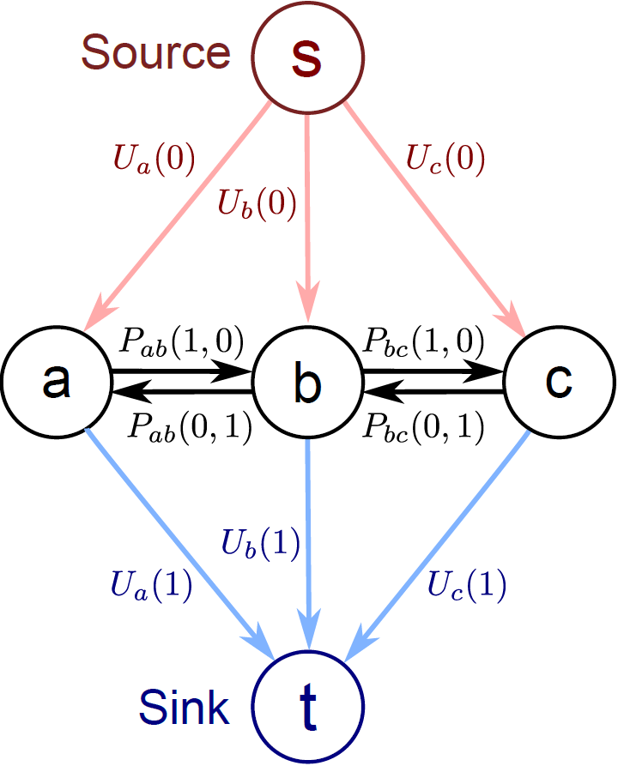
Graph Construction
Now add capacities so that minimum cut, minimizes our cost function
Unary costs U(0), U(1) attached to links to source and sink.
Either one or the other is paid.
Pairwise costs between pixel nodes as shown.
Why? Easiest to understand with some worked examples.

Slide 29
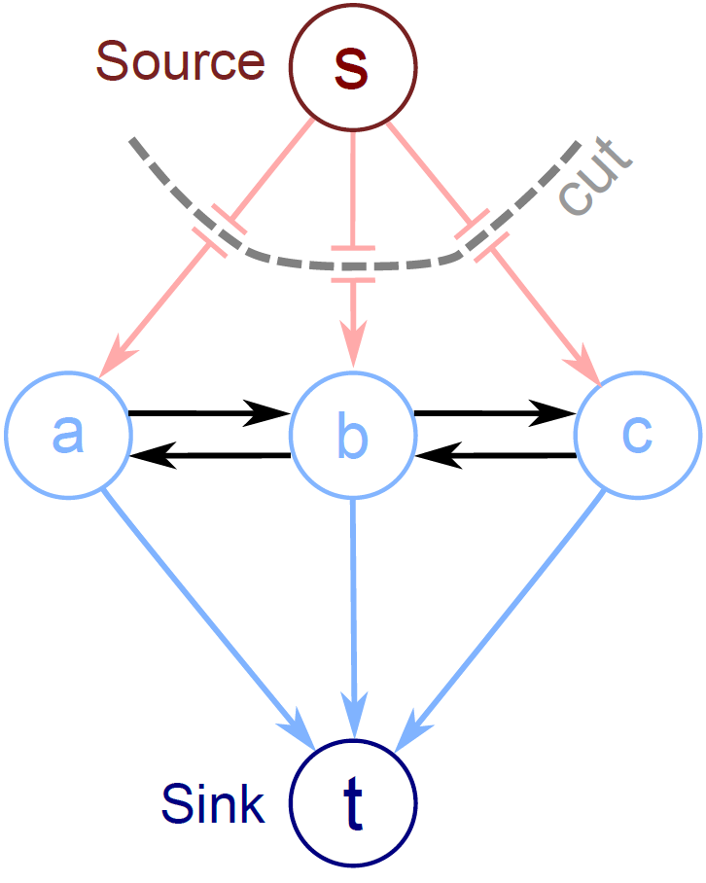
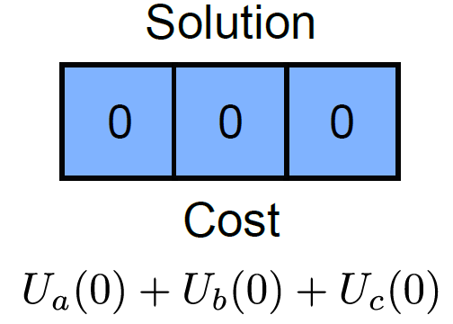
Example 1

Slide 30
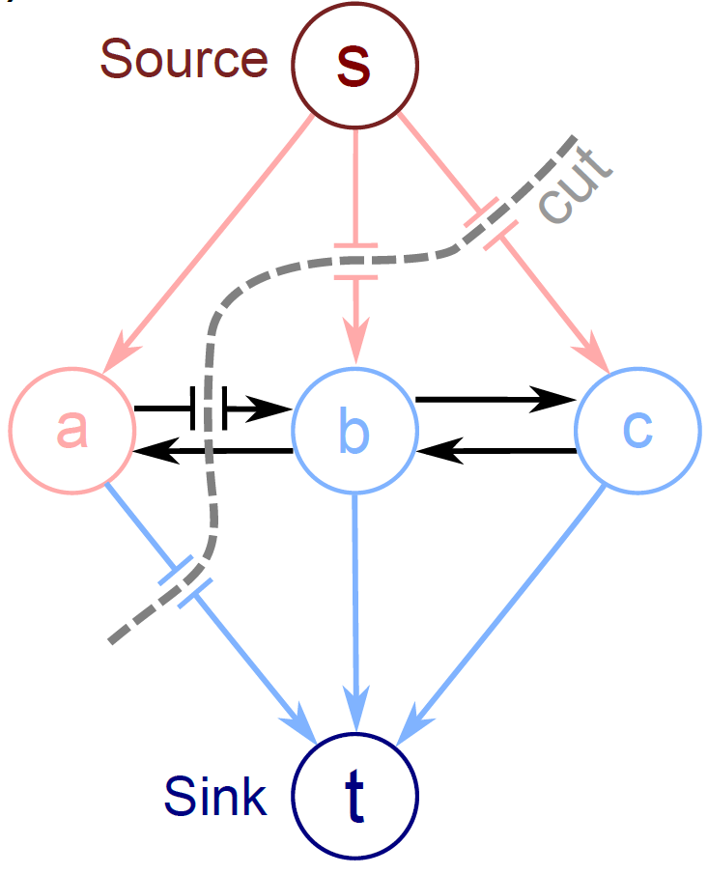
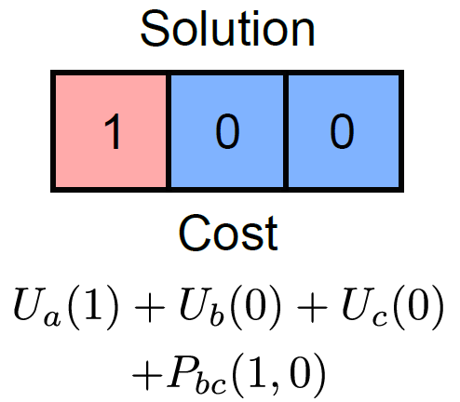
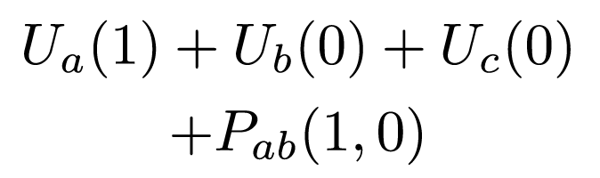
Example 2

Slide 31
Graph Cuts: Binary MRF
Graph cuts used to optimise this cost function:
Unary terms
(compatability of data with label y)
Pairwise terms
(compatability of neighboring labels)
Summary of approach
Associate each possible solution with a minimum cut on a graph
Set capacities on graph, so cost of cut matches the cost function
This minimizes the cost function and finds the MAP solution

Slide 32
Image Denoising
Foreground Extraction
Stereo Disparity

Slide 33
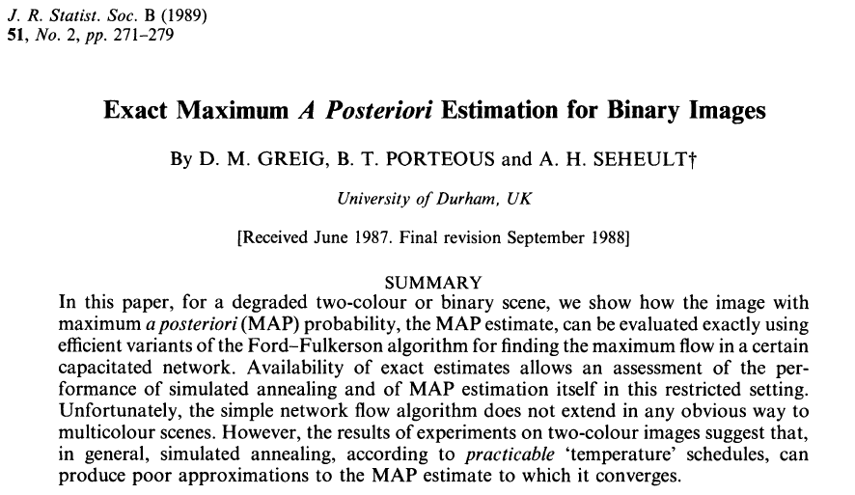
The connection between graph cuts and MRF inference was first made in this paper

