Slide 1
Solving for Stereo Correspondence
Many slides drawn from Lana Lazebnik, UIUC

Slide 2
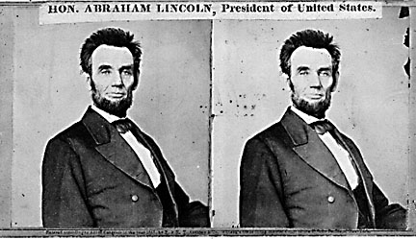
Basic stereo matching algorithm
For each pixel in the first image
Find corresponding epipolar line in the right image
Examine all pixels on the epipolar line and pick the best match
Triangulate the matches to get depth information

Slide 3
Simplest Case: Parallel images
Image planes of cameras are parallel to each other and to the baseline
Camera centers are at same height
Focal lengths are the same

Slide 4
Simplest Case: Parallel images
Image planes of cameras are parallel to each other and to the baseline
Camera centers are at same height
Focal lengths are the same
Then epipolar lines fall along the horizontal scan lines of the images

Slide 5
Essential matrix for parallel images
Epipolar constraint:
R = I t = (T, 0, 0)
x
x’
t
The y-coordinates of corresponding points are the same!

Slide 6
Stereo image rectification
Reproject image planes onto a common
plane parallel to the line between optical centers
Pixel motion is horizontal after this transformation
Two homographies (3x3 transform), one for each input image reprojection
C. Loop and Z. Zhang. Computing Rectifying Homographies for Stereo Vision. IEEE Conf. Computer Vision and Pattern Recognition, 1999.

Slide 7
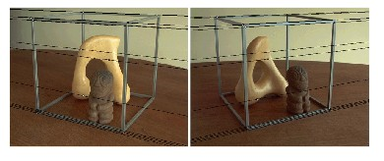
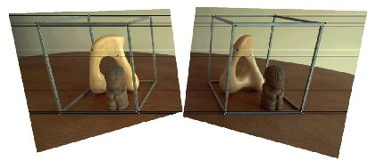
Rectification example

Slide 8
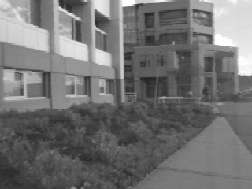
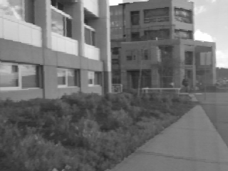
Correspondence search
Left
Right
scanline
Matching cost
disparity
Slide a window along the right scanline and compare contents of that window with the reference window in the left image
Matching cost: SSD or normalized correlation

Slide 9
Correspondence search
Left
Right
scanline
SSD

Slide 10
Correspondence search
Left
Right
scanline
Norm. corr

Slide 11
Basic stereo matching algorithm
If necessary, rectify the two stereo images to transform epipolar lines into scanlines
For each pixel x in the first image
Find corresponding epipolar scanline in the right image
Examine all pixels on the scanline and pick the best match x’
Compute disparity x–x’ and set depth(x) = B*f/(x–x’)

Slide 12

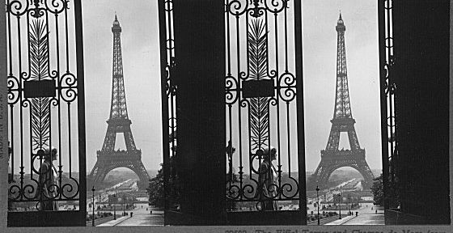
Failures of correspondence search
Textureless surfaces
Occlusions, repetition
Non-Lambertian surfaces, specularities

Slide 13
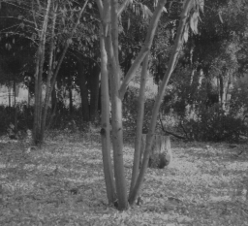
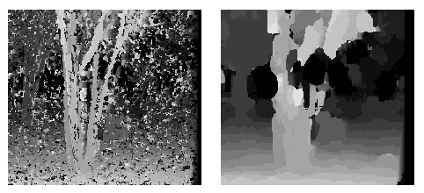
Effect of window size
W = 3
W = 20
Smaller window
More detail
More noise
Larger window
Smoother disparity maps
Less detail
Notes:
smaller window: more detail, more noise
bigger window: less noise, more detail

Slide 14
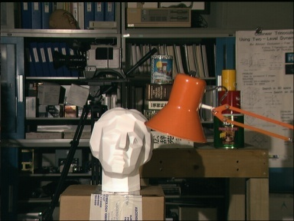

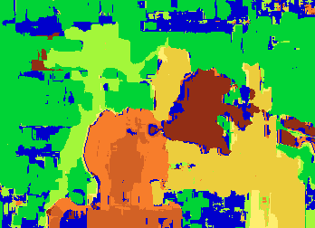
Results with window search
Data
Window-based matching
Ground truth

Slide 15
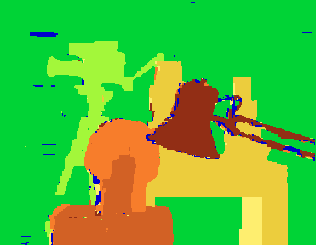
Better methods exist...
Graph cuts
Ground truth
Y. Boykov, O. Veksler, and R. Zabih, Fast Approximate Energy Minimization via Graph Cuts, PAMI 2001
For the latest and greatest: http://www.middlebury.edu/stereo/

Slide 16
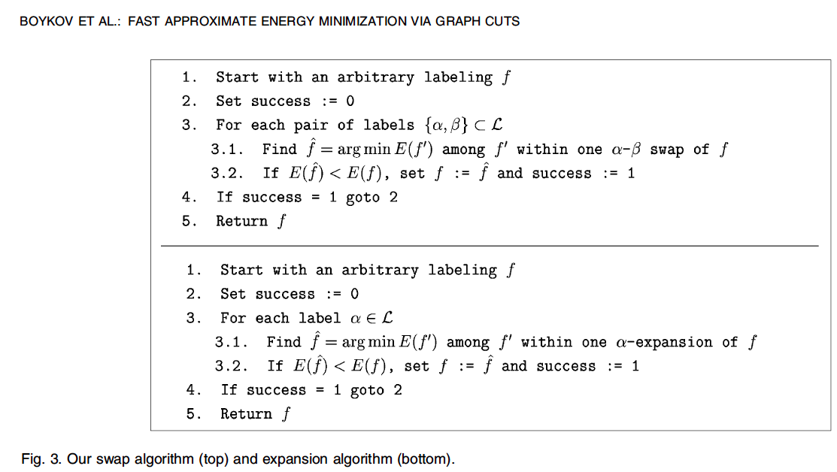
Labeling improved through label swap and expansion macro-moves

Slide 17
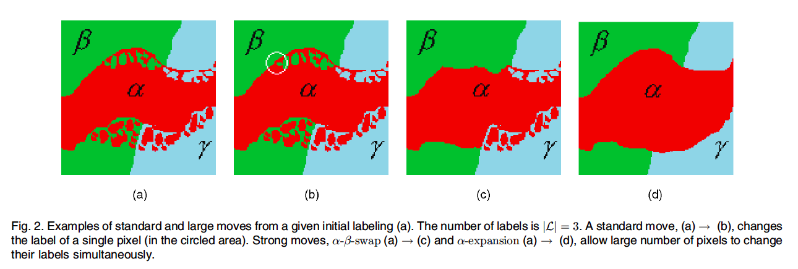
The two basic macro-moves

Slide 18
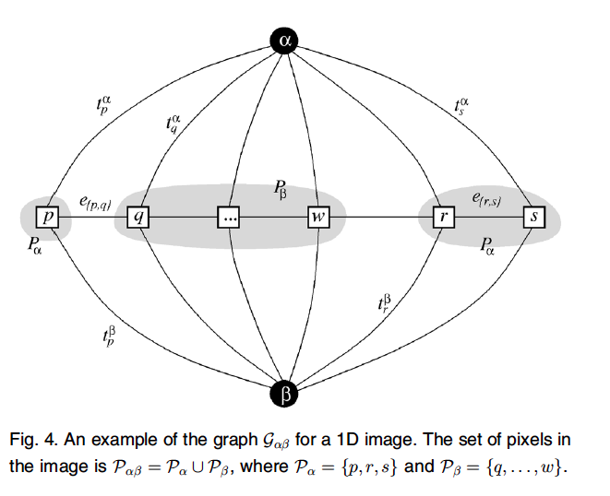
Each move is done by solving a graph cut problem

