Slide 1
Measuring Optical Flow
Jitendra Malik

Slide 2
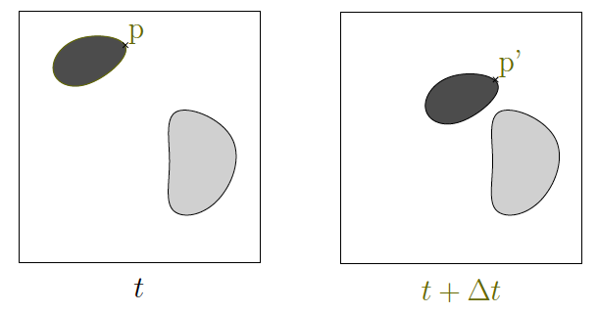
Optical flow is based on correspondence over time

Slide 3
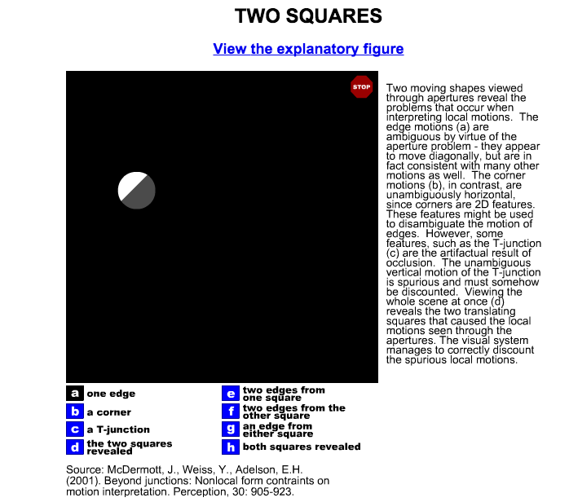
http://web.mit.edu/persci/demos/Motion&Form/master.html

Slide 4



Slide 5


Slide 6

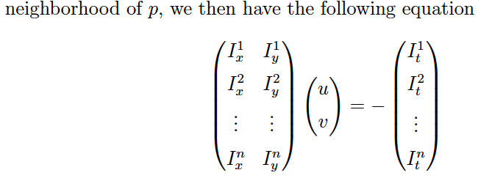

Slide 7
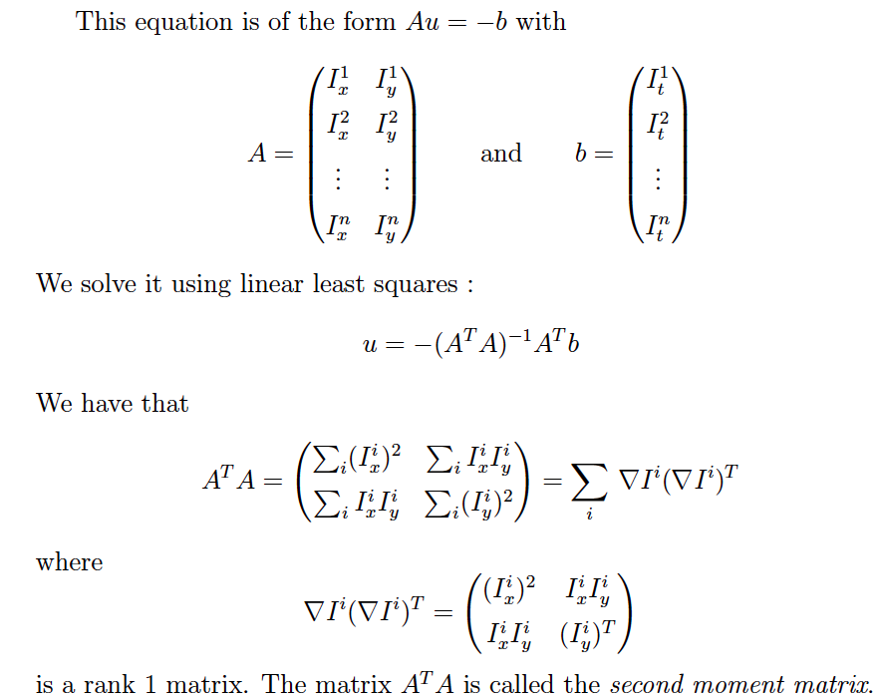

Slide 8



Slide 9
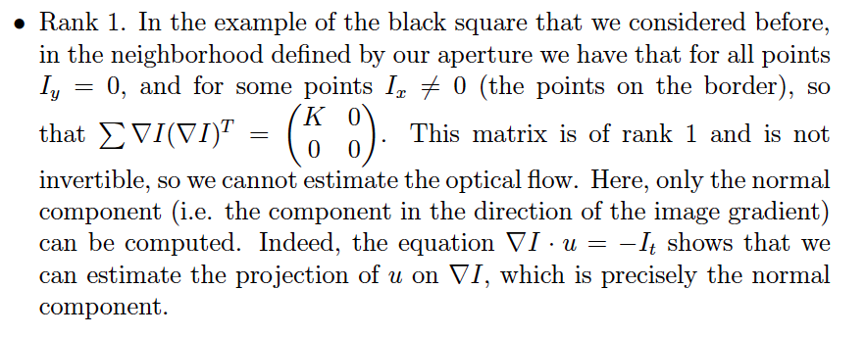
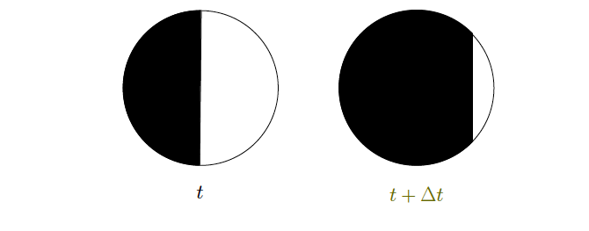

Slide 10


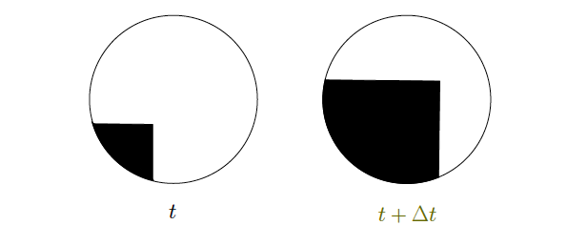

Slide 11
http://web.mit.edu/persci/demos/Motion&Form/master.html

