Slide 1
Fundamentals of Image Formation
Lecture 2
Jitendra Malik

Slide 2


A camera creates an image …
The image I(x,y) measures how much light is captured at pixel (x,y)
We want to know
Where does a point (X,Y,Z) in the world get imaged?
What is the brightness at the resulting point (x,y)?

Slide 3
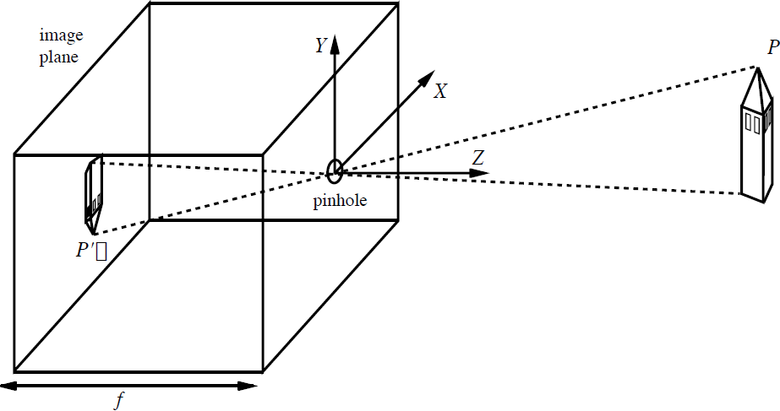


The Pinhole Camera
y
x

Slide 4
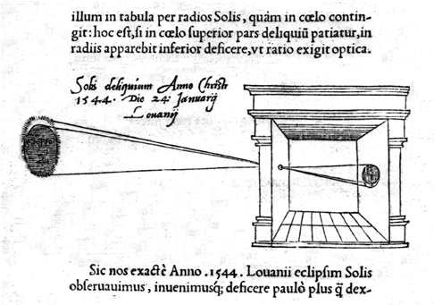
Camera Obscura (Reinerus Gemma-Frisius, 1544)

Slide 5
The Pinhole Camera
y
x

Slide 6

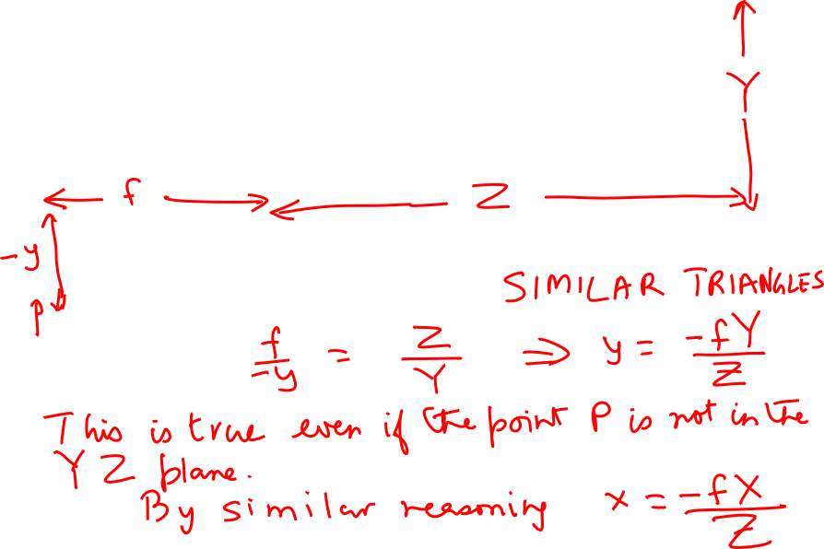


Let us prove this …
This diagram is for the special case of a point P in the Y-Z plane.
In the general case, consider the projection of P on the Y-Z plane.

Slide 7
The Pinhole Camera
y
x

Slide 8
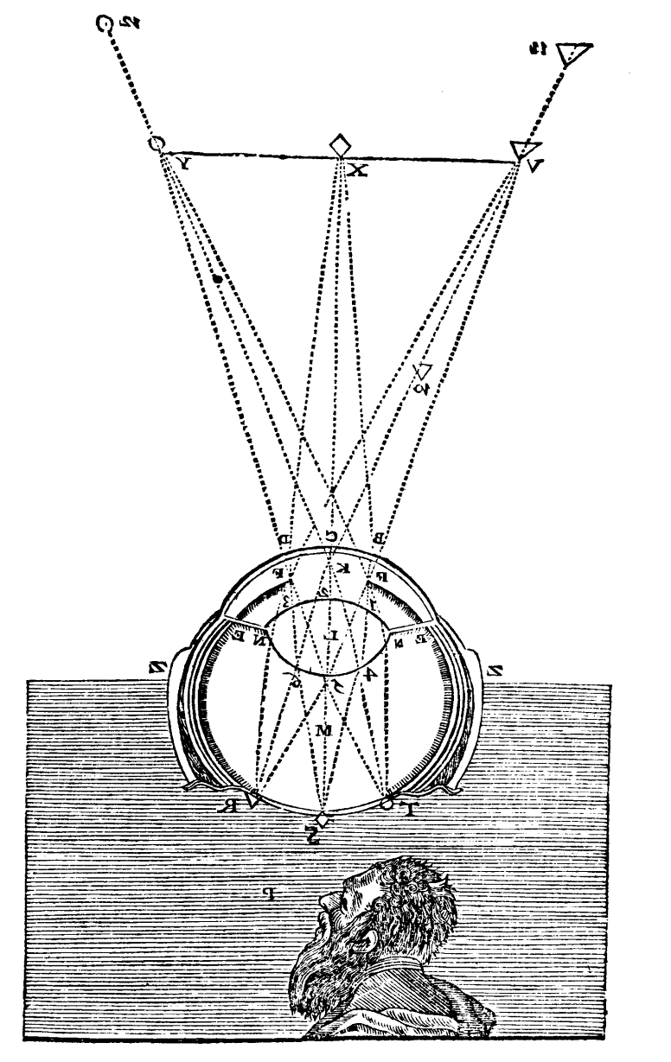

The image is inverted
This was pointed out by Kepler in 1604
But this is no big deal. The brain can interpret it the right way. And for a camera, software can simply flip the image top-down and right-left. After this trick, we get
From Descartes(1637), La Dioptrique

Slide 9
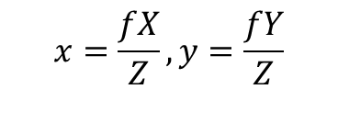

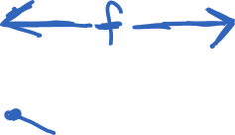




A projection model that avoids inversion
Perspective projection is a mapping from points in 3D space to rays through the Center of Projection

Slide 10
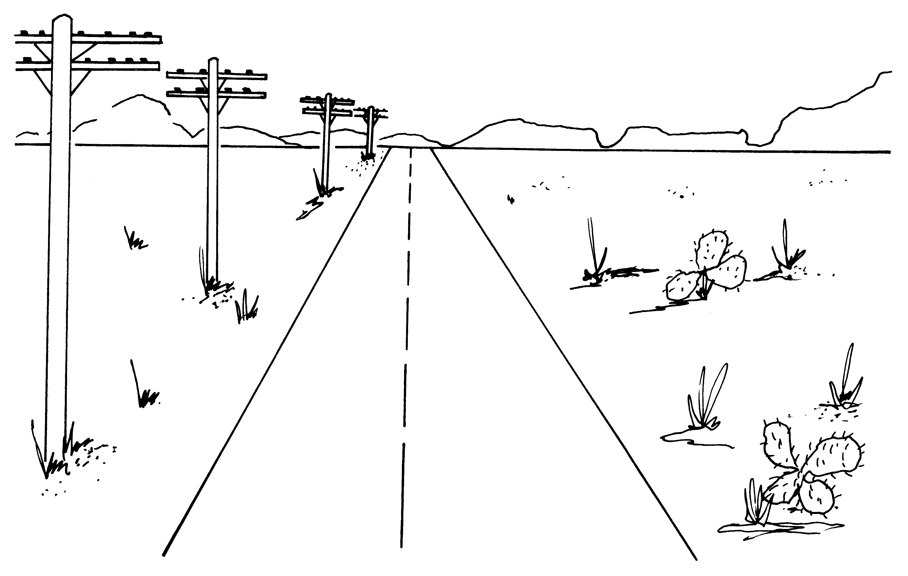
Some perspective phenomena…

Slide 11




Parallel lines converge to a vanishing point

Slide 12
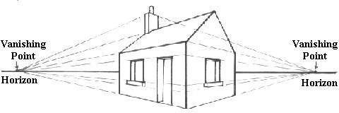
Each family of parallel lines has its own vanishing point

Slide 13
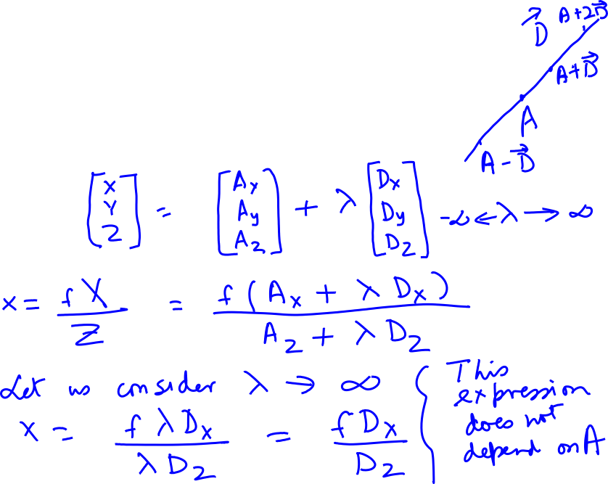
Proof
Let there be a point A and a direction vector D in three dimensional space.

Slide 14
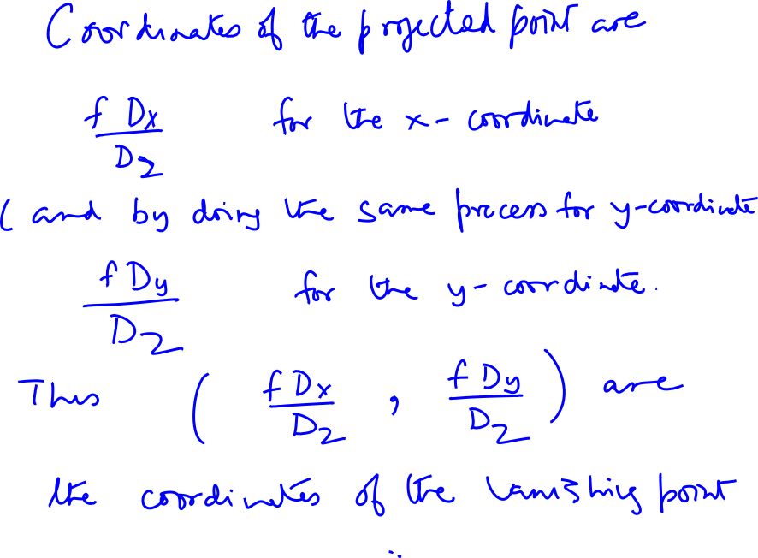

Slide 15
Each family of parallel lines has its own vanishing point
But this isn’t true of the vertical lines. They stay parallel. Why?

Slide 16

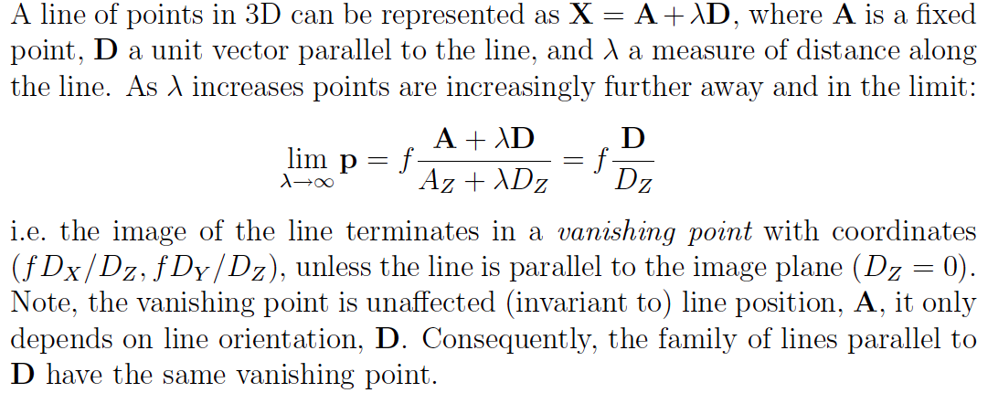
Vanishing point in vector notation

Slide 17

Nearer objects are lower in the image

Slide 18

Proof
The equation of the ground plane is Y = -h
A point on the ground plane will have y-coordinate y= -fh/Z

Slide 19


Nearer objects look bigger

Slide 20
Nearer objects look bigger
Top at (X, L – h, Z)
Bottom at (X, - h, Z)
It is straightforward to calculate the projection of the top &
bottom of the pole. The difference is the “apparent height”

Slide 21
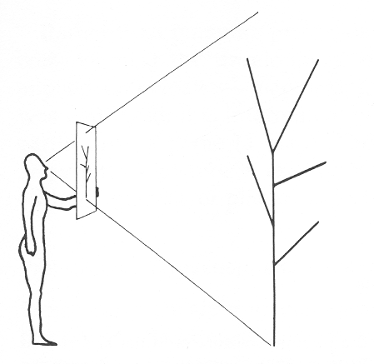
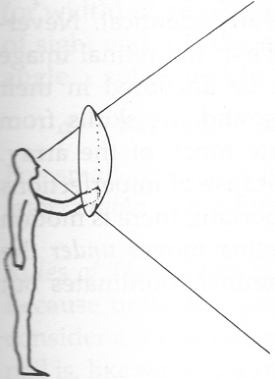
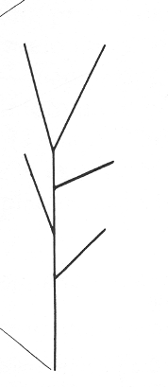
Perspective projection is a mapping from 3D points to rays through the center of projection; the imaging surface could be planar or spherical

Slide 22
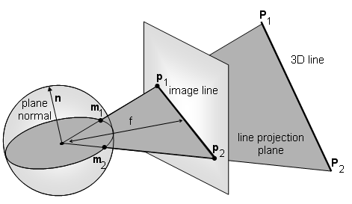
Projection of a line in planar perspective is a line, in spherical perspective is a great circle

Slide 23


The natural measure of image size is visual angle
Perspective projection is a mapping from points in 3D space to rays through the Center of Projection

Slide 24
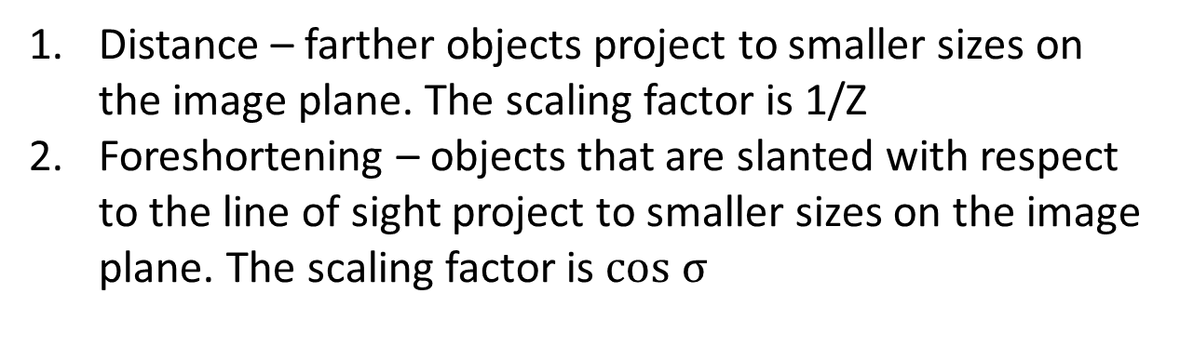

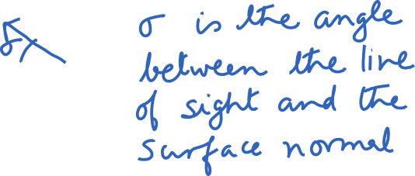

Two main effects of perspective projection

Slide 25
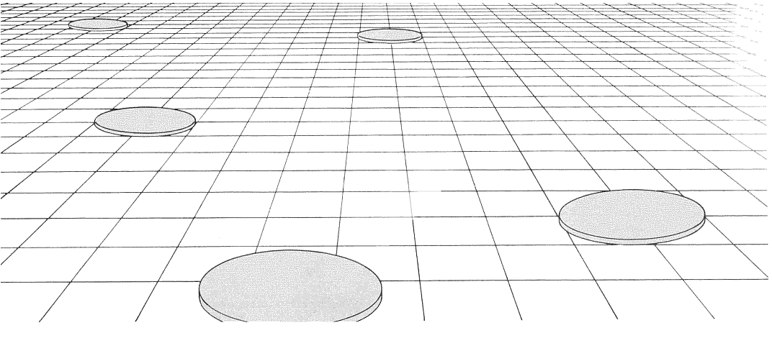
The slabs that are far away not only look smaller, but also more foreshortened
Notes:
Here if we assume that the slabs are all of the same size and shape in the scene, then the apparent diminution of size on the image plane is a cue to changes in depth and surface slant. These kinds of grids are ubiquitous in Renaissance paintings.

Slide 26
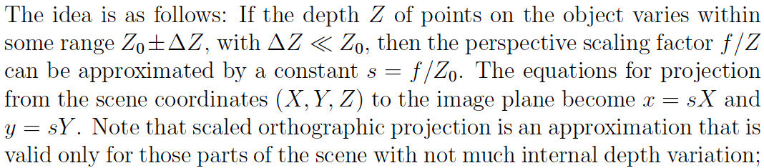
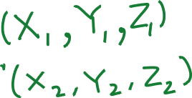


Orthographic projection
Approximation to perspective when the object is relatively far away
compared to the depth variation in it

Slide 27
