Slide 1
A quick tour of differential geometry
Jitendra Malik

Slide 2
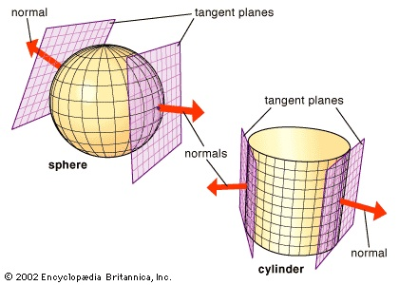

Slide 3
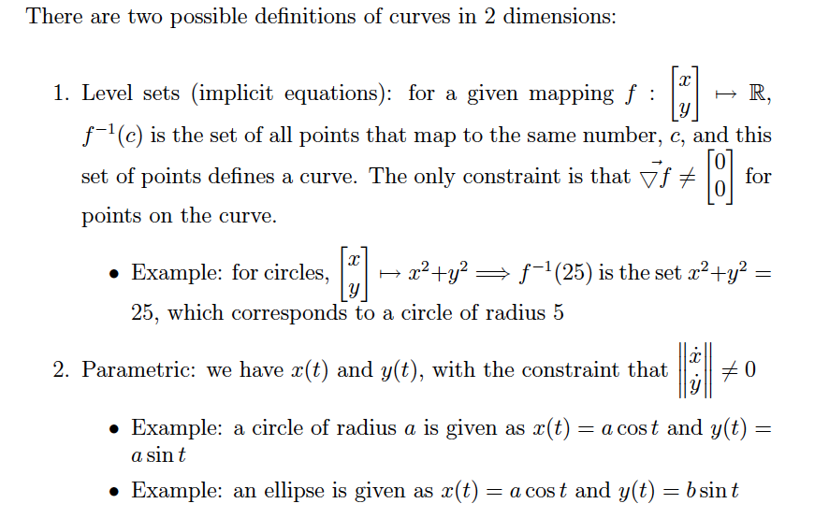

Slide 4
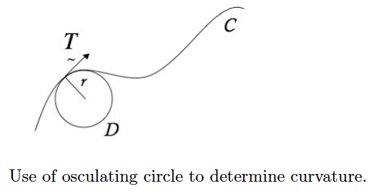

Slide 5
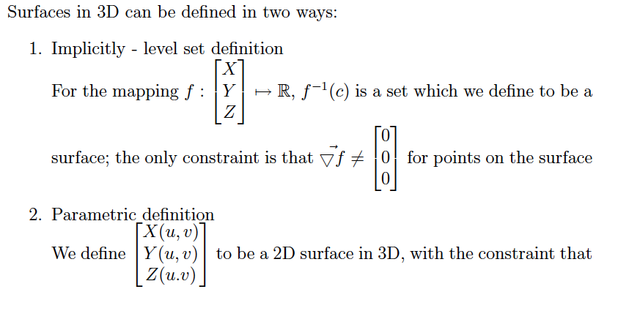


Slide 6
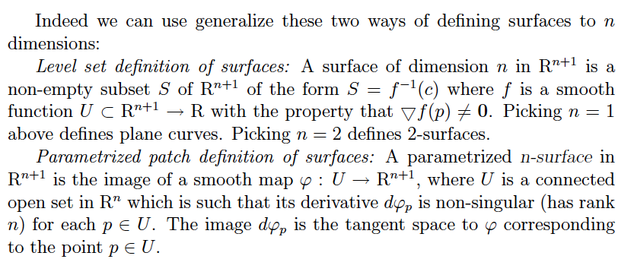
Two ways of defining surfaces

Slide 7
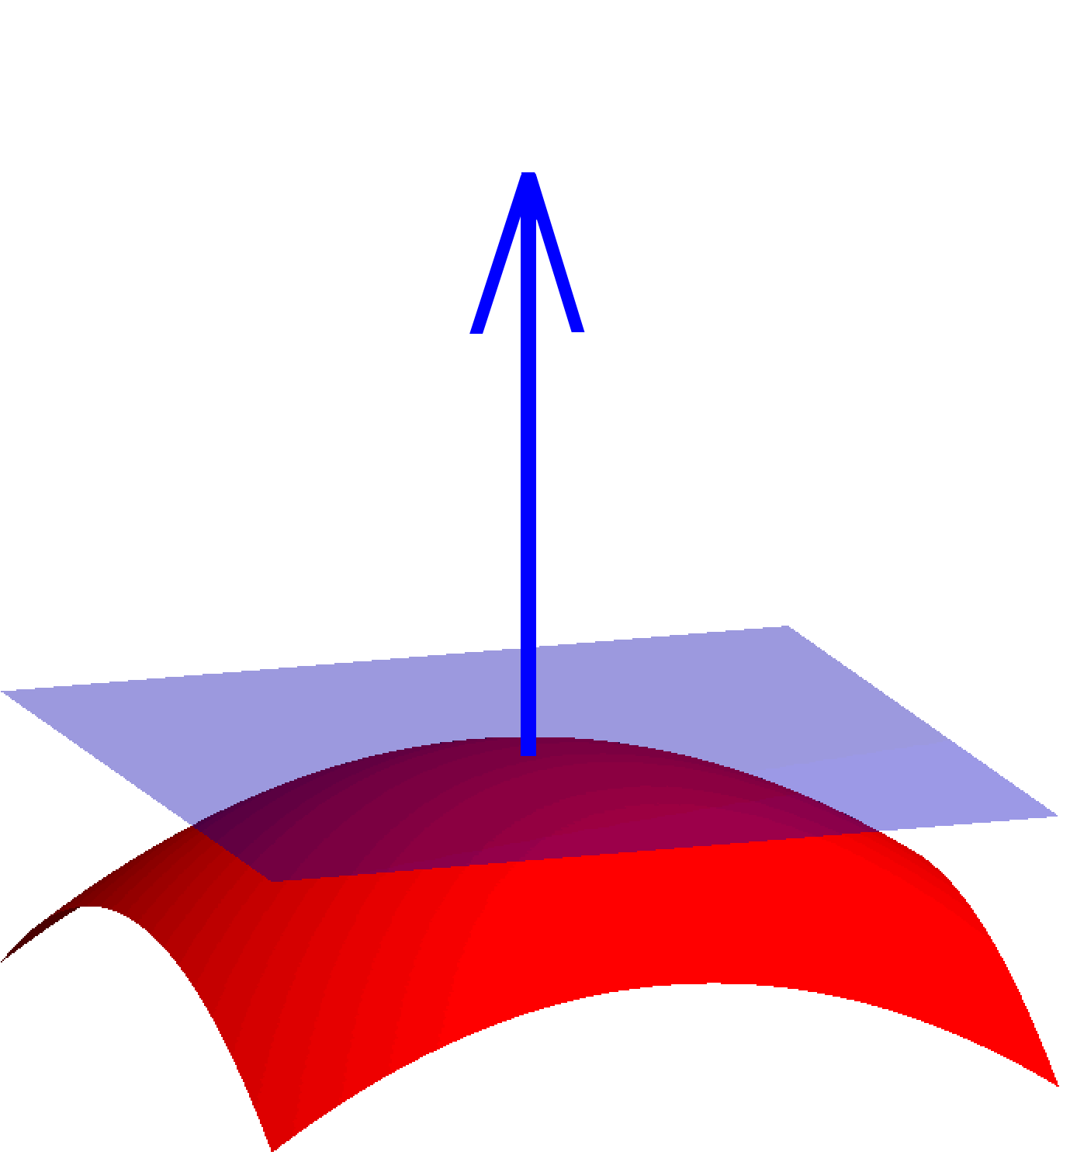

Slide 8

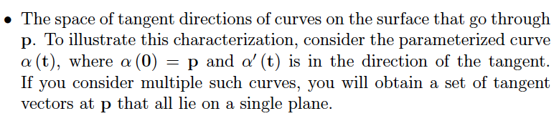

Slide 9
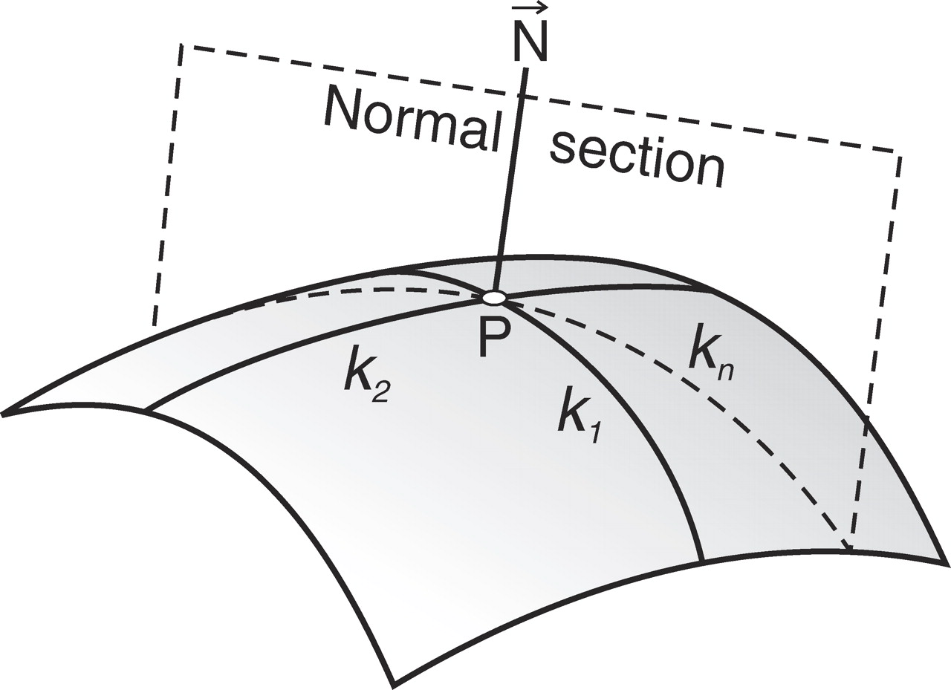

Slide 10
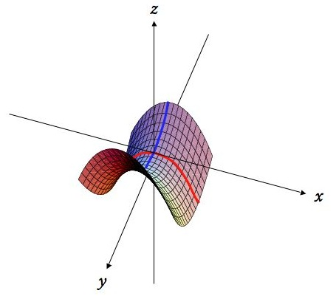

Slide 11
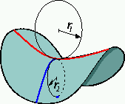
Defining normal curvature

Slide 12
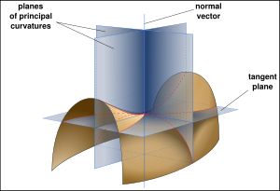

Slide 13
Principal curvatures for different surfaces
Plane
Cylinder
Sphere
Elliptic patch
Hyperbolic patch

Slide 14
Principal curvatures for different surfaces
Plane – both zero
Cylinder – one zero, other is 1/r
Sphere – both are 1/r
Elliptic patch – both have same sign
Hyperbolic patch – have opposite signs

Slide 15
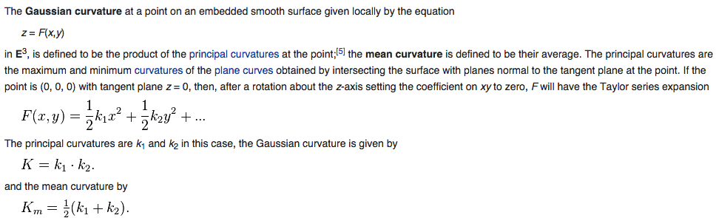
Gaussian and Mean Curvature

Slide 16
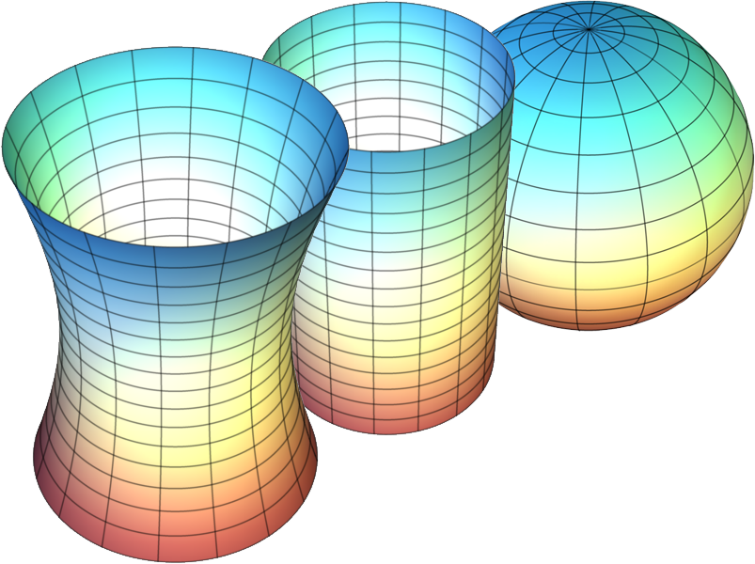
Surfaces of negative, zero and positive Gaussian Curvature

