Slide 1
Dynamic Perspective
How a moving camera reveals scene depth and egomotion parameters
Jitendra Malik
UC Berkeley

Slide 2
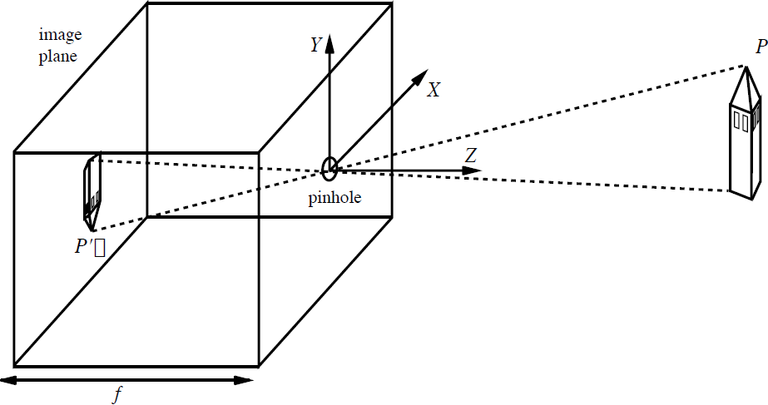

The Pinhole Camera
y
x
$$x=−\frac{fX}{Z} y=−\frac{fY}{Z}$$

Slide 3
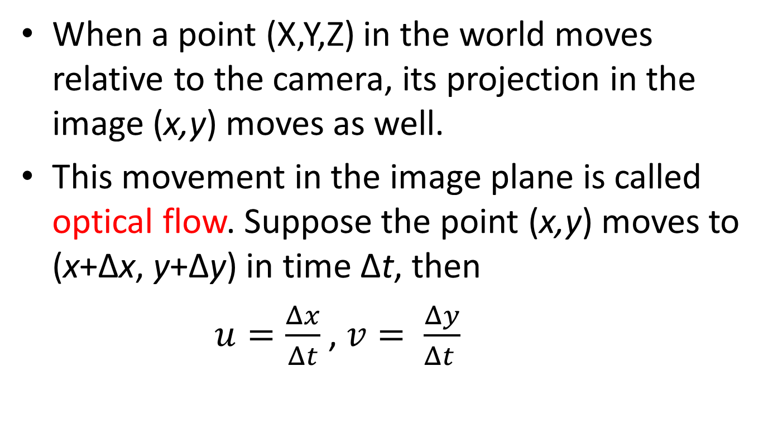
Suppose the camera moves with respect to the world…
When a point (X,Y,Z) in the world moves relative to the camera, its projection in the image (x,y) moves as well.
This movement in the image plane is called optical flow. Suppose the point (x,y) moves to (x+∆x, y+∆y) in time ∆t, then
$u=\frac{Δx}{Δt}$ , $v= \frac{Δy}{Δt }$
are the two components of the optical flow at (x,y)

Slide 4
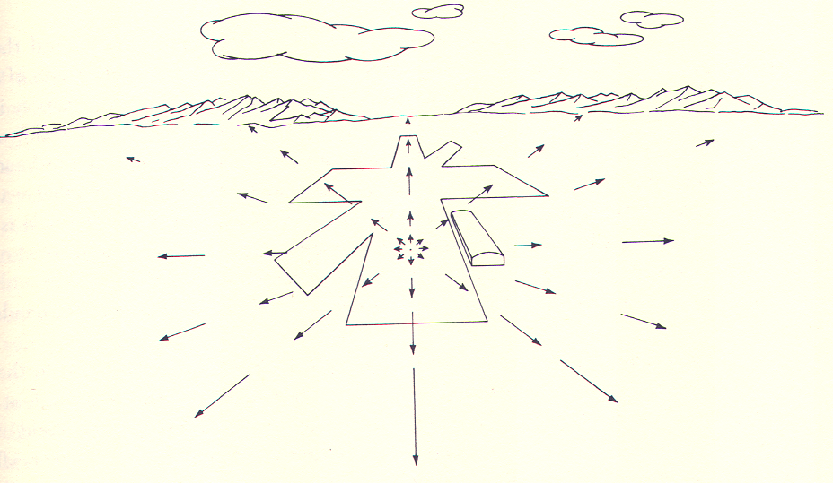
Gibson’s example I: Optical flow for a pilot landing a plane

Slide 5
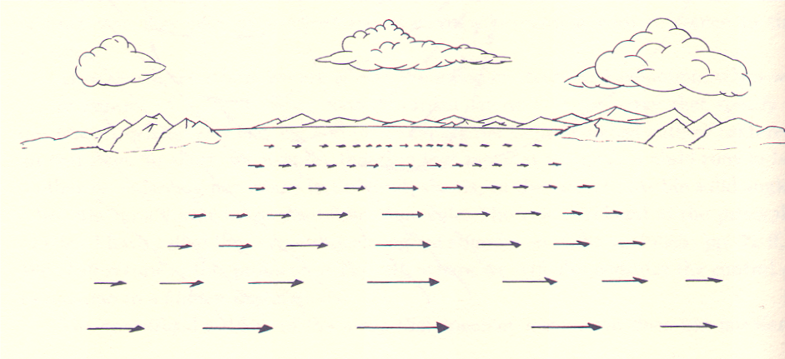
Gibson’s example II: Optical flow from the side window of a car

Slide 6
Outline
Derive equation relating optical flow field to scene depth Z(x,y) and the motion of the camera t, ω
The translational component of the flow field is the more important one – it is what tells Z(x,y) and the translation t
The rotational component of the flow field reveals information about ω

Slide 7
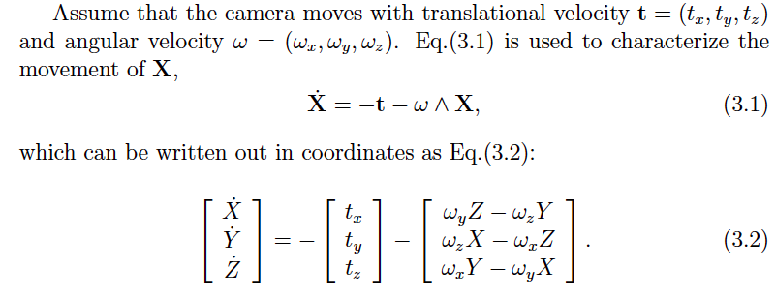
How does a point X in the scene move?

Slide 8
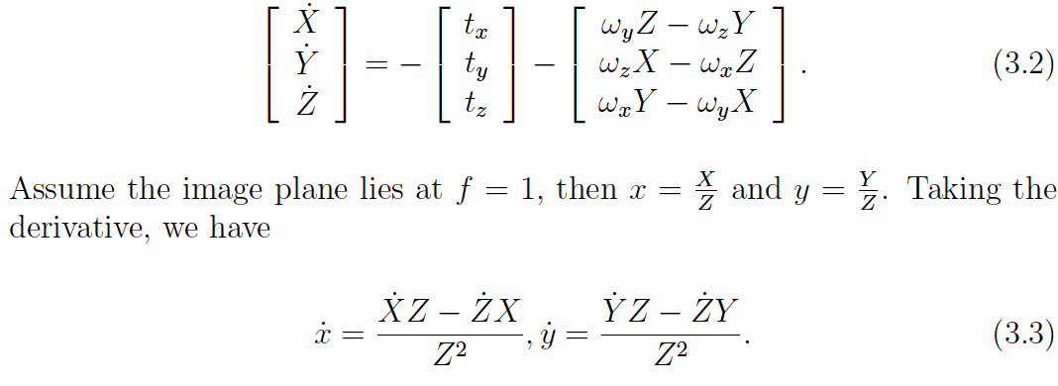
Now consider the effect of projection…

Slide 9
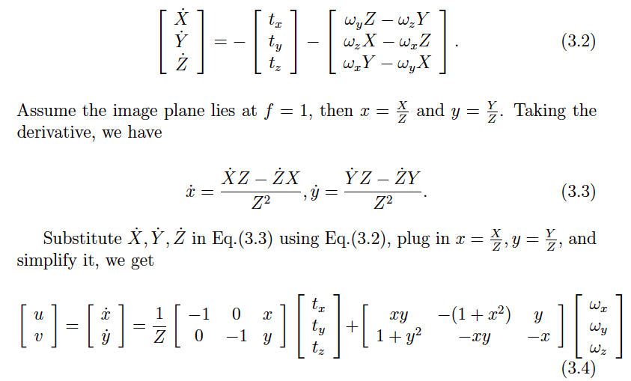
Now consider the effect of projection…

Slide 10
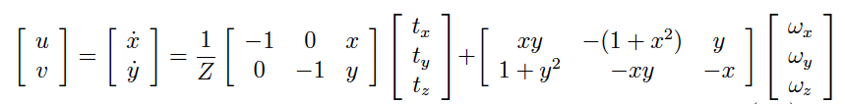
The Optical Flow Equations

Slide 11
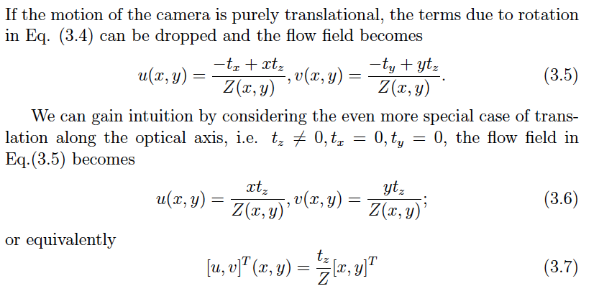
Optical flow for pure translation

Slide 12
Optical flow for pure translation along Z axis

Slide 13
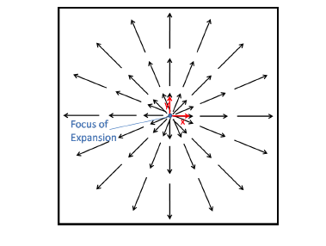
Optical flow for pure translation along Z-axis
The optical flow vector is a scalar multiple of the position vector

Slide 14
Scale Factor Ambiguity
However we can compute the time to contact

Slide 15
Optical flow for general translation
When is this (0,0)?

Slide 16
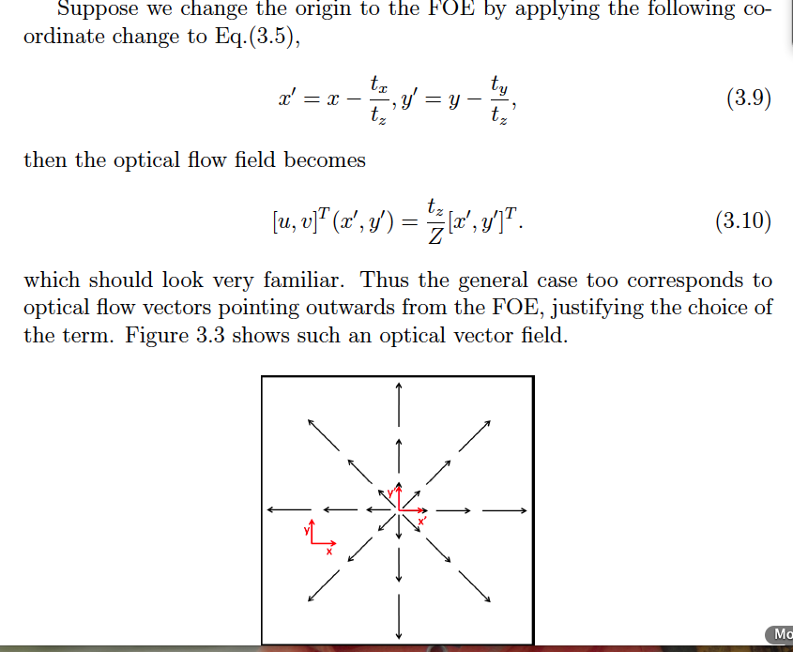
With respect to the FOE, the flow vectors are radially outward

Slide 17
The Optical Flow Equations

Slide 18
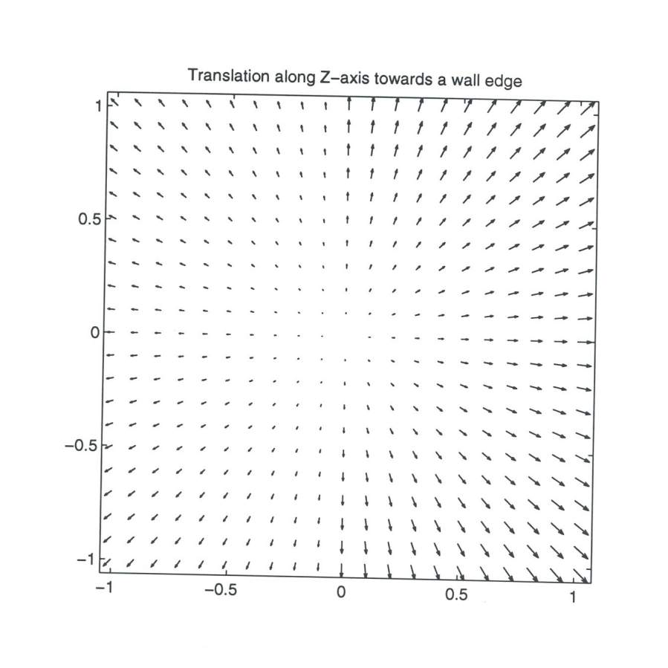

Slide 19
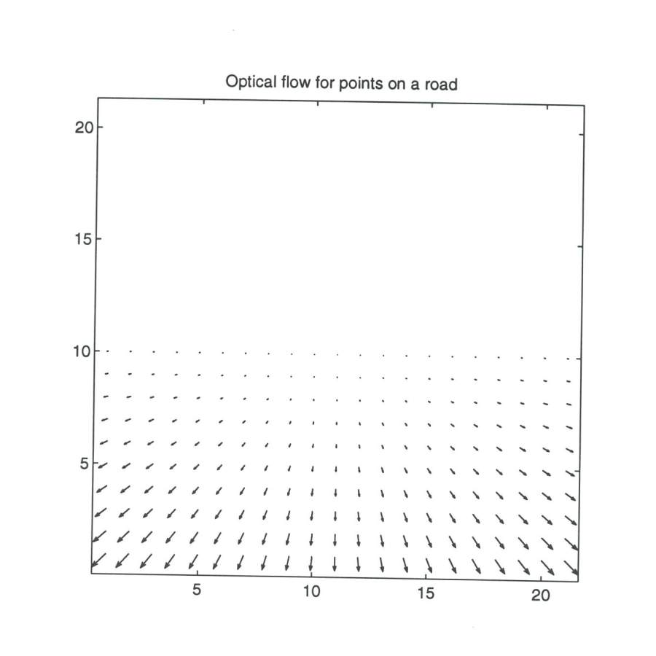

Slide 20
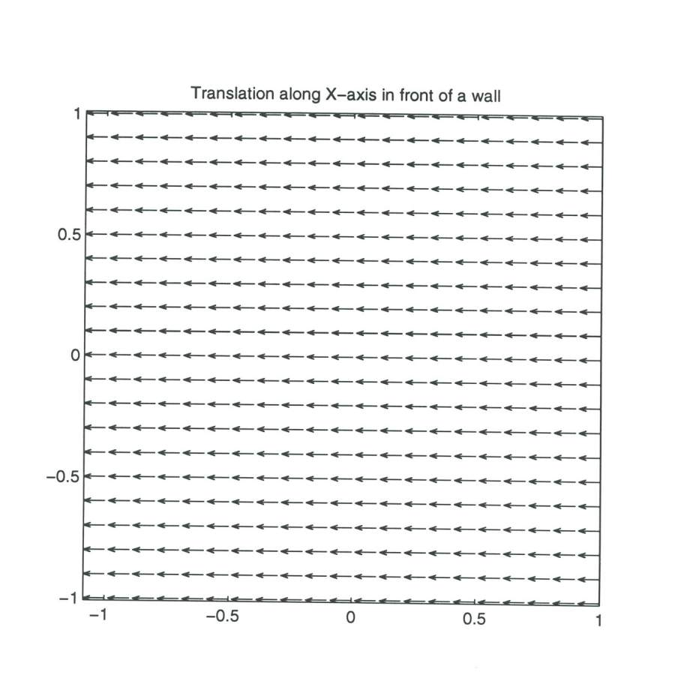

Slide 21
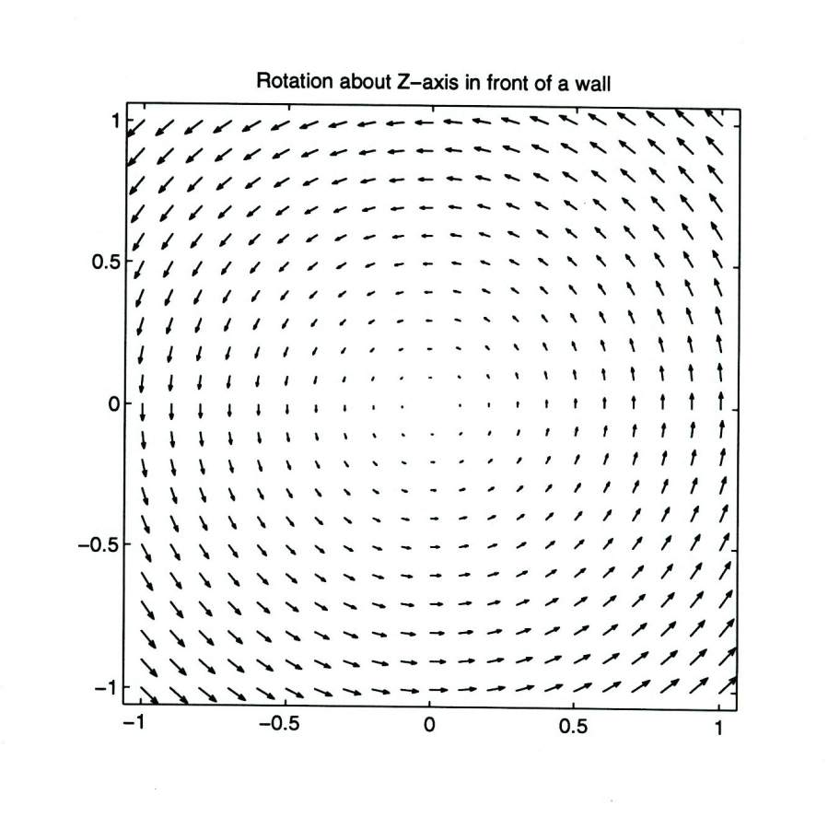

Slide 22
