Slide 1
Image Processing
Jitendra Malik

Slide 2
Different kinds of images
Radiance images, where a pixel value corresponds to the radiance from some point in the scene in the direction of the camera.
Other modalities
X-rays, MRI…
Light Microscopy, Electron Microscopy…
…

Slide 3
Canonical Image Processing problems
Image Restoration
denoising
deblurring
Image Compression
JPEG, JPEG2000, MPEG..
Computing Field Properties
orientation
optical flow
disparity
Locating Structural Features
corners
edges

Slide 4
Image Restoration (lookup Wikipedia for more details)
Based on priors of what the “true” image should be like. Typically the world consists of opaque piecewise smooth surfaces, and illumination is also piecewise smooth, therefore the resulting radiance images are piecewise smooth.
Some techniques
Median filtering
Gaussian smoothing
Anisotropic diffusion
Non-Local means
Deconvolution

Slide 5
Image Compression
Based on prior distributions on natural images, as well as properties of the human visual system, which is more sensitive to some error than others

Slide 6
Computing field properties these are defined at every pixel (x,y)
Orientation
at every pixel, one can define a local orientation by computing the gradient of the image
Optical Flow
at every pixel, a vector corresponding to the movement from one time frame to the next
Binocular Disparity
at every pixel, a vector corresponding to the displacement of the corresponding point from the left to the right image

Slide 7
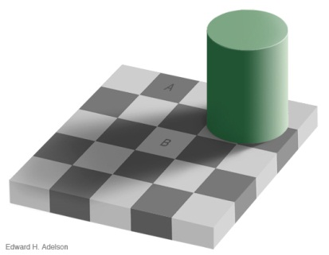
Locating Structural Features
Edges are curves in the image, across which the brightness changes “a lot”
Corners/Junctions

Slide 8
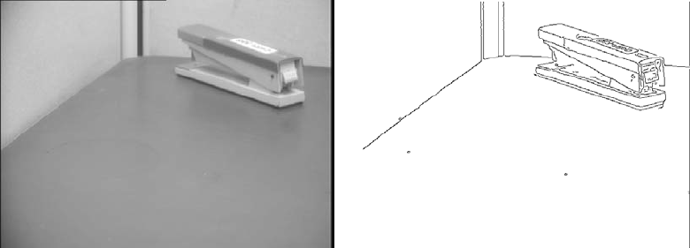
Edges detected in an image

Slide 9
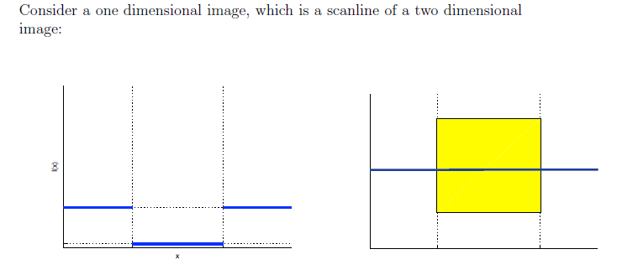
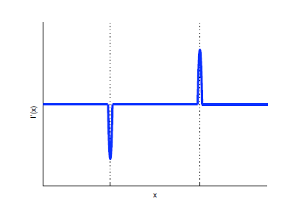
Edge Detection

Slide 10
However…
Differentiation amplifies noise
Compensate by Gaussian smoothing
Both of these are examples of convolution

Slide 11
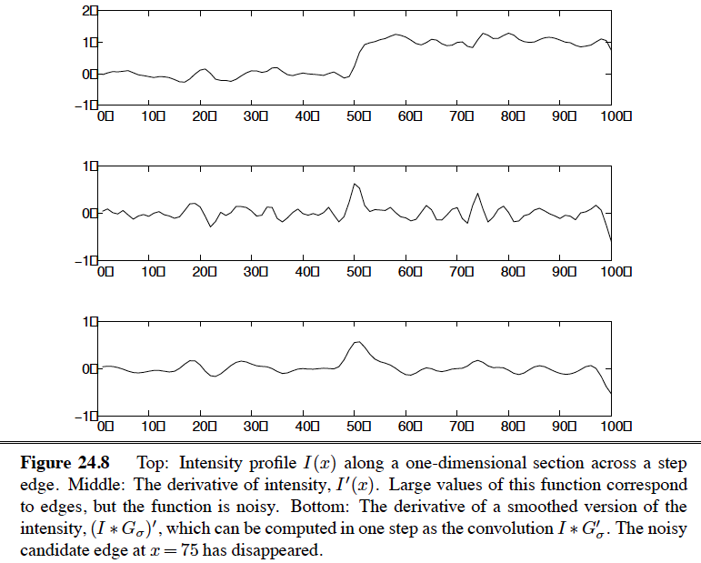
Edge detection in 1D

Slide 12

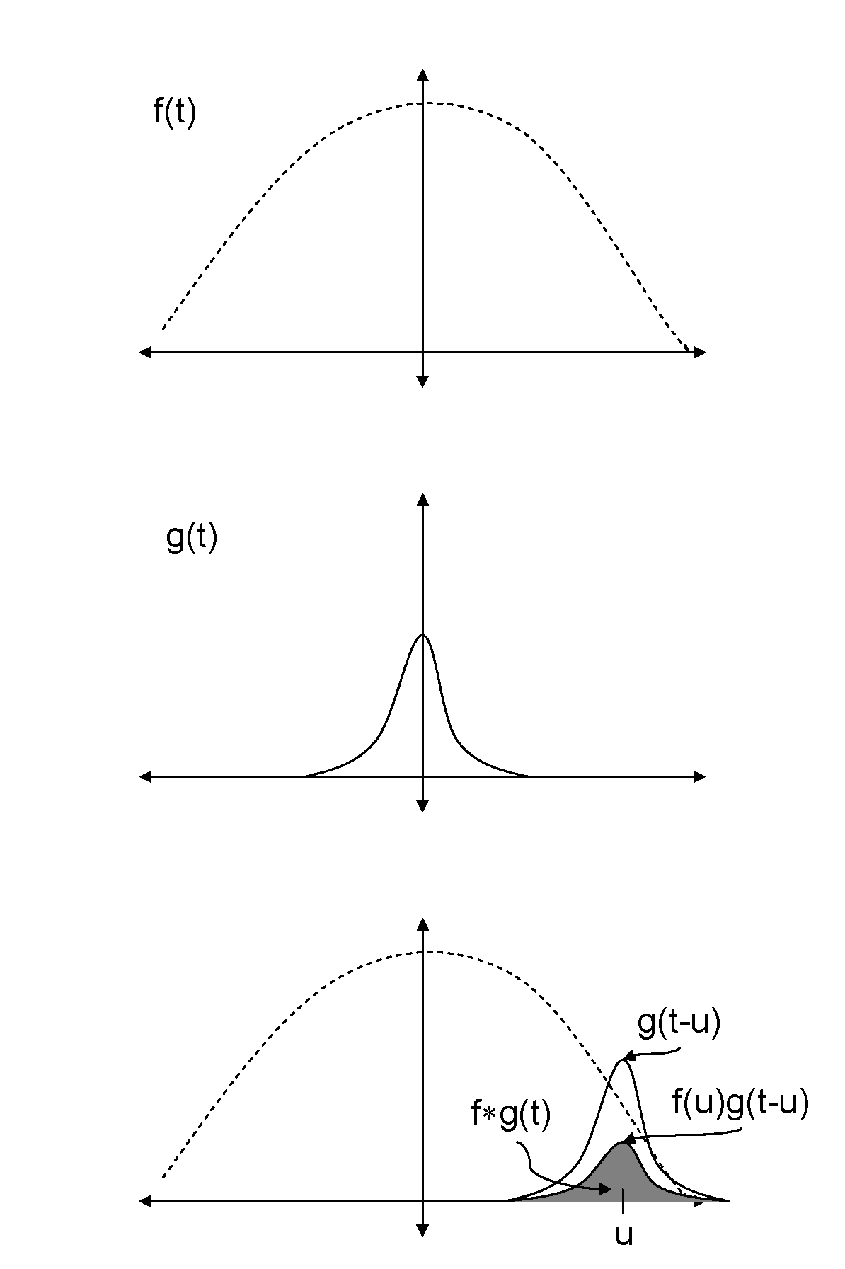
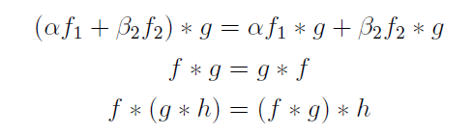
Convolution

Slide 13
Implementation Details
Images are 2D arrays of numbers, so how does one implement the process of computing derivatives, gradients etc?
The solution: use discrete convolution. In the formula for convolution, replace integral by sum. You can find an exposition in the Wikipedia entry on convolution, also in Wolfram MathWorld

Slide 14
An example

Slide 15
An example

Slide 16
An example

Slide 17
An example

Slide 18
An example

Slide 19
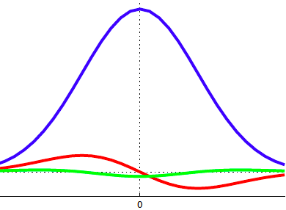
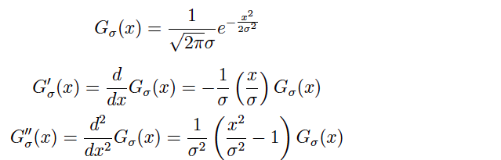
The 1D Gaussian and its derivatives

Slide 20
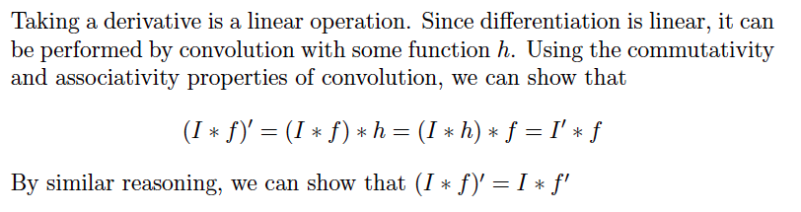
An important observation

Slide 21
Edge detection in 1D

Slide 22
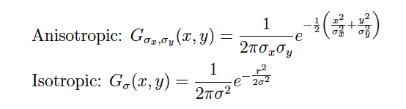
Two Dimensional Gaussian

Slide 23
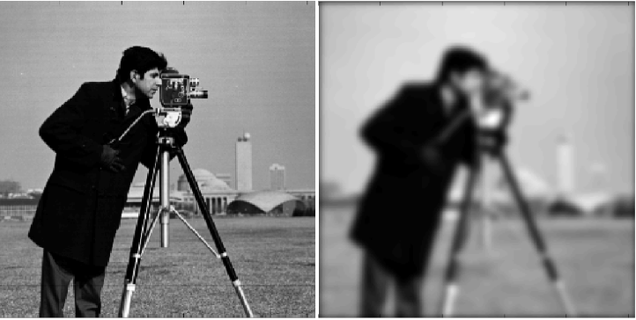
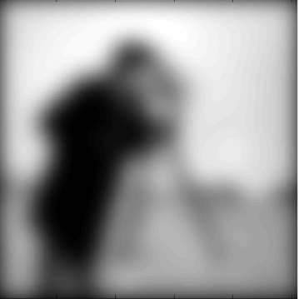
Image convolved with 2D Gaussian

Slide 24
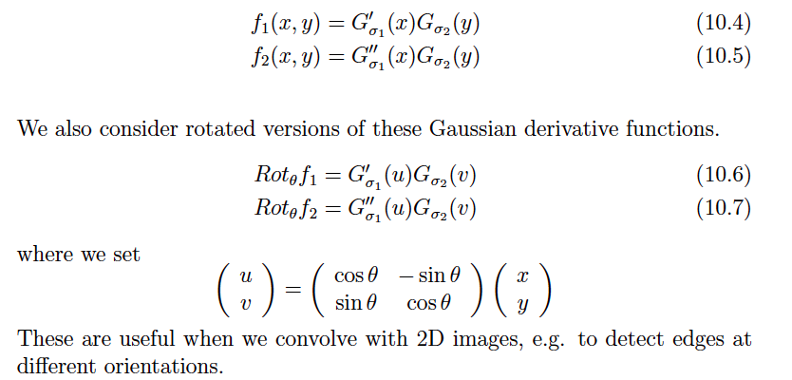
Oriented Gaussian Derivatives in 2D

Slide 25


Oriented Gaussian First and Second Derivatives

Slide 26
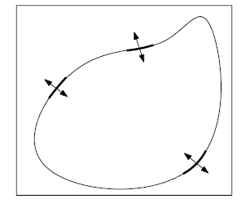
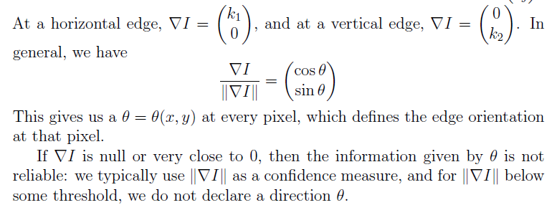
Computing Orientation

