Slide 1

Introduction
Programming in Network Environments
Biomedicine Engineering Degree 2021-2022
Rafael Villén Galera (rafael.villen.galera@urjc.es)
David Roldán Álvarez (david.roldan@urjc.es)

Slide 2

Course Goals
To understand the computers networks and how to create software applications over them in order to find solutions to the current challenges that biomedicine has in the present.
The course will be very practical with all the sessions in the laboratories and most of them with programming exercises to be implemented in order to learn the concepts presented in the course, and also, to learn programming.
The human genome has 3000 million of elements in its sequence. There are 7500 million of persons in the Earth. How to manage this huge volume of data? Computers networks.

Slide 3
Course Contents
Introduction to the tools
Object Oriented Programming
Network Service Models (client/server)
Communication Protocols Programming (TCP/IP, HTTP)
Web Applications Programming
https://github.com/davidrol6/2021-2022-PNE/wiki

Slide 4



Block 0. Tools
PyCharm

Slide 5
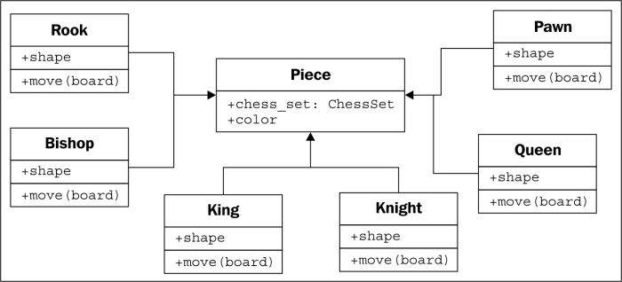
Block 1. Object Oriented Programming
Classes
Inheritance
Objects and Methods

Slide 6

Block 2. Network Services Models
Network Services Models Introduction
Peer to Peer Model (P2P)
REST Model
Cloud Computing for network services deployment

Slide 7
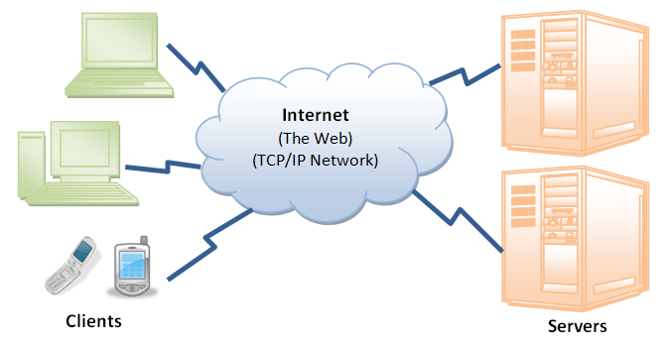
Block 3. Communications Protocols Programming
Protocol TCP/IP Protocol
Protocol HTTP Protocol
Security in Computer Networks
Distributed Applications Programming Techniques

Slide 8
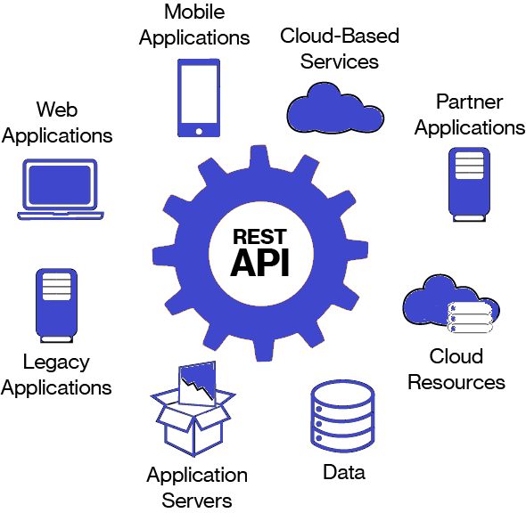
Block 4. Web Applications Programming
Basic Elements
API REST Description
API REST Design
API REST Use

Slide 9

Basic information
Schedule:
Tuesdays: 15:00 a 17:00 (Theory) (Aula S001 Edificio Gestión)
Wednesday: 17:00 to 19:00 (Practice) (Aula S001 Edificio Gestión)
If you need support, please send an email or leave a message in Teams

Slide 10
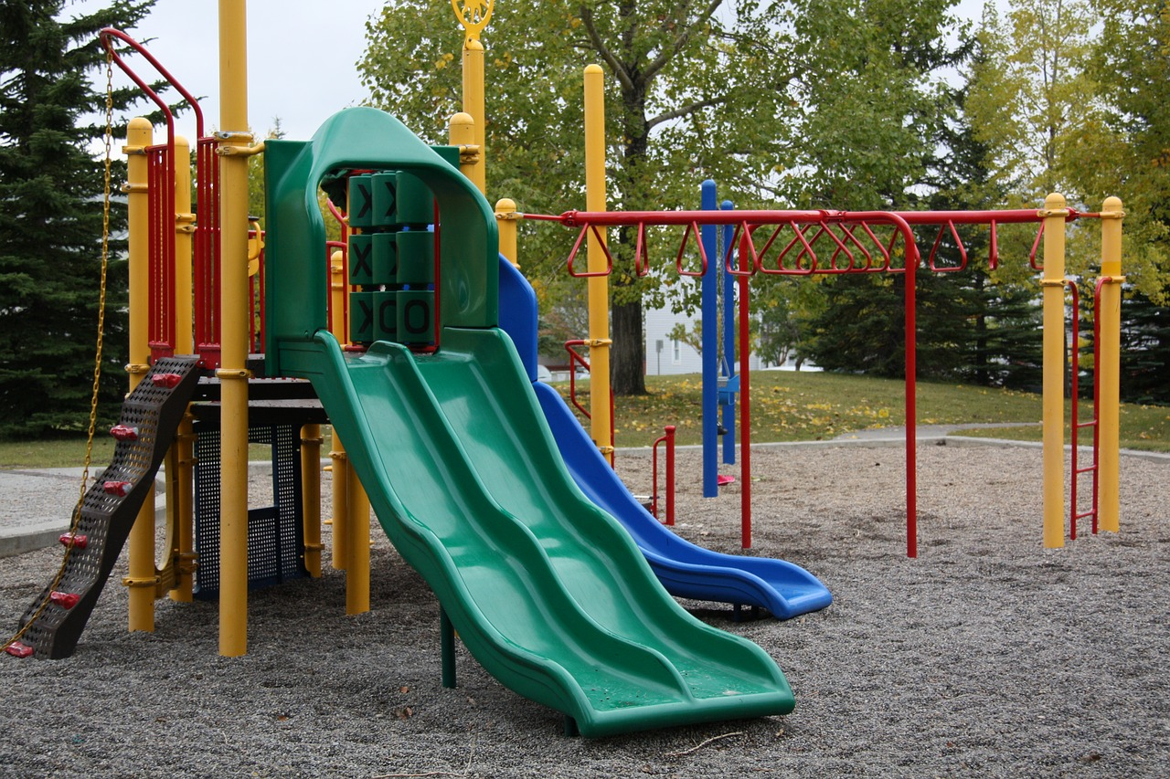
Practices
Evaluation
The description of the practices will be available both in “Aula Virtual” and in github
All the practices will be done using the Python programming language.
40%: Test about the concepts (20% mid-term test, 20% final-test)
60%: Practices
  20% one random practice, corrected in the middle of the term.
  40% final project, corrected at the end of the term.
  A presential defense will be required for the practice and the final project.
  Each student will upload the practices to his/her github account following the
instructions provided

