Slide 1
Case Fraud Data Analysis CloudWalk

Slide 2
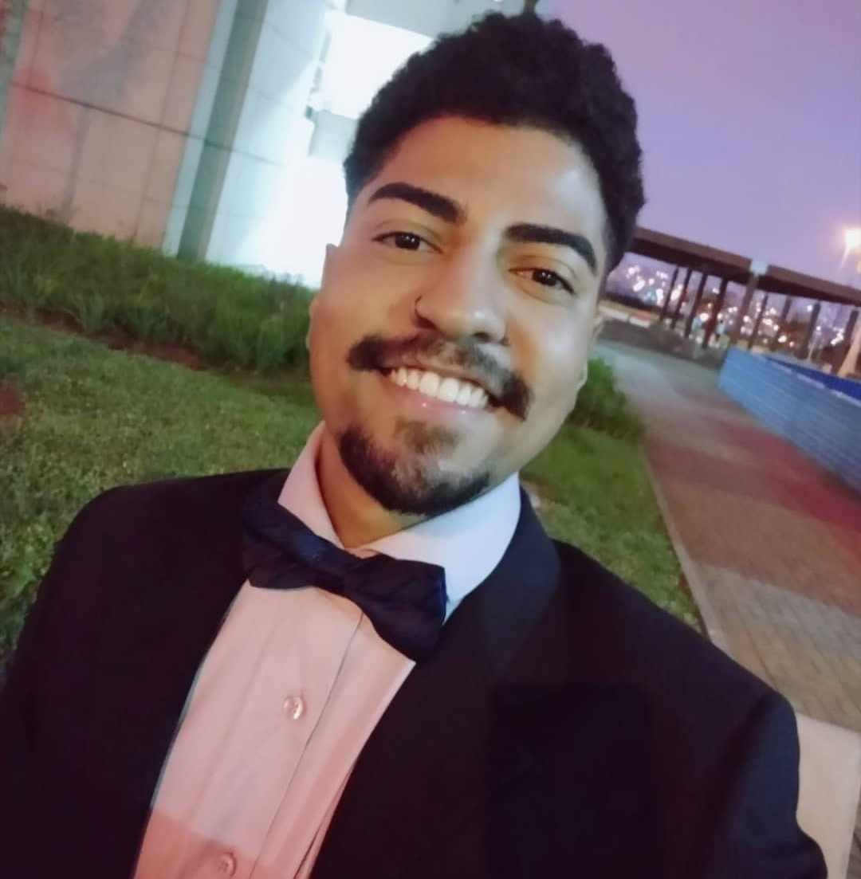
Hello!
I am Rodrigo Cabral
You can find me at rodrigovidalcabral@gmail.com

Slide 3
Next generation acquirer
1

Slide 4
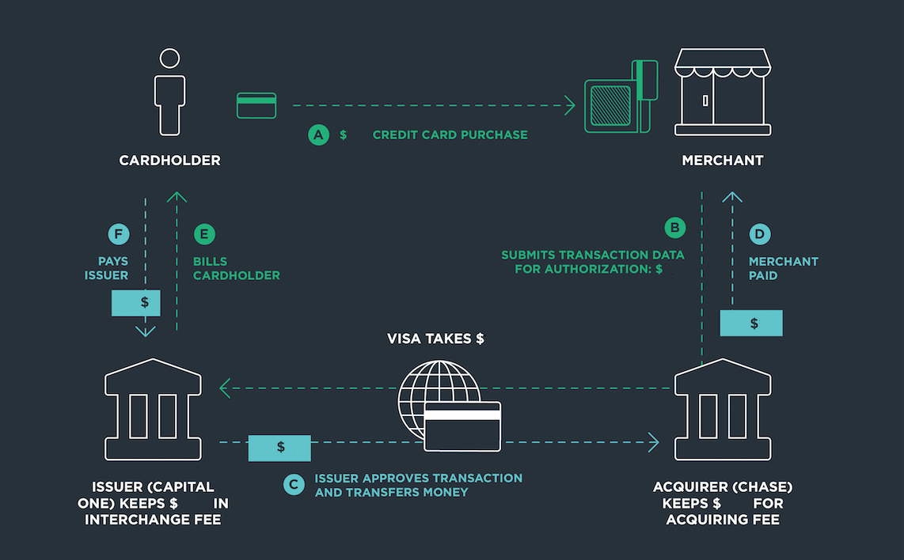

Slide 5
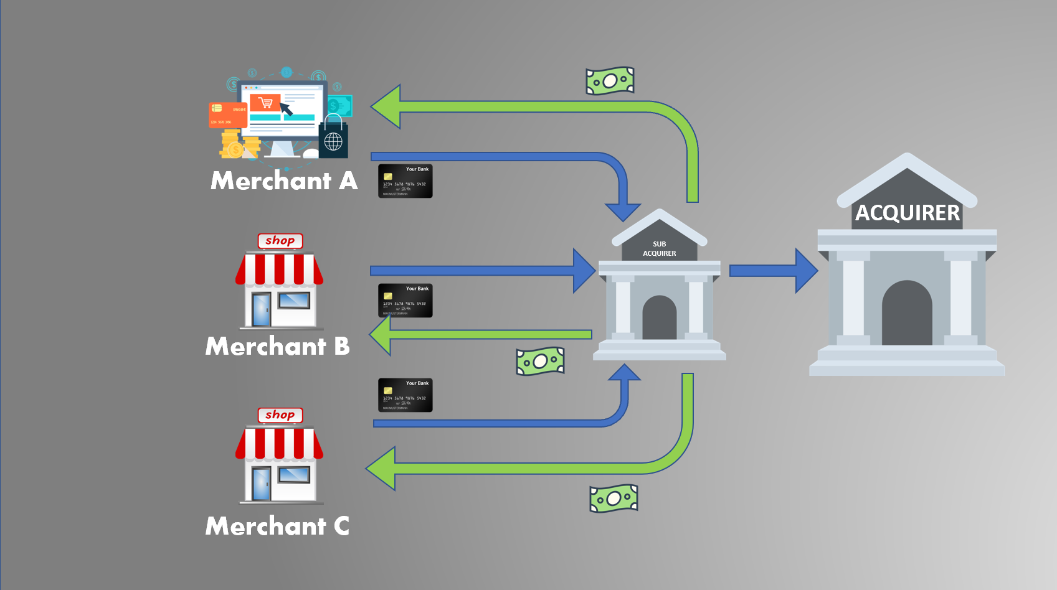

Slide 6
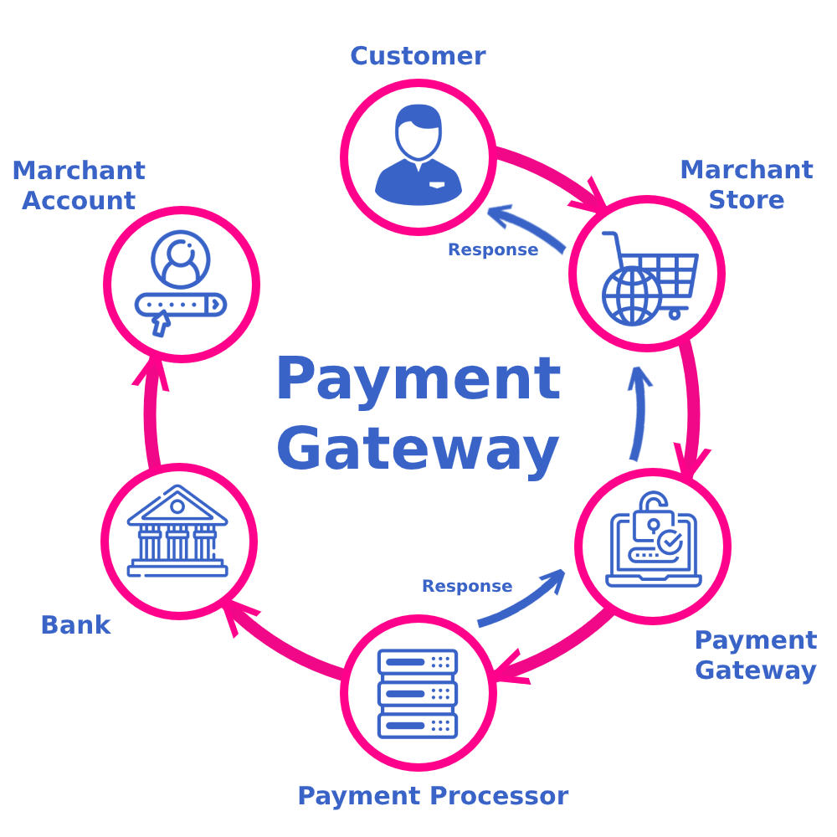

Slide 7
Cancellations x Chargebacks
- Same day
- First step
- 72h
- Refund of value
- Types:
• commercial disagreement
• fraud

Slide 8
Reduce Chargeback

Slide 9
“Desde o início, sabíamos que o problema da taxa não era financeiro, mas era um problema de dados e tecnologia […] se conguíssemos tirar os fraudadores da plataforma, pagar o cliente rapidamente, e vender apenas no digital, sabíamos que poderíamos repassar essa eficiência para os clientes.” – Luís Silva

Slide 10
Three significant pillars
Best Product
We plan to provide our services with the highest technological standards, featuring AI and Blockchain, compounded with top-notch user experience.
Next Level Customer Engagement
Our customers play a vital role in everything we do. They are our best sales promoters and also withhold the ability to change the product and the business at any time.
Disruptive Economics
We aim to grant the lowest prices for our customers to help them unlock purchasing power. We designed our business model to transform how merchants sell and profit.

Slide 11
+ US $ 1,000,000,000
Annually in more than 250,000 businesses

Slide 12
Process – Fraud Team
Automatic sorting
Manual review
Accept/reject

Slide 13
Information
1
ETL (Extract, Transform, Load)
.
2
Dataset
3

Slide 14





Tools used to solved the case

Slide 15
2,456,233,48$
4,78% users
3199
Analysis period
2019-11-01 2019-12-01
Total amount
568,346,62$ (23,14%)
Fraud - That’s a lot of money
And a lot of users
Total trasactions analyzed

Slide 16
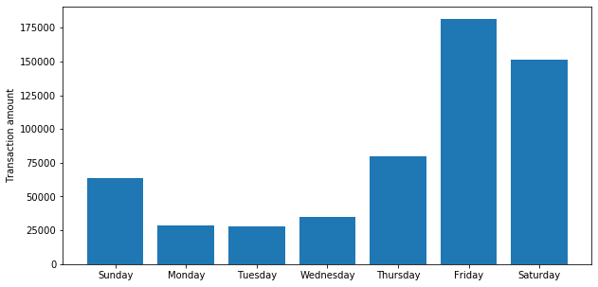
Days of the week the highest fraud amount

Slide 17
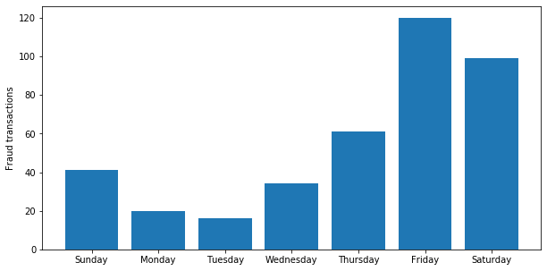
Days of the week the highest number of fraud

Slide 18
Merchant and card number whith highest fraud attempt
Merchant_id | Fraud transaction | Card_number | Fraud transaction
17275 | 22 | 5544827640 | 10
4705 | 19 | 5300343859 | 6
1308 | 15 | 6516532256 | 5

Slide 19
How to get the best performance?
2

Slide 20

Want big impact?
USE BIG IMAGE
Ask the right question!

Slide 21
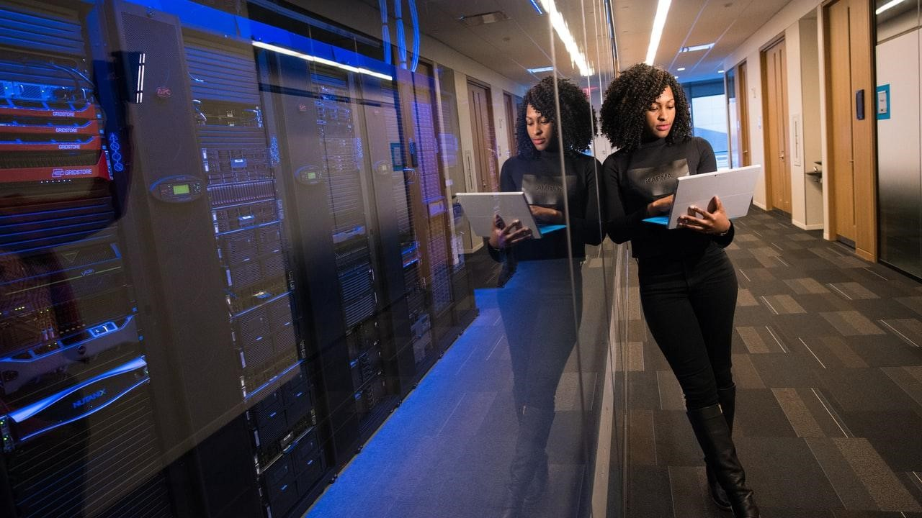
A image is worth a thousand words
A complex idea can be conveyed with just a single still image, namely making it possible to absorb large amounts of data quickly.

Slide 22
Data science
Cultura data driven
Data Analysis
Business
Intelligence

Slide 23
Brainstorming
Confere
Understanding the customer
LGPD
map data
Location
Canvas
Types of fraud

Slide 24
Innovation
Tools
ideia
Strategy

Slide 25
Metrics
Kolmogorv-Smimov
Gini index
KPIs

Slide 26
Data Analysis
Identify patterns
Modeling
Machine Learning
- Supervised
- unsupervised
- Logistic regression
- Neural Networks
- Decision tree
- Bayesian networks
- Gradient Boosting

Slide 27
Tools for data analysis and machine learning (open source)

Slide 28
Roadmap
MVP
System integration
Effective impacts
1
3
5
2
4
6
Agile methodology
Team Performance Metrics
Achieved
objectives

Slide 29
Gantt chart
 | Week 1 |  |  |  |  |  |  | Week 2
 | 1 | 2 | 3 | 4 | 5 | 6 | 7 | 8 | 9 | 10 | 11 | 12 | 13 | 14
Task 1
Task 2 |  |  |  |  |  | ◆
Task 3
Task 4 |  |  |  |  |  |  |  |  |  |  | ◆
Task 5 |  |  |  |  |  |  |  |  | ◆
Task 6
Task 7
Task 8

Slide 30
Goal
office

Slide 31
Bibliography
Gimenez, R. P., Impactos da pandemia nos modelos de detecção de fraude, thesis - Getulio Vargas Foundation, 2021.
Junior, J. C. P. J., Modelos de detecção de fraudes utilizando técnicas de aprendizado de máquina, thesis - Getulio Vargas Foundation, 2019.
Junior, J. C. P. J., Mineração de dados para detecção de fraudes em transações eletrônicas, thesis – Federal Fniversity of Minas Gerais, 2012.
Belo, O; Vieira C. Applying user signatures on fraud detection in telecommunication networks. P. 286-299, 2011.

Slide 32
Thanks!
Any questions?
My
repository

