Slide 1
Case Fraud Data Analysis CloudWalk

Slide 2
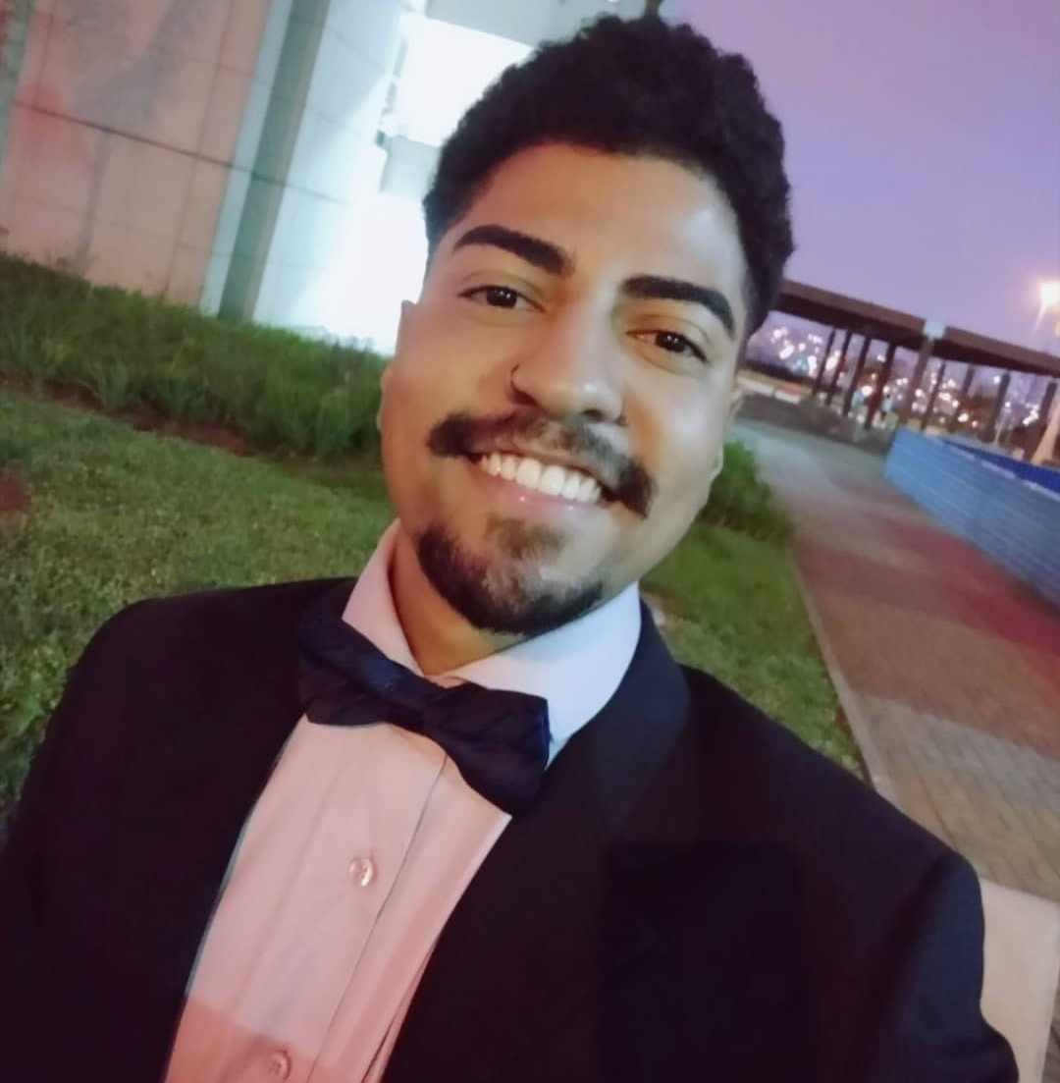
Hello!
I am Rodrigo Cabral
You can find me at rodrigovidalcabral@gmail.com

Slide 3
Transition headline
1
Let’s start with the first set of slides

Slide 4
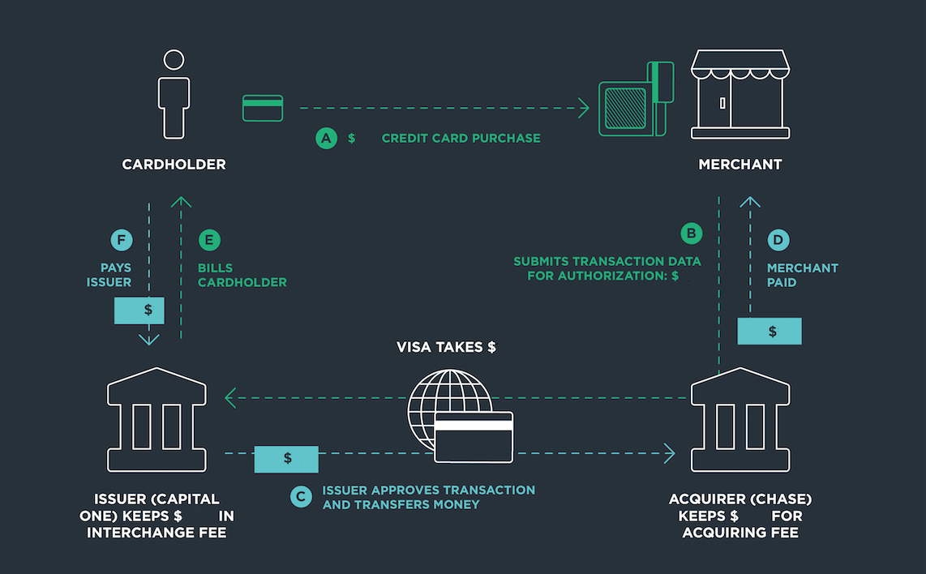

Slide 5
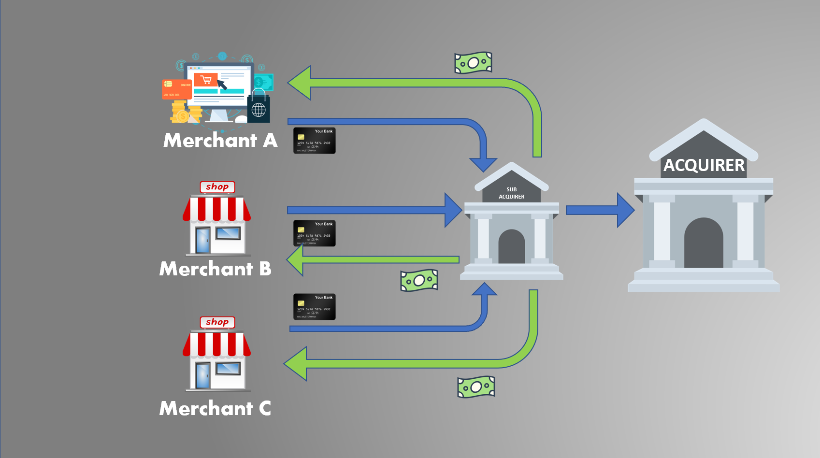

Slide 6
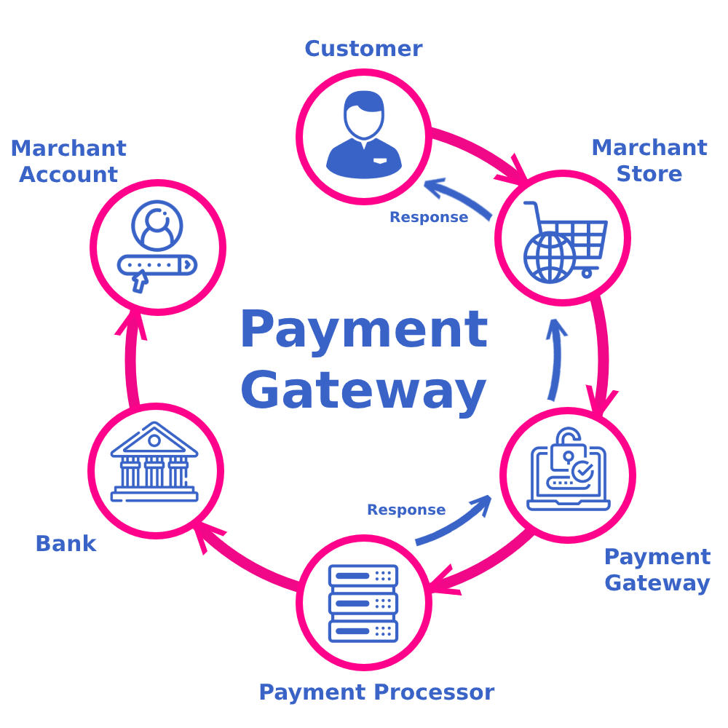

Slide 7
“Desde o início, sabíamos que o problema da taxa não era financeiro, mas era um problema de dados e tecnologia […] se conguíssemos tirar os fraudadores da plataforma, pagar o cliente rapidamente, e vender apenas no digital, sabíamos que poderíamos repassar essa eficiência para os clientes.” – Luís Silva

Slide 8
Three significant pillars
Best Product
We plan to provide our services with the highest technological standards, featuring AI and Blockchain, compounded with top-notch user experience.
Next Level Customer Engagement
Our customers play a vital role in everything we do. They are our best sales promoters and also withhold the ability to change the product and the business at any time.
Disruptive Economics
We aim to grant the lowest prices for our customers to help them unlock purchasing power. We designed our business model to transform how merchants sell and profit.

Slide 9
+ US $ 1,000,000,000
Annually in more than 250,000 businesses

Slide 10
2,456,233,48$
95,22% users
3199
Analysis period
2019-11-01 2019-12-01
Total amount
1,887,886,86$
Fraud - That’s a lot of money
And a lot of users
Total trasactions analyzed

Slide 11
Reduce Chargeback
Bring the attention of your audience over a key concept using icons or illustrations

Slide 12
Process – Fraud Team
Automatic sorting
Manual review
Accept/reject

Slide 13
Our sales funnel
Information
1
ETL (Extract, Transform, Load)
.
2
Dataset
3

Slide 14





Tools used to solved the case

Slide 15
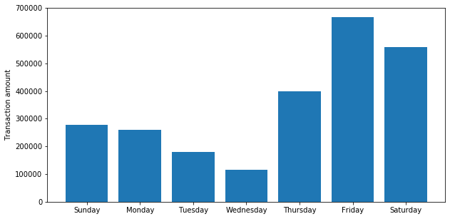
Days of the week the highest fraud amount

Slide 16
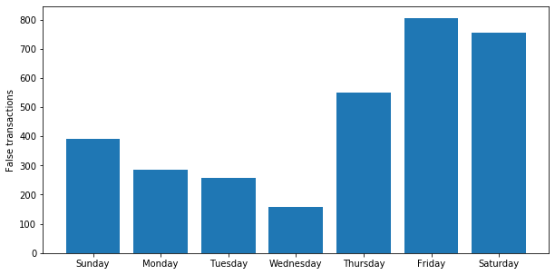
Days of the week the highest number of fraud

Slide 17
4000
3000
2000
1000
0
You can copy&paste graphs from Excel and Google Sheets

Slide 18
Merchant and card number whith highest fraud attempt
Merchant_id | False transaction | Card_number | False transaction
49205 | 73 | 4329577262 | 7
79698 | 22 | 5201327705 | 6
17275 | 18 | 5368057429 | 4

Slide 19
And tables to compare data
 | A | B | C
Yellow | 10 | 20 | 7
Blue | 30 | 15 | 10
Orange | 5 | 24 | 16

Slide 20
How to get the best performance?
2

Slide 21
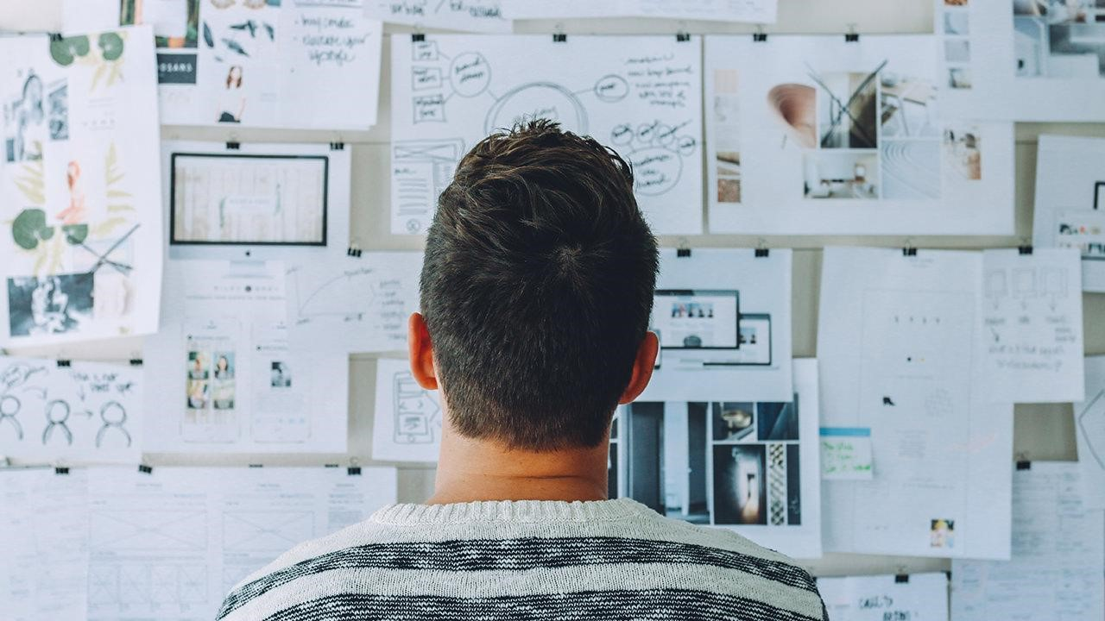
Want big impact?
USE BIG IMAGE
Ask the right question!

Slide 22
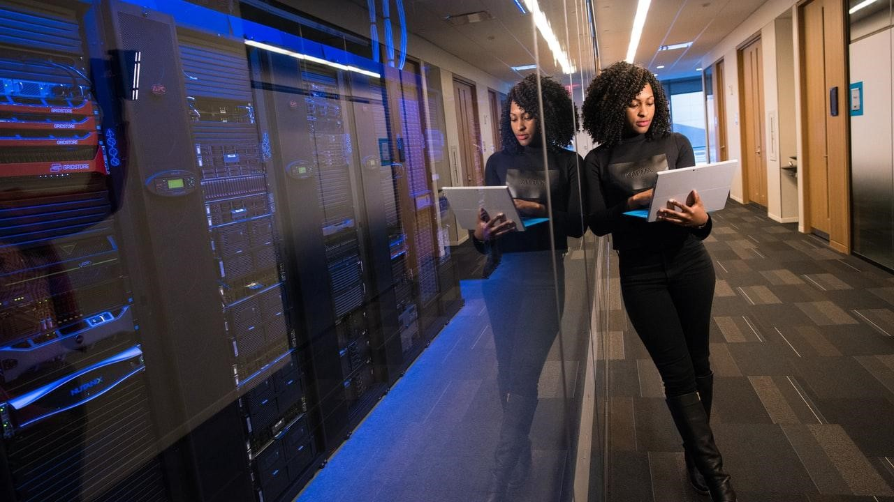
A image is worth a thousand words
A complex idea can be conveyed with just a single still image, namely making it possible to absorb large amounts of data quickly.

Slide 23
Data science
Cultura data driven
Data Analysis
Business
Intelligence

Slide 24
Brainstorming
Competitor
Understanding the customer
Competitor
LGPD
map data
Location
Competitor
Types of fraud

Slide 25
Maps
our office

Slide 26
Innovation
Tools
ideia
Strategy

Slide 27
Metrics
Kolmogorv-Smimov
Gini index
KPIs

Slide 28
Data Analysis
Identify patterns
Modeling
Machine Learning
- Supervised
- unsupervised
- Logistic regression
- Neural Networks
- Decision tree
- Bayesian networks
- Gradient Boosting

Slide 29
Tools for data analysis and machine learning (open source)

Slide 30
Roadmap
MVP
System integration
Effective impacts
1
3
5
2
4
6
Agile methodology
Team Performance Metrics
Achieved
objectives

Slide 31
Gantt chart
 | Week 1 |  |  |  |  |  |  | Week 2
 | 1 | 2 | 3 | 4 | 5 | 6 | 7 | 8 | 9 | 10 | 11 | 12 | 13 | 14
Task 1
Task 2 |  |  |  |  |  | ◆
Task 3
Task 4 |  |  |  |  |  |  |  |  |  |  | ◆
Task 5 |  |  |  |  |  |  |  |  | ◆
Task 6
Task 7
Task 8

Slide 32
Business Model Canvas
Key Partners
Insert your content
Key Activities
Insert your content
Value Propositions
Insert your content
Customer Relationships
Insert your content
Customer Segments
Insert your content
Key Resources
Insert your content
Channels
Insert your content
Cost Structure
Insert your content
Revenue Streams
Insert your content

Slide 33
Bibliography
Gimenez, R. P., Impactos da pandemia nos modelos de detecção de frude, thesis - getulio vargas foundation, 2021.
Junior, J. C. P. J., Modelos de detecção de fraudes utilizando técnicas de aprendizado de máquina, thesis - getulio vargas foundation, 2019.
Junior, J. C. P. J., Mineração de dados para detecção de fraudes em transações eletrônicas, thesis – Federal university of Minas Gerais, 2012.
Belo, O; Vieira C. Applying user signatures on fraud detection in telecommunication networks. P. 286-299, 2011.

Slide 34
Thanks!
Any questions?

