Slide 1
Derivativos
Gestão de risco de mercado

Slide 2
+ US $ 1,000,000,000
Annually in more than 250,000 businesses

Slide 3
História e tipos
Commodities
Moeda
Outros
Hedge
Alavancagem
Especulação

Slide 4
Roadmap (MVP)
Entender a necessidade do cliente
System integration
Effective impacts
1
3
5
2
4
6
Direcionar para
Team Performance Metrics
Achieved
objectives

Slide 5
Three significant pillars
Best Product
We plan to provide our services with the highest technological standards, featuring AI and Blockchain, compounded with top-notch user experience.
Next Level Customer Engagement
Our customers play a vital role in everything we do. They are our best sales promoters and also withhold the ability to change the product and the business at any time.
Disruptive Economics
We aim to grant the lowest prices for our customers to help them unlock purchasing power. We designed our business model to transform how merchants sell and profit.

Slide 6


“Colocar uma dor do cliente.” – Fulano da Silva

Slide 7
Metrics do negócio
Risco VaR DV01
Volatilidade
Liquidez

Slide 8
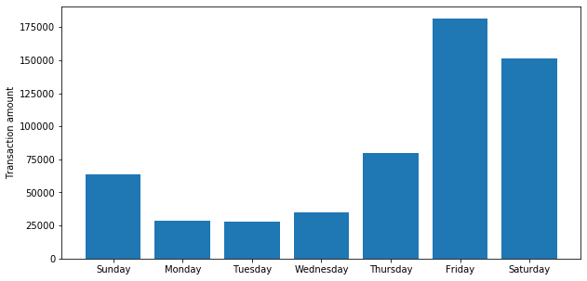
Days of the week the highest fraud amount

Slide 9
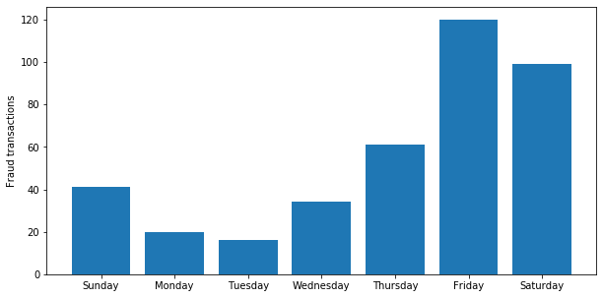
Days of the week the highest number of fraud

Slide 10
Information:
Sazonalidade de operação
Retorno esperado
Risco de mercado
1
ETL/modelo:
Cotação usd
Ipca
Igp-m
Selic
Yahoo finance .
2
3
Dataset:
- Série temporal diária
Cotação por commoditie
Quantidade negociada fonte: site bmf

Slide 11
Metricas do modelo

Slide 12
2,456,233,48$
4,78% users
3199
Analysis period
2019-11-01 2019-12-01
Total amount
568,346,62$ (23,14%)
Fraud - That’s a lot of money
And a lot of users
Total trasactions analyzed

Slide 13
Melhorias
Tools
ideia
Strategy

Slide 14
Thanks!
Any questions?
Colocar Qrcode/link streamlit

