Slide 1
Lab 3 – Bayesian learning and boosting
Machine Learning – DD2421

Slide 2
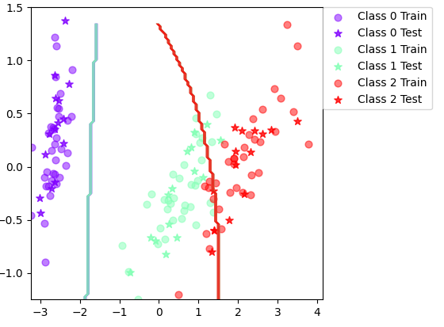
Bayesian Classifier accuracies
Iris accuracy: 89.8%
Iris Std: 4.05
Vowel accuracy: 65.4%
Vowel Std: 3.87
Feature independence assumed – We assume the features are not correlated. E.g., the 2 dimensions of the Iris feature set don’t tell us anything about each other. This assumption can be successfully made even with some weak dependence.

Slide 3
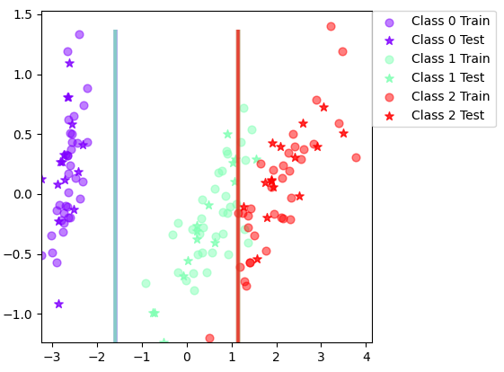
Improving Iris boundary
MAP could be used instead of ML estimate?
Clean up outliers
SVM could be used for class 1 and 2
Decision tree does not seem better
Decision Tree Classifier
Naïve Bayes Classifier

Slide 4
Iris - Adaboost
Without
With
Accuracy: 89.5%
Standard Deviation: 3.97
Accuracy: 94.2%
Standard Deviation: 3.76

Slide 5
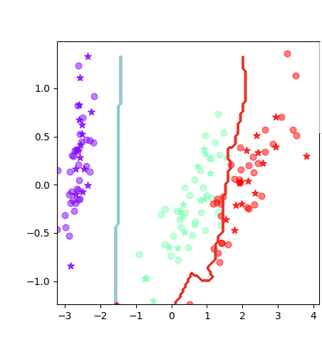
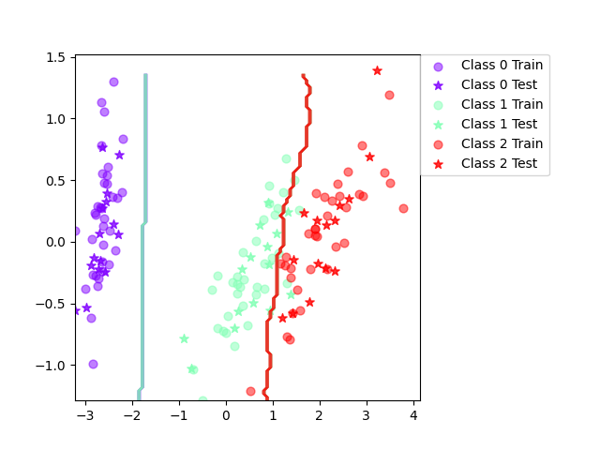
Boosted iris
More complex boundary
Large variance
Risk for overfitting

Slide 6
Vowel - adaboost
Without
With
Accuracy: 65.2%
Standard Deviation: 4.03
Accuracy: 79.7%
Standard Deviation: 3.76

Slide 7
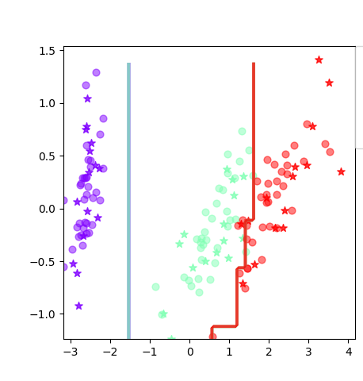
Decision tree - Iris
Without boosting: 92.7
With boosting: 93.7%

Slide 8
Decision tree - Vowel
Without boosting: 64.4%
With boosting: 86.7%

Slide 9
Outliers
With large noise boosting can give too much precedence to outliers and overfit
Naïve Bayes is ideal
Decision Tree can overfit

Slide 10
Irrelevant Input
Decision Tree pruning gets rid of irrelevant features, therefore it is an ideal method
Boosting affects all features, since it is done on the datapoint.

Slide 11
Predictive Power
Boosted methods seem to work better generally
Data dependent which method is preferred, Naïve Bayes may be ideal for independent feature spaces

Slide 12
Mixed data types
Naïve Bayes is ideal for continuous data
Both can be used for mixed data

Slide 13
Scalability
Naïve Bayes has high computational cost due to matrix inversion and computation
Decision Trees are highly effective methods which scale well, but training also increases in complexity with large datsets

