Slide 1
Lab 3 – Bayesian learning and boosting
Machine Learning – DD2421

Slide 2
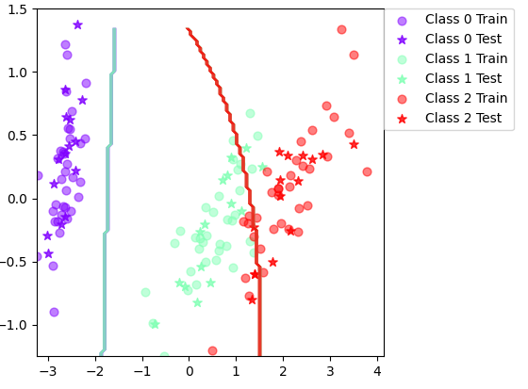
Bayesian Classifier accuracies
Iris accuracy: 89.8%
Iris Std: 4.05
Vowel accuracy: 65.4%
Vowel Std: 3.87
Feature independence assumed – We assume the features are not correlated. E.g., the 2 dimensions of the Iris feature set don’t tell us anything about each other. This assumption can be successfully made even with some weak dependence.

Slide 3
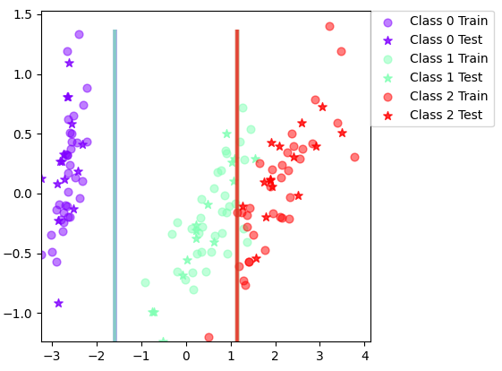
Improving Iris boundary
MAP could be used instead of ML estimate?
Clean up outliers
Decision tree does not seem better
Decision Tree Classifier
Naïve Bayes Classifier

