Slide 1

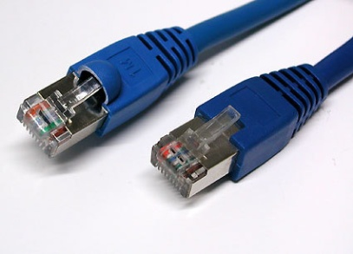
Aula 14
Rede de Computadores
Prof. Luiz Fernando Albertin Bono Milan

Slide 2


Escolha dos Alunos
Apache no Windows https://www.youtube.com/watch?v=3igxd4xv_5U
IIS no Windows 7
https://www.youtube.com/watch?v=hFpu-APYxY0
NGINX no Windows (fácil fácil)
https://www.youtube.com/watch?v=HL-gvgOnOBo

Slide 3
Simulador de Redes
Cisco Packet Tracer

Slide 4
Toolbox
http://sectools.org/tag/linux/
htop w Iptraf tcpdump bmon nmap mtr | etherape lsof iotop iftop logs netstat tracepath

Slide 5
Toolbox
Descobrir máquinas na rede:
time ( s=192.168.0 ; for i in $(seq 1 254) ; do ( ping -n -c 1 -w 1 $s.$i 1>/dev/null 2>&1 && printf "%-16s %s\n" $s.$i responded ) & done ; wait ; echo )

