Slide 1
A1 Level
Unit 6: “Important events”
Session 5
English Area

Slide 2


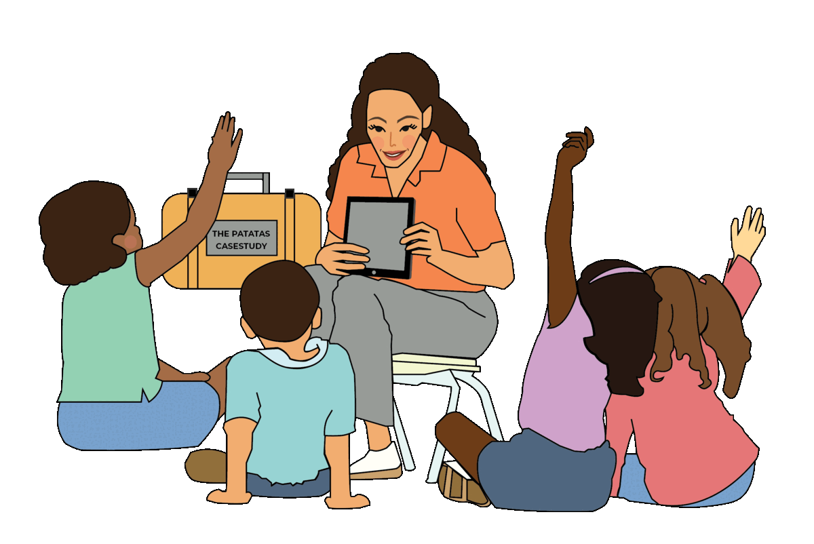


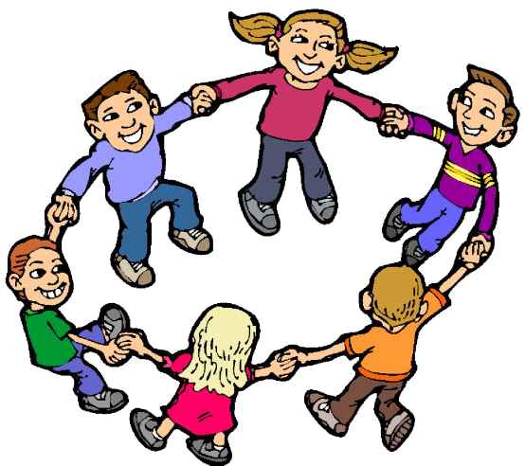
Our golden rules
01
02
Listen carefully to the instructions
Raise your hand to speak
03
04
Be kind and friendly
Be active and do all
the activities

Slide 3


Birthday
Wedding
SPECIAL EVENTS IN A PERSON’S LIFE
Baptism
Graduation
I think a… is not enjoyable because…
I think a… is enjoyable because…
Are these events enjoyable, in your opinion?

Slide 4


Monday, September 14th, 2026.
Session N5: Writing
Objective:
Write a short text about an important personal event.

Slide 5

Read the text and tick the aspects mentioned.
My cousin’s wedding was on June 12th, 2022, in a beautiful church in Lima. The ceremony started at 4:00 p.m., and many family members and friends were there. The bride wore a long white dress, and the groom looked very elegant in a black suit. After the ceremony, we went to a restaurant for the reception. We danced, ate delicious food, and took many photos together. My grandparents didn’t dance because they were tired, but they enjoyed the music and the dinner. Later, at night, everyone sang and laughed. On June 13th, we visited the couple. I felt very excited and happy because it was a wonderful and beautiful event for our family.
✅
When it was
Where it was
What happened before the day
People in the celebration
Activities people did
Activities people didn’t do
Decorations
Feelings
✅
✅
✅
✅
✅

Slide 6
Read again and follow the instructions.
My cousin’s wedding was on June 12th, 2022, in a beautiful church in Lima. The ceremony started at 4:00 p.m., and many family members and friends were there. The bride wore a long white dress, and the groom looked very elegant in a black suit. After the ceremony, we went to a restaurant for the reception. We danced, ate delicious food, and took many photos together. My grandparents didn’t dance because they were tired, but they enjoyed the music and the dinner. Later, at night, everyone sang and laughed. On June 13th, we visited the couple. I felt very excited and happy because it was a wonderful and beautiful event for our family.
Circle the time expressions and/or connectors.
Underline examples of past simple in positive.
Draw a square around examples of past simple in negative.

Slide 7

COLLABORATIVE WORK
Choose your partner.
Interviewer
2. Choose your role.
Speaker

Slide 8
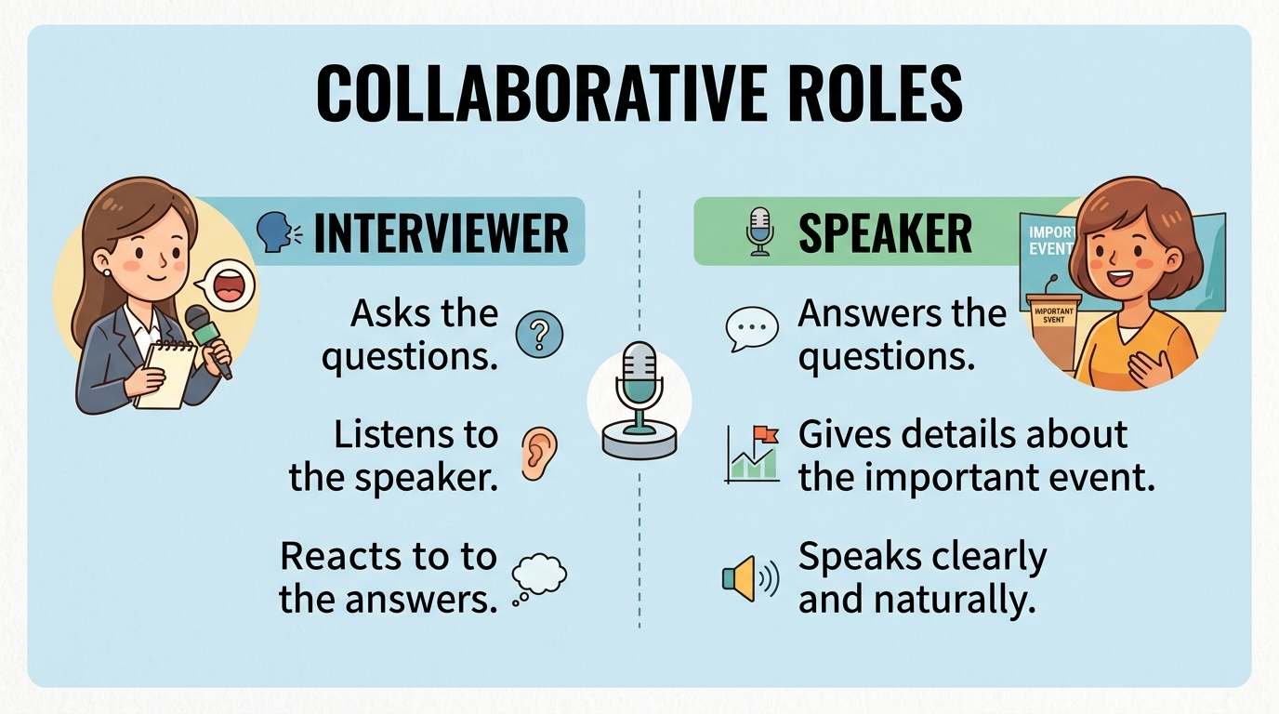




Discuss the questions
Evaluator:
Ask questions and listen carefully.
OUR ROLES
What was the most interesting part from the story for you?
2. Would you like to attend a wedding?
Speaker:
Yes, I would like to attend because…
For me, the most interesting part of the story was…
I don’t know. Maybe because…
Evaluator:
Evaluates answers.
I agree with you in question…because…
I don’t agree with you in question…because…
Include Past Simple at least 2 times.

Slide 9



Did we complete the activity successfully?

Slide 10
WRITING TASK
Write a paragraph about an important personal event.
When it was
Where it was
People in the celebration
Activities people did
Activities people didn’t do
Feelings
Write around 90 words.
SUCCESS CRITERIA
Include the points in the task
Include connectors
Include time expressions
Include examples of past simple in positive and negative.

Slide 11

Where it was
When it was
People in the celebration
BRAINSTORMING WORKSHEET
Feelings
Activities people did
Activities people didn’t do

Slide 12
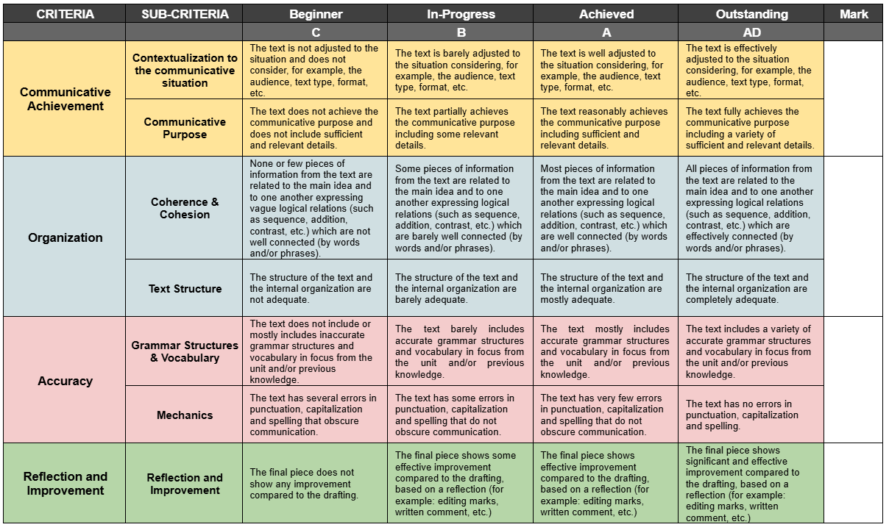
RUBRICS

Slide 13
DRAFTING
Write your drafting in your notebook. Create your own paragraph.
Write a paragraph about an important personal event.
When it was
Where it was
People in the celebration
Activities people did
Activities people didn’t do
Feelings
Write around 90 words.
SUCCESS CRITERIA
Include the points in the task
Include connectors
Include time expressions
Include examples of past simple in positive and negative.

Slide 14
FEEDBACK
SUCCESS CRITERIA
Include the points in the task
Include connectors
Include time expressions
Include examples of past simple in positive and negative.

Slide 15
REFLECTION
 | Yes | In progress | No
1 – I can write sentences using the Past Simple in positive and negative.
2 – I can use different connectors in a short text.
3 – I can include time expressions in a short text.

