Slide 1

Bachelor Thesis: Comparative Analysis of Widely
Used Zipfian Distribution Implementations
Rodrigo Felix Forno
Technische Universität München
TUM School of Computation, Information and Technology
Decentralized Information Systems (DIS)
Garching, 10th of April 2025

Slide 2
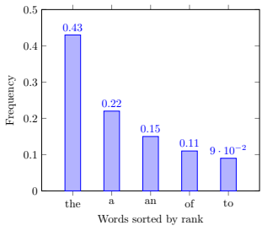
Zipfian Distribution
Power laws and the Zipfian Distribution
Used to express exponential rations between two quantities
f(x) = C ⋅ x^{α}
Zipfian: Relationship between frequency – P(k) - and rank – k
P(k) = C ⋅ k^{−α}
Constant C :
HN, α = ∑k = 1 ^{N} k^{−α}

Slide 3
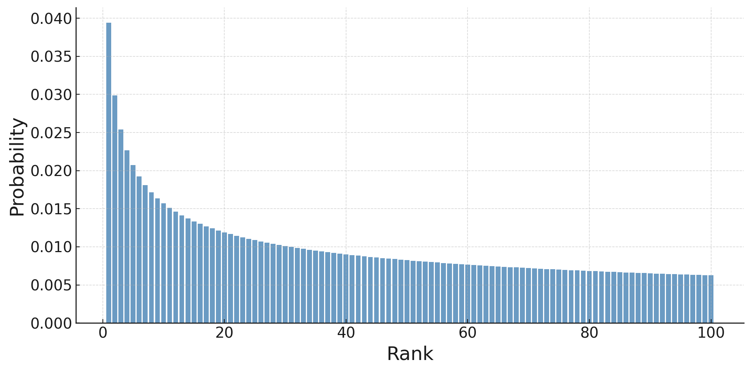
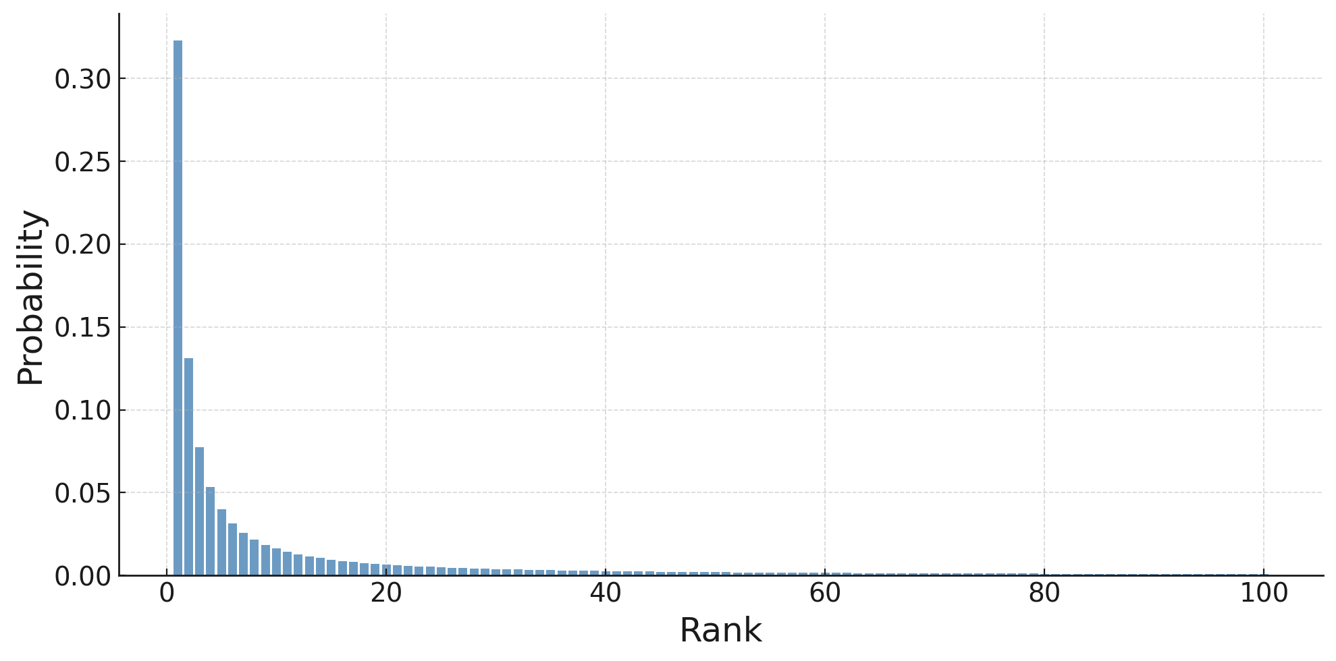
Why is it important?
A lot of events in different areas are skewed
I/O
Network traffic
RDBMS
The skew is represented by θ or α. The higher, the more compact around the mode

Slide 4
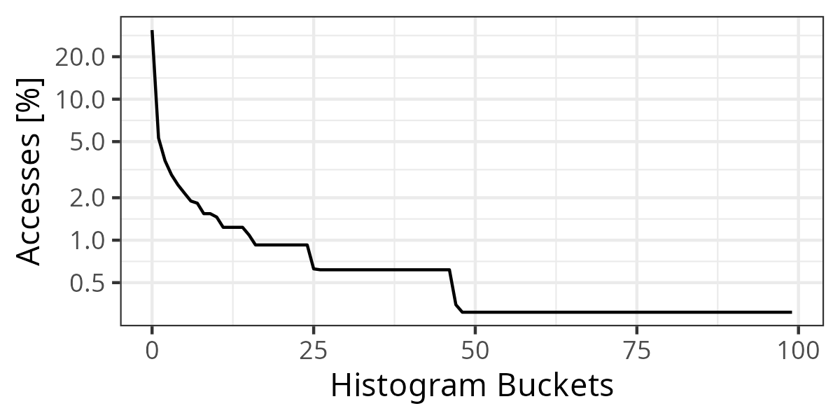
Common Benchmarks
Benchmarking frameworks have been developed for testing systems
Flexible I/O Tester (FIO)
Yahoo! Cloud Serving Benchmark (YCSB)
Sysbench
OLTP-Bench (CMU Benchmark)
ApacheCommons (baseline)

Slide 5
Contributions
Comparison of widely used Zipfian distribution samplers
Implementation and discussion of alternative algorithms
Performance and accuracy evaluations of samplers

Slide 6
Background: Discrete Variate Generation
Goal
Difficulty
Produce variates/samples
Samples are distributed according to target distribution
Quick and accurate
Uniform Distribution Sampler (PRNG)
Limited precision
Tail precision is hard

Slide 7
Background: Discrete Variate Generation
Many algorithms exist and variate generation is a wide field, focus on 4
Rejection Sampling
Condensed Table Lookup
Rejection-Inversion
Approximative (Gray)

Slide 8
Recap: Comparison of implementations
Goal: Compare commmon algorithms found in literature and industry practice
Yahoo! Cloud Serving Benchmark | Approximative (Java)
Flexible I/O Tester (FIO) | Approximative (C)
Sysbench | Rejection-Inversion (C)
ApacheCommons | Rejection-Inversion (Java)
OLTP-Bench | Approximative (Java)
Rejection Sampling | Rejection (C++)
Condensed Table Lookup | Table (C++)

Slide 9

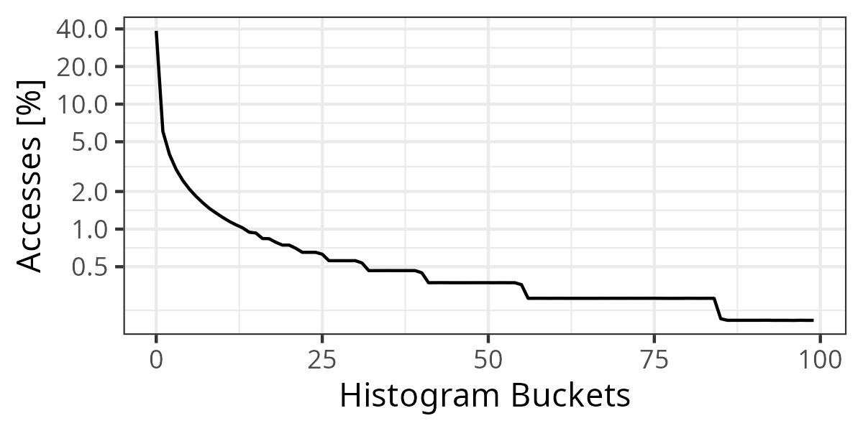

Results: The probability plots
Approx
(C)
Approx
(Java)
Table
(C++)
RI
(Java)

Slide 10
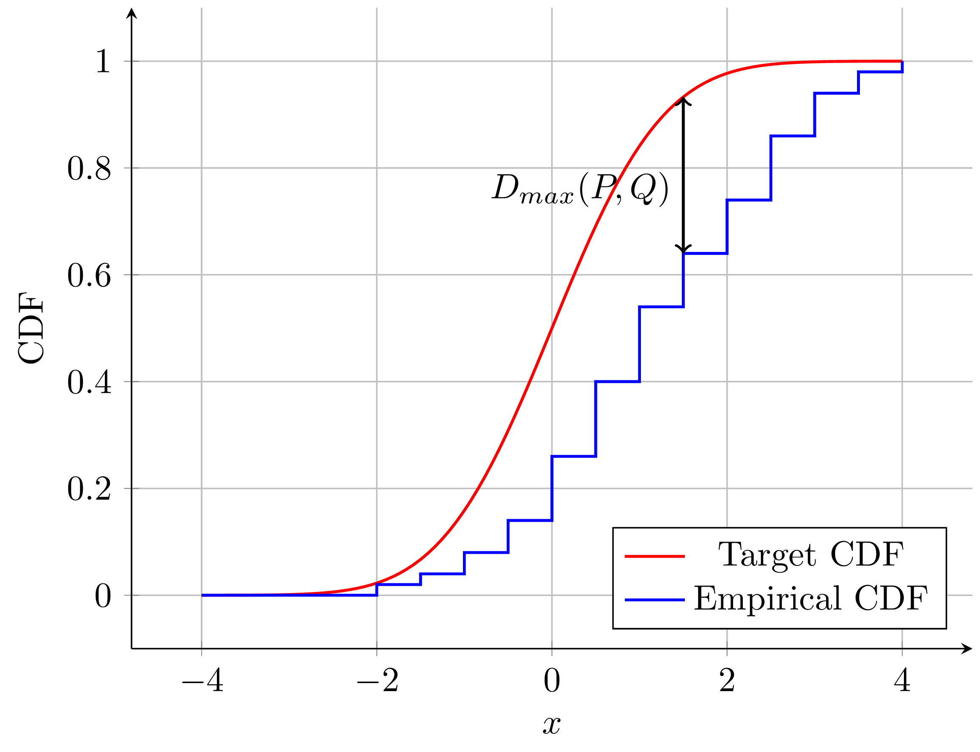
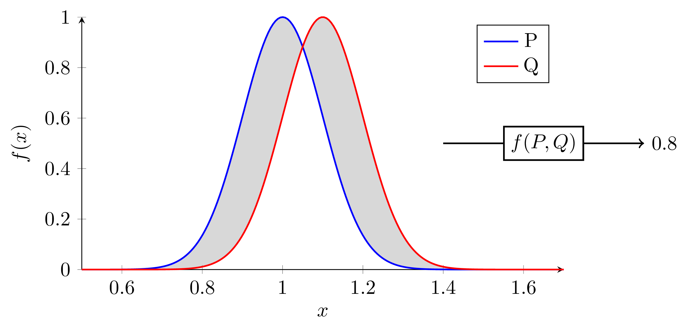
Results: Accuracy
Evaluation requires metrics and a baseline
Maximal distance in CDF
Integraded distance in PMF

Slide 11
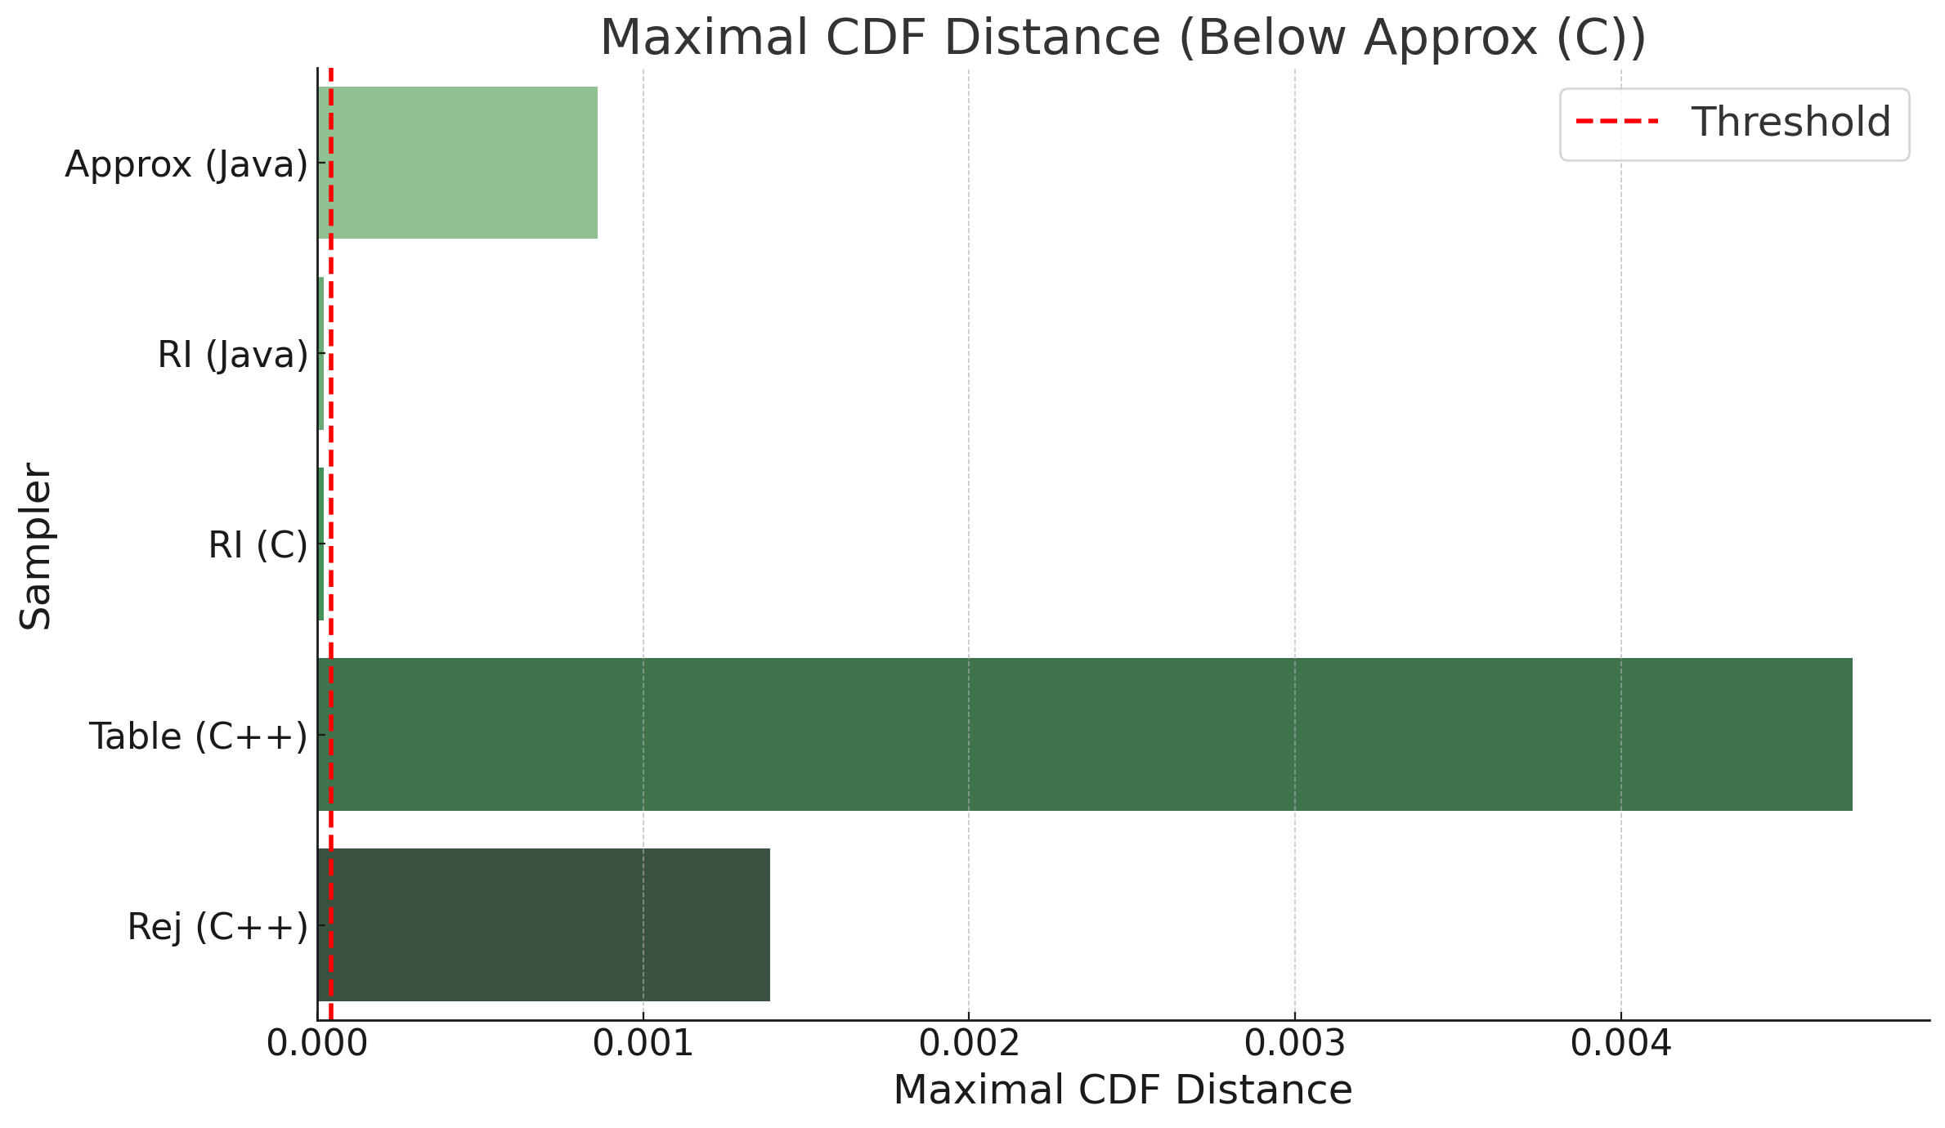
Results: Maximal CDF distance
1 billion samples
α = 0.8
Domain = 100 mil.
Only Rejection-Inversion passes the test
Warning: Not all assumptions hold for the test

Slide 12
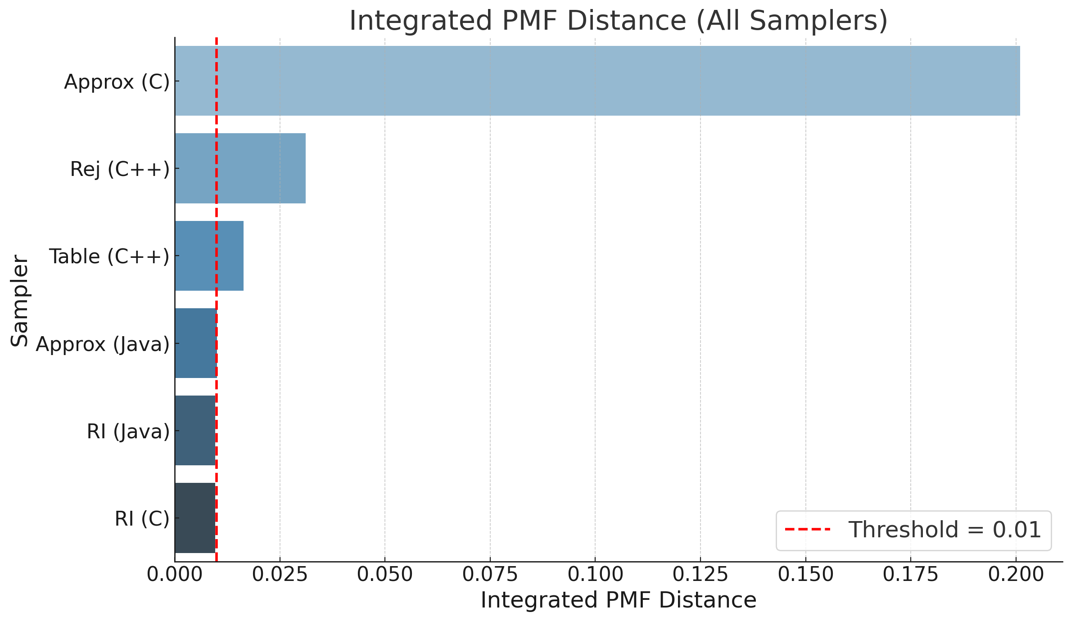
Results: Integrated PMF distance
1 billion samples
α = 0.8
Domain = 100 mil.
Only Approximation (Java) and Rejection-Inversion pass the test

Slide 13
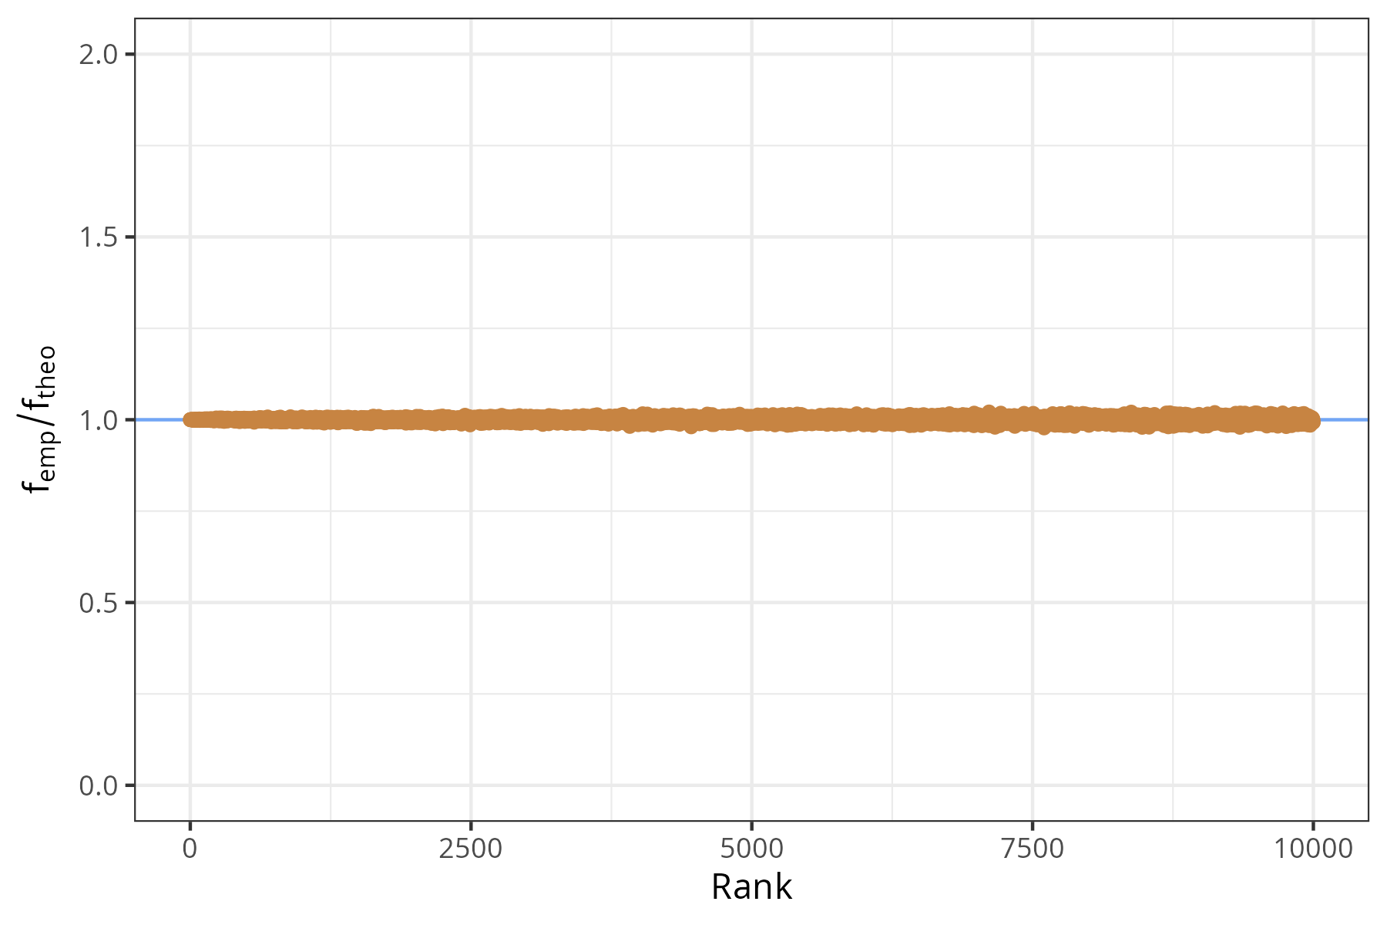
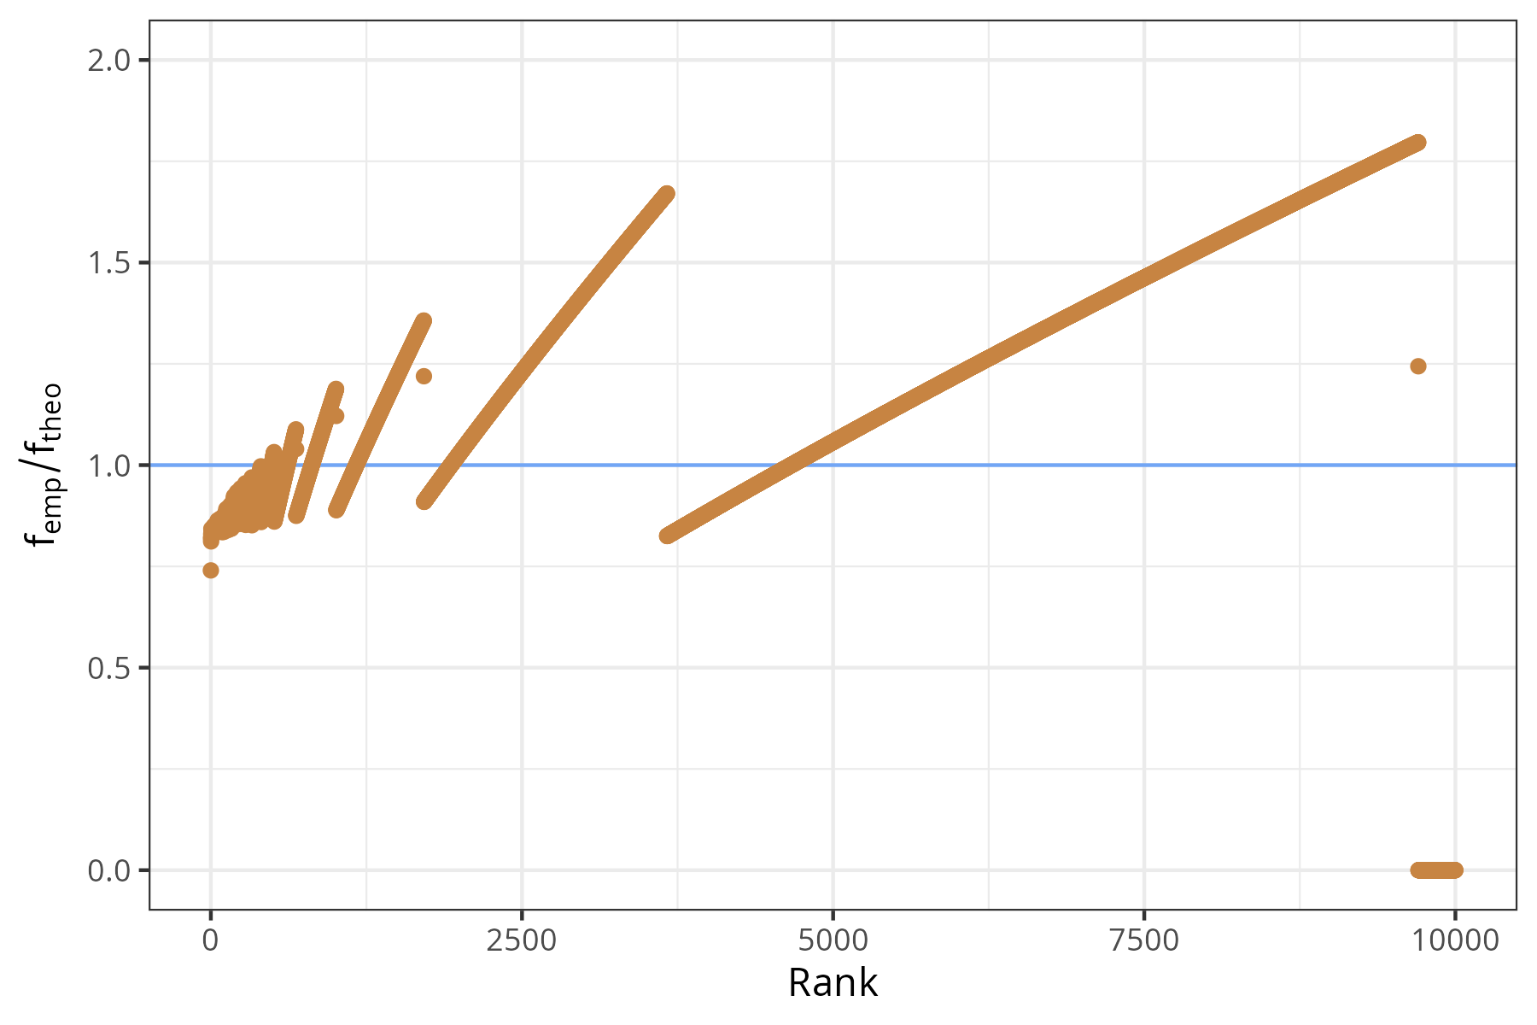
Results: Tail accuracy
Metrics do not represent the tail well.
    Ratio graphs
Ratio (y-axis)
pempirical(k)/ptheoretical(k)
Rejection, RI, Table, Approx. (Java)
Approx. (C)

Slide 14
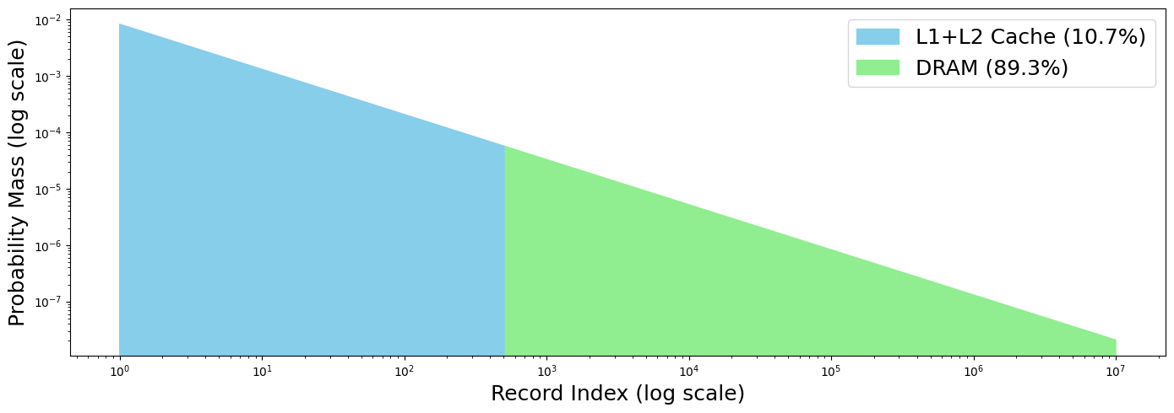
Results: An IO example
Assumptions:
L1+L2 Cache: 4ns
DRAM: 100ns
Dataset: 10GB
Page Size: 4KB
Integrated error is 0.1
 | Expected Latency | Relative Error
True | 89.7 ns | -
Worst-case | 99.31 ns | +10.7%
Uniformly spread error | 94.51 ns | +5.3%

Slide 15
Results: Performance
Measuring performance is tricky
The runs
1 second Warmup
Domain = (0, 100M)
Experiment lasts 1 second
30 experiments
Interrupts
Program isolation
Swapping
Memory cap
Frequency scaling
No scaling
Unwanted optimization
doNotOptimize

Slide 16
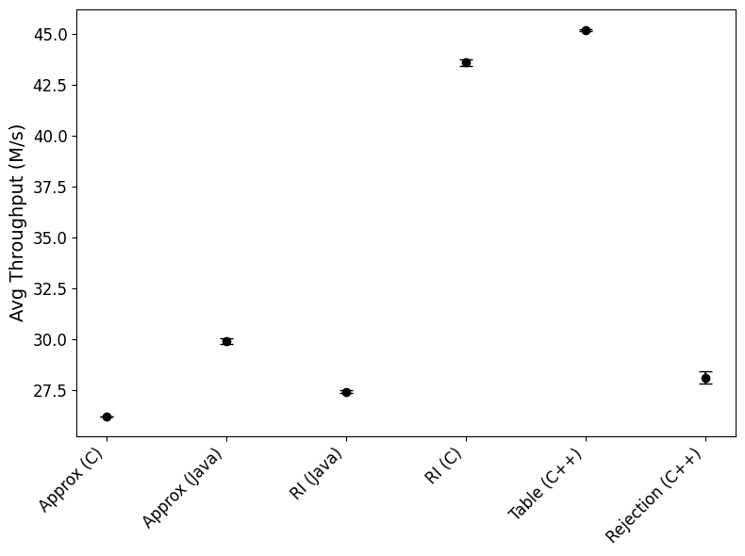
Results: Performance
Observations
Java has ~40% less throughput than C
Approximative (C) is slower than its Java counterpart
The table method is the fastest

Slide 17
Future Work
Some improvements and new directions:
Interpolation in table methods
Other distributions
More robust metrics for discrete distributions
Performance differences in Java and C code

Slide 18
Conclusion
Table methods are competitive with established algorithms
FIO (Approximative C) should not be used
YCSB, Sysbench and OLTP-Bench are accurate enough
YCSB and OLTP-Bench are underperforming in comparison to Sysbench

Slide 20
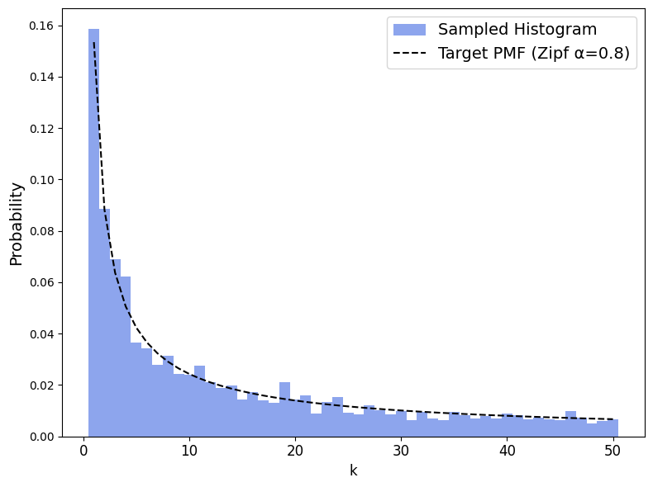
Rejection Sampling
Fundamental idea: Bounding function, Acceptance-rejection

Slide 21
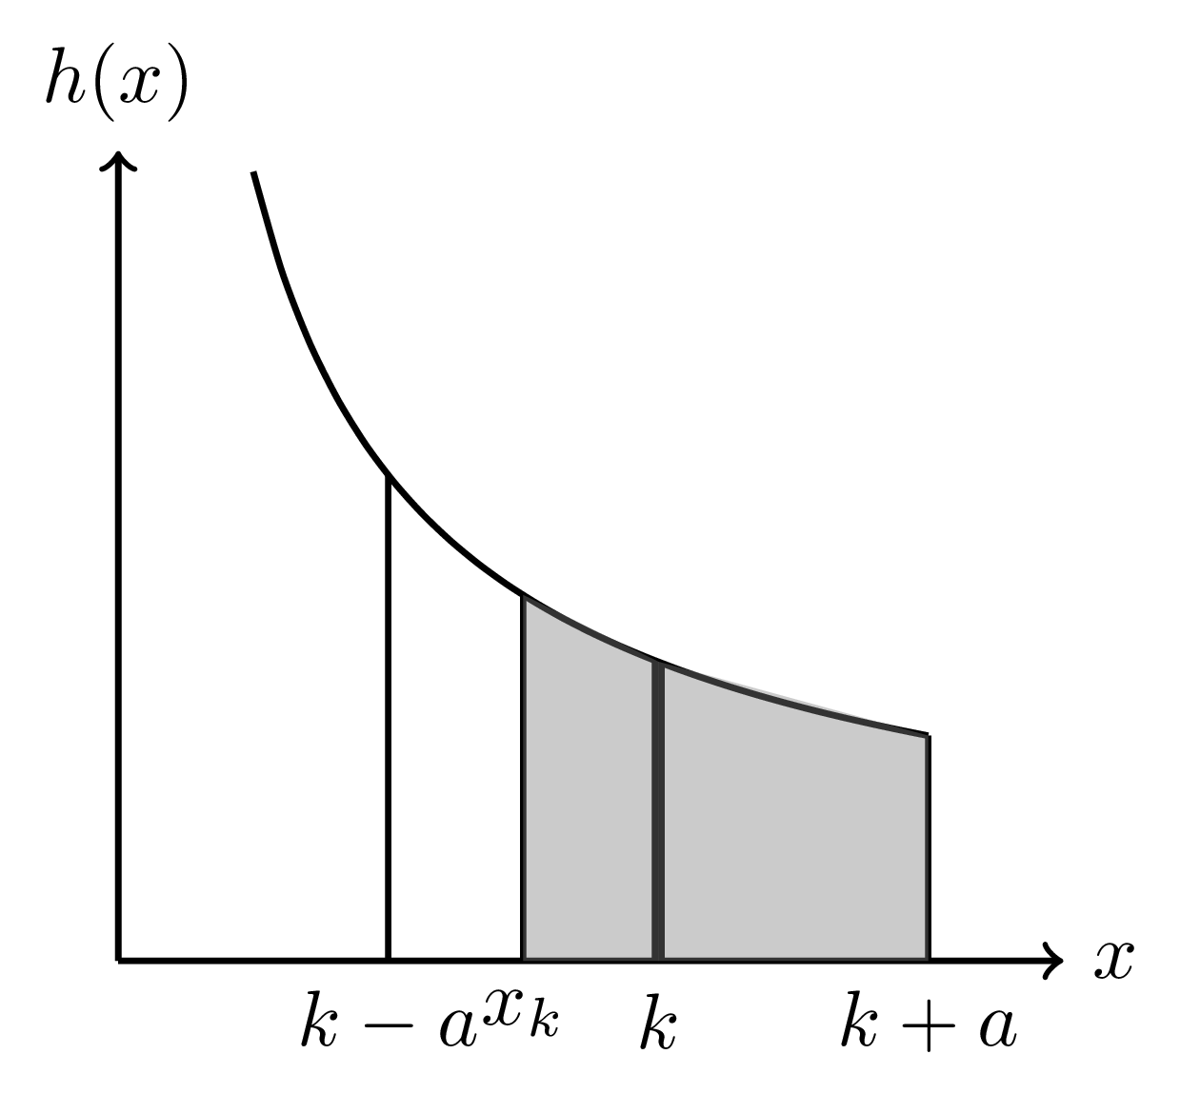
Rejection-Inversion
Rejection sampling:
One sample for the proposal variable (x-axis)
One sample for the target variable (y-axis)
To avoid (2), do inversion first!
Sample from Uniform(0,1)
Inversion sampling yields a proposal variable
Accept it if inside the interval

Slide 22
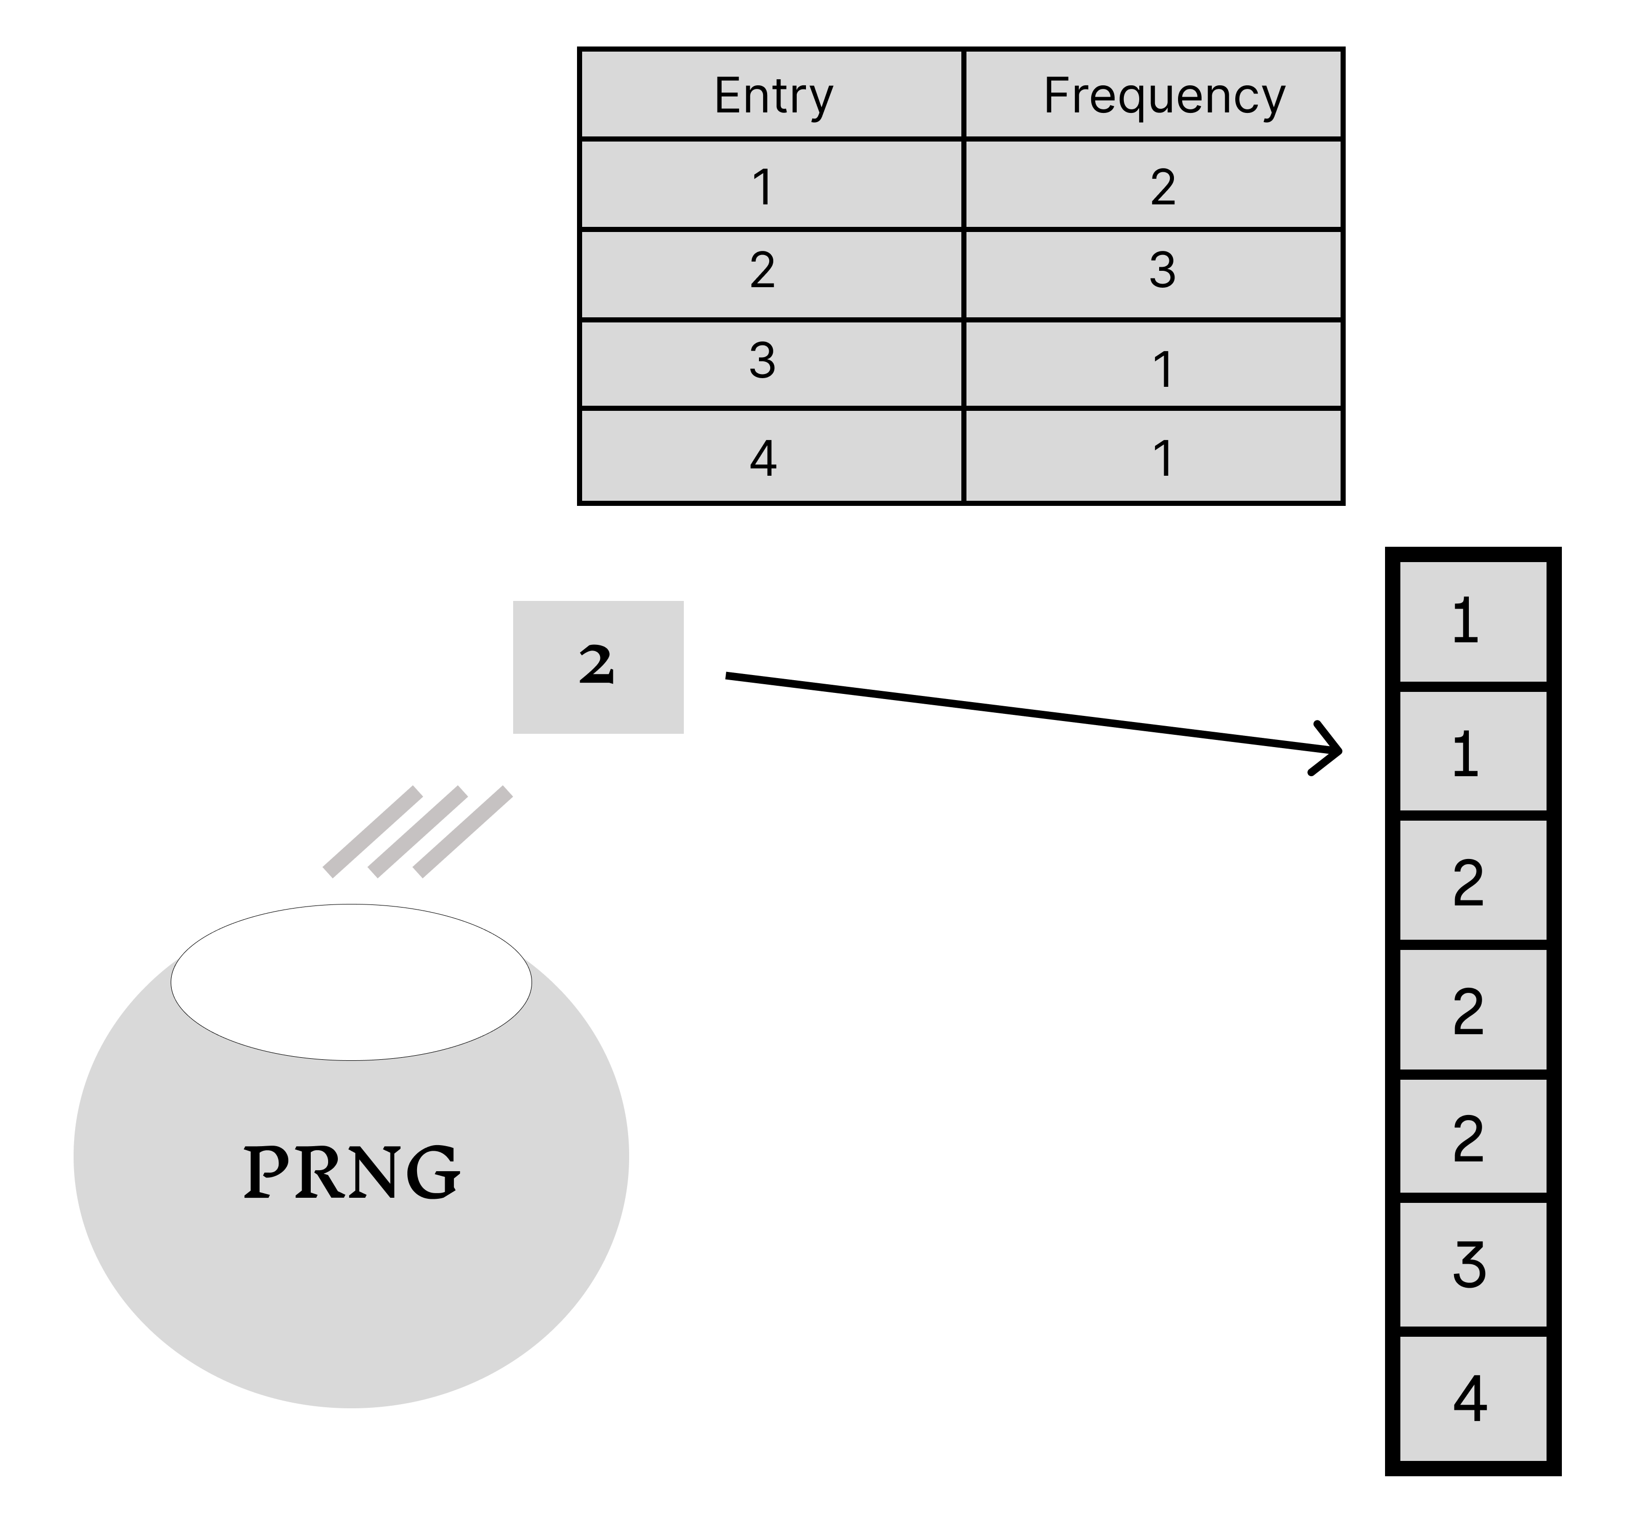
Condensed Table Lookup
Table method
„# of samples“ entries
# of occurences of rank k ∝ P(X = k)
Condensed table method
Instead of # of samples, frequency as float
Decide on precision 10^{−d}
Make d tables with as many entries as the d-th digit of rank k

Slide 23
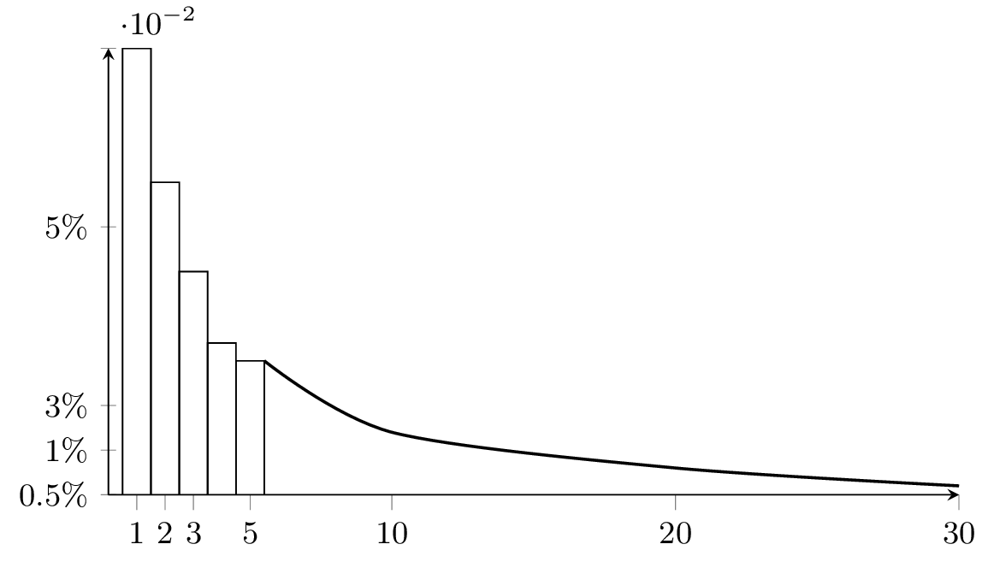
Approximative (Gray)
Balance of precision and speed
First ~10 entries are exact
Rest is approximated with exponential function
Sample with inversion transformation sampling

Slide 24
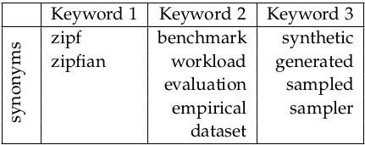
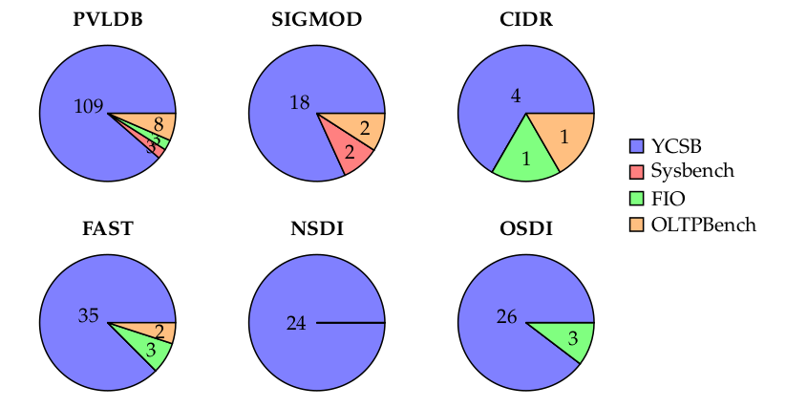
Literature Research
Keyword search matrix
Results by conference

Slide 25
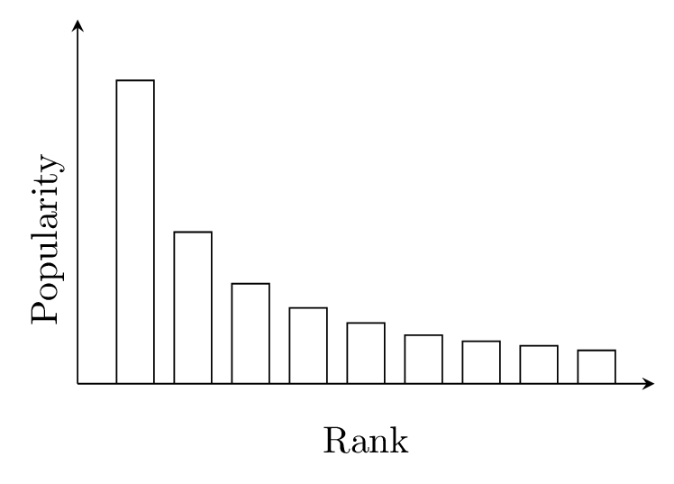
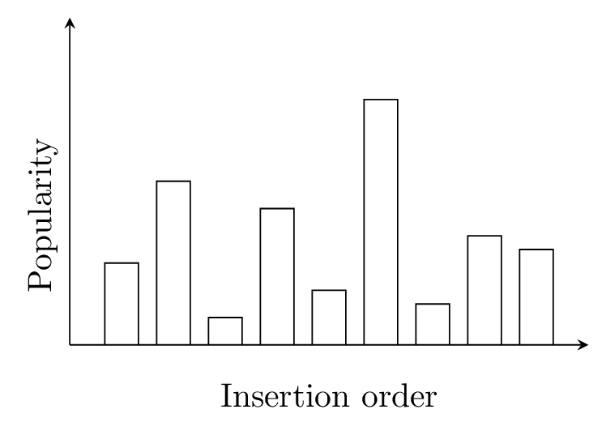
Yahoo! Cloud Serving Benchmark
Algorithm: Approximative (Gray)
Problem
Keys always have the same probability
Solution
Scramble with „outsized“ hashing

Slide 26
Flexible I/O Tester (FIO)
Algorithm: Approximative (Gray)
Problem
Keys always have the same probability
Solution
Scramble with „outsized“ hashing
Problem #2
Hash funciton is only 32-bits

