Slide 1

Limits of Prediction and the Value of Anticipation in Logistics
From flood emergency response to anticipative freight decisions
Rodrigo A. Garrido | Universidad Adolfo Ibáñez
Northwestern University · Evanston / Chicago • October 2026

Slide 2
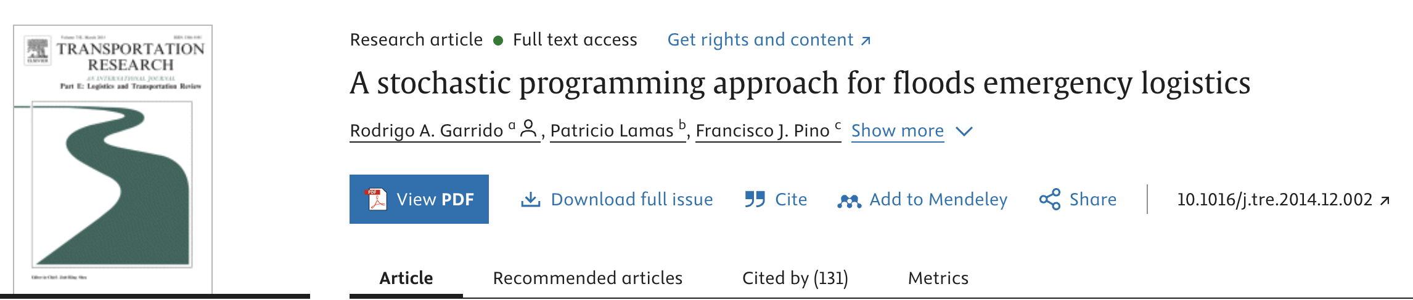
Flood emergency logistics | The scientific question
RESEARCH QUESTION
How can we optimize emergency logistics under uncertain flood conditions while ensuring reliable demand satisfaction?
METHODOLOGY
A chance-constrained stochastic optimization model, combining three components: a stochastic flood-demand process, a multi-period emergency logistics network, and a sample average approximation (SAA) solution procedure.
Garrido et al. (2015), DOI 10.1016/j.tre.2014.12.002
03

Slide 3
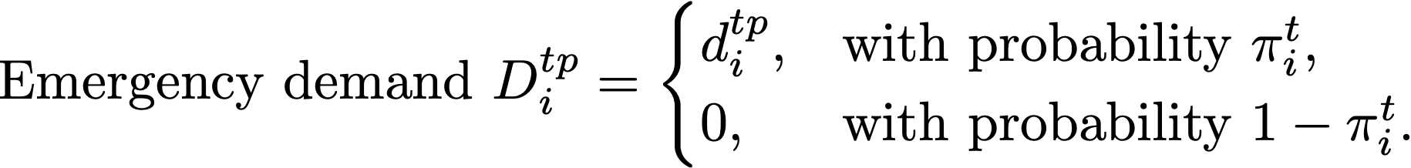
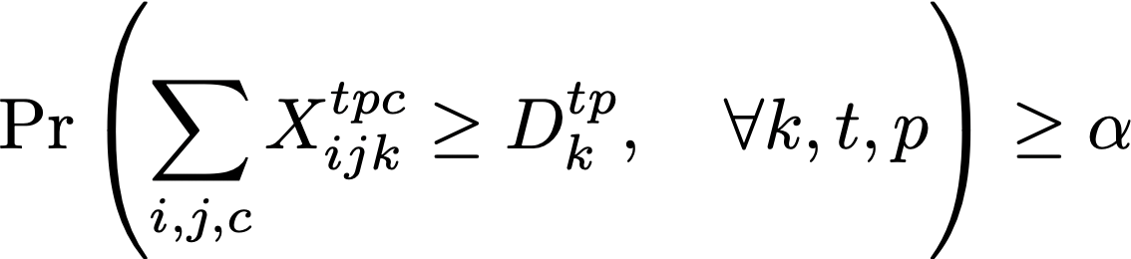
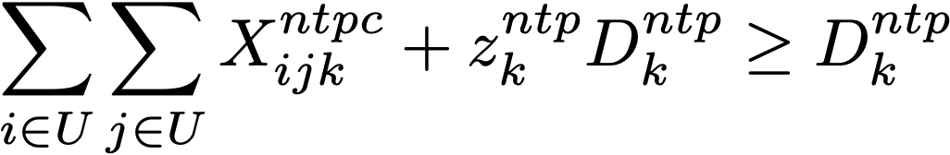
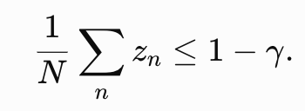
Flood emergency logistics | The scientific question
S. T: standard constraints.
Solving with Sample Average Approximation:
Garrido et al. (2015), DOI 10.1016/j.tre.2014.12.002
03

Slide 4
Floods | What determines the cost of readiness?
Sensitivity analysis in the original paper
The number of products and planning periods strongly changes generalized cost.
Raising the required demand-satisfaction level becomes increasingly expensive.
Inventory capacity and product mix matter for feasible emergency distribution.
Garrido et al. (2015), Table 2
07

Slide 5
Why Study Predictability in Dynamic Systems?
An example of a typical urban discrete dynamic pattern
QUESTION
Can ML architectures predict the next move of deterministic yet complex Discrete Dynamic systems?
Garrido (2026), working manuscript, October
12

Slide 6
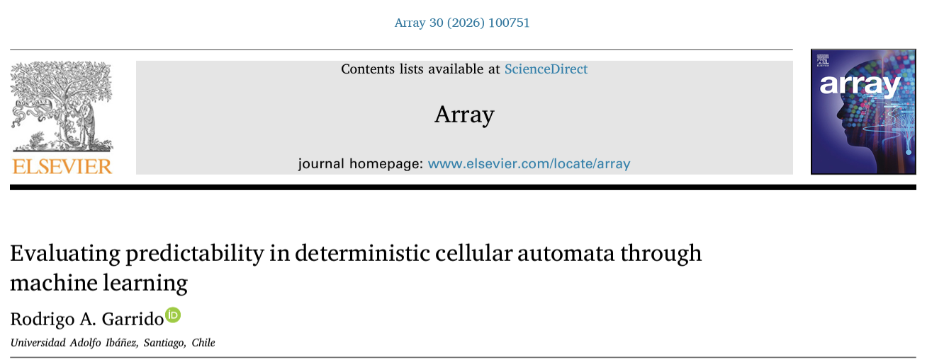
Predictive limits depend on the dynamics
METHOD
ML models: LSTM and Transformer architectures trained to predict future cellular configurations from observed past states. Evaluation: Out-of-sample predictive accuracy and error analysis across different rules to assess how dynamical complexity affects model performance.
Garrido (2026), Array 30, 100751; Garrido, Distinct Regimes… (manuscript)
08

Slide 7
TAKEAWAY
We examined how different neural architectures predict deterministic cellular automata. This raised a deeper question: is prediction failure primarily a limitation of the learning architecture, or does it also depend on how predictive information is organized within the system?
🤔 Why do deterministic systems exhibit different predictive regimes?

Slide 8
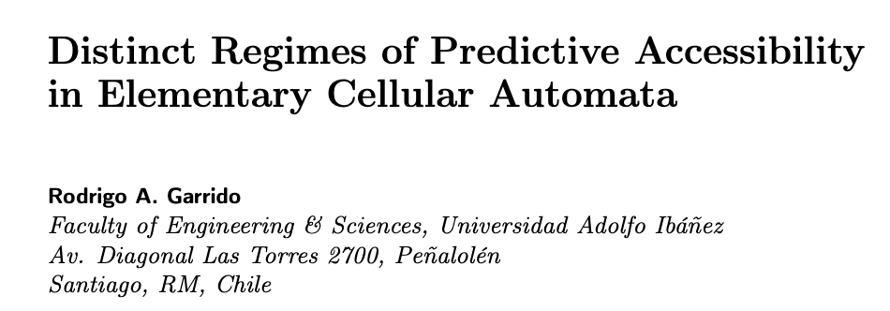

RESEARCH QUESTION
How does the organization and propagation of information affect long-horizon predictability under finite learned representations?
METHODOLOGY
Controlled multi-step forecasting across cellular automata.
Neural predictors with varying receptive fields and prediction horizons.
Analysis of mutual information, causal accessibility, compressibility and parity dependencies.

Slide 9


Predictive limits depend on the dynamics
OBSERVED REGIMES RESULTS
R30 Chaotic, aparently random patterns:
Abrupt loss
R45 Chaotic, irregular structures:
Gradual degradation
Garrido (2026), Array 30, 100751; Garrido, Distinct Regimes… (manuscript)
08

Slide 10


Predictive limits depend on the dynamics
OBSERVED REGIMES RESULTS
R90: Additive XOR / self-similar patterns.structures:
Near-chance prediction
TAKEAWAY Determinism does not guarantee learnability or predictability. LSTMs perform well on certain local temporal dependencies, while Transformers better capture some long-range patterns. Predictability is related to how information is organized and propagated within a system.
R110: Complex dynamics / persistent structures:
Sustained predictive structure
Garrido (2026), Array 30, 100751; Garrido, Distinct Regimes… (manuscript)
08

Slide 11
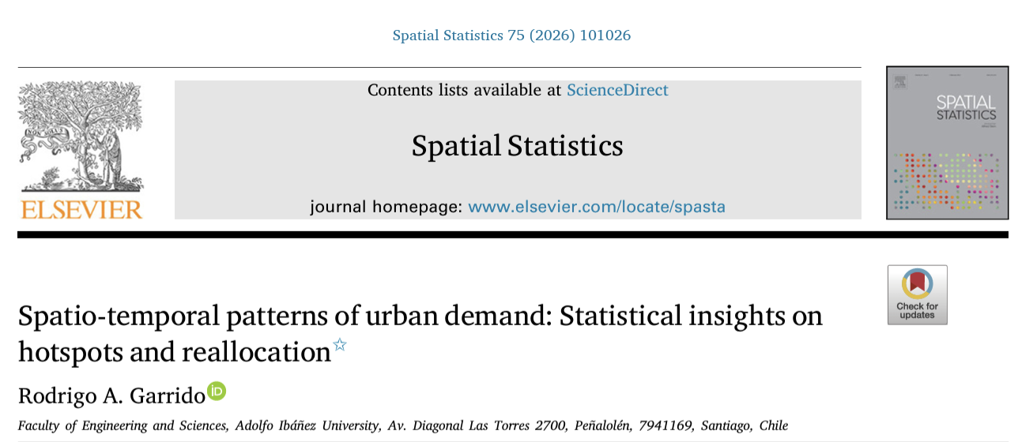
Observation scale changes what we can see
SCIENTIFIC QUESTION
To what extent are changes in urban demand driven by temporal reallocation versus spatial redistribution, and how do these patterns relate to economic value?
Garrido (2026), Spatial Statistics 75, 101026; DOI 10.1016/j.spasta.2026.101026
09

Slide 12
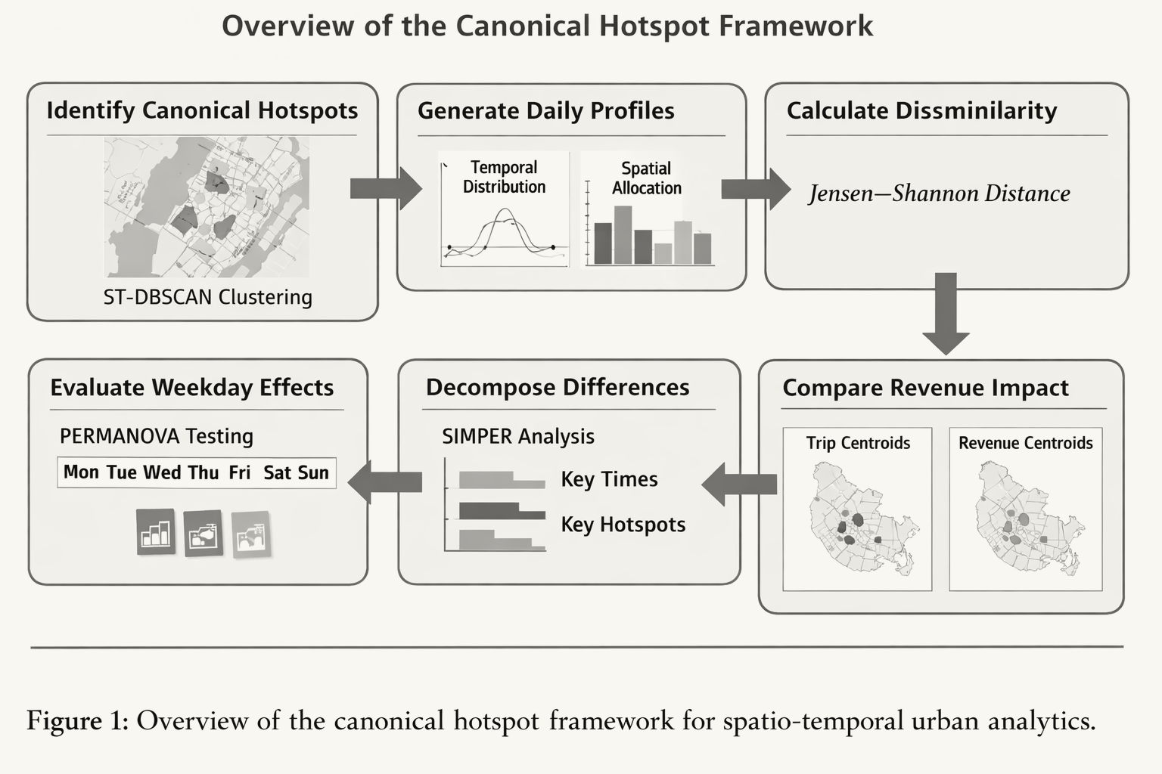
Observation scale changes what we can see
TAKEAWAY: Urban demand variation is primarily temporal, spatial differences are concentrated in a few hotspots, and persistent demand does not necessarily imply economic relevance
.
Garrido (2026), Spatial Statistics 75, 101026; DOI 10.1016/j.spasta.2026.101026
09

Slide 13



Dynamic Two-Stage Pickup-and-Delivery Assignment. Rodrigo A. Garrido (2027)
Standard Assignment Problem
t = 0

Slide 14




t = 1
t = 2
t = 3
t = …
t = T

Slide 15
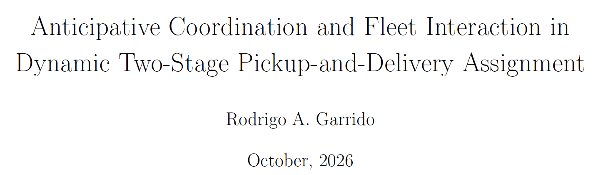
How do anticipative coordination, intertemporal complementarities, and fleet availability affect the value of dynamic freight assignment?

Slide 16
Dynamic freight | The scientific question
Anticipative Coordination and Fleet Interaction in Dynamic Two-Stage Pickup-and-Delivery Assignment (2026)
METHODOLOGY
Problem: A two-stage pickup-and-delivery assignment problem where current decisions change vehicle locations, availability, and feasibility of future deliveries.
Mathematical modeling: Feasible single-request services and two-request chains are represented through a conflict graph, formulated as a cardinality-constrained Maximum-Weight Independent Set problem, with an equivalent QUBO/Ising representation.
Garrido (2026), working manuscript, October
12

Slide 17
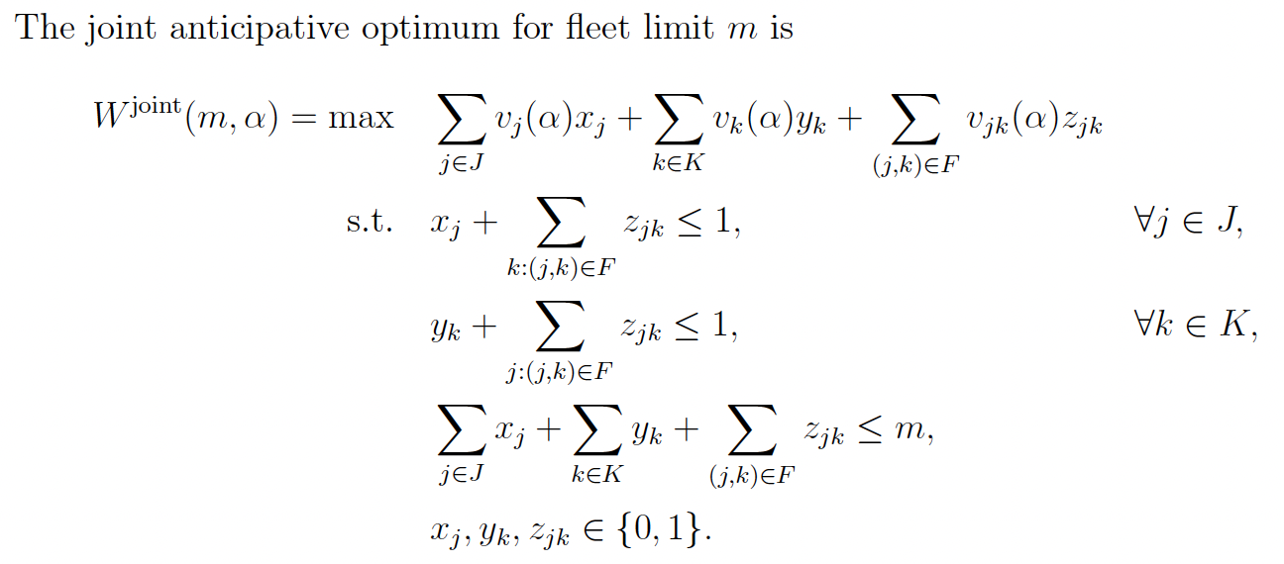
Freight | Model and combinatorial structure
Service alternatives: initial singleton, future singleton, or feasible chain
Garrido (2026), Sections 2–4
13

Slide 18
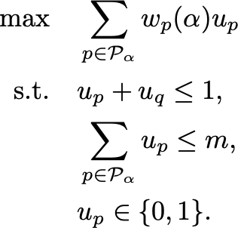

Freight | Model and combinatorial structure
Service alternatives: initial singleton, future singleton, or feasible chain
Garrido (2026), Sections 2–4
13

Slide 19
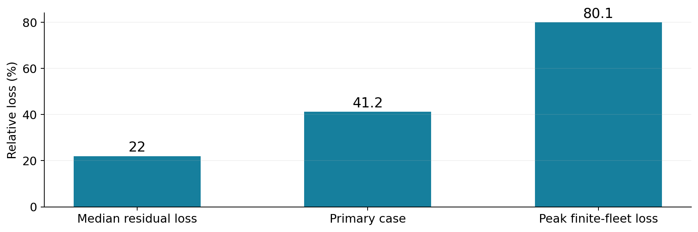
Freight | How much does anticipation matter?
Li–Lim LC101 dynamic construction · 30 independently generated realizations
TAKEAWAY Anticipative coordination creates value even with abundant vehicles, because individually unprofitable requests can enable profitable future service chains. Fleet limitations can further amplify the cost of sequential decisions.
Garrido (2026), Results §§6.1–6.4
14

Slide 20
Takeaways for uncertainty in logistics modeling
What the three research strands establish
Uncertainty has an operational cost. In emergency logistics, higher service reliability requires increasingly costly resource allocation and prepositioning decisions.
Determinism does not guarantee predictability. Even when the governing dynamics are fully known, machine-learning performance depends on how predictive information is organized, propagated, and accessed.
Anticipation creates value beyond fleet capacity. In dynamic freight assignment, intertemporal complementarities can make individually unprofitable requests worth serving, even when vehicles are abundant.
Next question: how can these mechanisms be combined in a freight decision system?
15

Slide 21

Scan to access presentations, research and contact details:

Slide 22
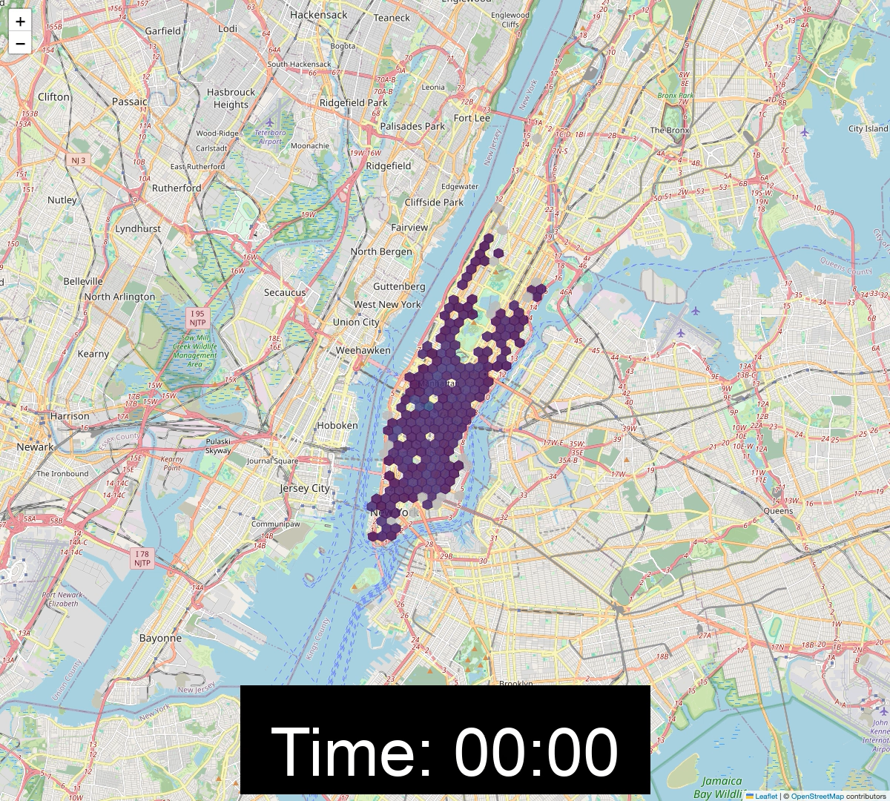

Slide 23


