Slide 1
PROBLEM STATEMENT
To develop an interactive app which will provide an easily accessible medium to interact with a PC.

Slide 2
INTRODUCTION
This project aims at accessing computer remotely using an Android platform.
We create an user friendly application on Android based smartphones.
Networking plays an important role in inter -communication between Phone and the System
Client-Server architecture is used.
TCP connection will be setup between the Device and the System.

Slide 3
HOW TO USE THE PRODUCT
Install the android application on mobile.
Open the application.
On the server side, the user has to run the server.
The client and server must lie in the same network and use the same IP address.
After the connection setup,the user can easily access their PC using the app interface.

Slide 4
OBJECTIVES
General
To control the remote device using android based smartphones
Specific
To start and stop applications .
To control mouse
To control keyboard.
Take snapshots of live screen.
To use voice commands.

Slide 5
REQUIREMENTS
PC/Laptop
Android based smartphones.
Internet connection.

Slide 6
FUNCTIONAL REQUIREMENTS
The user traces the mouse movement on the desktop.
Keyboard access is given to the user.
Voice command can be given as input.
Live capturing of screen can be provided to the user.

Slide 7
NON FUNCTIONAL REQUIREMENTS
USABILITY: The system shall provide a uniform look and feel between all the pages. The UI is very simple and easy to use.
RELIABILITY: Each feature of the application is reliable as it does accurately what is expected.

Slide 8
DEVELOPMENT TOOLS
Java SE Development Kit.
Android Studio with Android SDK.
Windows operating system.
jGRASP.

Slide 9
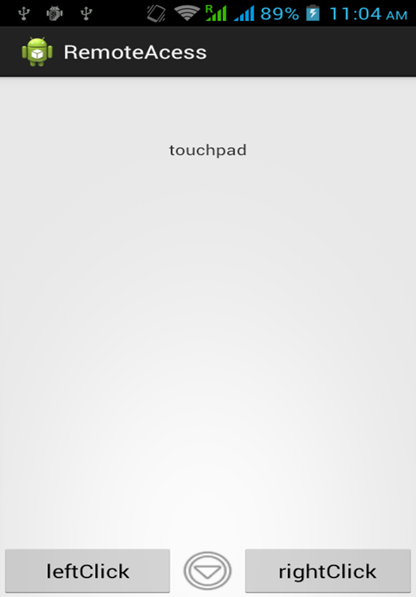
USER INTERFACE
Homepage
User can use screen as touchpad.
Providing left click and right click functionality similar to mouse.
Dropdown arrow in the middle lists other advanced features.

Slide 10
CHALLENGES FACED UNTIL NOW…
Tracing coordinates of mouse on the desktop.
Accessing input from keyboard.
Executing voice commands.

Slide 11
REFERENCES
www.developer.android/sdk
www.jgrasp.com
www.youtube.com
The New Boston Series for android development.
http://www.7tutorials.com/connecting-remotely-windows-desktop-windows-8.html

Slide 12
THANK YOU

