Slide 1
Metrics & Monitors
Learning Week
DATADOG TSE • BRAZIL
A practical path from noisy data to useful alerts

Slide 2
The Week at a Glance
01
Metrics + APM: read the signal before the alert
02
Containers: aggregate by the owner of the action
03
DBM: growth, spikes, and query ownership
04
Logs: precision beats volume
05
Dynamic challenge: investigate like support

Slide 3
The TSE troubleshooting method
method
Signal -> Metric -> Query -> Monitor -> Customer explanation
For every case, prove the signal first. Then tune the query, fix the monitor, and explain the result clearly.

Slide 4
The monitor quality loop
The core question
A useful monitor alerts the right person, about the right slice of data, at the right time.
Everything else becomes noise, silence, or a page nobody can act on.
Every day repeats the same move
1. See the symptom
2. Prove the metric shape
3. Find what the query hides
4. Fix the monitor and explain it clearly
Metric
Aggregator
Group
Threshold
>
>
>
raw signal
time + space
owner
action

Slide 5
LEARNING WEEK
Hard mode contract
You do not win by finding the answer. You win by proving it.
1
Hypothesis first
2
Evidence over opinion
State the suspected failure mode before touching the monitor.
Show the graph, query, sample, or monitor state that proves it.
3
Compare two fixes
4
Explain at 3 AM
Choose after weighing detection, noise, ownership, and delay.
Write an alert the on-call can act on while tired.
Rule: the slide does not give the final answer. The live investigation earns it.
DATADOG

Slide 6
METRICS
Troubleshooting Foundations
Before you tune the alert, prove the signal is telling the truth.

Slide 7
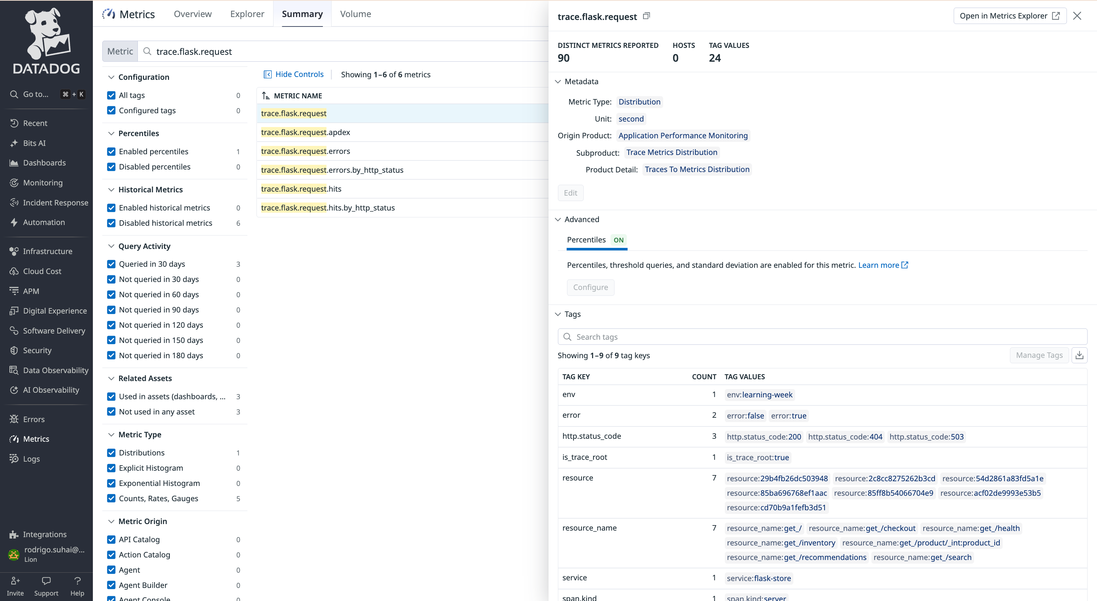
Start every Metrics case with the source of truth

Slide 8
The first TSE question is: what is this number?
A metric is a claim with metadata
Name: what is being measured?
Type: gauge, count/rate, distribution, histogram.
Unit: seconds, milliseconds, bytes, percent, events.
Tags: which dimensions can explain the problem?
Source: Agent check, APM, DogStatsD, API, integration.
Case posture
Do not start with the threshold. Start with the metric identity.
Name
Type
Unit
Tags
meaning
>
math
>
scale
>
ownership

Slide 9
Metric type tells you what math is legal
GAUGE
COUNT / RATE
DISTRIBUTION
HISTOGRAM
State right now
Events over time
Server-side spread
Agent-side spread
CPU %, memory used, battery level
requests, errors, restarts, orders
APM latency, trace metrics
DogStatsD latency, payload size
Ask: is the current value actionable?
Ask: raw total, .as_count(), or .as_rate()?
Ask: avg, p95, p99, max?
Ask: which generated metric suffix?
Troubleshooting smell: when the graph looks impossible, verify type and unit before assuming the product is wrong.
Reference: Metric types

Slide 10
Every graph is an aggregation pipeline
Read a query from left to right
Why this matters
Two engineers can look at the same metric and see different stories because the query changed the signal.
Raw points
Time agg
Space agg
Functions
10s-ish samples
>
avg/max/sum/last
>
avg by host
>
rollup/change
Time aggregation answers: what happened inside each bucket?
Space aggregation answers: which sources are combined or split?
Functions can reveal the issue or erase it.
A monitor evaluates the transformed signal, not the raw universe.

Slide 11
Time aggregation vs space aggregation
Same metric, different story. Separate the two questions before changing the threshold.
TIME AGG
SPACE AGG
What happened inside the time window?
Which sources were mixed together?
avg over 10m can hide a spike
max keeps short peaks visible
rollup changes the evidence
avg across hosts can hide one hot host
no group-by can hide one bad endpoint
split only when action differs
TSE move: change time first, then space. Do not change both axes and the threshold at once.

Slide 12
Tags decide whether you can find the problem
Use tags as investigation handles
APM
resource_name reveals the slow endpoint
Troubleshooting lens
A metric without useful tags can tell you something is wrong, but not where to act.
kube_deployment maps the issue to an owner
Kubernetes
DBM
db separates the hot database from the quiet ones
Logs
service/status/region keeps the query precise
Custom metrics
region/payment_method/sensor_id expose the hidden segment
Cardinality check: the tag that helps investigation can also explode cost/noise. Use it when it maps to action.

Slide 13
Resolution changes the story you tell
Troubleshoot the graph before the customer
raw
rolled up
Case smell
The customer says the spike happened. Your graph says it did not. Both can be true.
Zoom in to the incident window.
Compare automatic rollup with explicit .rollup(max, 60).
Use timeshift only after the current signal is understood.
Do not tune a monitor from a smoothed dashboard alone.

Slide 14
Metrics Explorer: a repeatable TSE recipe
1
Start broad
Plot the metric exactly as the monitor uses it.
2
Change statistic
Compare avg, max, p95/p99, sum, or count depending on type.
3
Split by tags
Group by host, resource_name, db, region, sensor_id, or deployment.
4
Change time
Zoom, roll up, timeshift, and compare incident vs baseline.
5
Decide action
Only then decide whether the monitor, metric, or instrumentation is wrong.
The goal is not to memorize queries. The goal is to build a debugging loop you can reuse on any Metrics or Monitors case.

Slide 15
Three timing knobs change alert behavior
They do not change the metric. They change when Datadog is willing to evaluate it.
EVALUATION WINDOW
REQUIRE FULL WINDOW
NEW GROUP DELAY
How much time must be bad?
Must the whole window have data?
Should new groups wait?
MONITOR TIMING
Short can be noisy
Long can be late
Match the failure mode
Good for dense metrics
Risky for sparse metrics
Skipped windows look silent
Useful during startup
Can hide fast failures
Applies to new groups
TSE question: is the monitor wrong, or is its evaluation timing wrong?
Related cases: #2543610 · #2533730
Reference: Monitor config · No Data guide

Slide 16
When a monitor is silent, debug the evaluation path
Do not start by changing the threshold. First find where the alert pipeline stopped.
Metric reports
Group exists
Delay expires
Window fills
Query evaluates
Alert routes
MONITOR TIMING
Is data present?
Is this a new group?
Is new group delay holding it?
Did full window skip?
Did the window hide it?
Did notification rules apply?
Talk track
A silent monitor is not automatically a bad threshold. It may be waiting for a new group delay, skipping incomplete windows, or evaluating a window that no longer contains the spike.
Related cases: #2879820 · #2533730
Reference: Monitor config · API options

Slide 17
Monitor Admin: inspect what the evaluator saw
Use it when the graph, source data, evaluated data, and alert state disagree.
INPUT
EVALUATION
COMPARE
Start from the exact monitor
Read the evaluator's view
Explain the mismatch
MONITOR ADMIN
Monitor ID or support URL
Org and site/region
Incident timeframe
Evaluated value
Group status
Window and timestamps
Source data vs evaluated data
Skipped windows
Delay or no-data behavior
Internal tool: use it for investigation, but do not share Monitor Admin screenshots with customers.
Reference: Monitor Admin KB

Slide 18
Cloud metrics monitors need patience
Crawler-based metrics can arrive late or backfilled. A monitor can be wrong simply because it evaluated too soon.
ARRIVAL
TIMING
SPARSITY
Data may be delayed
Delay evaluation
No data is not always outage
CLOUD METRICS
Cloud APIs expose data later
Crawler schedules add latency
Recent graph gaps may fill later
Use evaluation delay
Use a realistic timeframe
Do not page on incomplete data
Some metrics report infrequently
Full window can skip sparse data
Check no-data behavior
TSE move: compare metric arrival time before declaring the monitor broken.
Related cases: #2543610 · #2535898
Reference: Cloud metric delay · No Data guide

Slide 19
Cloud monitor troubleshooting path
For AWS, Azure, GCP, and other cloud integrations, debug ingestion timing before changing the alert threshold.
Provider emits
Crawler pulls
Metric arrives
Delay applies
Window evaluates
Alert routes
source time
API schedule
Datadog time
evaluation delay
threshold check
notification
CLOUD METRICS
Ask first
Is the graph using the same window the monitor evaluates, or are we looking at data after it arrived?
Then tune
Evaluation delay, timeframe, require full window, and no-data settings before changing threshold.
Related cases: #2538260 · #2535898
Reference: Cloud metric delay · Monitor config

Slide 20
How a metric is submitted changes how it behaves
Accepted submission types: COUNT, RATE, GAUGE, SET, HISTOGRAM, DISTRIBUTION. The stored in-app type can still differ by path.
AGENT
DOGSTATSD
API / GENERATED
Agent check
App emits to Agent
Direct or derived
CUSTOM METRICS
Collected on a host
Agent aggregates per flush
Type controls the stored value
Great for custom app KPIs
Count can appear as a rate
Tags arrive with the metric
API stores submitted points
Log/APM/RUM metrics derive from events
Timestamp and tags matter
TSE move: ask how the metric is produced before deciding the query is wrong.
Related cases: #2530392 · #2543035
Reference: Metric types · DogStatsD · DogStatsD KB

Slide 21
Custom metrics: one name can become many series
A custom metric is identified by its name plus tag-value combinations, including the host tag.
metric name
tag values
host tag
time series
cost + noise
CUSTOM METRICS
Troubleshoot value
Troubleshoot volume
submission type
unit and timestamp
reporting frequency
query statistic
high-cardinality tags
unbounded IDs
host and container dimensions
multi-alert group count
Good custom metrics are designed for action: stable name, useful tags, bounded cardinality, clear unit.
Related cases: #2537553 · #2513073 · #2869511
Reference: Custom metrics · Cardinality KB

Slide 22
Common Metrics cases are pattern-recognition drills
When a case feels unfamiliar, classify the failure
Missing data
last reported, source, tag filter, no-data behavior
TSE mindset
You will not know every metric. You can still reason from first principles.
Wrong-looking value
type, unit, rollup, as_count/as_rate
Hidden segment
group by the action dimension
Too much noise
cardinality, group-by count, threshold, evaluation window
Cost/cardinality spike
new tags, custom metric volume, high-cardinality values

Slide 23
Metrics takeaway: a monitor is only as good as the signal it evaluates.

Slide 24
DAY 1
APM: The Latency Lie
Average latency can look healthy while checkout users wait seconds.

Slide 25
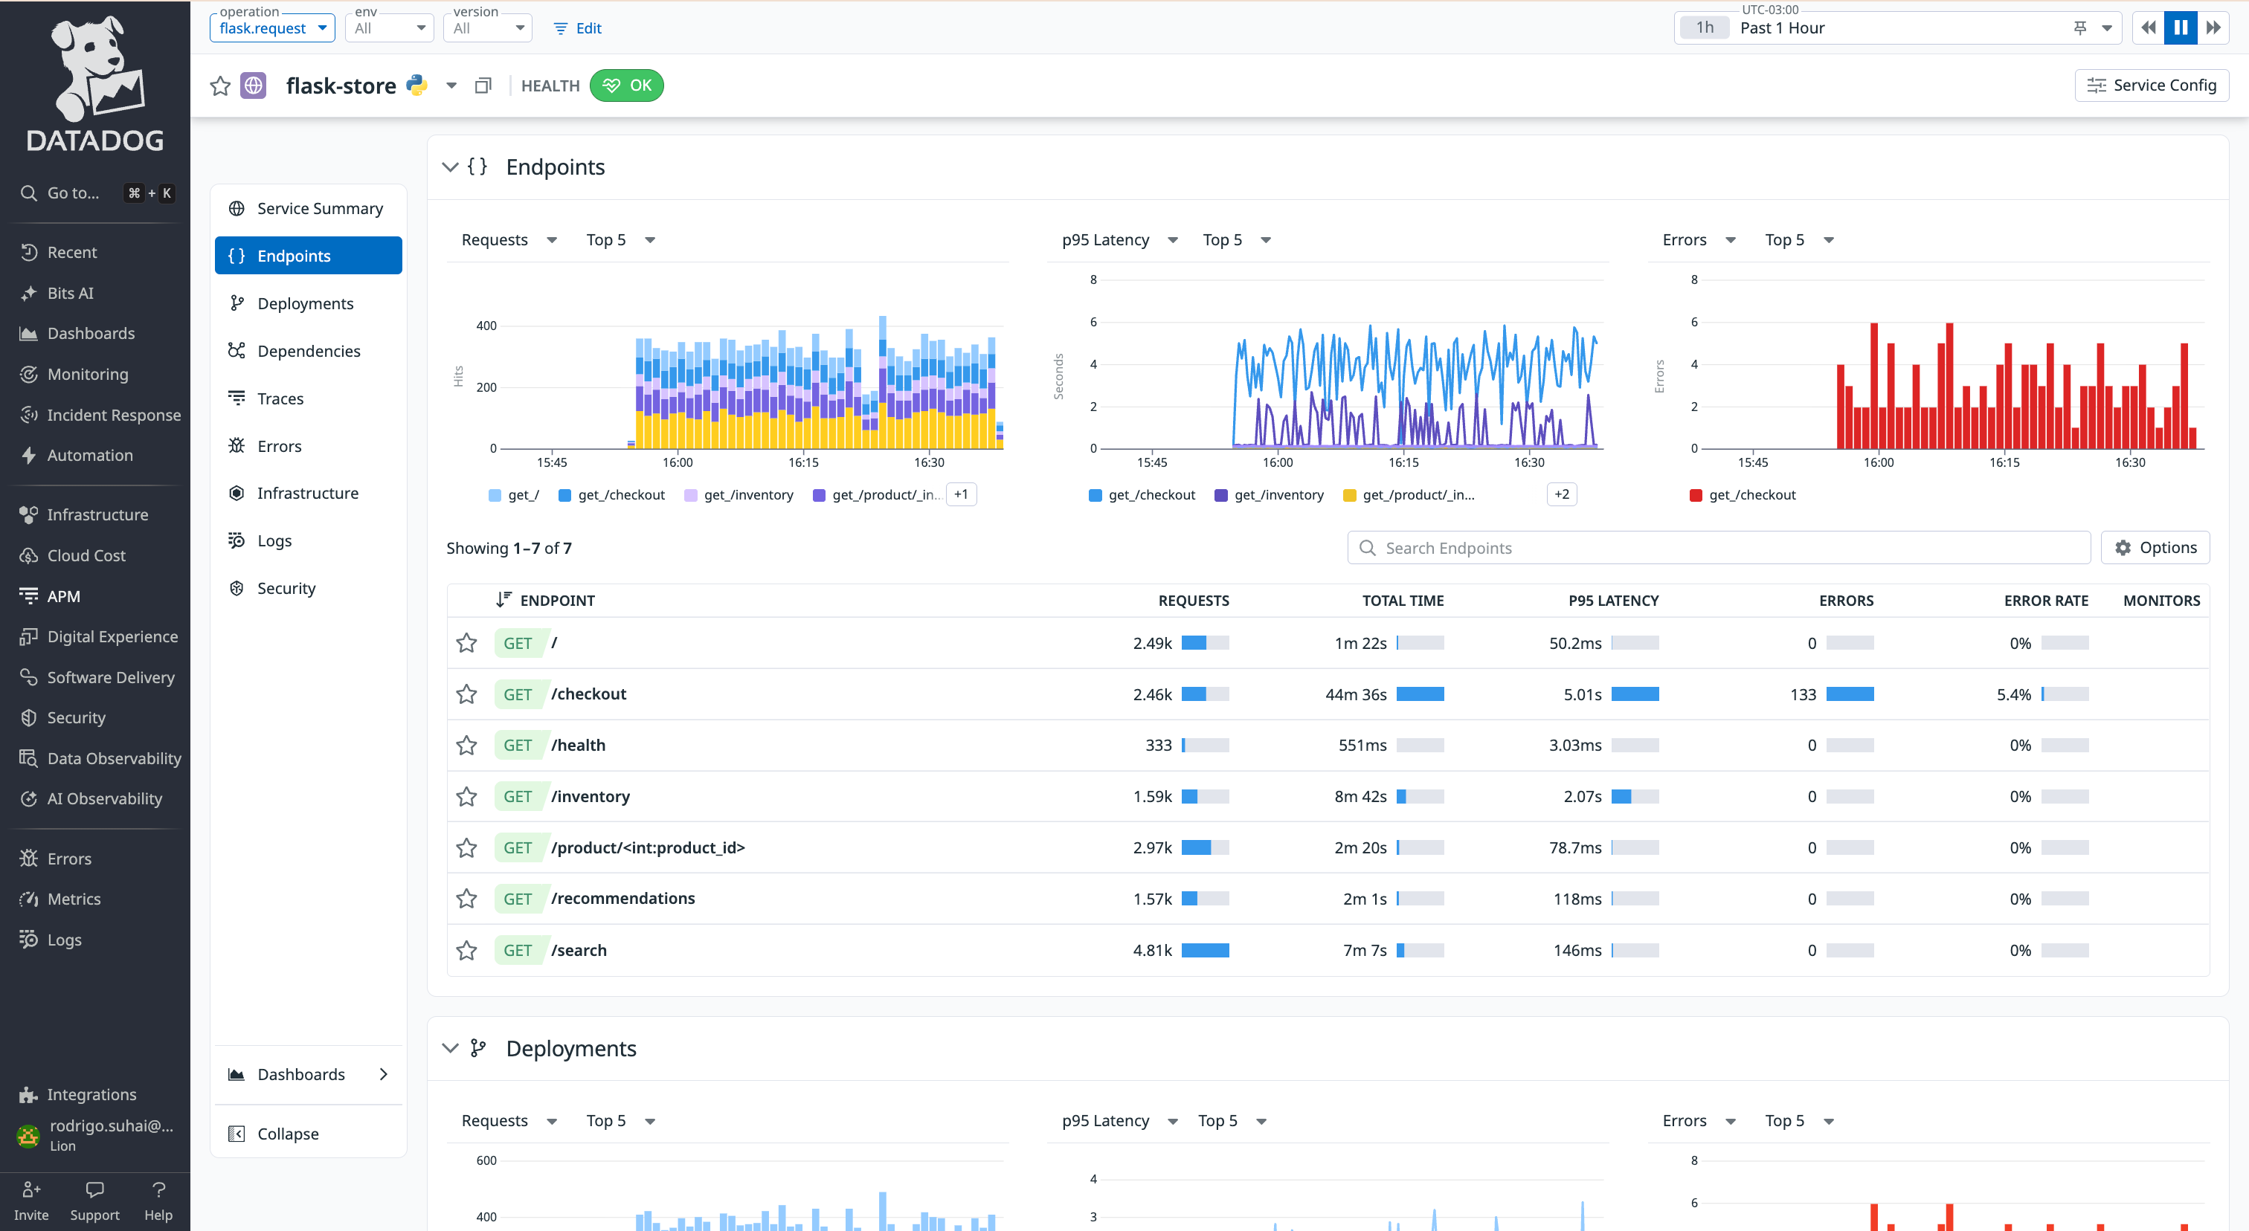
Start with the bad user experience

Slide 26
Average is not experience
Better monitor instinct
Latency needs percentiles, not only avg.
For checkout, segment by resource_name.
Use distribution metrics when you need p95/p99.
What learners should feel
The monitor says OK.
Users still wait.
The metric was not wrong; the question was.
raw signal
10m avg

Slide 27
Rollup can erase the incident
Fix the shape of the query
Use a rollup interval that matches the failure mode.
Use max rollup when the peak is what matters.
Then tune the evaluation window for noise.
The trap
A 30 second spike disappears inside a 10 minute average.
The graph becomes calm because we smoothed the evidence.
raw signal
10m avg
Related cases: #2879820 · #2547404

Slide 28
Segment where action happens
The query move
Errors without group-by can hide a broken endpoint.
Use by {resource_name} when each endpoint deserves its own state.
Then route with context in the alert message.
Tag logic
Service-level totals answer: is anything wrong?
resource_name answers: where do I fix it?
Metric
Aggregator
Group
Threshold
>
>
>
raw signal
time + space
owner
action
Related cases: #2457050

Slide 29
Lab missions
Day 1 lab: four broken APM monitors
01
APM Latency - All Good
The rule
Bring evidence, one rejected hypothesis, and two possible fixes.
The slide gives the case and the question.
The final answer stays for the live discussion.
Why does the monitor say OK while checkout users still feel pain?
02
APM Spike Detector
Where did the short incident go when the graph was rolled up?
03
APM Error Surge
Which endpoint owns the error pattern?
04
APM Throughput Alert
Is the alert detecting customer impact or normal traffic shape?

Slide 30
Day 1 takeaway: when user impact lives in the tail, average is camouflage.

Slide 31
DAY 2
Containers: The Kubernetes Resource Crisis
Cluster averages hide the workload that needs action.

Slide 32
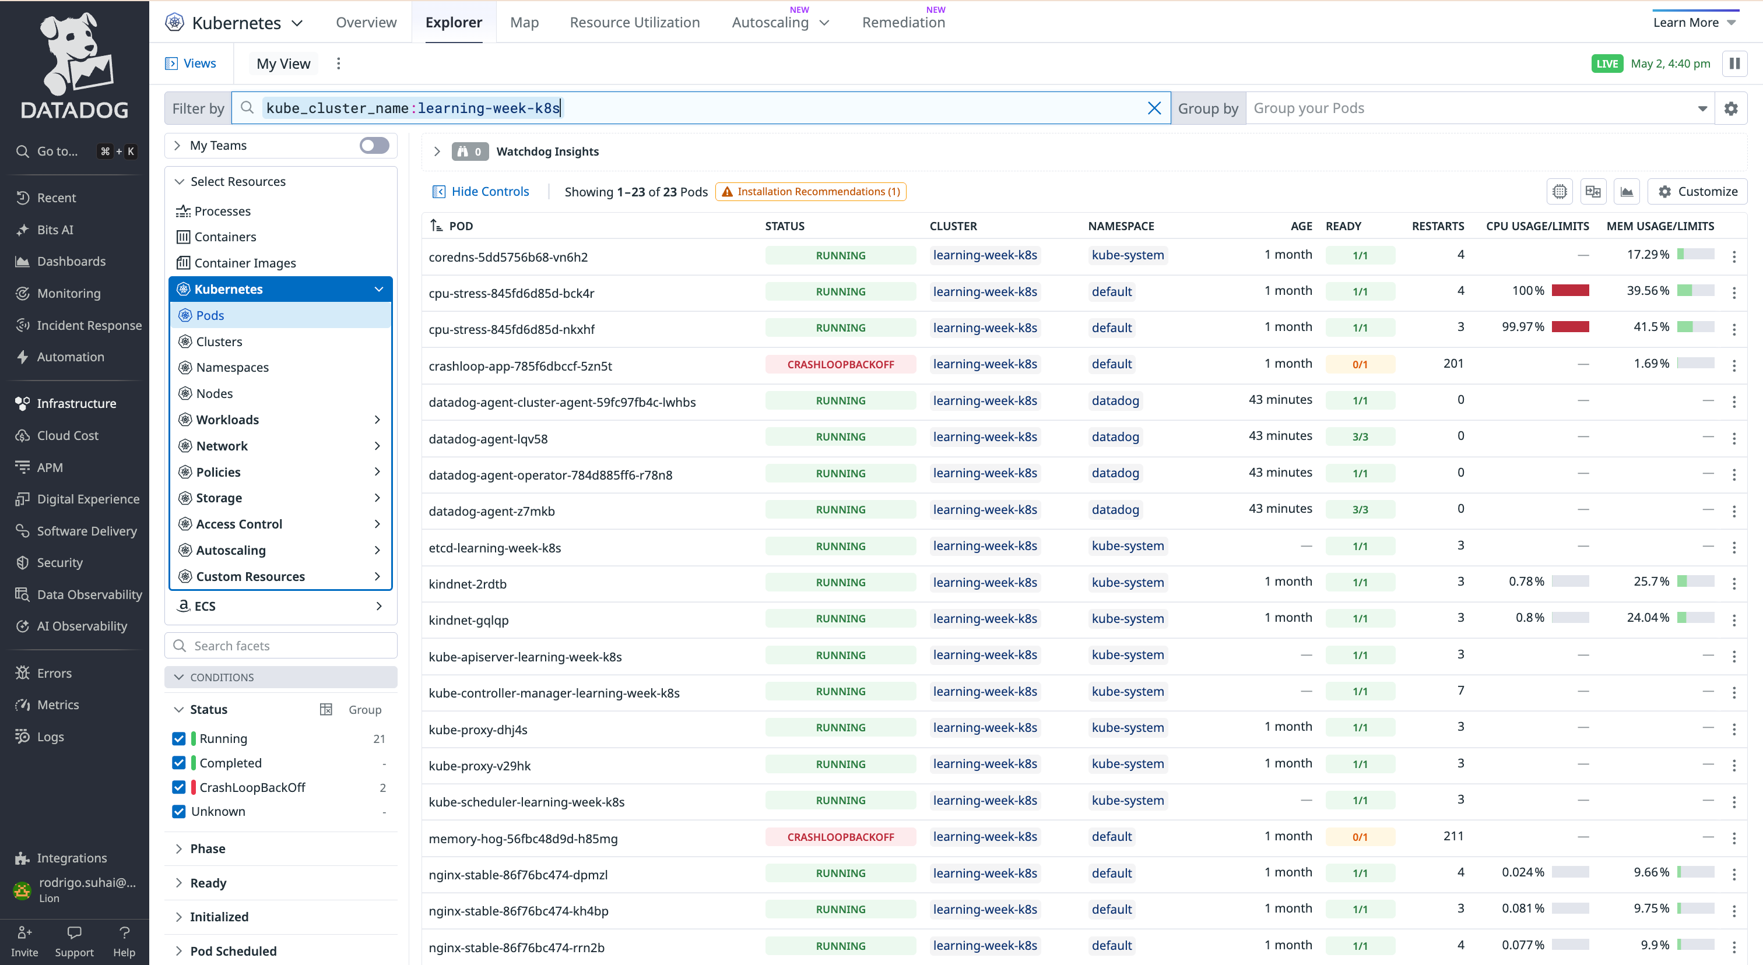
Make the cluster visible

Slide 33
Average by cluster is usually not a diagnosis
Better monitor instinct
Group by kube_deployment when deployment owners take action.
Use pod_name only when the pod identity matters.
Avoid group-bys that create alert storms.
The trap
One deployment is hot.
Another is tiny.
The cluster average says almost nothing useful.
Metric
Aggregator
Group
Threshold
>
>
>
raw signal
time + space
owner
action

Slide 34
Cumulative counters need recent change
The query move
Use change() for recent restarts.
Use static gauges directly only when the value itself is actionable.
Ask: is this number a state, a count, or a rate?
The trap
Restart counters only go up.
A raw threshold can stay ALERT after the incident is over.
raw signal
10m avg

Slide 35
Silent monitors are worse than noisy ones
Better monitor instinct
Compare desired vs ready when health is the question.
Be careful with require_full_window on sparse metrics.
Treat missing data as part of monitor design.
Two quiet failures
Pod count can look OK while a deployment is unhealthy.
Require full window can skip sparse or crashy series.
Metric
Aggregator
Group
Threshold
>
>
>
raw signal
time + space
owner
action
Related cases: #2517536

Slide 36
Lab missions
Day 2 lab: Kubernetes monitor traps
01
CPU Limits - Cluster Average
The rule
Bring evidence, one rejected hypothesis, and two possible fixes.
The slide gives the case and the question.
The final answer stays for the live discussion.
Which workload is hidden by the cluster average?
02
Pod Restart Alert
Did restarts happen recently, or only sometime in the past?
03
Memory Limits - Watching Changes
Is the metric changing, or is the query forcing it to look dynamic?
04
Pod Count - Static Check
Which number represents healthy capacity versus actual readiness?
05
CrashLoop Silent Monitor
Why can a broken pod stay silent during monitor evaluation?

Slide 37
Day 2 takeaway: group by the thing someone can fix.

Slide 38
DAY 3
DBM: The Silent Database Killer
A database can be burning because of growth, spikes, or one query hidden inside an average.

Slide 39
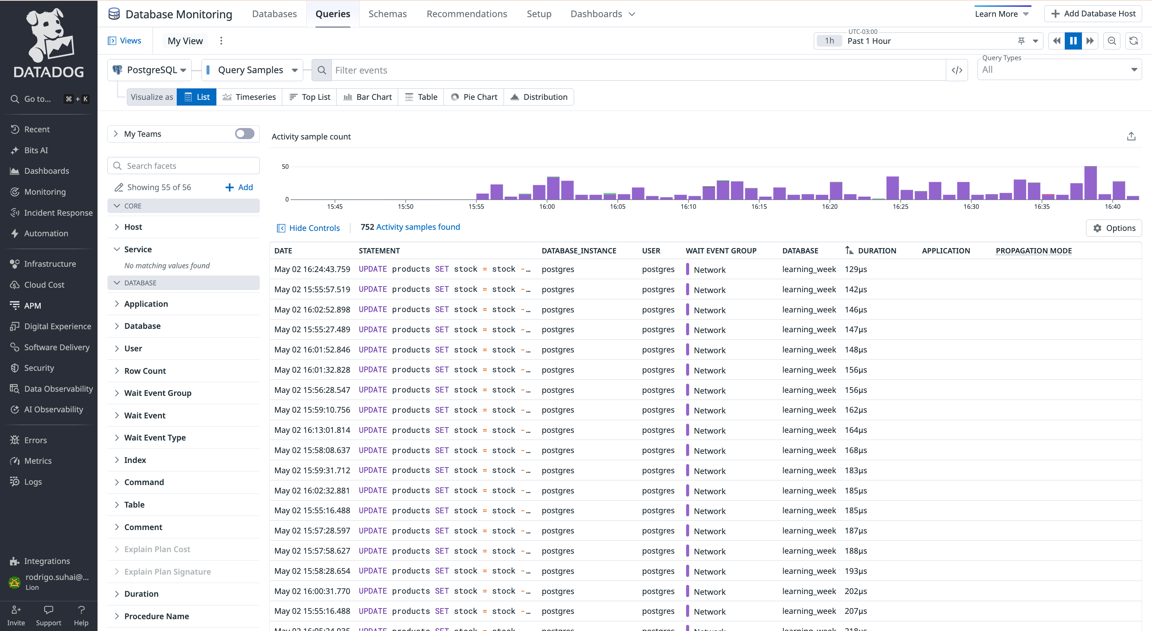
Show the query, not just the host

Slide 40
Thresholds need context
Better monitor instinct
Monitor growth, percent change, or sudden movement.
Segment by db so the alert names the database.
Use static thresholds only when the absolute value means action.
The trap
database_size > 1MB is always true.
An always-red monitor stops being a signal.
raw signal
10m avg

Slide 41
Spikes matter in databases too
Better monitor instinct
Use max when saturation is the failure mode.
Group by state to explain connection pool behavior.
Use DBM samples for query-level investigation.
Same pattern as Day 1
avg sessions can hide connection floods.
The peak is the risk when capacity is finite.
raw signal
10m avg

Slide 42
The alert message is part of the fix
Good page
Name current value and threshold.
Show likely impact and state.
Give the first query or dashboard to check.
Bad page
Too many connections!
@slack-dba
No value, no state, no next step.
Metric
Aggregator
Group
Threshold
>
>
>
raw signal
time + space
owner
action

Slide 43
Lab missions
Day 3 lab: DBM monitor traps
01
DB Size - Always Alerting
The rule
Bring evidence, one rejected hypothesis, and two possible fixes.
The slide gives the case and the question.
The final answer stays for the live discussion.
Is size itself the problem, or the way it is changing?
02
DB Session Spikes
Are short database bursts visible in the monitor view?
03
DB Row Volume
Which database or workload owns the volume?
04
DB Connections
Would this page tell a DBA what to check first?

Slide 44
Day 3 takeaway: if the monitor wakes someone up, the message should already start the investigation.

Slide 45
DAY 4
Logs: The Log Flood
Log monitors fail when the query is too broad, the grouping is too granular, or the notification never stops.

Slide 46
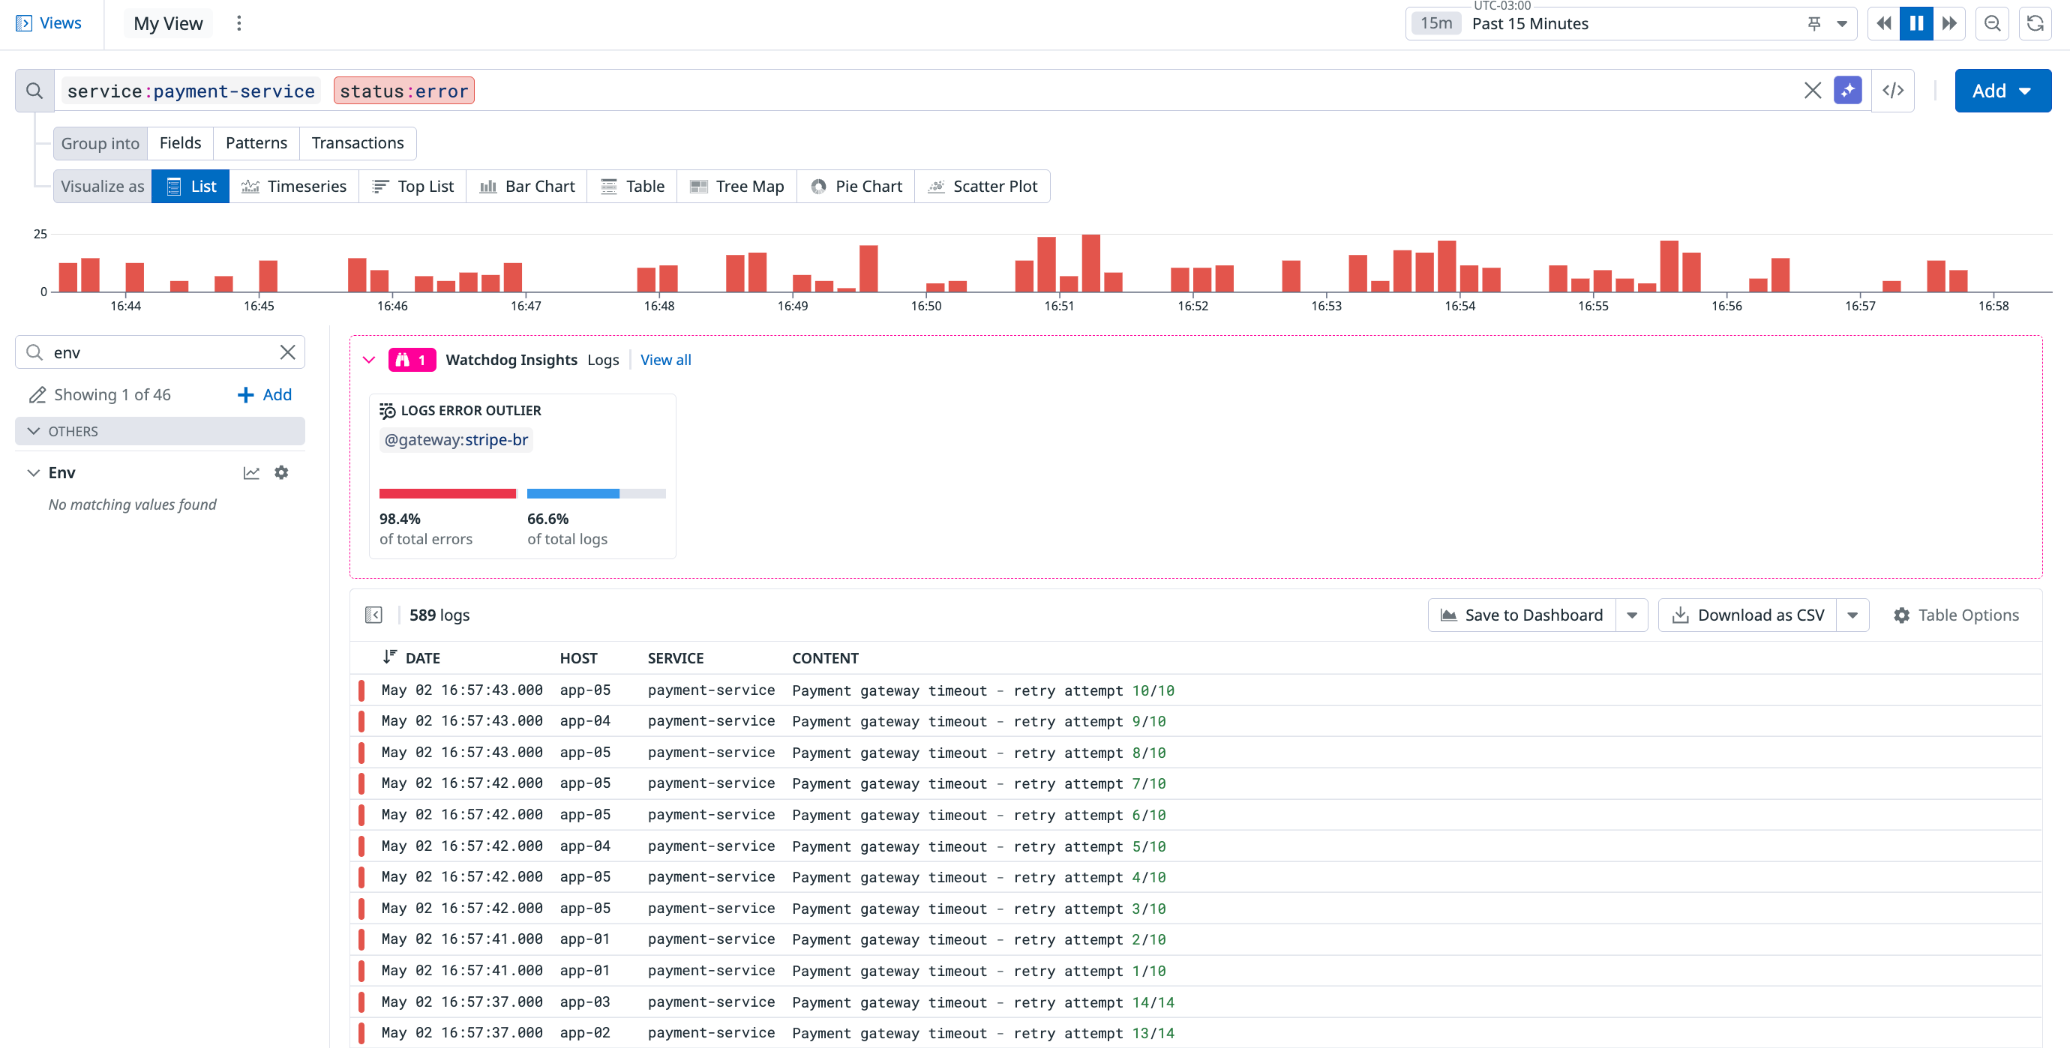
Show precision before alerting
Related cases: #2868302 · #2529585

Slide 47
Text search is not an alert strategy
Better monitor instinct
Use facets: status:error, service, env, region.
Keep the query narrow enough to represent one failure mode.
Use examples from Log Explorer before creating the monitor.
The trap
logs("error") catches wording, not meaning.
It can mix real errors with harmless text.
Metric
Aggregator
Group
Threshold
>
>
>
raw signal
time + space
owner
action
Related cases: #2868302

Slide 48
Group-by is a volume knob
Better monitor instinct
Group by the dimension that changes ownership.
Keep extra dimensions in the message or dashboard.
Use multi-alert only when each group needs separate action.
The trap
host + service + region + level can create dozens of pages.
More context is not always more signal.
Metric
Aggregator
Group
Threshold
>
>
>
raw signal
time + space
owner
action
Related cases: #2545635 · #2509862

Slide 49
Renotify should match urgency
Better monitor instinct
Page only actionable critical conditions.
Send recovery so people know the incident ended.
Use renotify for sustained impact, not every noisy blip.
The trap
Every repeat notification teaches people to ignore the monitor.
Escalation is not the same as spamming.
raw signal
10m avg
Related cases: #2868302

Slide 50
Lab missions
Day 4 lab: log monitor traps
01
Catches Everything
The rule
Bring evidence, one rejected hypothesis, and two possible fixes.
The slide gives the case and the question.
The final answer stays for the live discussion.
Which query proves this is one failure mode, not every error?
02
Alert Storm
Which dimensions create ownership, and which create alert spam?
03
Inbox Flood
Who needs the page, and when should it repeat?
04
Static Count
Does a static count describe this service's normal pattern?

Slide 51
Day 4 takeaway: a log alert should point to one failure mode, not the entire log stream.

Slide 52
DAY 5
Dynamic Challenge: Custom Metrics
Participants switch roles and prove they can investigate, fix, and communicate.

Slide 53
Day 5 is not another lecture
What success looks like
Ask clarifying questions.
Use segmented metrics to find the hidden issue.
Fix or replace the monitor.
Explain it without dumping query syntax on the customer.
Format
Half the room plays customer.
Half the room plays support.
Then they switch.
Customer
Support
Data
Monitor
>
>
>
vague ticket
questions
segmented
fixed

Slide 54
DAY 5 HARD MODE
Challenge cards make the case less linear
Use one when a group reaches a fix too quickly.
TAG
TIME
WINDOW
Missing tag
Late data
Sparse metric
Expected tag is absent or inconsistent.
The graph changes when the window moves back.
Require Full Window would skip evaluation.
MATH
GROUP
PUSHBACK
Wrong statistic
Noisy group-by
Customer pushback
Average looks fine; max or p95 shows pain.
The first fix creates too many alert groups.
Monitor fired, but dashboard looked normal.
DATADOG

Slide 55
DogStatsD type changes the truth
Why learners need this
Failed payments sent as the wrong type can look impossibly low.
Latency as histogram gives avg/p95/max views.
Counts usually need .as_count() or .as_rate() in monitors.
The trap
Gauge keeps the last value.
Count sums events.
Histogram preserves distribution summaries.
Metric
Aggregator
Group
Threshold
>
>
>
raw signal
time + space
owner
action

Slide 56
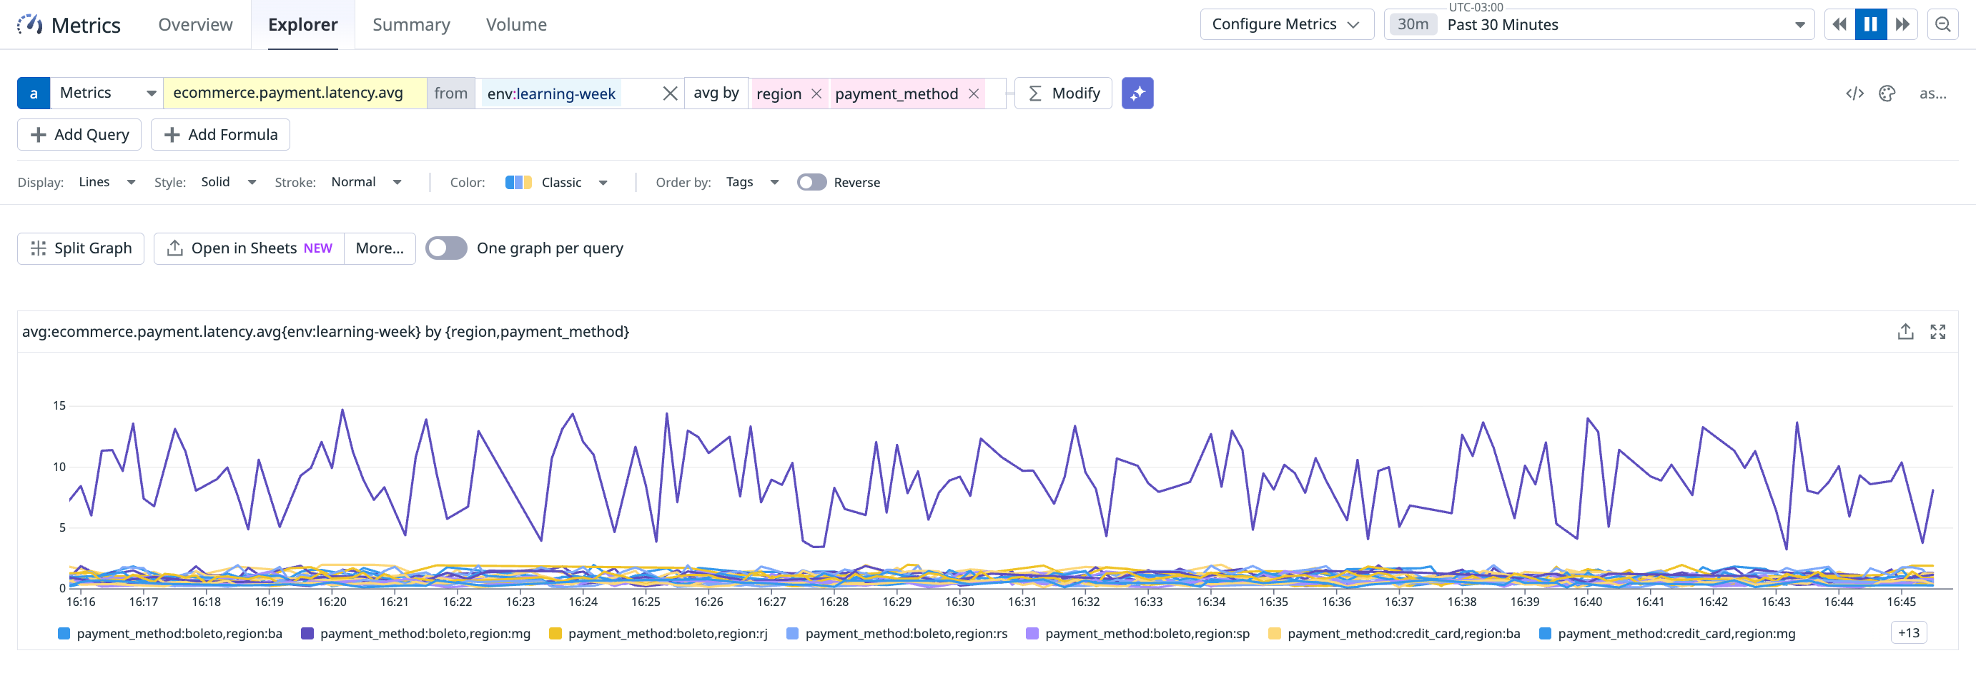
Lab A: Online Store

Slide 57
E-commerce investigation prompts
Signals to inspect
ecommerce.payment.latency.*
ecommerce.orders.count
ecommerce.cart.abandonment
ecommerce.failed_payments
Learner job
Start from vague customer tickets.
Build hypotheses before changing the monitor.
Prove or reject each hypothesis in Metrics Explorer.
Metric
Aggregator
Group
Threshold
>
>
>
raw signal
time + space
owner
action

Slide 58
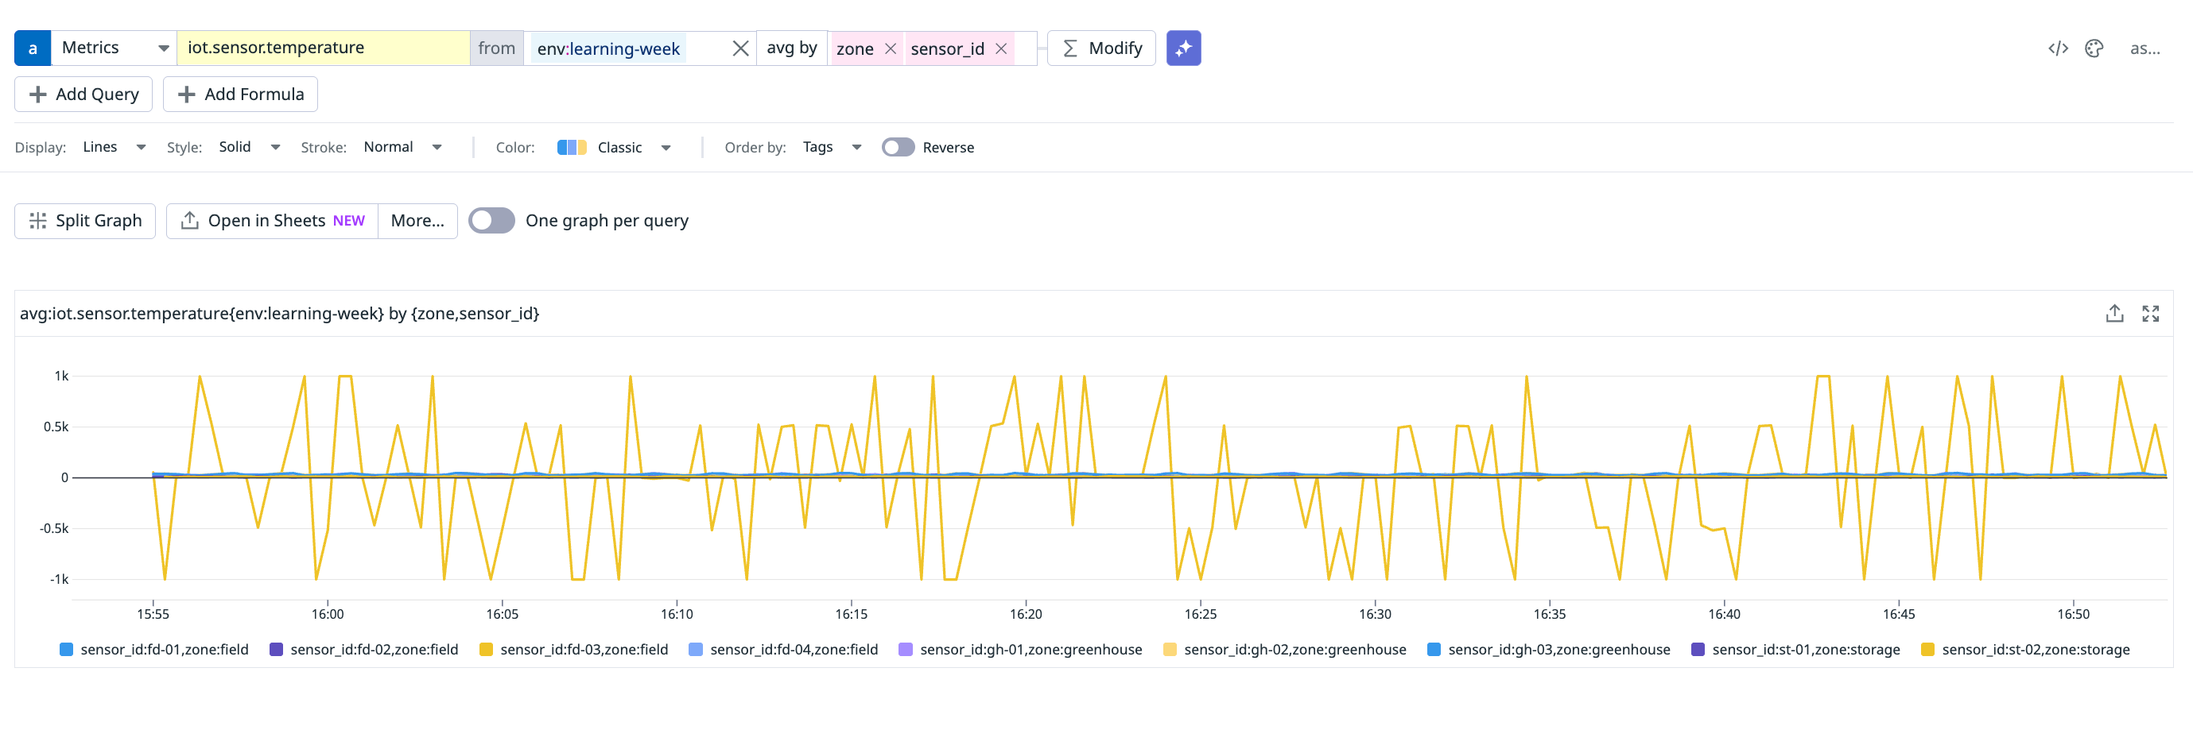
Lab B: Farm IoT Sensors

Slide 59
IoT investigation prompts
Signals to inspect
temperature by zone and sensor_id
battery level by sensor_id
reading frequency and missing data
one sensor versus peer baseline
Learner job
Start from symptoms, not monitor types.
Compare each sensor against its peer group.
Choose alert behavior only after the signal is proven.
raw signal
10m avg

Slide 60
The final tribunal
Score the work
Evidence: did they prove it?
Alternatives: did they compare fixes?
Noise: will it avoid false positives?
Detection: will it fire soon enough?
Clarity: can the receiver act?
Each group presents
The original vague ticket.
Evidence that proves the failure mode.
One rejected hypothesis.
Two possible fixes and the chosen trade-off.
The customer-ready explanation.
Customer
Support
Evidence
Trade-off
>
>
>
vague ticket
questions
proven
defended

Slide 61
The six rules TSEs should remember
final mental model
Prove the metric is trustworthy before tuning the monitor.
2. Pick the statistic that matches user pain.
3. Segment by the thing someone can fix.
4. Treat counters, gauges, histograms, and distributions differently.
5. Tune noise before you add routing.
6. Bring evidence, alternatives, and a useful 3 AM message.

Slide 62
A good Metrics and Monitors TSE can explain the signal, prove the query, and turn the alert into action.

