Slide 1
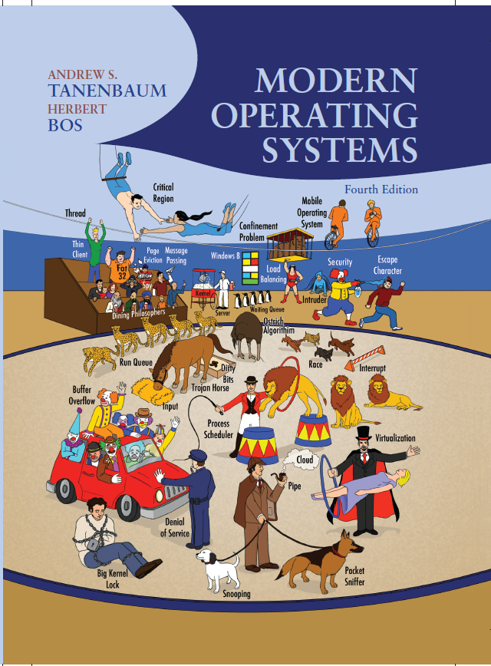
Modern Operating Systems
Fourth Edition
Chapter 1
Introduction
Copyright © 2014 Pearson Education, Inc. All Rights Reserved
Notes:
If this PowerPoint presentation contains mathematical equations, you may need to check that your computer has the following installed:
1) MathType Plugin
2) Math Player (free versions available)
3) NVDA Reader (free versions available)

Slide 2
Components of a Modern Computer (1 of 2)
One or more processors
Main memory
Disks
Printers
Keyboard
Mouse
Display
Network interfaces
I/O devices

Slide 3
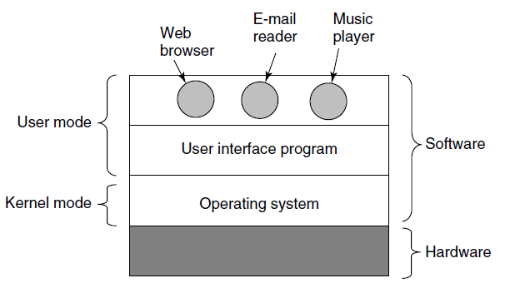
Components of a Modern Computer (2 of 2)
Figure 1-1. Where the operating system fits in.

Slide 4
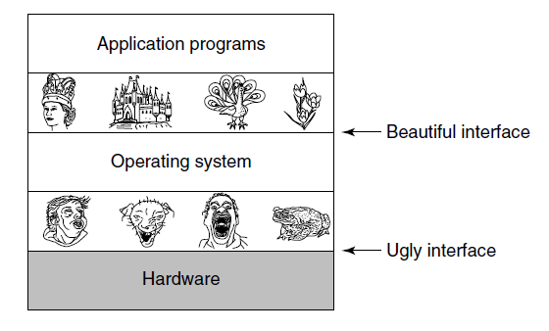
The Operating System as an Extended Machine
Figure 1-2. Operating systems turn ugly hardware into beautiful abstractions.

Slide 5
The Operating System as a Resource Manager
Top down view
Provide abstractions to application programs
Bottom up view
Manage pieces of complex system
Alternative view
Provide orderly, controlled allocation of resources

Slide 6
History of Operating Systems
The first generation (1945-55) vacuum tubes
The second generation (1955-65) transistors and batch systems
The third generation (1965-1980) I Cs and multiprogramming
The fourth generation (1980-present) personal computers
The fifth generation (1990-present) mobile computers

Slide 7
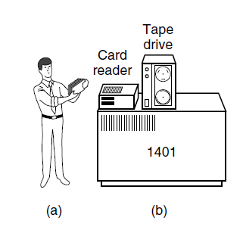
Transistors and Batch Systems (1 of 3)
Figure 1-3. An early batch system. (a) Programmers bring cards to 1401. (b) 1401 reads batch of jobs onto tape.

Slide 8
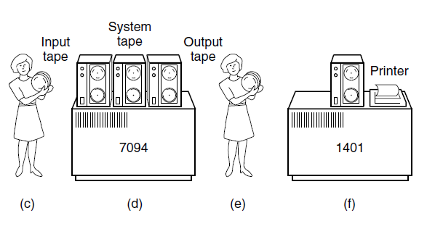
Transistors and Batch Systems (2 of 3)
Figure 1-3. An early batch system. (c) Operator carries input tape to 7094. (d)7094 does computing. (e) Operator carries output tape to 1401. (f) 1401 prints output.

Slide 9
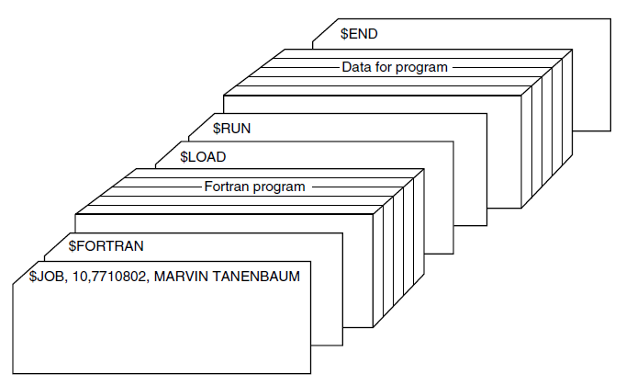
Transistors and Batch Systems (3 of 3)
Figure 1-4. Structure of a typical F M S job.

Slide 10
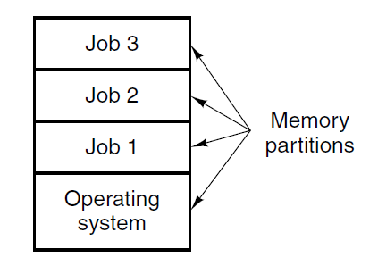
I Cs and Multiprogramming
Figure 1-5. A multiprogramming system with three jobs in memory.

Slide 11
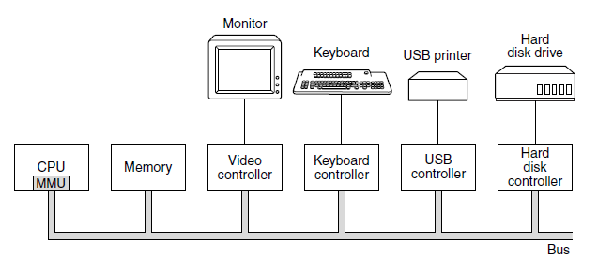
Processors (1 of 2)
Figure 1-6. Some of the components of a simple personal computer.

Slide 12
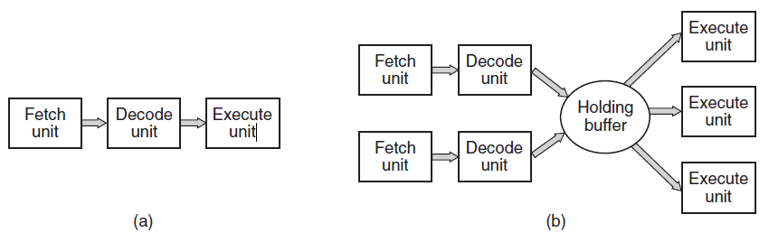
Processors (2 of 2)
Figure 1-7. (a) A three-stage pipeline. (b) A superscalar C P U.

Slide 13
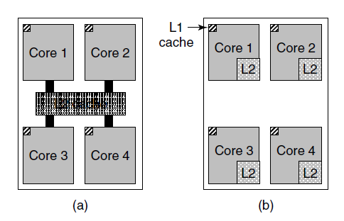
Memory (1 of 3)
Figure 1-8. (a) A quad-core chip with a shared L2 cache. (b) A quad-core chip with separate L2 caches.

Slide 14
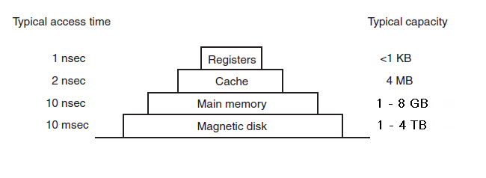
Memory (2 of 3)
Figure 1-9. A typical memory hierarchy. The numbers are very rough approximations.

Slide 15
Memory (3 of 3)
Caching system issues:
When to put a new item into the cache.
Which cache line to put the new item in.
Which item to remove from the cache when a slot is needed.
Where to put a newly evicted item in the larger memory.

Slide 16
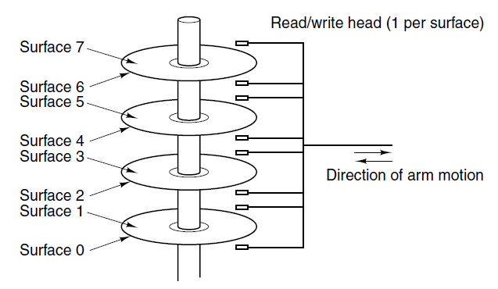
Disks
Figure 1-10. Structure of a disk drive.

Slide 17
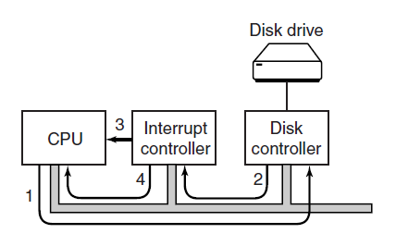
I/O Devices (1 of 2)
Figure 1-11. (a) The steps in starting an I/O device and getting an interrupt.

Slide 18
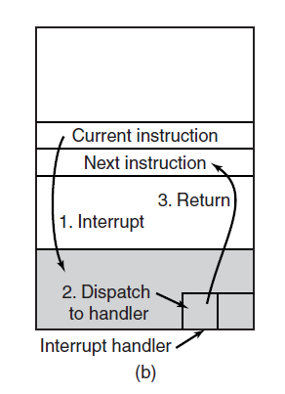
I/O Devices (2 of 2)
Figure 1-11. (b) Interrupt processing involves taking the interrupt, running the interrupt handler, and returning to the user program.

Slide 19
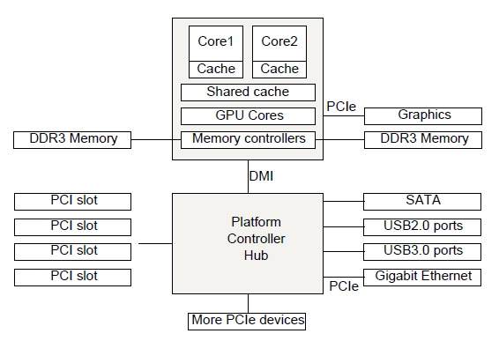
Buses
Figure 1-12. The structure of a large x86 system

Slide 20
The Operating System Zoo
Mainframe Operating Systems
Server Operating Systems
Multiprocessor Operating Systems
Personal Computer Operating Systems
Handheld Computer Operating Systems
Embedded Operating Systems
Sensor Node Operating Systems
Real-Time Operating Systems
Smart Card Operating Systems

Slide 21
Processes (1 of 2)
Key concept in all operating systems
Definition: a program in execution
Process is associated with an address space
Also associated with set of resources
Process can be thought of as a container
Holds all information needed to run program

Slide 22
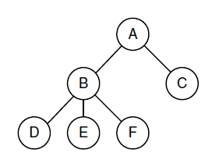
Processes (2 of 2)
Figure 1-13. A process tree. Process A created two child processes, B and C. Process B created three child processes, D, E, and F.

Slide 23
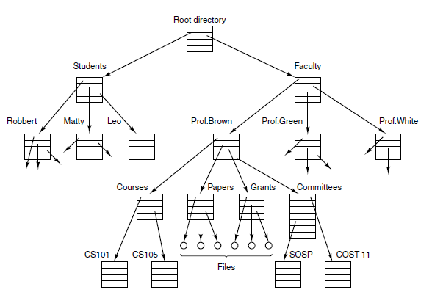
Files (1 of 3)
Figure 1-14. A file system for a university department.

Slide 24
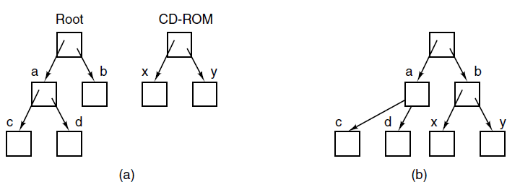
Files (2 of 3)
Figure 1-15. (a) Before mounting, the files on the C D-R O M are not accessible. (b) After mounting, they are part of the file hierarchy.

Slide 25
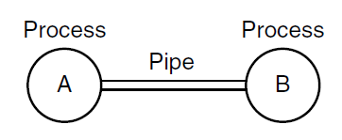
Files (3 of 3)
Figure 1-16. Two processes connected by a pipe.

Slide 26
Ontogeny Recapitulates Phylogeny
Each new “species” of computer
Goes through same development as “ancestors”
Consequence of impermanence
Text often looks at “obsolete” concepts
Changes in technology may bring them back
Happens with large memory, protection hardware, disks, virtual memory

Slide 27
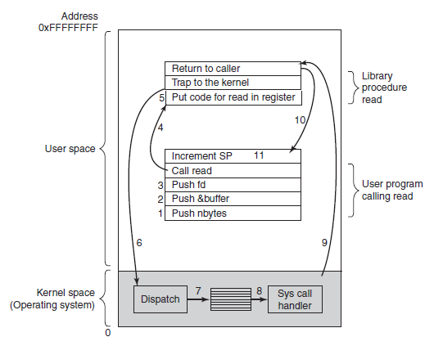
System Calls (1 of 5)
Figure 1-17. The 11 steps in making the system call read(fd, buffer, nbytes).

Slide 28
System Calls (2 of 5)
Some of the major POSIX system calls. The return code s is −1 if an error has occurred. The return codes are as follows: pid is a process id, fd is a file descriptor, n is a byte count, position is an offset within the file, and seconds is the elapsed time.
Process Management
Call | Description
p i d fork( ) | Create a child process identical to the parent
p i d waitp i d( pid, &statloc, options) | Wait for a child to terminate
s execve(name, argv, environp) | Replace a process' core image
exit(status) | Terminate process execution and return status

Slide 29
System Calls (3 of 5)
Some of the major P O S I X system calls. The return code s is −1 if an error has occurred. The return codes are as follows: p i d is a process id, fd is a file descriptor, n is a byte count, position is an offset within the file, and seconds is the elapsed time.
File Management
Call | Description
fd open(file, how, ...) | Open a file for reading, writing, or both
s = close(fd) | Close an open file
n = read(fd, buffer, nbytes) | Read data from a file into a buffer
n = write(fd, buffer, nbytes) | Write data from a buffer into a file
Position = Iseek(fd, offset, whence) | Move the file pointer
s = stat(name, &buf) | Get a file's status information

Slide 30
System Calls (4 of 5)
Some of the major P O S I X system calls. The return code s is −1 if an error has occurred. The return codes are as follows: pid is a process id, fd is a file descriptor, n is a byte count, position is an offset within the file, and seconds is the elapsed time.
Directory and file system management
Call | Description
s = mkdir(name, mode) | Open a file for reading, writing, or both
s= rmdir(name) | Close an open file
s= link(name1 , name2) | Read data from a file into a buffer
s= unlink(name) | Write data from a buffer into a file
s= mount(special, name, flag) | Move the file pointer
s= umount(special) | Get a file's status information

Slide 31
System Calls (5 of 5)
Some of the major P O S I X system calls. The return code s is −1 if an error has occurred. The return codes are as follows: pid is a process id, fd is a file descriptor, n is a byte count, position is an offset within the file, and seconds is the elapsed time.
Miscellaneous
Call | Description
s = chdir(dirname) | Change the working directory
s= chmod(name,mode) | Change a file's protection bits
s= kill(pid,signal) | Send a signal to a process
s= time(&seconds) | Get the elapsed time since Jan. 1, 1970

Slide 32
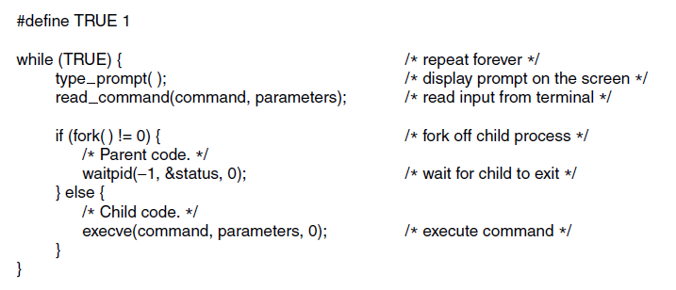
System Calls for Process Management
Figure 1-19. A stripped-down shell. Throughout this book, TRUE is assumed to be defined as 1.

Slide 33
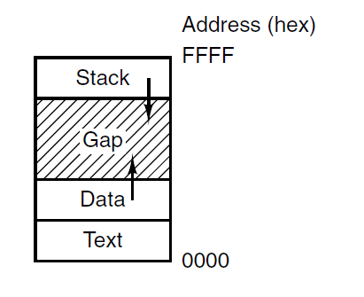
System Calls for File Management
Figure 1-20. Processes have three segments: text, data, and stacks

Slide 34
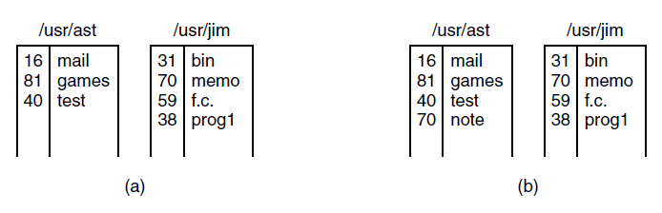
System Calls for Directory Management (1 of 2)
Figure 1-21. (a) Two directories before linking usr/jim/memo to ast’s directory. (b) The same directories after linking.s

Slide 35
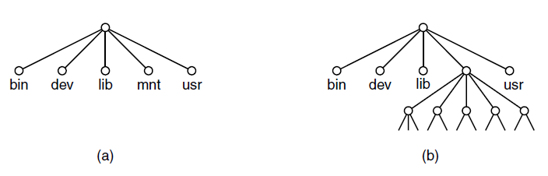
System Calls for Directory Management (2 of 2)
Figure 1-22. (a) File system before the mount. (b) File system after the mount.

Slide 36
The Windows Win32 A P I (1 of 2)
The Win32 A P I calls that roughly correspond to the U N I X calls of Fig. 1-18.
UNIX | Win32 | Description
fork | CreateProcess | Create a new process
waitpid | WaitForSingIeObject | Can wait for a process to exit
execve | (none) | Createprocess fork + execve
exit | ExitProcess | Terminate execution
open | createFile | Create a file or open an existing file
close | CloseHandIe | Close a file
read | ReadFile | Read data from a tile
Write | WriteFile | Write data to a file
I seek | SetFilePointer | Move the file pointer
stat | GetFileAttributesEx | Get various file attributes
mkdir | CreateDirectory | Create a new directory

Slide 37
The Windows Win32 A P I (2 of 2)
The Win32 A P I calls that roughly correspond to the U N I X calls of Fig. 1-18.
Iseek | SetFilePointer | Move the tile pointer
stat | GetFileAttributesEx | Get various file attributes
mkdir | CreateDirectory | Remove an empty directory
rmdjr | RemoveDjrectory | Create a new directory
link | (none) | Win32 does not support links
unlink | DeleteFile | Win32 does not support mount
mount | (none) | Win32 does not support mount
umount | (none) | Destroy an existing file
chdir | SetCurrentDirectory | Change the current working directory
chmod | (none) | Win32 does not support security (although NT does)
kill | (none) | Win32 does not support signals
time | GetLocamme | Get the current time

Slide 38
Monolithic Systems (1 of 2)
Basic structure of O S
A main program that invokes the requested service procedure.
A set of service procedures that carry out the system calls.
A set of utility procedures that help the service procedures.

Slide 39
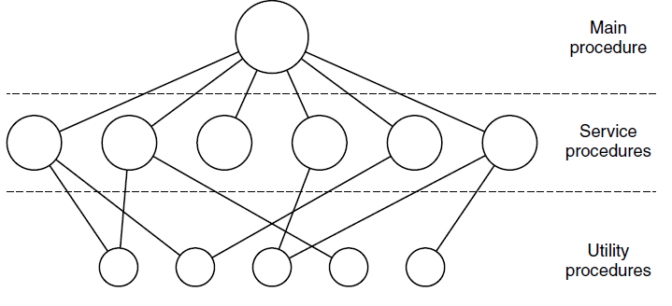
Monolithic Systems (2 of 2)
Figure 1-24. A simple structuring model for a monolithic system.

Slide 40
Layered Systems
Structure of the THE operating system.
Layer | Function
5 | The operator
4 | User programs
3 | Input/output management
2 | Operator-process communication
1 | Memory and drum management
0 | Processor allocation and multiprogramming

Slide 41
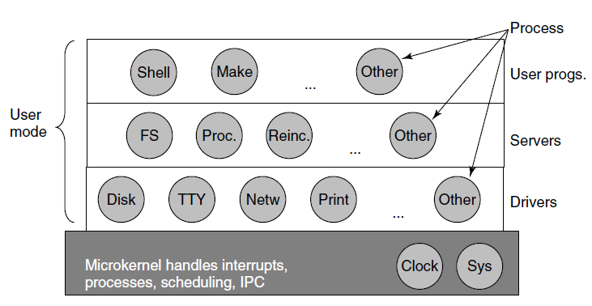
Microkernels
Figure 1-26. Simplified structure of the M I N I X 3 system.

Slide 42
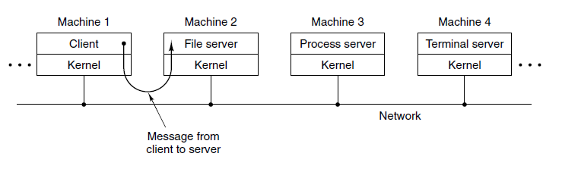
Client-Server Model
Figure 1-27. The client-server model over a network.

Slide 43
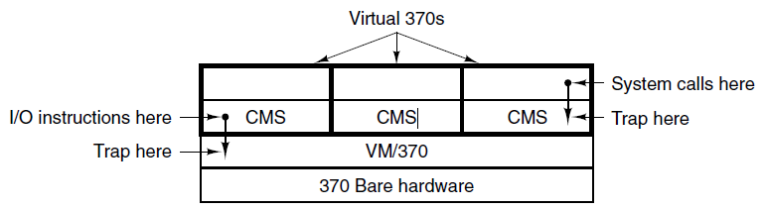
Virtual Machines
Figure 1-28. The structure of V M/370 with C M S.

Slide 44
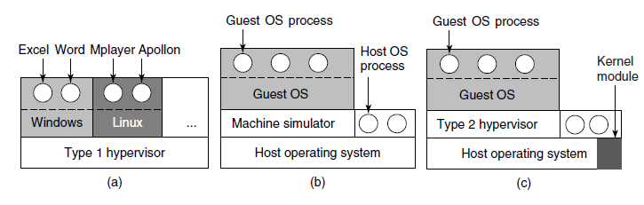
Virtual Machines Rediscovered
Figure 1-29. (a) A type 1 hypervisor. (b) A pure type 2 hypervisor. (c) A practical type 2 hypervisor.

Slide 45
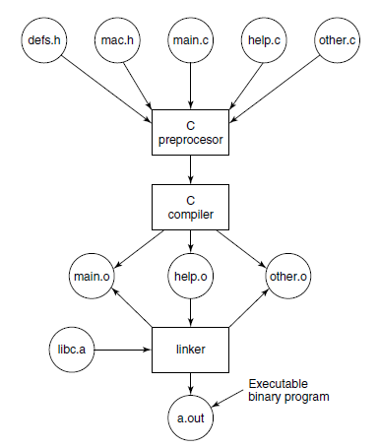
Large Programming Projects
Figure 1-30. The process of compiling C and header files to make an executable.

Slide 46
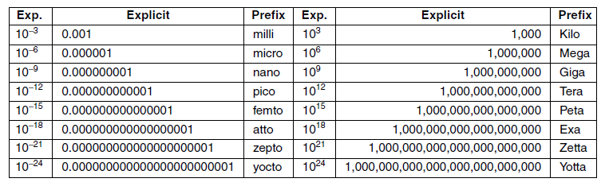
Metric Units
Figure 1-31. The principal metric prefixes.

Slide 47
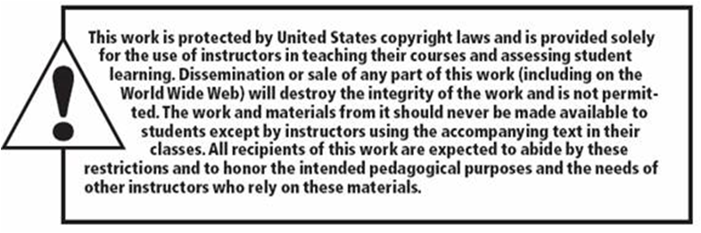
Copyright

