Slide 1

Modern Operating Systems
Fourth Edition
Chapter 4
File Systems
Copyright © 2014 Pearson Education, Inc. All Rights Reserved
Notes:
If this PowerPoint presentation contains mathematical equations, you may need to check that your computer has the following installed:
1) MathType Plugin
2) Math Player (free versions available)
3) NVDA Reader (free versions available)

Slide 2
File Systems (1 of 3)
Essential requirements for long-term information storage:
It must be possible to store a very large amount of information.
Information must survive termination of process using it.
Multiple processes must be able to access information concurrently.

Slide 3
File Systems (2 of 3)
Think of a disk as a linear sequence of fixed-size blocks and supporting two operations:
Read block k.
Write block k

Slide 4
File Systems (3 of 3)
Questions that quickly arise:
How do you find information?
How do you keep one user from reading another user’s data?
How do you know which blocks are free?

Slide 5
File Naming
Some typical file extensions.
Extension | Meaning
.b a k | Backup file
.c | C source program
.g i f | Compuserve Graphical Interchange Format image
.h l p | Help file
.h t m l | World Wide Web HyperText Markup Language document
.j p g | Still picture encoded with the J P E G standard
.m p 3 | Music encoded in M P E G layer 3 audio format
.m p g | Movie encoded with the M P E G standard
.o | Object file (compiler output, not yet linked)
.p d f | Portable Document Format file
.p s | PostScript file
.t e x | Input for the T E X formatting program
.t x t | General text file
.z i p | Compressed archive

Slide 6
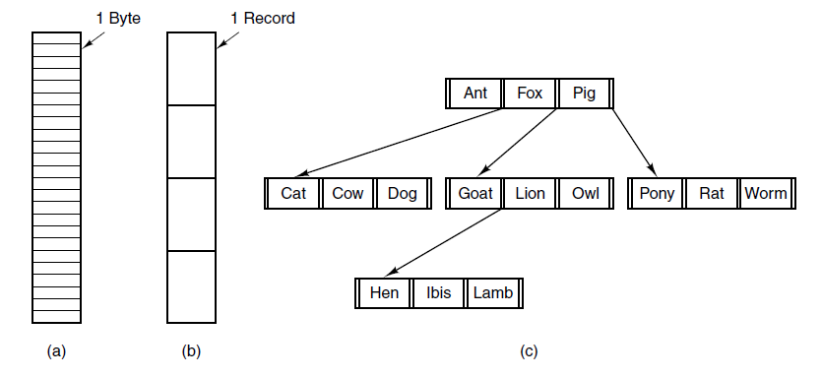
File Structure
Figure 4-2. Three kinds of files. (a) Byte sequence. (b) Record sequence. (c) Tree.

Slide 7
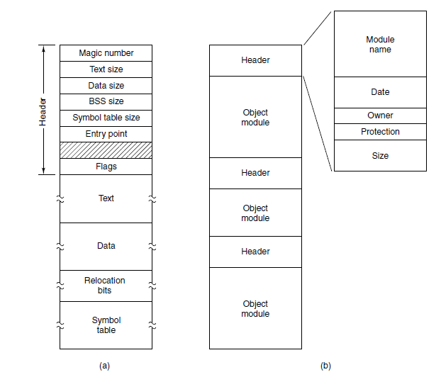
File Types
Figure 4-3. (a) An executable file. (b) An archive

Slide 8
File Attributes (1 of 2)
Some possible file attributes.
Attribute | Meaning
Protection | Who can access the file and in what way
Password | Password needed to access the file
Creator | I D of the person who created the file
Owner | Current owner
Read-only flag | 0 for read/write; 1 for read only
Hidden flag | 0 for normal; 1 for do not display in listings
System flag | 0 for normal files; 1 for system file
Archive flag | 0 for has been backed up; 1 for needs to be backed up
A S C I I/binary flag | 0 for A S C I I file; 1 for binary file
Random access flag | 0 for sequential access only; 1 for random access

Slide 9
File Attributes (2 of 2)
Some possible file attributes.
Attribute | Meaning
Temporary flag | 0 for normal; 1 for delete file on process exit
Lock flags | 0 for unlocked; nonzero for locked
Record length | Number of bytes in a record
Key position | Offset of the key within each record
Key length | Number of bytes in the key field
Creation time | Date and time the file was created
Time of last access | Date and time the file was last accessed
Time of last change | Date and time the file was last changed
Current size | Number of bytes in the file
Maximum size | Number of bytes the file may grow to

Slide 10
File Operations (1 of 2)
Create
Delete
Open
Close
Read
Write
Append
Seek

Slide 11
File Operations (2 of 2)
Get attributes
Set attributes
Rename

Slide 12
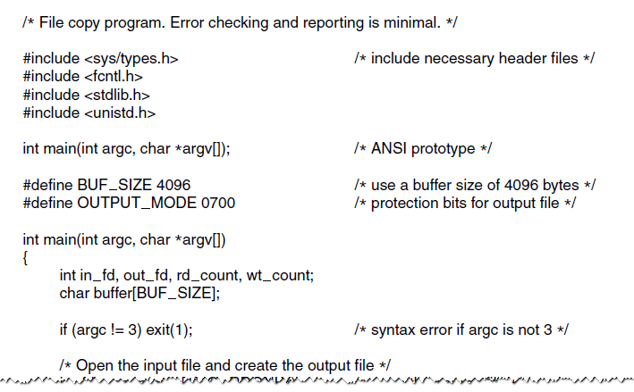
Example Program Using File System Calls (1 of 3)
Figure 4-5. A simple program to copy a file.

Slide 13
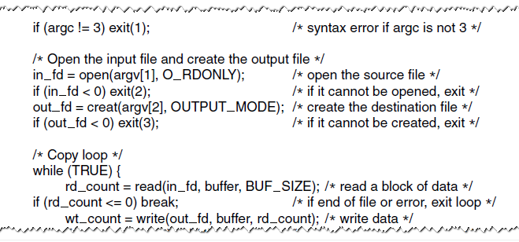
Example Program Using File System Calls (2 of 3)
Figure 4-5. A simple program to copy a file.

Slide 14
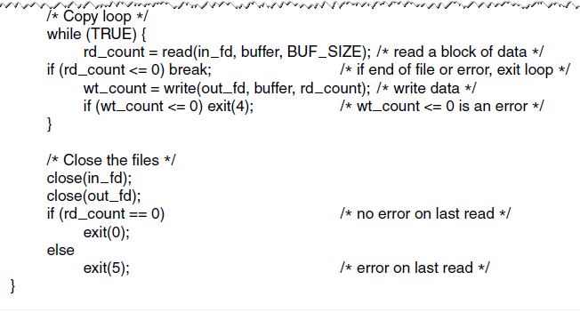
Example Program Using File System Calls (3 of 3)
Figure 4-5. A simple program to copy a file.

Slide 15
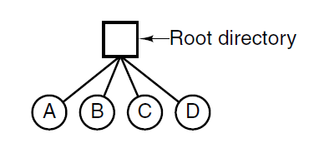
Single-Level Directory Systems
Figure 4-6. A single-level directory system containing four files.

Slide 16
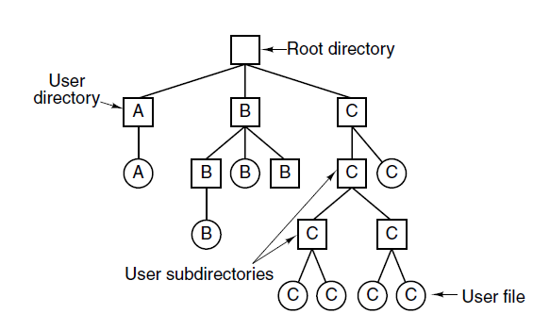
Hierarchical Directory Systems
Figure 4-7. A hierarchical directory system.

Slide 17
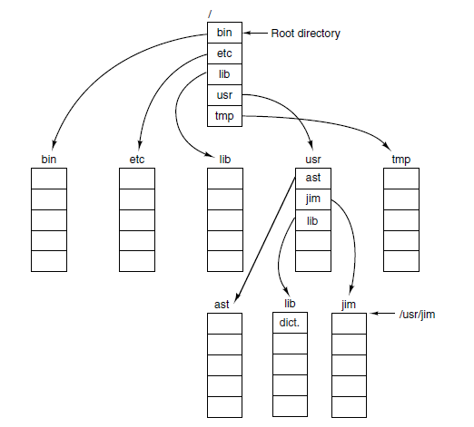
Path Names
Figure 4-8. A U N I X directory tree.

Slide 18
Directory Operations
Create
Delete
Opendir
Closedir
Readdir
Rename
Link
Unlink

Slide 19
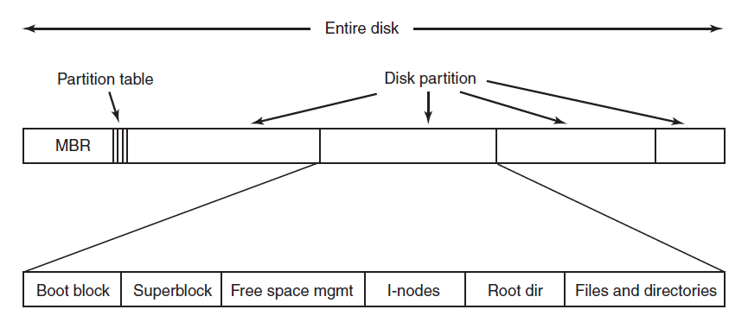
File System Layout
Figure 4-9. A possible file system layout.

Slide 20
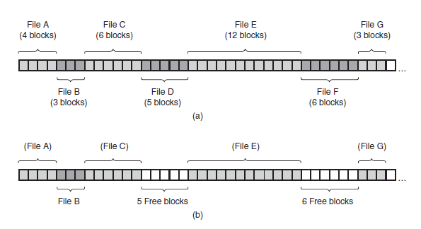
Implementing Files Contiguous Layout
Figure 4-10. (a) Contiguous allocation of disk space for seven files. (b) The state of the disk after files D and F have been removed.

Slide 21
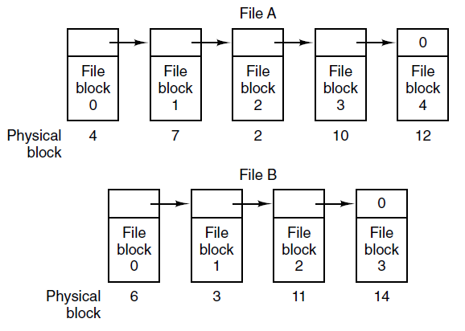
Implementing Files Linked List Allocation
Figure 4-11. Storing a file as a linked list of disk blocks.

Slide 22
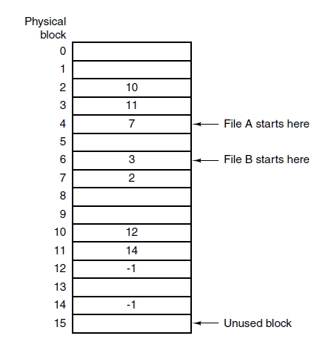
Implementing Files Linked List - Table in Memory
Figure 4-12. Linked list allocation using a file allocation table in main memory.

Slide 23
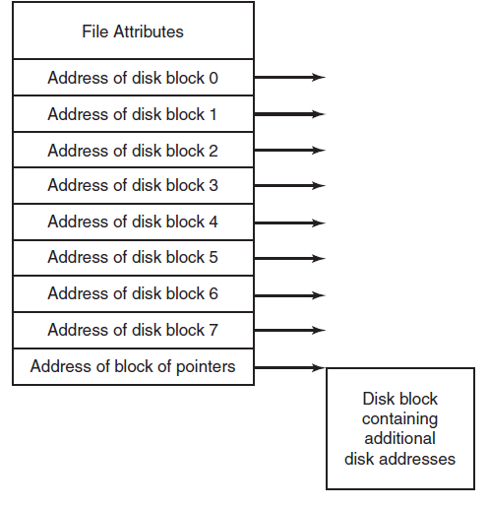
Implementing Files I-nodes
Figure 4-13. An example i-node.

Slide 24
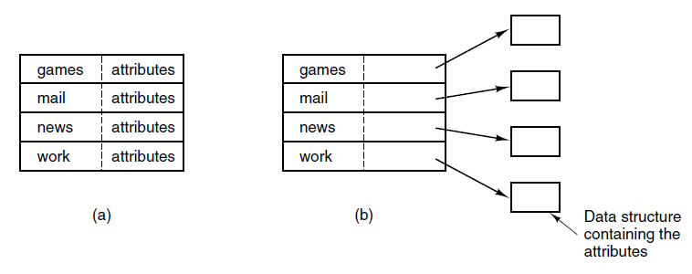
Implementing Directories (1 of 2)
Figure 4-14. (a) A simple directory containing fixed-size entries with the disk addresses and attributes in the directory entry. (b) A directory in which each entry just refers to an i-node.

Slide 25
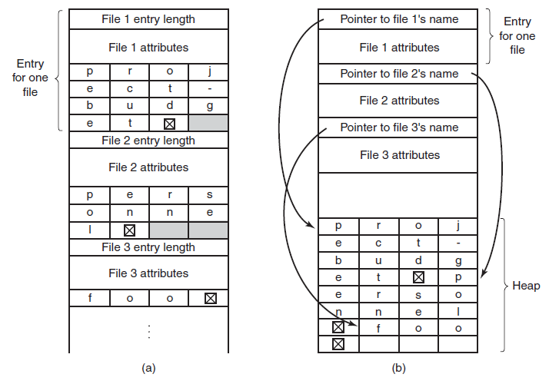
Implementing Directories (2 of 2)
Figure 4-15. Two ways of handling long file names in a directory. (a) In-line. (b) In a heap.

Slide 26
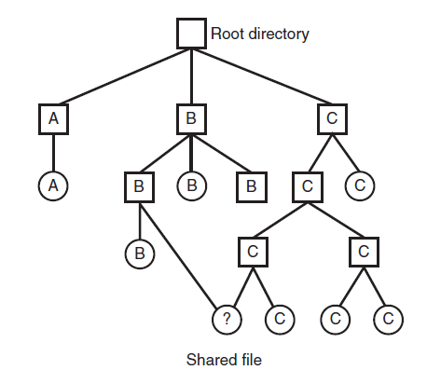
Shared Files (1 of 2)
Figure 4-16. File system containing a shared file.

Slide 27
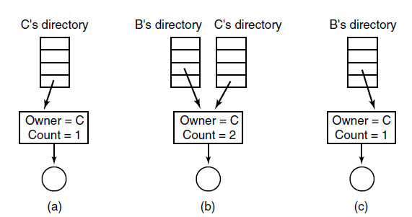
Shared Files (2 of 2)
Figure 4-17. (a) Situation prior to linking. (b) After the link is created. (c) After the original owner removes the file.

Slide 28
Journaling File Systems
Steps to remove a file in U N I X:
Remove file from its directory.
Release i-node to the pool of free i-nodes.
Return all disk blocks to pool of free disk blocks.

Slide 29
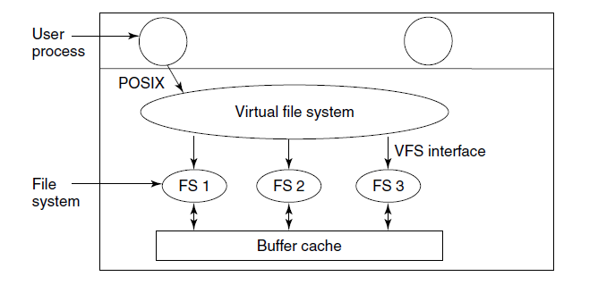
Virtual File Systems (1 of 2)
Figure 4-18. Position of the virtual file system.

Slide 30
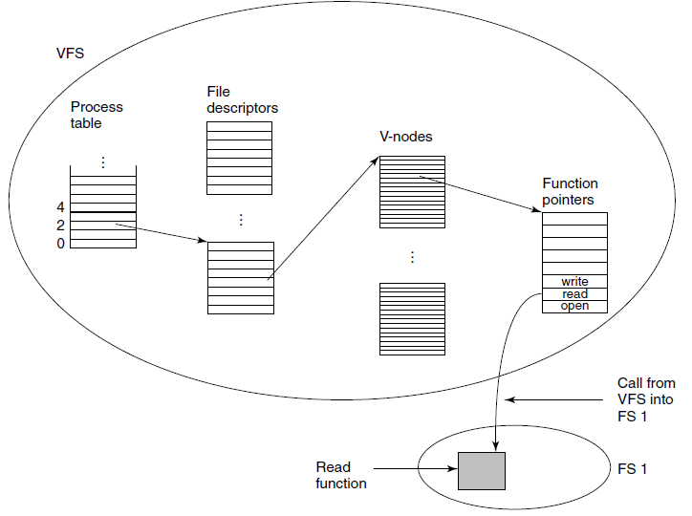
Virtual File Systems (2 of 2)
Figure 4-19. A simplified view of the data structures and code used by the V F S and concrete file system to do a read.

Slide 31
Disk Space Management (1 of 2)
Percentage of files smaller than a given size (in bytes).
Length | V U 1984 | V U 2005 | Web
1 | 1.79 | 1.38 | 6.67
2 | 1.88 | 1.53 | 7.67
4 | 2.01 | 1.65 | 8.33
8 | 2.31 | 1.80 | 11.30
16 | 3.32 | 2.15 | 11.46
32 | 5.13 | 3.15 | 12.33
64 | 8.71 | 4.98 | 26.10
128 | 14.73 | 8.03 | 28.49
256 | 23.09 | 13.29 | 32.10
512 | 34.44 | 20.62 | 39.94
1 K B | 48.05 | 30.91 | 47.82
2 K B | 60.87 | 46.09 | 59.44
4 K B | 75.31 | 59.13 | 70.64
8 K B | 84.97 | 69.96 | 79.69
Length | V U 1984 | V U 2005 | Web
16 K B | 92.53 | 78.92 | 86.79
32 K B | 97.21 | 85.87 | 91.65
64 K B | 99.18 | 90.84 | 94.80
128 K B | 99.84 | 93.73 | 96.93
256 K B | 99.96 | 96.12 | 98.48
512 K B | 100.00 | 97.73 | 98.99
1 M B | 100.00 | 98.87 | 99.62
2 M B | 100.00 | 99.44 | 99.80
4 M B | 100.00 | 99.71 | 99.87
8 M B | 100.00 | 99.86 | 99.94
16 M B | 100.00 | 99.94 | 99.97
32 M B | 100.00 | 99.97 | 99.99
64 M B | 100.00 | 99.99 | 99.99
128 M B | 100.00 | 99.99 | 100.00

Slide 32
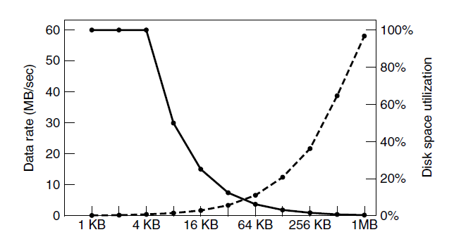
Disk Space Management (2 of 2)
Figure 4-21. The dashed curve (left-hand scale) gives the data rate of a disk. The solid curve (right-hand scale) gives the disk space efficiency. All files are 4 K B.

Slide 33
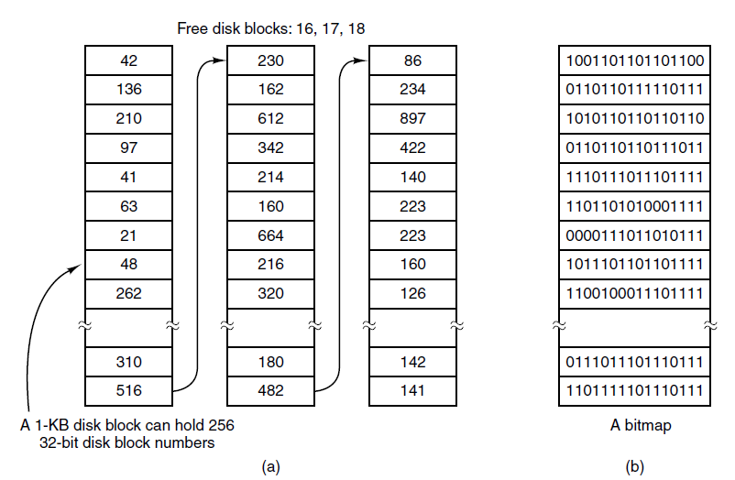
Keeping Track of Free Blocks (1 of 2)
Figure 4-22. (a) Storing the free list on a linked list. (b) A bitmap.

Slide 34
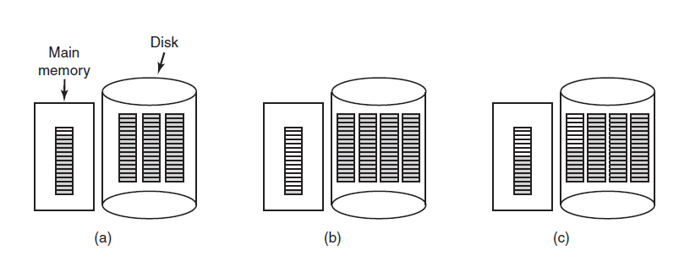
Keeping Track of Free Blocks (2 of 2)
Figure 4-23. (a) An almost-full block of pointers to free disk blocks in memory and three blocks of pointers on disk. (b) Result of freeing a three-block file. (c) An alternative strategy for handling the three free blocks. The shaded entries represent pointers to free disk blocks.

Slide 35
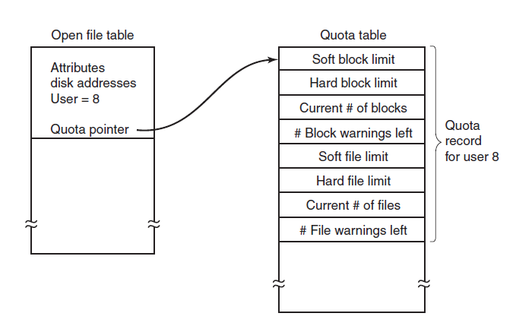
Disk Quotas
Figure 4-24. Quotas are kept track of on a per-user basis in a quota table.

Slide 36
File System Backups (1 of 3)
Backups to tape are generally made to handle one of two potential problems:
Recover from disaster.
Recover from stupidity.

Slide 37
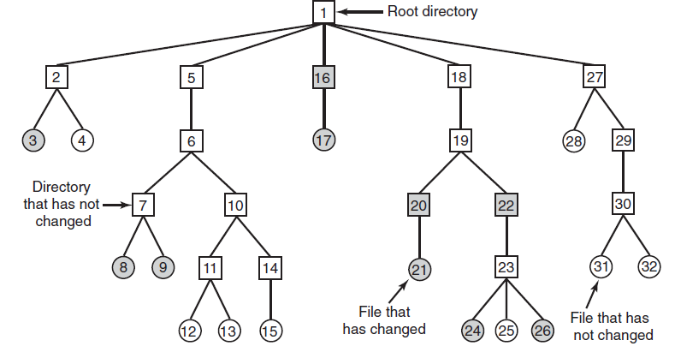
File System Backups (2 of 3)
Figure 4-25. A file system to be dumped. The squares are directories and the circles are files. The shaded items have been modified since the last dump. Each directory and file is labeled by its i-node number.

Slide 38
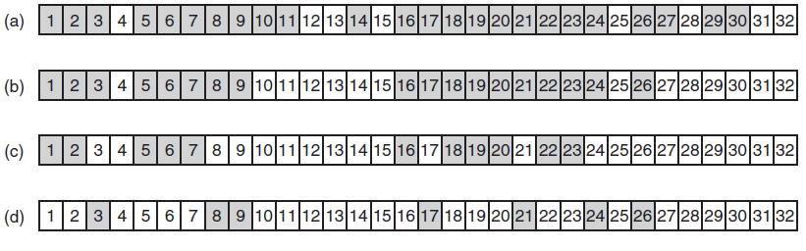
File System Backups (3 of 3)
Figure 4-26. Bitmaps used by the logical dumping algorithm.

Slide 39
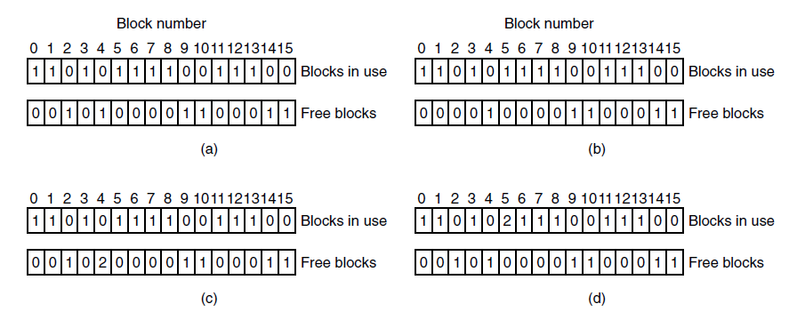
File System Consistency
Figure 4-27. File system states. (a) Consistent. (b) Missing block. (c) Duplicate block in free list. (d) Duplicate data block.

Slide 40
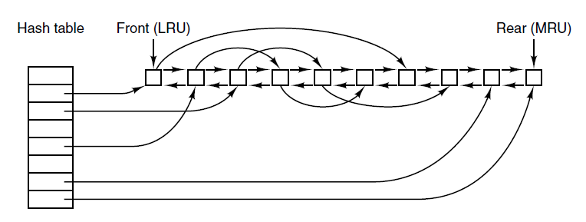
File System Performance (1 of 2)
Figure 4-28. The buffer cache data structures.

Slide 41
File System Performance (2 of 2)
Some blocks rarely referenced two times within a short interval.
Leads to a modified L R U scheme, taking two factors into account:
Is the block likely to be needed again soon?
Is the block essential to the consistency of the file system?

Slide 42
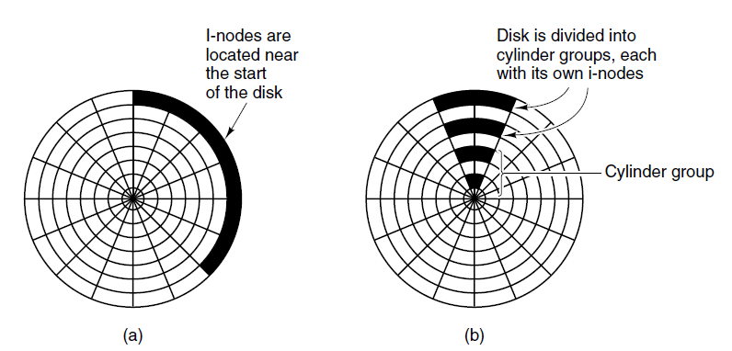
Reducing Disk Arm Motion
Figure 4-29. (a) I-nodes placed at the start of the disk. (b) Disk divided into cylinder groups, each with its own blocks and i-nodes.

Slide 43
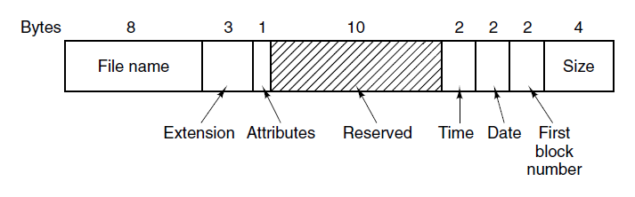
The M S-D O S File System (1 of 2)
Figure 4-30. The M S-D O S directory entry.

Slide 44
The M S-D O S File System (2 of 2)
Maximum partition size for different block sizes. The empty boxes represent forbidden combinations.
Block size | F A T-12 | F A T-16 | F A T-32
0.5 K B | 2 M B | Blank | Blank
1 K B | 4 M B | Blank | Blank
2 K B | 8 M B | 128 M B | Blank
4 K B | 16 M B | 256 M B | 1 T B
8 K B | Blank | 512 M B | 2 T B
16 K B | Blank | 1024 M B | 2 T B
32 K B | Blank | 2048 M B | 2 T B

Slide 45
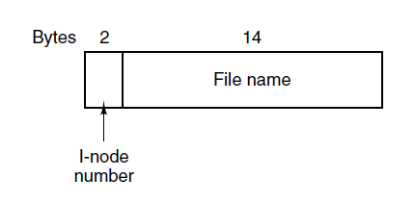
The U N I X V7 File System (1 of 3)
Figure 4-32. A U N I X V7 directory entry.

Slide 46
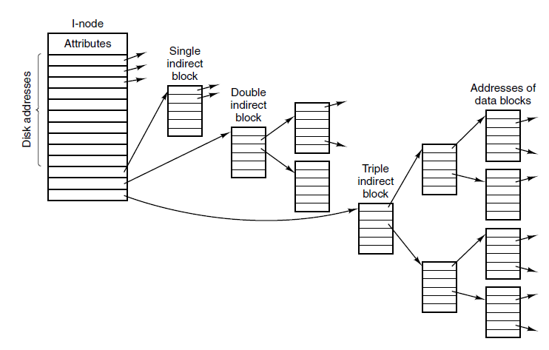
The U N I X V7 File System (2 of 3)
Figure 4-33. A U N I X i-node

Slide 47
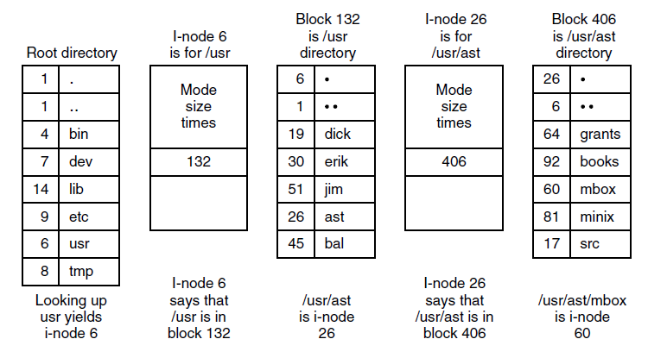
The U N I X V7 File System (3 of 3)
Figure 4-34. The steps in looking up /u s r/a s t/m box.

Slide 48
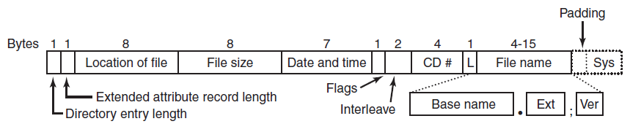
The I S O 9660 File System
Figure 4-35. The I S O 9660 directory entry.

Slide 49
Rock Ridge Extensions
P X – P O S I X attributes.
P N - Major and minor device numbers.
S L - Symbolic link.
N M - Alternative name.
C L - Child location.
P L - Parent location.
R E - Relocation.
T F - Time stamps.

Slide 50
Joliet Extensions
Long file names.
Unicode character set.
Directory nesting deeper than eight levels.
Directory names with extensions

Slide 51

Copyright

