Slide 1

Modern Operating Systems
Fourth Edition
Chapter 5
Input /Output
Copyright © 2014 Pearson Education, Inc. All Rights Reserved
Notes:
If this PowerPoint presentation contains mathematical equations, you may need to check that your computer has the following installed:
1) MathType Plugin
2) Math Player (free versions available)
3) NVDA Reader (free versions available)

Slide 2
I/O Devices (1 of 2)
Block devices
Stores information in fixed-size blocks
Transfers are in units of entire blocks
Character devices
Delivers or accepts stream of characters, without regard to block structure
Not addressable, does not have any seek operation

Slide 3
I/O Devices (2 of 2)
Some typical device, network, and bus data rates.
Device | Data rate
Keyboard | 10 bytes/sec
Mouse | 100 bytes/sec
56K modem | 7 K B/sec
Scanner at 300 dpi | 1 M B/sec
Digital camcorder | 9.5 M B/sec
4x Blu-ray disc | 18 M B/sec
802.1 In Wireless | 37.5 M B/sec
U S B 2.0 | 60 M B/sec
FireWire 800 | 100 M B/sec
Gigabit Ethernet | 125 M B/sec
S A T A 3 disk drive | 600 M B/sec
U S B 9.0 | 625 M B/sec
S C S I Ultra 5 bus | 640 M B/sec
Single-lane P C I e 3.0 bus | 985 M B/sec
Thunderbolt 2 bus | 2.5 G B/sec
S O N E T O C-768 network | 5 G B/sec

Slide 4
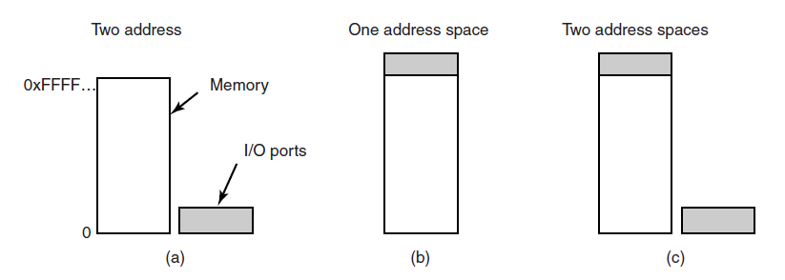
Memory-Mapped I/O (1 of 2)
Figure 5-2. (a) Separate I/O and memory space. (b) Memory-mapped I/O. (c) Hybrid.

Slide 5
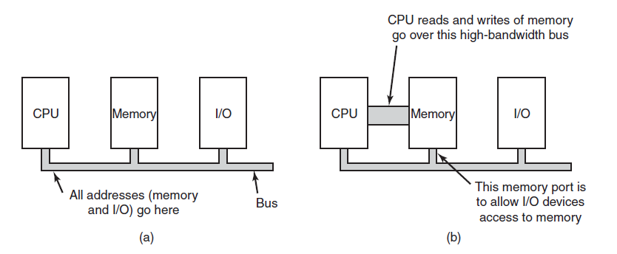
Memory-Mapped I/O (2 of 2)
Figure 5-3. (a) A single-bus architecture. (b) A dual-bus memory architecture.

Slide 6
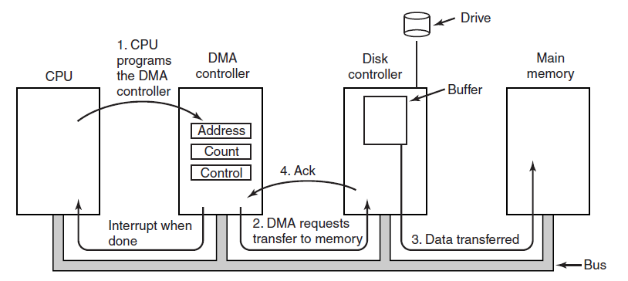
Direct Memory Access
Figure 5-4. Operation of a D M A transfer.

Slide 7
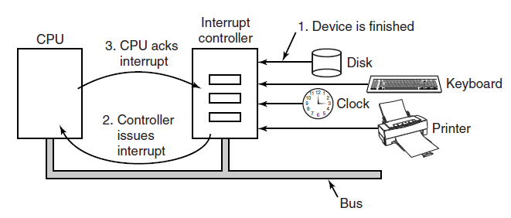
Interrupts Revisited
Figure 5-5. How an interrupt happens. The connections between the devices and the interrupt controller actually use interrupt lines on the bus rather than dedicated wires.

Slide 8
Precise Interrupt
Four properties of a precise interrupt:
The P C saved in a known place.
All instructions before that pointed to by P C have fully executed.
No instruction beyond that pointed to by P C has been executed.
Execution state of instruction pointed to by P C is known.

Slide 9
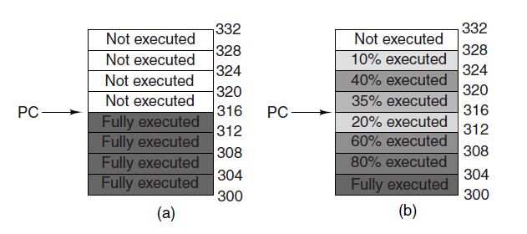
Precise vs. Imprecise
Figure 5-6. (a) A precise interrupt. (b) An imprecise interrupt.

Slide 10
Goals of the I/O Software
Issues:
Device independence
Uniform naming
Error handling
Synchronous versus asynchronous
Buffering.

Slide 11
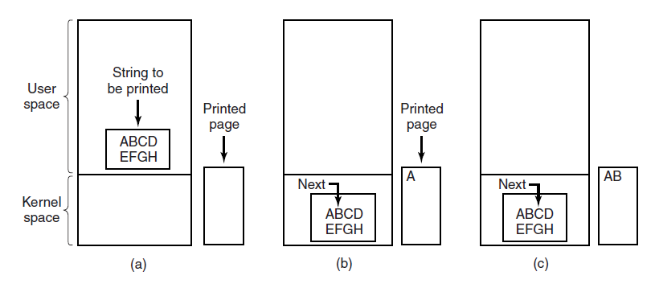
Programmed I/O (1 of 2)
Figure 5-7. Steps in printing a string.

Slide 12
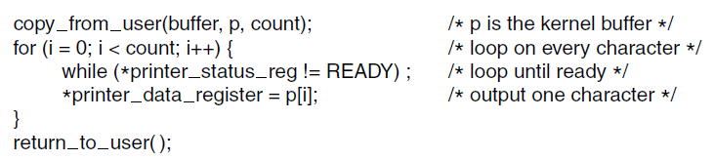
Programmed I/O (2 of 2)
Figure 5-8. Writing a string to the printer using programmed I/O.

Slide 13
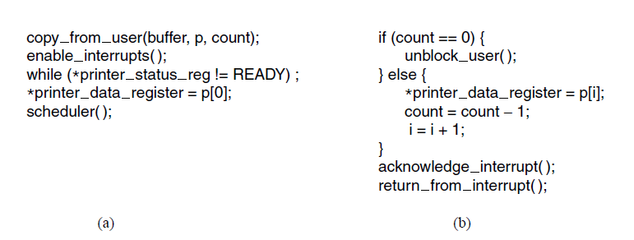
Interrupt-Driven I/O
Figure 5-9. Writing a string to the printer using interrupt-driven I/O. (a) Code executed at the time the print system call is made. (b) Interrupt service procedure for the printer.

Slide 14
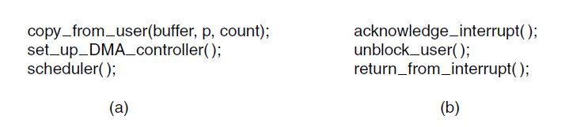
I/O Using D M A
Figure 5-10. Printing a string using D M A. (a) Code executed when the print system call is made. (b) Interrupt service procedure.

Slide 15
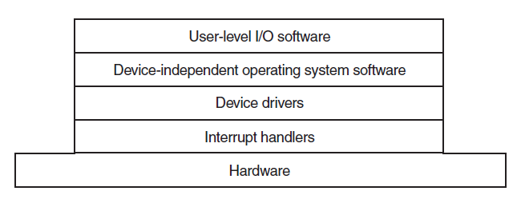
I/O Software Layers
Figure 5-11. Layers of the I/O software system.

Slide 16
Interrupt Handlers (1 of 2)
Typical steps after hardware interrupt completes:
Save registers (including the P S W) not already saved by interrupt hardware.
Set up context for interrupt service procedure.
Set up a stack for the interrupt service procedure.
Acknowledge interrupt controller. If no centralized interrupt controller, reenable interrupts.
Copy registers from where saved to process table.

Slide 17
Interrupt Handlers (2 of 2)
Typical steps after hardware interrupt completes:
Run interrupt service procedure. Extract information from interrupting device controller’s registers.
Choose which process to run next.
Set up the M M U context for process to run next.
Load new process’ registers, including its P S W.
Start running the new process.

Slide 18
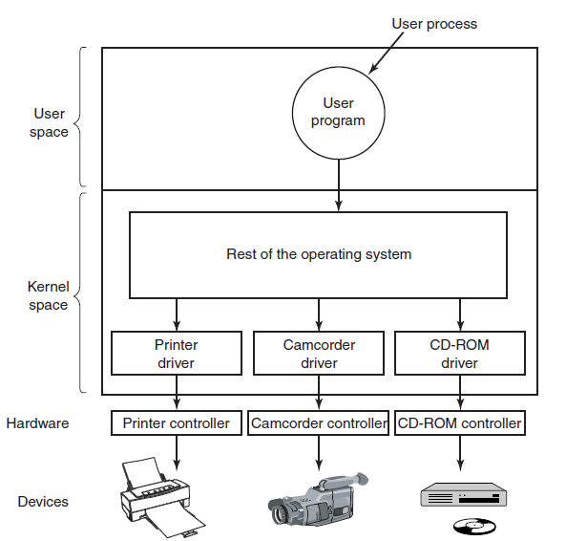
Device Drivers
Figure 5-12. Logical positioning of device drivers. In reality all communication between drivers and device controllers goes over the bus.

Slide 19
Device-Independent I/O Software
A typical page table entry.
Uniform interfacing for device drivers
Buffering
Error reporting
Allocating and releasing dedicated devices
Providing a device-independent block size

Slide 20
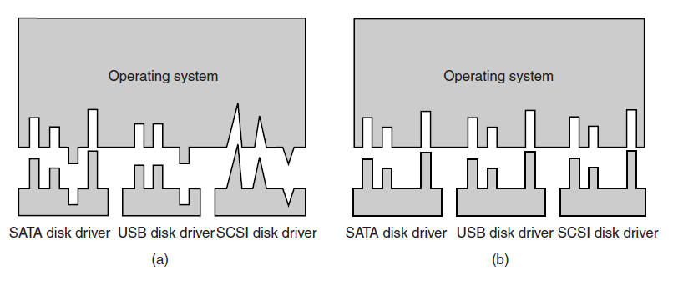
Uniform Interfacing for Device Drivers
Figure 5-14. (a) Without a standard driver interface. (b) With a standard driver interface.

Slide 21
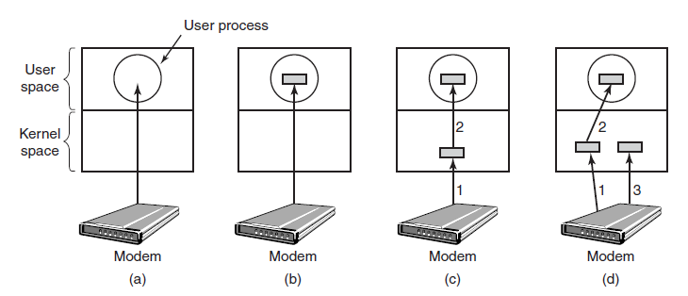
Buffering (1 of 2)
Figure 5-15. (a) Unbuffered input. (b) Buffering in user space. (c) Buffering in the kernel followed by copying to user space. (d) Double buffering in the kernel.

Slide 22
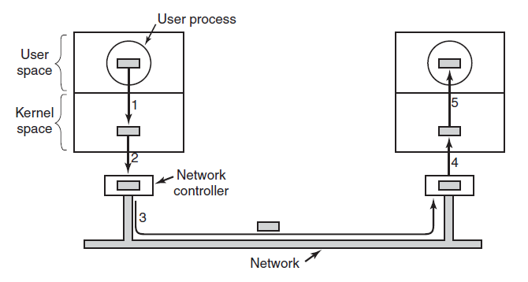
Buffering (2 of 2)
Figure 5-16. Networking may involve many copies of a packet.

Slide 23
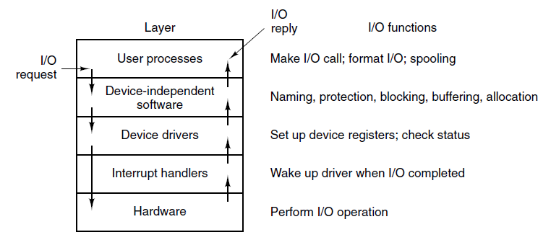
User-Space I/O Software
Figure 5-17. Layers of the I/O system and the main functions of each layer.

Slide 24
Magnetic Disks (1 of 2)
Disk parameters for the original I B M PC 360-KB floppy disk and a Western Digital W D 3000 H L F S (‘‘Velociraptor’’) hard disk.
Parameter | I B M 360-K B floppy disk | W D 3000 H L F S hard disk
Number of cylinders | 40 | 36481
Tracks per cylinder | 2 | 255
Sectors per track | 9 | 63 (avg)
Sectors per disk | 720 | 586,072,368
Bytes per sector | 512 | 512
Disk capacity | 360 K B | 300 G B
Seek time (adjacent cylinders) | 6 msec | 0.7 msec
Seek time (average case) | 77 msec | 4.2 msec
Rotation time | 200 msec | 6 msec
Time to transfer 1 sector | 22 msec | 1.4 usec

Slide 25
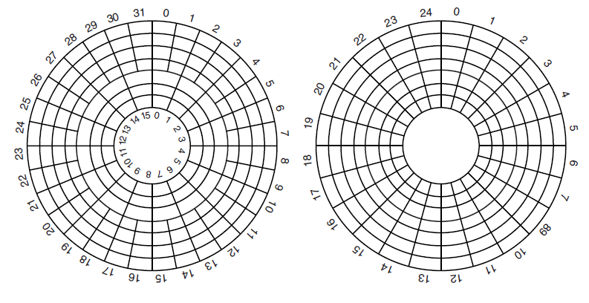
Magnetic Disks (2 of 2)
Figure 5-19. (a) Physical geometry of a disk with two zones. (b) A possible virtual geometry for this disk.

Slide 26
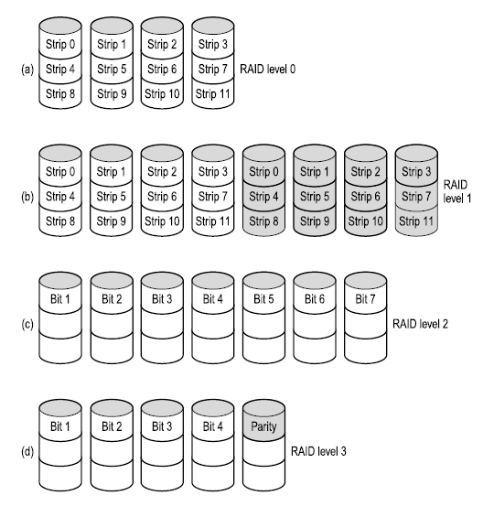
R A I D (1 of 2)
Figure 5-20. R A I D levels 0 through 3. Backup and parity drives are shown shaded.

Slide 27
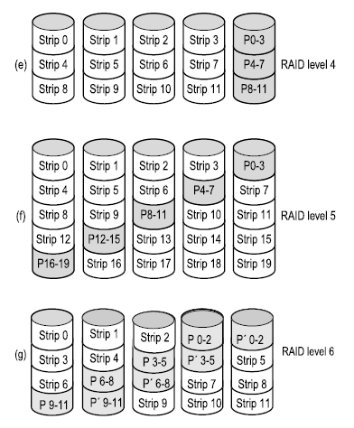
R A I D (2 of 2)
Figure 5-20. R A I D levels 4 through 6. Backup and parity drives are shown shaded.

Slide 28
Disk Formatting (1 of 3)
A disk sector.
Preamble | Data | E C C

Slide 29
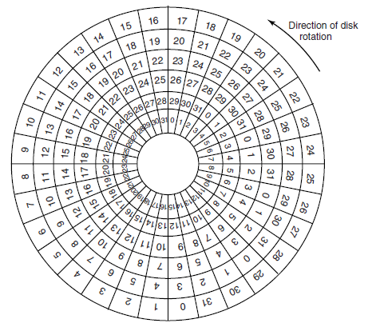
Disk Formatting (2 of 3)
Figure 5-22. An illustration of cylinder skew.

Slide 30
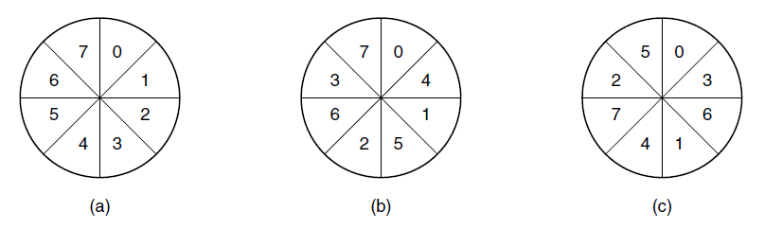
Disk Formatting (3 of 3)
Figure 5-23. (a) No interleaving. (b) Single interleaving. (c) Double interleaving.

Slide 31
Disk Arm Scheduling Algorithms (1 of 3)
Factors of a disk block read/write:
Seek time (the time to move the arm to the proper cylinder).
Rotational delay (how long for the proper sector to come under the head).
Actual data transfer time.

Slide 32
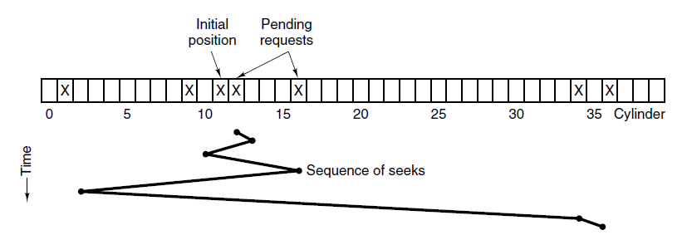
Disk Arm Scheduling Algorithms (2 of 3)
Figure 5-24. Shortest Seek First (S S F) disk scheduling algorithm.

Slide 33
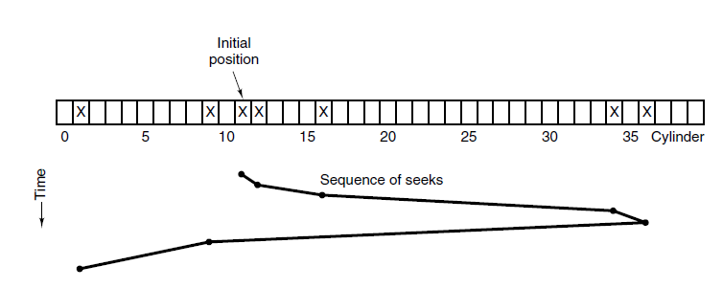
Disk Arm Scheduling Algorithms (3 of 3)
Figure 5-25. The elevator algorithm for scheduling disk requests.

Slide 34
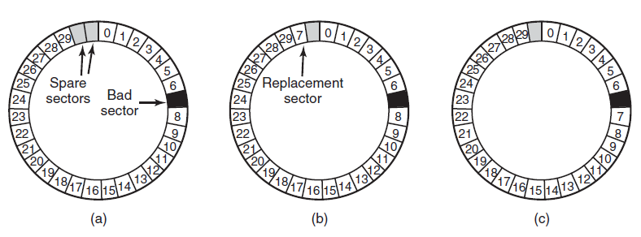
Error Handling
Figure 5-26. (a) A disk track with a bad sector. (b) Substituting a spare for the bad sector. (c) Shifting all the sectors to bypass the bad one.

Slide 35
Stable Storage (1 of 2)
Uses pair of identical disks
Either can be read to get same results
Operations defined to accomplish this:
Stable Writes
Stable Reads
Crash recovery

Slide 36
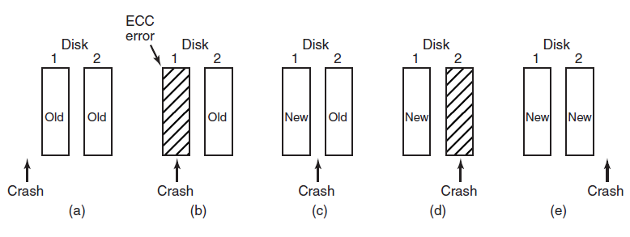
Stable Storage (2 of 2)
Figure 5-27. Analysis of the influence of crashes on stable writes.

Slide 37
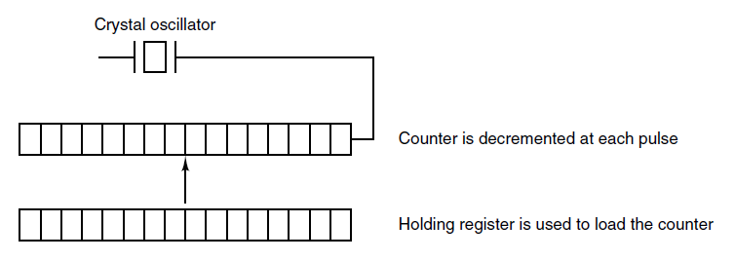
Clock Hardware
Figure 5-28. A programmable clock.

Slide 38
Clock Software (1 of 3)
Typical duties of a clock driver:
Maintaining the time of day.
Preventing processes from running longer than allowed.
Accounting for C P U usage.
Handling alarm system call from user processes.
Providing watchdog timers for parts of system itself.
Profiling, monitoring, statistics gathering.

Slide 39
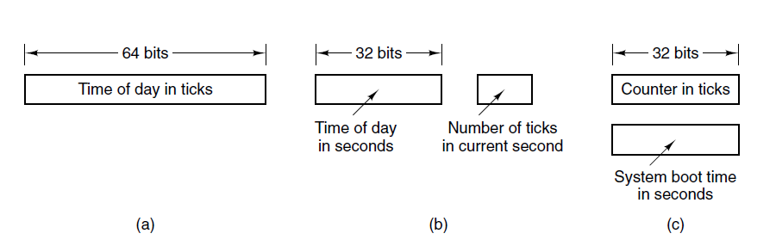
Clock Software (2 of 3)
Figure 5-29. Three ways to maintain the time of day.

Slide 40
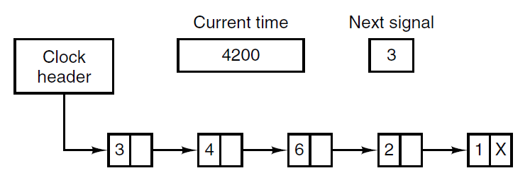
Clock Software (3 of 3)
Figure 5-30. Simulating multiple timers with a single clock.

Slide 41
Soft Timers
Soft timers stand or fall with the rate at which kernel entries are made for other reasons. These reasons include:
System calls.
T L B misses.
Page faults.
I/O interrupts.
The C P U going idle.

Slide 42
Keyboard Software
Characters that are handled specially in canonical mode.
Character | POSIX name | Comment
CTRL-H | ERASE | Backspace one character
CTRL-U | KILL | Erase entire line being typed
CTRL-V | LNEXT | Interpret next character literally
CTRL-S | STOP | Stop output
CTRL-Q | START | Start output
DEL | INTR | Interrupt process
CTRL-\ | QUIT | Force core dump
CTRL-D | E O F | End of file
CTRL-M | CR | Carriage return (unchangeable)
CTRL-J | NL | Linefeed (unchangeable)

Slide 43
Output Software – Text Windows (1 of 2)
The ANSI escape sequences accepted by the terminal driver on output. E S C denotes the A S C I I escape character (0x1B), and n, m, and s are optional numeric parameters.
Escape Sequence | Meaning
ESC [n A | Move up n lines
ESC [n B | Move down n lines
ESC [n C | Move right n spaces
ESC [n D | Move left n spaces
ESC [m ; nH | Move cursor to (m,n)
ESC [s J | Clear screen from cursor (0 to end, 1 1from start, 2 all)
ESC [s K | Clear line from cursor (0 to end, 1 1from start, 2 all)

Slide 44
Output Software – Text Windows (2 of 2)
The ANSI escape sequences accepted by the terminal driver on output. E S C denotes the A S C I I escape character (0x1B), and n, m, and s are optional numeric parameters.
Escape Sequence | Meaning
ESC [n L | Insert n lines at cursor
ESC [n M | Delete n lines at cursor
ESC [n P | Delete n chars at cursor
ESC [n @ | Insert n chars at cursor
ESC [n m | Enable rendition n (0=normal, 4=bold, 5=blinking, 7=reverse)
ESC M | Scroll the screen backward if the cursor is on the top line

Slide 45
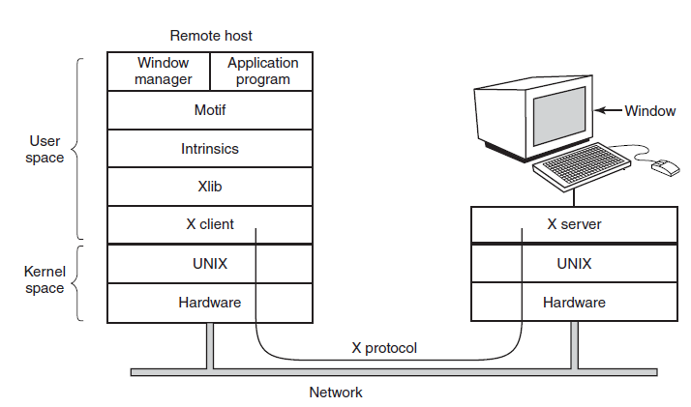
The X Window System (1 of 4)
Figure 5-33. Clients and servers in the M.I.T. X Window System.

Slide 46
The X Window System (2 of 4)
Types of messages between client and server:
Drawing commands from program to workstation.
Replies by workstation to program queries.
Keyboard, mouse, and other event announcements.
Error messages.

Slide 47
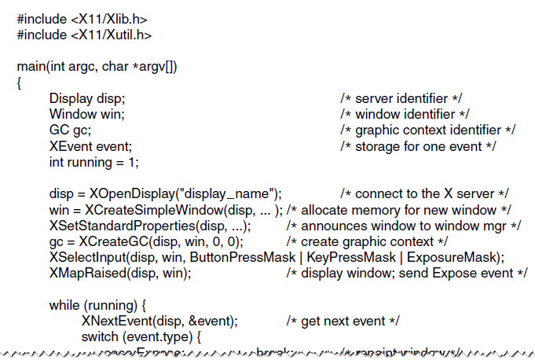
The X Window System (3 of 4)
Figure 5-34. A skeleton of an X Window application program.

Slide 48
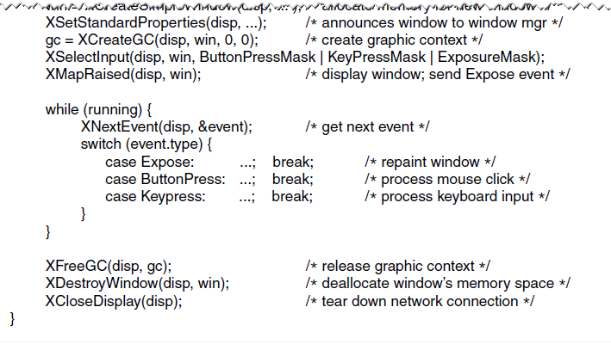
The X Window System (4 of 4)
Figure 5-34. A skeleton of an X Window application program.

Slide 49
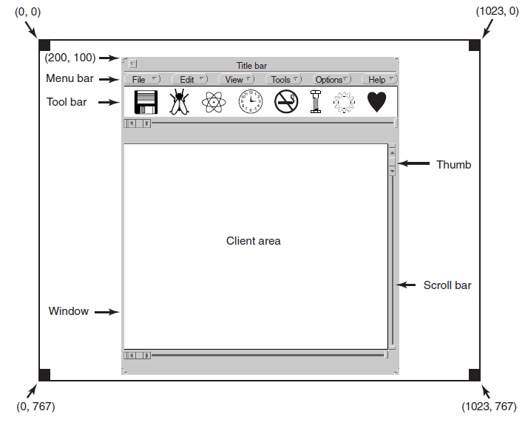
Graphical User Interfaces (1 of 4)
Figure 5-35. A sample window located at (200, 100) on an X G A display.

Slide 50
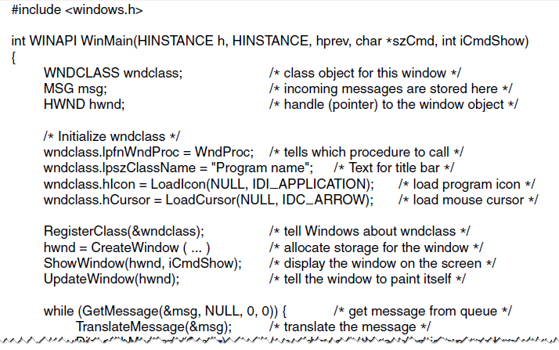
Graphical User Interfaces (2 of 4)
Figure 5-36. A skeleton of a Windows main program.

Slide 51
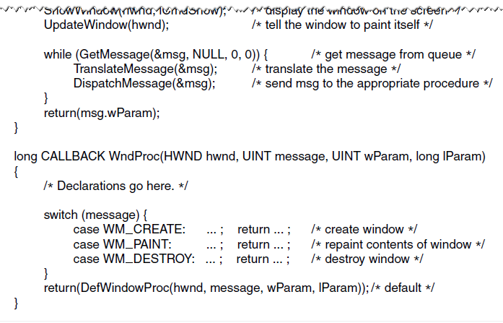
Graphical User Interfaces (3 of 4)
Figure 5-36. A skeleton of a Windows main program.

Slide 52
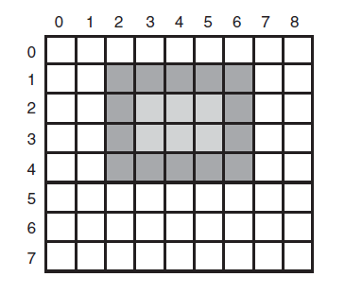
Graphical User Interfaces (4 of 4)
Figure 5-37. An example rectangle drawn using Rectangle. Each box represents one pixel.

Slide 53
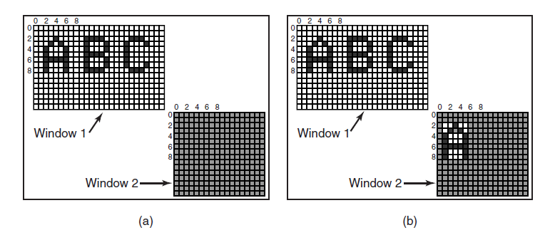
Bitmaps
Figure 5-38. Copying bitmaps using BitBlt. (a) Before. (b) After.

Slide 54
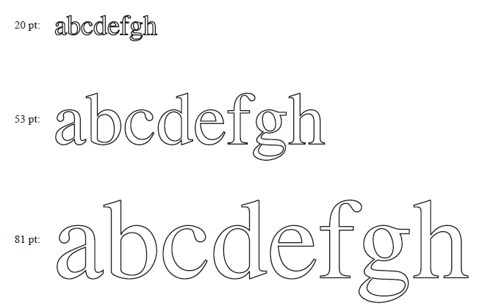
Fonts
Figure 5-39. Some examples of character outlines at different point sizes.

Slide 55
Hardware Issues
Power consumption of various parts of a notebook computer.
Device | Li et al. (1994) | Lorch and Smith (1998)
Display | 68% | 39%
C P U | 12% | 18%
Hard Disk | 20% | 12%
Modem | Blank | 6%
Sound | Blank | 2%
Memory | 0.5% | 1%
Other | Blank | 22%

Slide 56
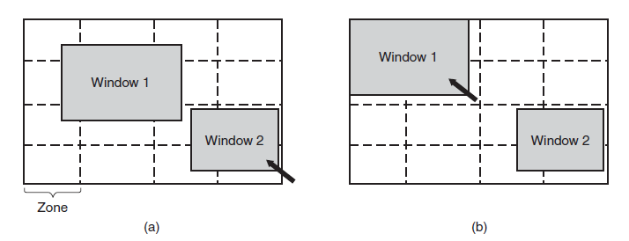
Operating System Issues: The Display
Figure 5-41. The use of zones for backlighting the display. (a) When window 2 is selected it is not moved. (b) When window 1 is selected, it moves to reduce the number of zones illuminated.

Slide 57
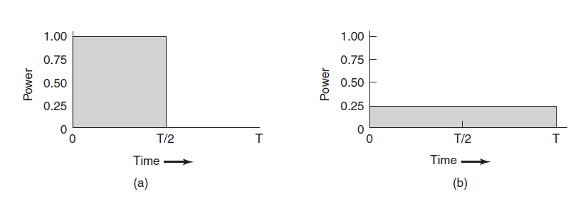
Operating System Issues: The C P U
Figure 5-42. (a) Running at full clock speed. (b) Cutting voltage by two cuts clock speed by two and power consumption by four

Slide 58

Copyright

