Slide 1

Modern Operating Systems
Fourth Edition
Chapter 6
Deadlocks
Copyright © 2014 Pearson Education, Inc. All Rights Reserved
Notes:
If this PowerPoint presentation contains mathematical equations, you may need to check that your computer has the following installed:
1) MathType Plugin
2) Math Player (free versions available)
3) NVDA Reader (free versions available)

Slide 2
Preemptable and Nonpreemptable Resources
Sequence of events required to use a resource
Request the resource.
Use the resource.
Release the resource.

Slide 3
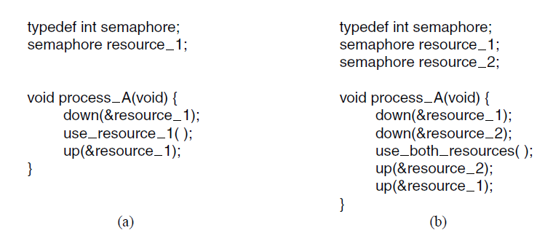
Resource Acquisition (1 of 2)
Figure 6-1. Using a semaphore to protect resources. (a) One resource. (b) Two resources.

Slide 4
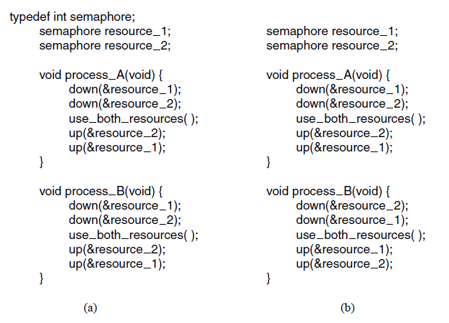
Resource Acquisition (2 of 2)
Figure 6-2. (a) Deadlock-free code. (b) Code with a potential deadlock.

Slide 5
Deadlock Definition
A set of processes is deadlocked if …
Each process in the set waiting for an event
That event can be caused only by another process

Slide 6
Conditions for Resource Deadlocks
Four conditions that must hold:
Mutual exclusion
Hold and wait
No preemption
Circular wait condition

Slide 7
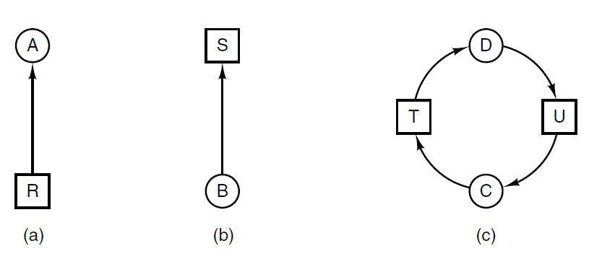
Deadlock Modeling (1 of 5)
Figure 6-3. Resource allocation graphs. (a) Holding a resource. (b) Requesting a resource. (c) Deadlock.

Slide 8
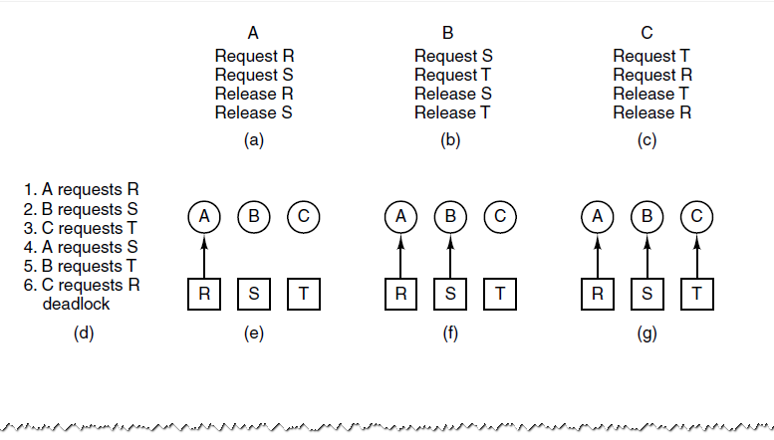
Deadlock Modeling (2 of 5)
Figure 6-4. An example of how deadlock occurs and how it can be avoided.

Slide 9
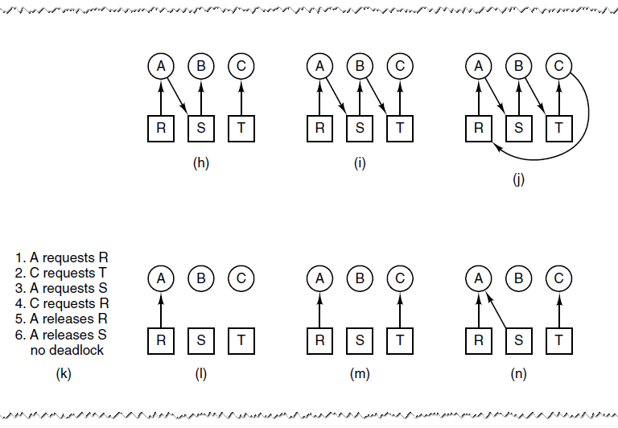
Deadlock Modeling (3 of 5)
Figure 6-4. An example of how deadlock occurs and how it can be avoided.

Slide 10
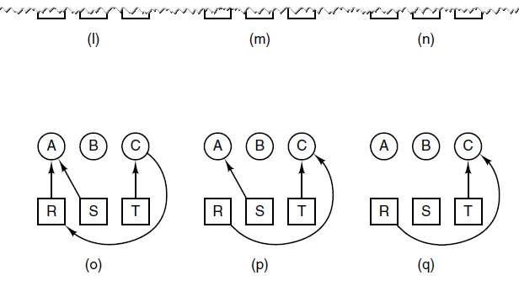
Deadlock Modeling (4 of 5)
Figure 6-4. An example of how deadlock occurs and how it can be avoided.

Slide 11
Deadlock Modeling (5 of 5)
Strategies are used for dealing with deadlocks:
Ignore the problem, maybe it will go away.
Detection and recovery. Let deadlocks occur, detect them, and take action.
Dynamic avoidance by careful resource allocation.
Prevention, by structurally negating one of the four required conditions.

Slide 12
Deadlock Detection with One Resource of Each Type (1 of 2)
Example of a system – is it deadlocked?
Process A holds R, wants S
Process B holds nothing, wants T
Process C holds nothing, wants S
Process D holds U, wants S and T
Process E holds T, wants V
Process F holds W, wants S
Process G holds V, wants U

Slide 13
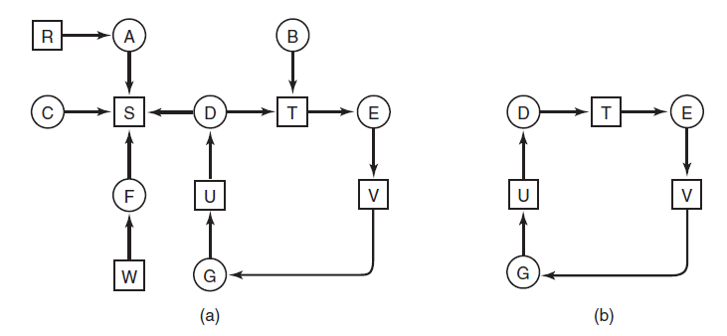
Deadlock Detection with One Resource of Each Type (2 of 2)
Figure 6-5. (a) A resource graph. (b) A cycle extracted from (a).

Slide 14
Algorithm to Detect Deadlocks (1 of 2)
For each node, N in the graph, perform following five steps with N as starting node.
Initialize L to empty list, and designate all arcs as unmarked.
Add current node to end of L, check to see if node now appears in L two times. If so, graph contains a cycle (listed in L) and algorithm terminates

Slide 15
Algorithm to Detect Deadlocks (2 of 2)
From given node, see if there are any unmarked outgoing arcs. If so, go to step 5; if not, go to step 6.
Pick unmarked outgoing arc at random, mark it. Then follow to new current node and go to step 3.
If this is initial node, graph does not contain cycles, algorithm terminates. Otherwise, dead end. Remove it and go back to the previous node.

Slide 16
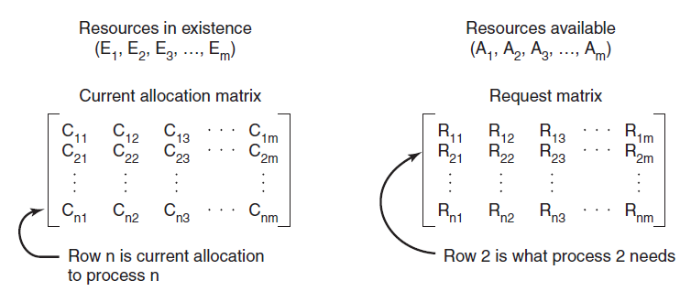
Deadlock Detection with Multiple Resources of Each Type (1 of 3)
Figure 6-6. The four data structures needed by the deadlock detection algorithm.

Slide 17
Deadlock Detection with Multiple Resources of Each Type (2 of 3)
Deadlock detection algorithm:
Look for unmarked process,
for which the i-th
row of R is less than or equal to A.
If such a process is found, add the i-th row of C to A, mark the process, go back to step 1.
If no such process exists, algorithm terminates.

Slide 18
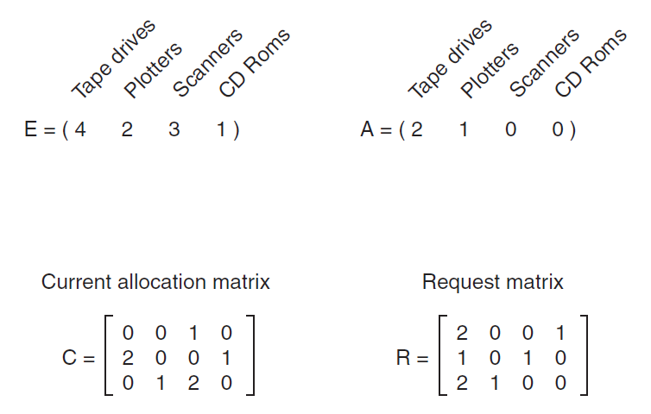
Deadlock Detection with Multiple Resources of Each Type (3 of 3)
Figure 6-7. An example for the deadlock detection algorithm.

Slide 19
Recovery from Deadlock
Possible Methods of recovery (though none are “attractive”):
Preemption
Rollback
Killing processes

Slide 20
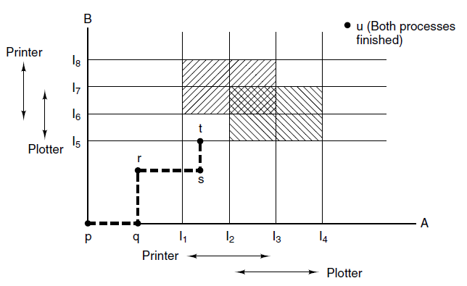
Deadlock Avoidance Resource Trajectories
Figure 6-8. Two process resource trajectories.

Slide 21
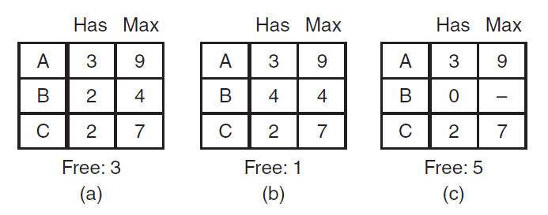
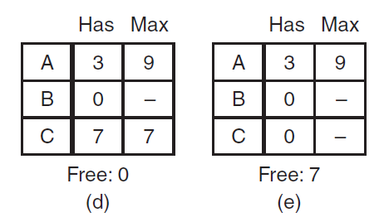
Safe and Unsafe States (1 of 2)
Figure 6-9. Demonstration that the state in (a) is safe.

Slide 22
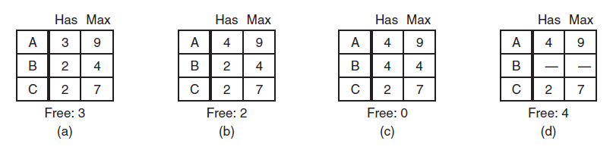
Safe and Unsafe States (2 of 2)
Figure 6-10. Demonstration that the state in (b) is not safe.

Slide 23
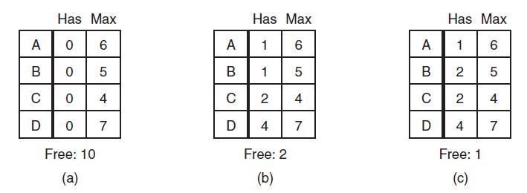
Banker’s Algorithm for Single Resource
Figure 6-11. Three resource allocation states: (a) Safe. (b) Safe. (c) Unsafe.

Slide 24
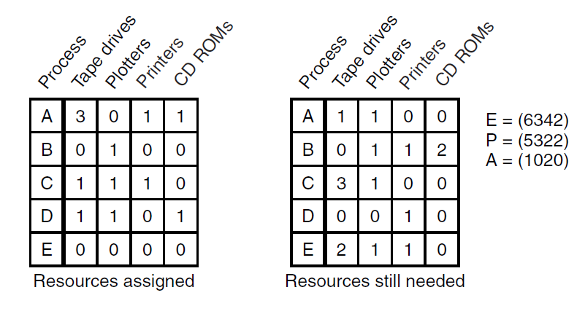
Banker’s Algorithm for Multiple Resources (1 of 2)
Figure 6-12. The banker’s algorithm with multiple resources.

Slide 25
Banker’s Algorithm for Multiple Resources (2 of 2)
Look for a row, R, whose unmet resource needs are all smaller than or equal to A. If no such row exists, system will eventually deadlock.
Assume the process of row chosen requests all resources needed and finishes. Mark that process as terminated, add its resources to the A vector.
Repeat steps 1 and 2 until either all processes are marked terminated (safe state) or no process is left whose resource needs can be met (deadlock)

Slide 26
Deadlock Prevention
Assure that at least one of conditions is never satisfied
Mutual exclusion
Hold and wait
No Preemption
Circular wait

Slide 27
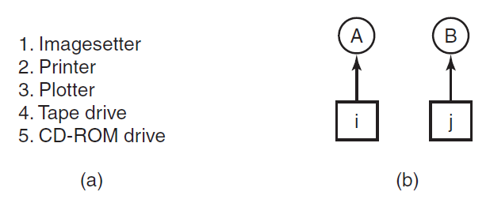
Attacking Circular Wait Condition (1 of 2)
Figure 6-13. (a) Numerically ordered resources. (b) A resource graph

Slide 28
Attacking Circular Wait Condition (2 of 2)
Summary of approaches to deadlock prevention.
Condition | Approach
Mutual exclusion | Spool everything
Hold and wait | Request all resources initially
No preemption | Take resources away
Circular wait | Order resources numerically

Slide 29
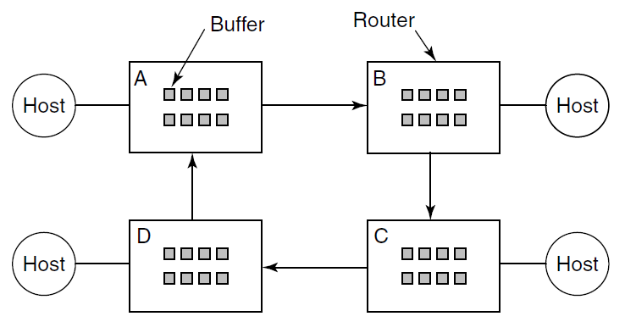
Communication Deadlocks
Figure 6-15. A resource deadlock in a network.

Slide 30
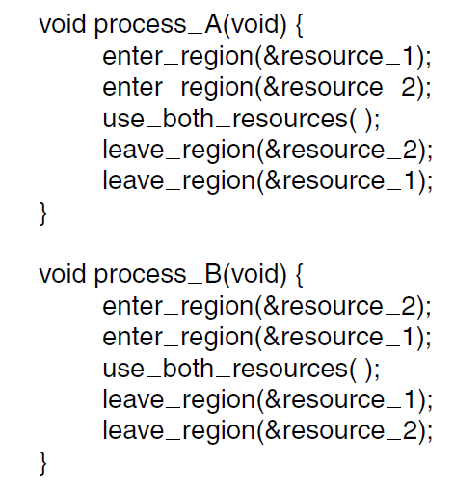
Livelock
Figure 6-16. Busy waiting that can lead to livelock.

Slide 31

Copyright

