Slide 1
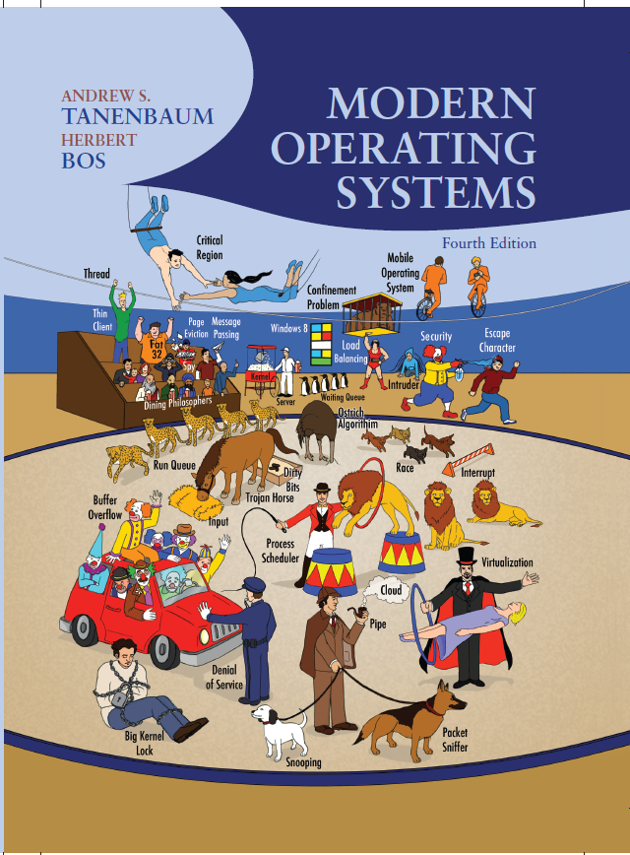
Modern Operating Systems
Fourth Edition
Chapter 7
Virtualization and the Cloud
Copyright © 2014 Pearson Education, Inc. All Rights Reserved
Notes:
If this PowerPoint presentation contains mathematical equations, you may need to check that your computer has the following installed:
1) MathType Plugin
2) Math Player (free versions available)
3) NVDA Reader (free versions available)

Slide 2
Requirements for Virtualization
Hypervisors should score well in three dimensions:
Safety: hypervisor should have full control of virtualized resources.
Fidelity: behavior of a program on a virtual machine should be identical to same program running on bare hardware.
Efficiency: much of code in virtual machine should run without intervention by hypervisor.

Slide 3
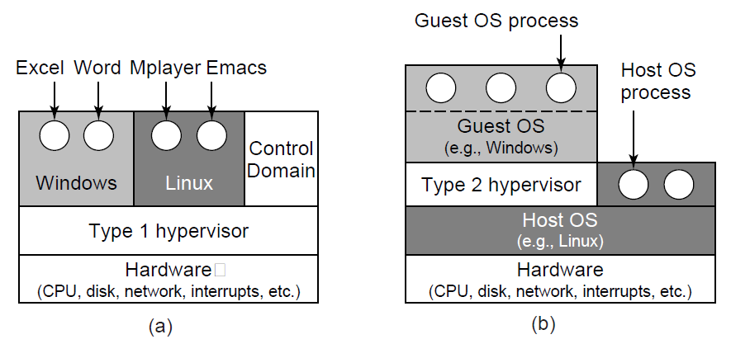
Type 1 and Type 2 Hypervisors (1 of 2)
Figure 7-1. Location of type 1 and type 2 hypervisors.

Slide 4
Type 1 and Type 2 Hypervisors (2 of 2)
Figure 7-2. Examples of the various combinations of virtualization type and hypervisor. Type 1 hypervisors always run on the bare metal whereas type 2 hypervisors use the services of an existing host operating system.
Virtualization method | Type 1 hypervisor | Type 2 hypervisor
Virtualization without H W support | E S X Server 1.0 | VMware Workstation 1
Paravirtualization | Xen 1.0 | Blank
Virtualization with H W support | vSphere, Xen, Hyper-V | VMware Fusion, K V M, Parallels
Process virtualization | Blank | Wine

Slide 5
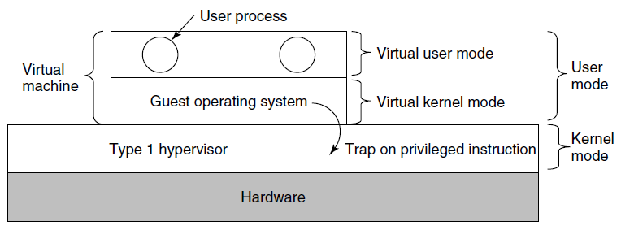
Techniques for Efficient Virtualization
Figure 7-3. When the operating system in a virtual machine executes a kernel only instruction, it traps to the hypervisor if virtualization technology is present.

Slide 6
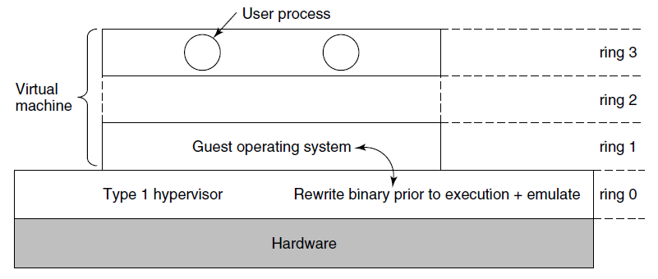
Virtualizing the Unvirtualizable
Figure 7-4. The binary translates rewrites the guest operating system running in ring 1, while the hypervisor runs in ring 0

Slide 7
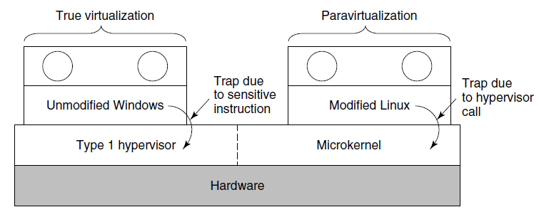
Are Hypervisors Microkernels Done Right? (1 of 2)
Figure 7-5. True virtualization and paravirtualization

Slide 8
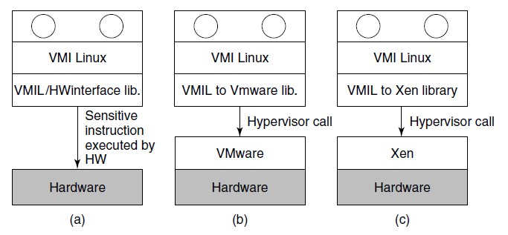
Are Hypervisors Microkernels Done Right? (2 of 2)
Figure 7-6. VMI Linux running on (a) the bare hardware (b) VMware (c) Xen.

Slide 9
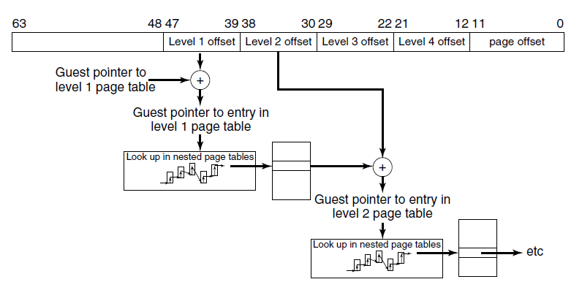
Hardware Support For Nested Page Tables
Figure 7-7. Extended/nested page tables are walked every time a guest physical address is accessed—including the accesses for each level of the guest’s page tables.

Slide 10
Clouds
National Institute of Standards and Technology defines characteristics of “cloud”
On-demand self-service
Broad network access
Resource pooling
Rapid elasticity
Measured service

Slide 11
Challenges in Bringing Virtualization to the x86 (1 of 2)
Core attributes of a virtual machine to x86-based target platform:
Compatibility
Performance
Isolation

Slide 12
Challenges in Bringing Virtualization to the x86 (2 of 2)
Major Challenges:
The x86 architecture was not virtualizable
The x86 architecture was of daunting complexity
x86 machines had diverse peripherals
Need for a simple user experience

Slide 13
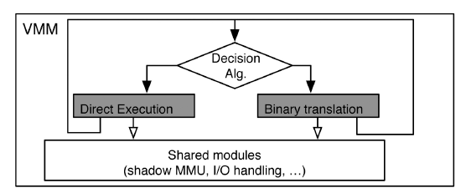
Virtualizing the x86 Architecture (1 of 2)
Figure 7-8. High-level components of the VMware virtual machine monitor (in the absence of hardware support).

Slide 14
Virtualizing the x86 Architecture (2 of 2)
Binary translation must be used if any of the following is true:
Virtual machine is currently running in kernel mode
Virtual machine can disable interrupts and issue I/O instruction
Virtual machine is currently running in real mode

Slide 15
Virtual Hardware Platform (1 of 2)
Figure 7-9 Virtual hardware configuration options of the early VMware Workstation, c a. 2000.
Multiplexed
Virtual Hardware (front end) | Back end
1 virtual x86 C P U, with the same instruction set extensions as the un- derlying hardware C U P | Scheduled by the host operating system on either a uniprocessor or multiprocessor host
Up to 512 M B of contiguous D R A M | Allocated and managed by the host O S (page-by-page)

Slide 16
Virtual Hardware Platform (2 of 2)
Virtual hardware configuration options of the early VMware Workstation, ca. 2000.
Emulated
PCI Bus | Fully emulated compliant P C I bus
Four Units ofI D E disks Seven units ofBuslogic S C S I Disks | Virtual disks (stored as files) or direct access to a given raw device
One unit of I D E C D-R O M | I S O image or emulated access to the real CD-R O M
Two units of 1.44 M B floppy drives | Physical floppy or floppy image
One unit of VMware graphics card with V G A and S V G A support | Ran in a window and in full-screen mode. S V G A required VMware S V G A guest driver
Two times of serial ports COM1 and COM 2 | Connect to host serial port or a file
One unit of printer (L P T) | Can connect to host L P T port
One unit of keyboard (104-key) | Fully emulated; keycode events are generated when they are received by the VMware application
One unit of P S-2 mouse | Same as keyboard
Three units of A M D Lance Ethernet cards | Bridge mode and host-only modes
One unit of Soundblaster | Fully emulated

Slide 17
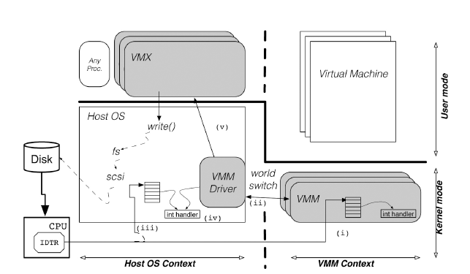
Role of the Host Operating System (1 of 2)
Figure 7-10. The V Mware Hosted Architecture and its three components: V M X, V M M driver and V M M.

Slide 18
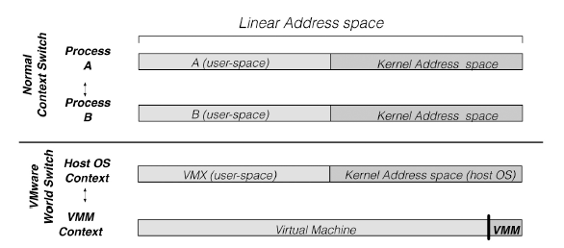
Role of the Host Operating System (2 of 2)
Figure 7-11. Difference between a normal context switch and a world switch.

Slide 19
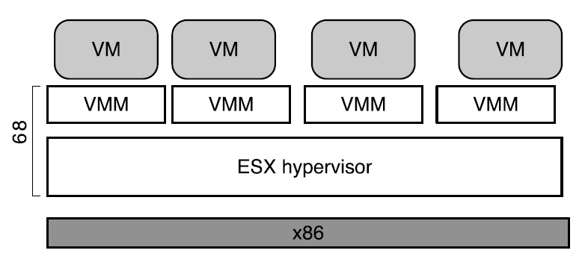
E S X Server: VMware’s type-1 Hypervisor (1 of 2)
Figure 7-11. E S X Server: VMware’s type-1 Hypervisor

Slide 20
E S X Server: VMware’s type-1 Hypervisor (2 of 2)
E S X Server architecture provides substantial benefits
C P U scheduler ensures that each virtual machine gets a fair share of the C P U
Memory manager is optimized for scalability
I/O subsystem is optimized for performance
Back ends also typically relied on abstractions provided by host operating system.
E S X Server made it easy to introduce new capabilities

Slide 21
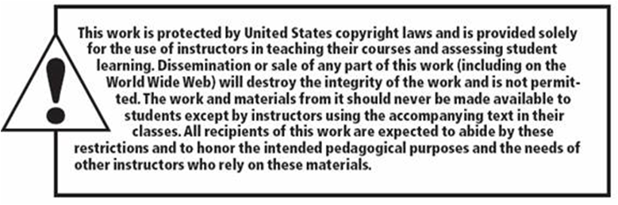
Copyright

