Slide 1
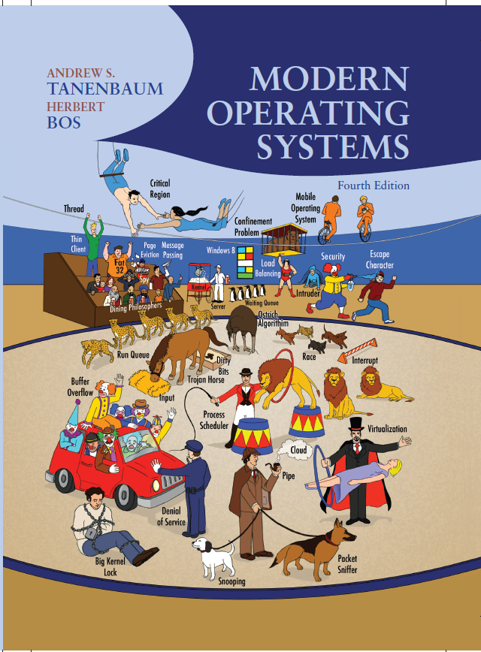
Modern Operating Systems
Fourth Edition
Chapter 8
Multiple Processor Systems
Slides in this presentation contains hyperlinks. JAWS users should be able to get a list of links by using INSERT+F7
Copyright © 2014 Pearson Education, Inc. All Rights Reserved
Notes:
If this PowerPoint presentation contains mathematical equations, you may need to check that your computer has the following installed:
1) MathType Plugin
2) Math Player (free versions available)
3) NVDA Reader (free versions available)

Slide 2
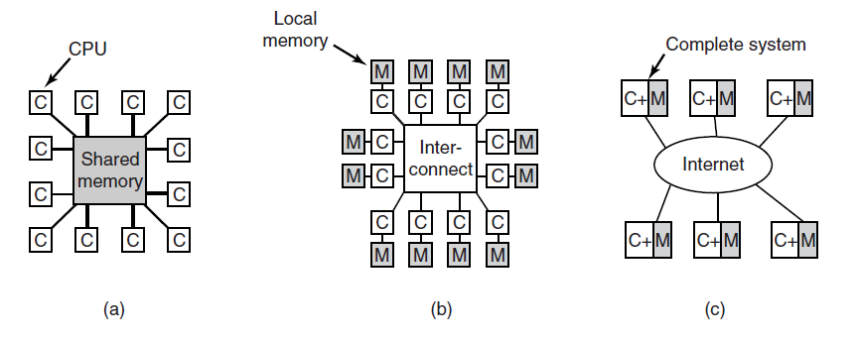
Multiple Processor Systems
Figure 8-1. (a) A shared-memory multiprocessor. (b) A message-passing multicomputer. (c) A wide area distributed system

Slide 3
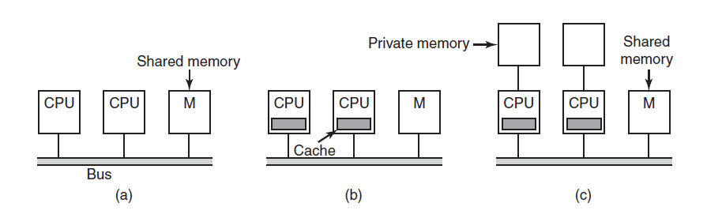
Multiprocessor Hardware
Figure 8-2. Three bus-based multiprocessors. (a) Without caching. (b) With caching. (c) With caching and private memories.

Slide 4
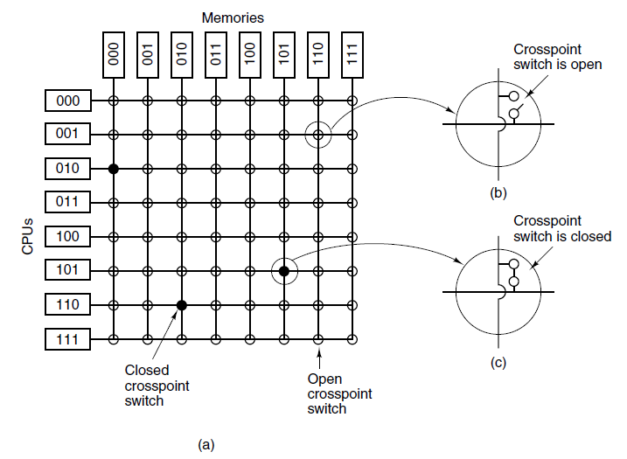
U M A Multiprocessors Using Crossbar Switches
Figure 8-3. (a) An 8 × 8 crossbar switch. (b) An open crosspoint. (c) A closed crosspoint.

Slide 5
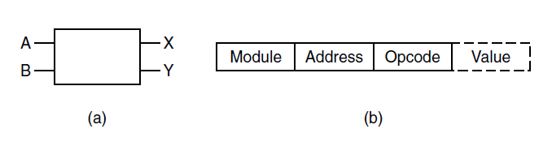
U M A Multiprocessors Using Multistage Switching Networks (1 of 2)
Figure 8-4. (a) A 2 × 2 switch with two input lines, A and B, and two output lines, X and Y. (b) A message format.

Slide 6
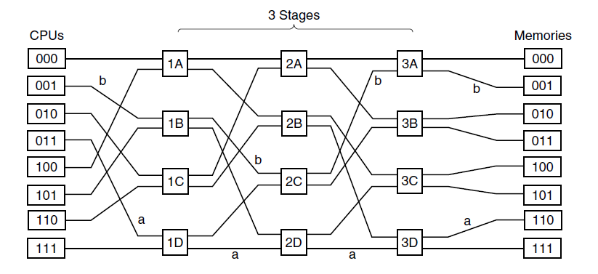
U M A Multiprocessors Using Multistage Switching Networks (2 of 2)
Figure 8-5. An omega switching network.

Slide 7
N U M A Multiprocessors (1 of 3)
Characteristics of N U M A machines which distinguish them from other multiprocessors:
There is a single address space visible to all C P Us.
Access to remote memory is via LOAD and STORE instructions.
Access to remote memory is slower than access to local memory.

Slide 8
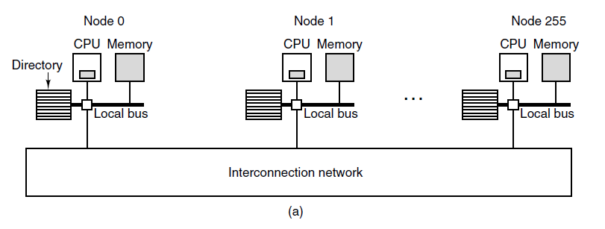
N U M A Multiprocessors (2 of 3)
Figure 8-6. (a) A 256-node directory-based multiprocessor

Slide 9
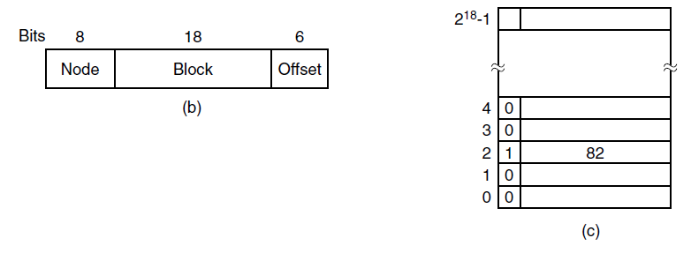
N U M A Multiprocessors (3 of 3)
Figure 8-6. (b) Division of a 32-bit memory address into fields. (c) The directory at node 36.

Slide 10
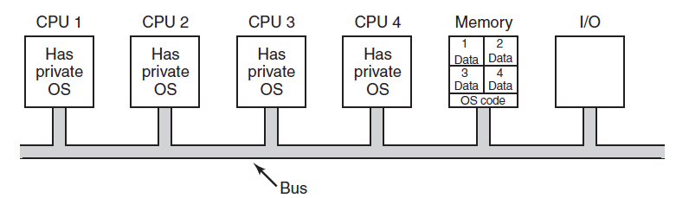
Multiprocessor Operating System Types Each C P U Has Its Own Operating System
Figure 8-7. Partitioning multiprocessor memory among four C P Us, but sharing a single copy of the operating system code. The boxes marked Data are the operating system’s private data for each C P U.

Slide 11
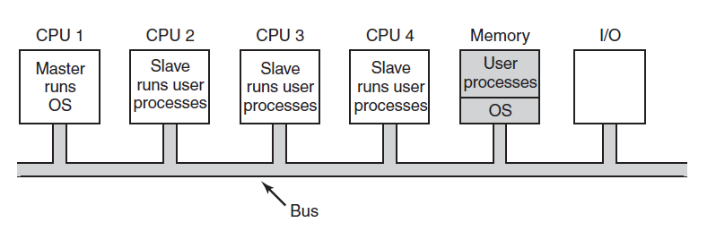
Master-Slave Multiprocessors
Figure 8-8. A master-slave multiprocessor model.

Slide 12
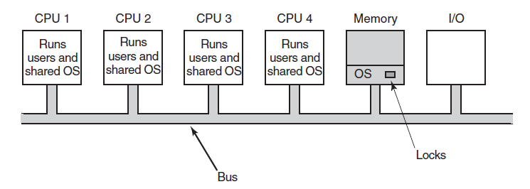
Symmetric Multiprocessors
Figure 8-9. The S M P multiprocessor model.

Slide 13
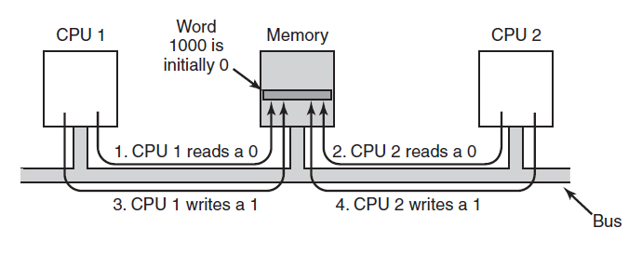
Multiprocessor Synchronization (1 of 2)
Figure 8-10. The T S L instruction can fail if the bus cannot be locked. These four steps show a sequence of events where the failure is demonstrated.

Slide 14
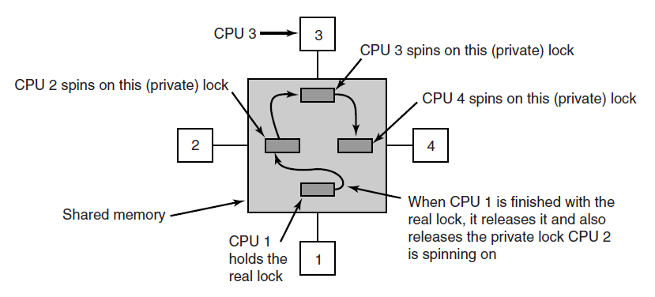
Multiprocessor Synchronization (2 of 2)
Figure 8-11. Use of multiple locks to avoid cache thrashing.

Slide 15
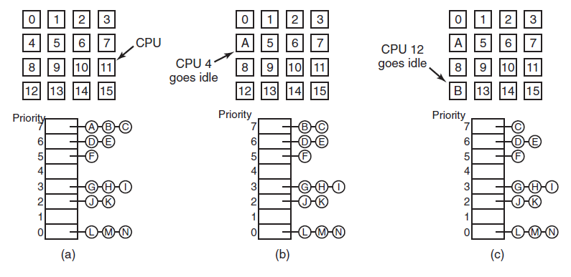
Time Sharing
Figure 8-12. Using a single data structure for scheduling a multiprocessor.

Slide 16
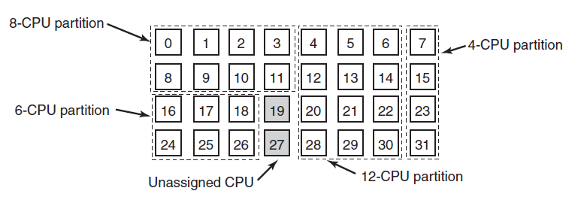
Space Sharing
Figure 8-13. A set of 32 C P Us split into four partitions, with two C P Us available.

Slide 17
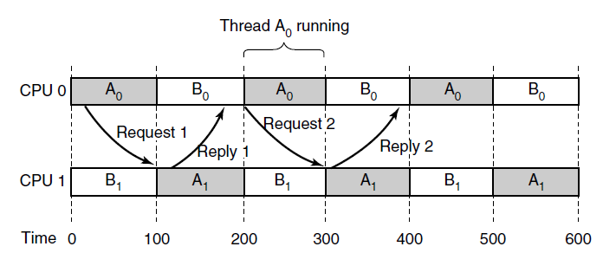
Gang Scheduling (1 of 3)
Figure 8-14. Communication between two threads belonging to thread A that are running out of phase.

Slide 18
Gang Scheduling (2 of 3)
Gang scheduling has three parts:
Groups of related threads are scheduled as a unit, a gang.
All members of a gang run at once on different timeshared C P Us.
All gang members start and end their time slices together.

Slide 19
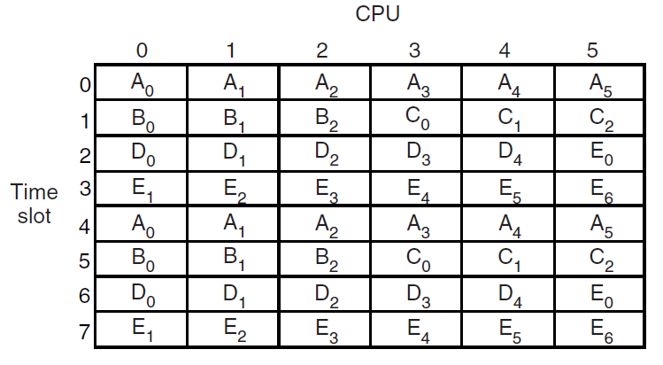
Gang Scheduling (3 of 3)
Figure 8-15. Gang scheduling.

Slide 20
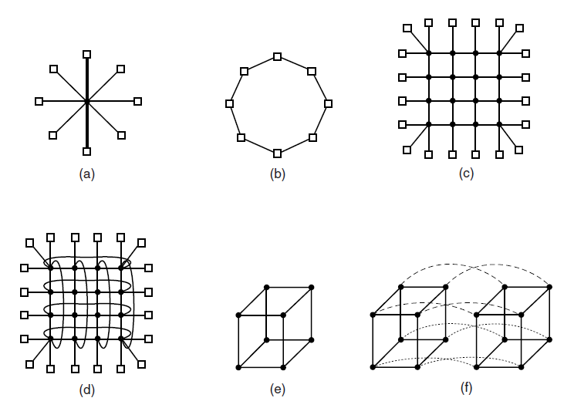
Interconnection Technology (1 of 2)
Figure 8-16. Various interconnect topologies. (a) A single switch. (b) A ring. (c) A grid. (d) A double torus. (e) A cube. (f) A 4D hypercube.

Slide 21
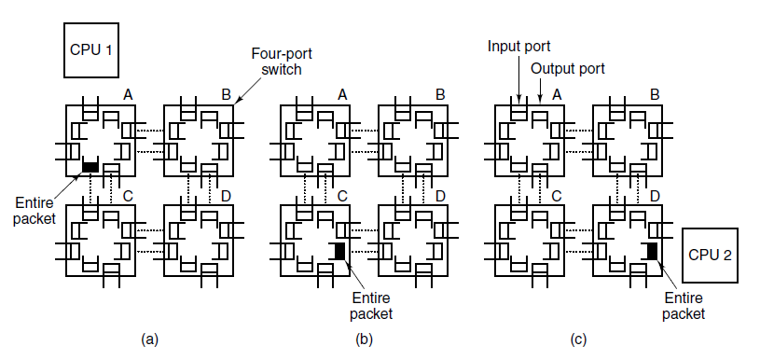
Interconnection Technology (2 of 2)
Figure 8-17. Store-and-forward packet switching.

Slide 22
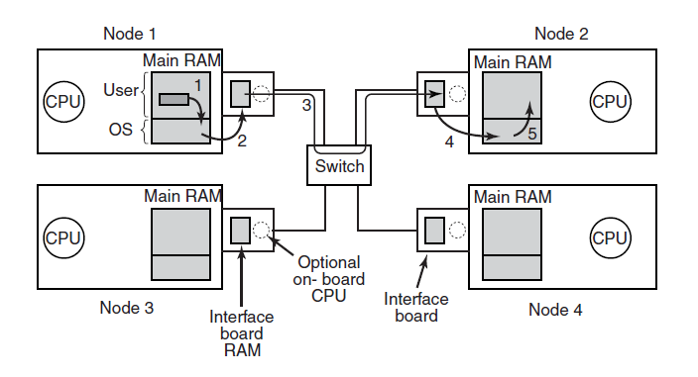
Network Interfaces
Figure 8-18. Position of the network interface boards in a multicomputer.

Slide 23
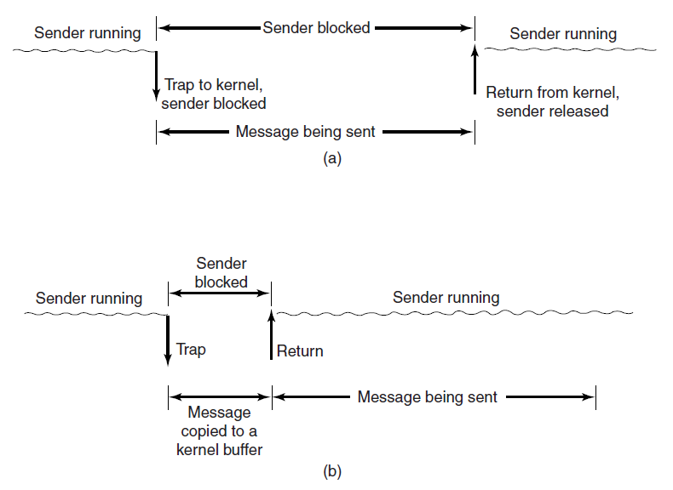
Blocking versus Nonblocking Calls (1 of 2)
Figure 8-19. (a) A blocking send call. (b) A nonblocking send call.

Slide 24
Blocking versus Nonblocking Calls (2 of 2)
Choices on the sending side:
Blocking send (C P U idle during transmission).
Nonblocking send with copy (C P U time wasted for the extra copy).
Nonblocking send with interrupt (makes programming difficult).
Copy on write (extra copy probably needed eventually).

Slide 25
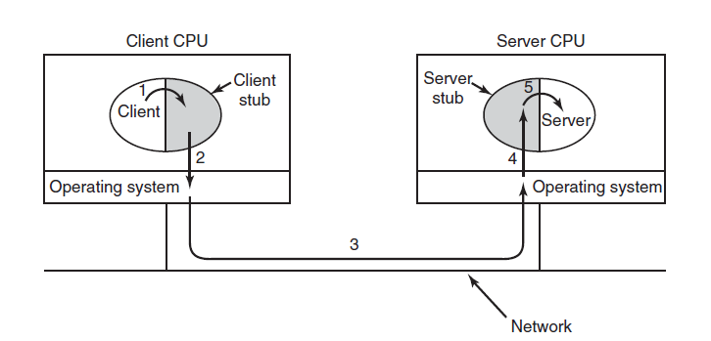
Remote Procedure Call
Figure 8-20. Steps in making a remote procedure call. The stubs are shaded gray.

Slide 26
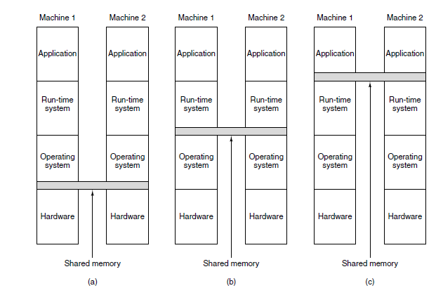
Distributed Shared Memory (1 of 4)
Figure 8-21. Various layers where shared memory can be implemented. (a) The hardware. (b) The operating system. (c) User-level software.

Slide 27
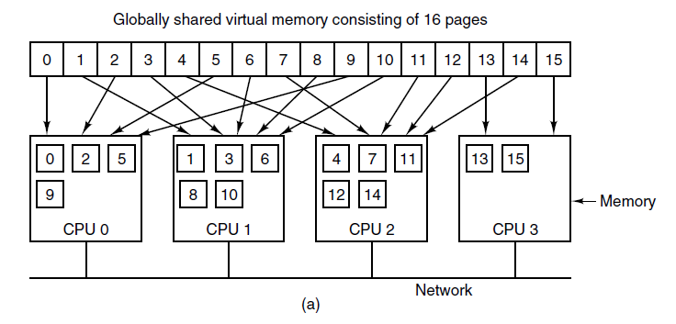
Distributed Shared Memory (2 of 4)
Figure 8-22. (a) Pages of the address space distributed among four machines.

Slide 28
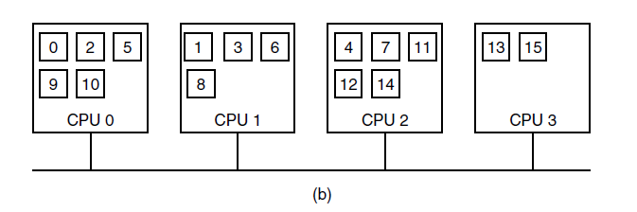
Distributed Shared Memory (3 of 4)
Figure 8-22. (b) Situation after C P U 1 references page 10 and the page is moved there.

Slide 29
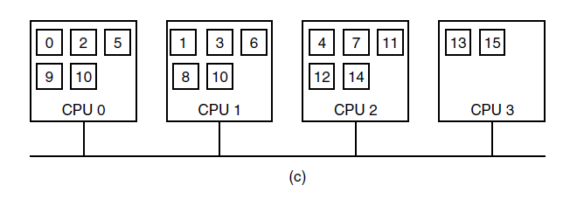
Distributed Shared Memory (4 of 4)
Figure 8-22. (c) Situation if page 10 is read only and replication is used.

Slide 30
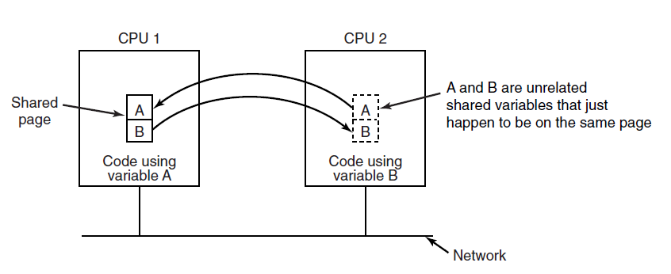
False Sharing
Figure 8-23. False sharing of a page containing two unrelated variables.

Slide 31
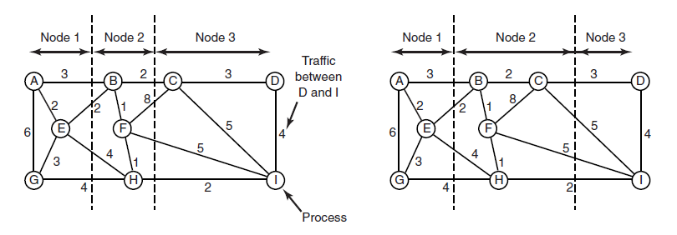
Graph-Theoretic Deterministic Algorithm
Figure 8-24. Two ways of allocating nine processes to three nodes.

Slide 32
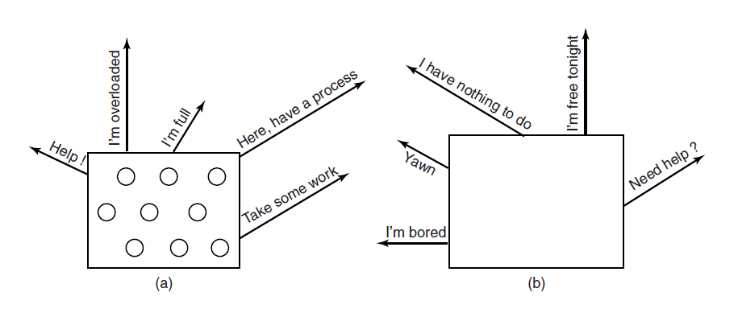
Sender-Initiated Distributed Heuristic Algorithm
Figure 8-25. (a) An overloaded node looking for a lightly loaded node to hand off processes to. (b) An empty node looking for work to do.

Slide 33
Distributed Systems (1 of 2)
Figure 8-26. Comparison of three kinds of multiple C P U systems.
Item | Multiprocessor | Multicomputer | Distributed System
Node configuration | C P U | C P U, RAM, net interface | Complete computer
Node peripherals | All shared | Shared exc. Maybe disk | Full set per node
Location | Same track | Same room | Possibly worldwide
Internode communication | Shared RAM | Dedicated interconnect | Traditional network
Operating systems | One, shared | Multiple, same | Possibly all different
File systems | One, shared | One, shared | Each node has own
Administration | One organisation | One organisation | Many organisations

Slide 34
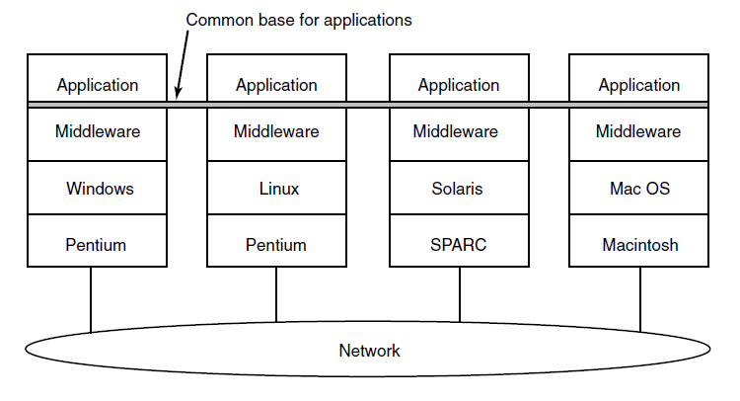
Distributed Systems (2 of 2)
Figure 8-27. Positioning of middleware in a distributed system.

Slide 35
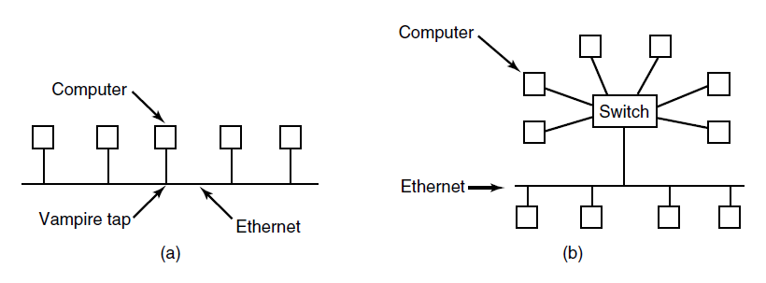
Network Hardware Ethernet
Figure 8-28. (a) Classic Ethernet. (b) Switched Ethernet.

Slide 36
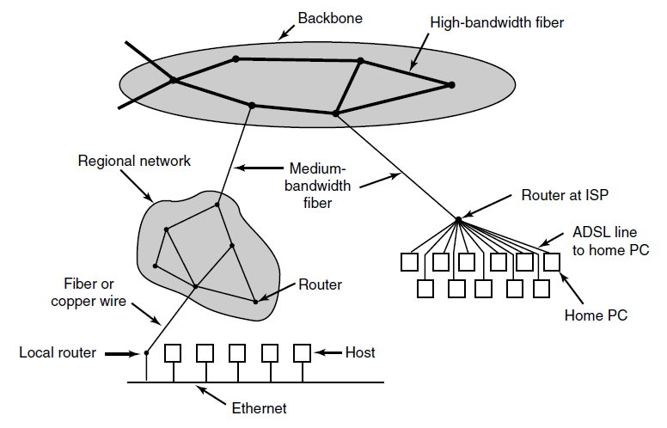
The Internet
Figure 8-29. A portion of the Internet.

Slide 37
Network Services (1 of 2)
Six different types of network service.
Connection Oriented
Service | Example
Reliable message stream | Sequence of pages of a book
Reliable byte stream | Remote login
Unreliable Connection | Digitized voice

Slide 38
Network Services (2 of 2)
Six different types of network service.
Connectionless
Service | Example
Unreliable datagram | Network test packets
Acknowledged datagram | Registered mails
Request-reply | Database query

Slide 39
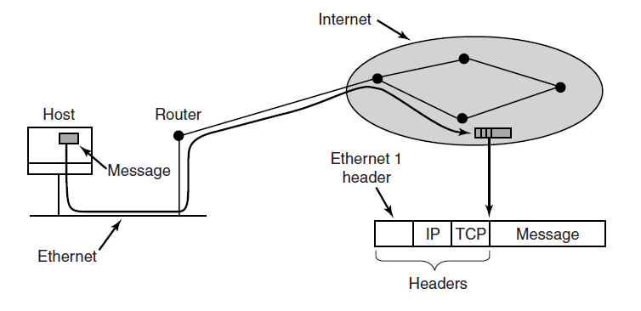
Network Protocols
Figure 8-31. Accumulation of packet headers.

Slide 40
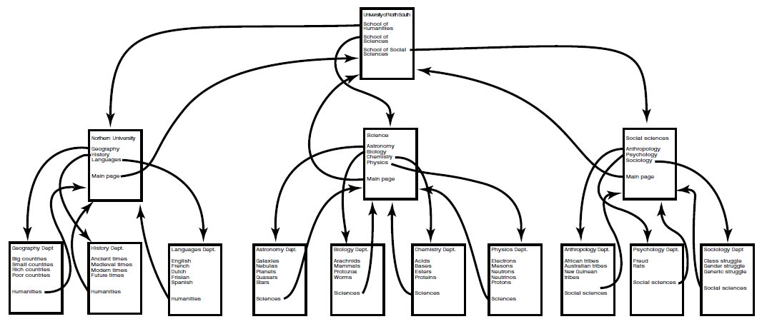
Document-Based Middleware (1 of 3)
Figure 8-32. The Web is a big directed graph of documents.

Slide 41
Document-Based Middleware (2 of 3)
For the browser to get the page http://www.minix3.org/getting-started/index.html
Browser asks D N S for I P address of www.minix3.org
D N S replies with 66.147.238.215
Browser makes a T C P connection to port 80 on 66.147.238.215
Browser sends a request asking for the file getting-started/index.html

Slide 42
Document-Based Middleware (3 of 3)
The www.minix3.org server sends the file getting-started/index.html
Browser displays all the text in getting-started/index.html.
Browser also fetches and displays all images on the page
The T C P connection is released

Slide 43
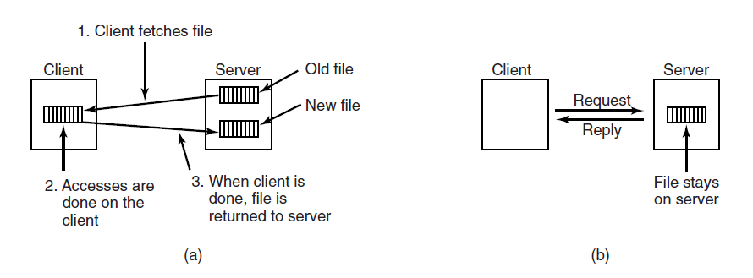
File-System-Based Middleware: Transfer Model
Figure 8-33. (a) The upload/download model. (b) The remote access model.

Slide 44
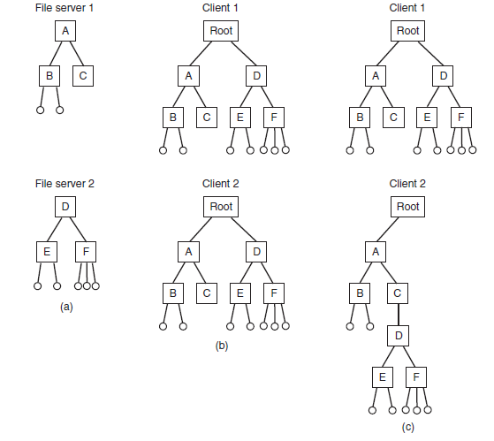
The Directory Hierarchy
Figure 8-34. (a) Two file servers. The squares are directories and the circles are files. (b) A system in which all clients have the same view of the file system. (c) A system in which different clients may have different views of the file system.

Slide 45
Naming Transparency
Common approaches to file and directory naming in a distributed system:
Machine + path naming, such as /machine/path or machine:path.
Mounting remote file systems onto the local file hierarchy.
A single name space that looks the same on all machines.

Slide 46
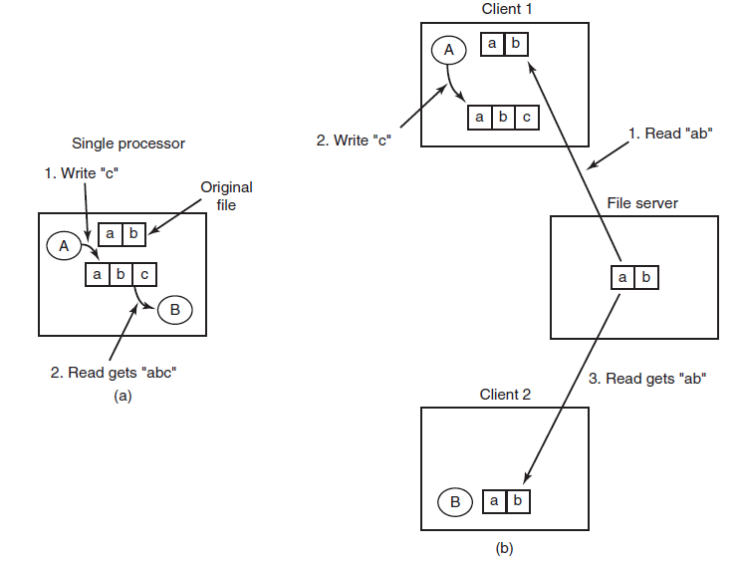
Semantics of File Sharing
Figure 8-35. (a) Sequential consistency. (b) In a distributed system with caching, reading a file may return an obsolete value.

Slide 47
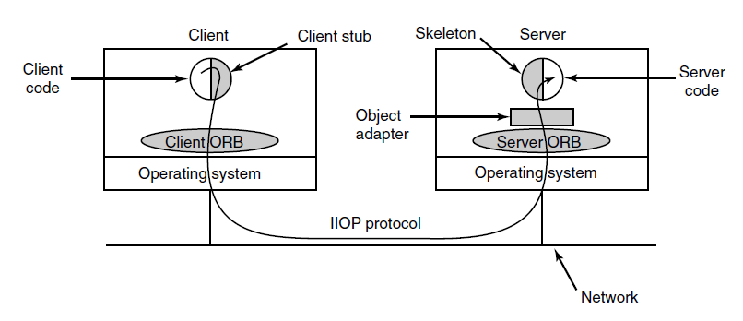
Object-Based Middleware
Figure 8-36. The main elements of a distributed system based on C O R B A. The C O R B A parts are shown in gray.

Slide 48
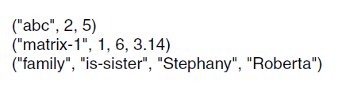
Coordination-Based Middleware (1 of 2)
Figure 8-37. Three Linda tuples

Slide 49
Coordination-Based Middleware (2 of 2)
A match occurs if the following three conditions
are all met:
Template and tuple have the same number of fields.
Types of corresponding fields are equal.
Each constant or variable in the template matches its tuple field.

Slide 50
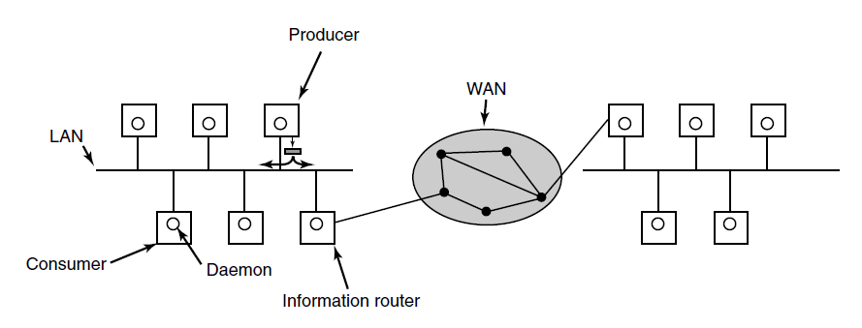
Publish/Subscribe
Figure 8-38. The publish/subscribe architecture.

Slide 51

Copyright

