Slide 1
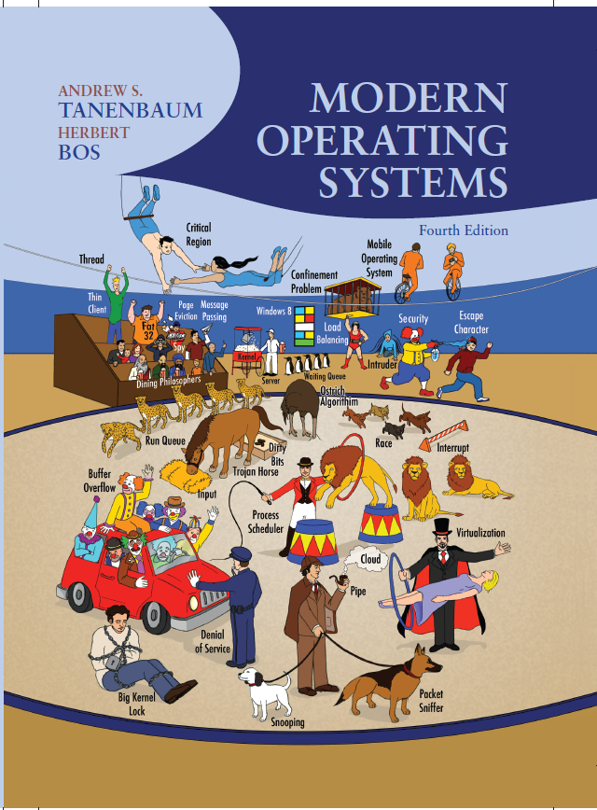
Modern Operating Systems
Fourth Edition
Chapter 9
Security
Copyright © 2014 Pearson Education, Inc. All Rights Reserved
Notes:
If this PowerPoint presentation contains mathematical equations, you may need to check that your computer has the following installed:
1) MathType Plugin
2) Math Player (free versions available)
3) NVDA Reader (free versions available)

Slide 2
The Security Environment Threats
Security goals and threats.
Goal | Threat
Confidentiality | Exposure of data
Integrity | Tampering with data
Availability | Denial of service

Slide 3
Can We Build Secure Systems?
Two questions concerning security:
Is it possible to build a secure computer system?
If so, why is it not done?

Slide 4
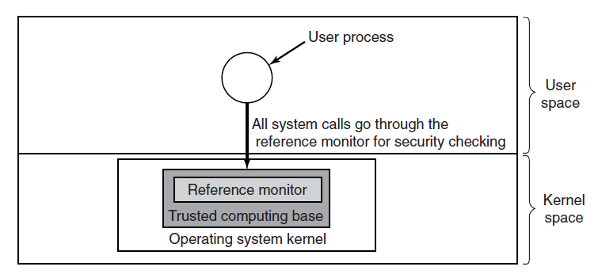
Trusted Computing Base
Figure 9-2. A reference monitor.

Slide 5
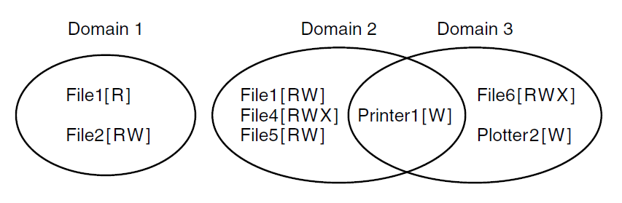
Protection Domains (1 of 3)
Figure 9-3. Three protection domains.

Slide 6
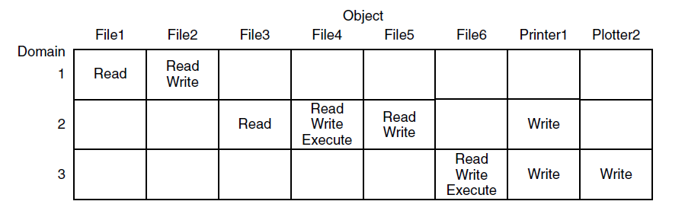
Protection Domains (2 of 3)
Figure 9-4. A protection matrix.

Slide 7
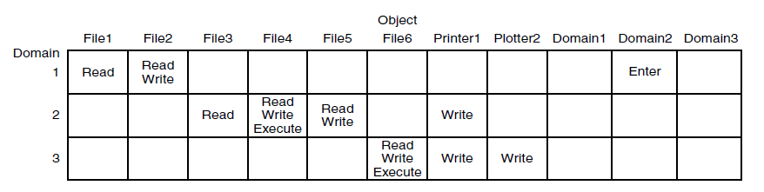
Protection Domains (3 of 3)
Figure 9-5. A protection matrix with domains as objects.

Slide 8
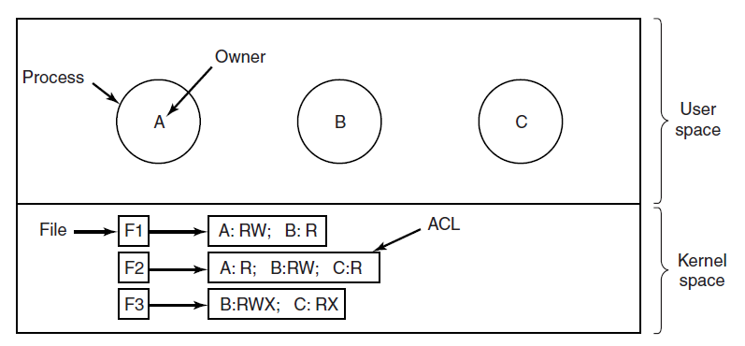
Access Control Lists (1 of 2)
Figure 9-6. Use of access control lists to manage file access.

Slide 9
Access Control Lists (2 of 2)
Use of access control lists to manage file access.
File | Access control list
Password | Tana,sysadm: R W
Pigeon_data | Bill,pigfan: R W; tana,pigfan: R W; …

Slide 10
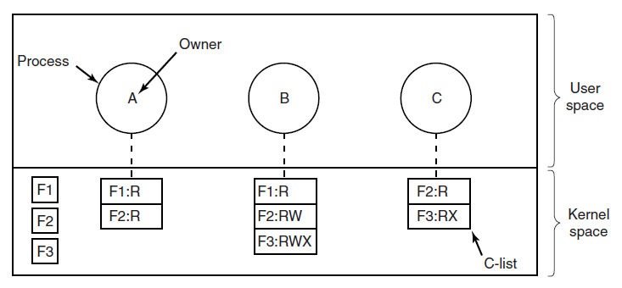
Capabilities (1 of 3)
Figure 9-8. When capabilities are used, each process has a capability list.

Slide 11
Capabilities (2 of 3)
A cryptographically protected capability.
Server | Object | Rights | Function of objects, rights and check

Slide 12
Capabilities (3 of 3)
Examples of generic rights:
Copy capability: create new capability for same object.
Copy object: create duplicate object with new capability.
Remove capability: delete entry from C-list; object unaffected.
Destroy object: permanently remove object and capability.

Slide 13
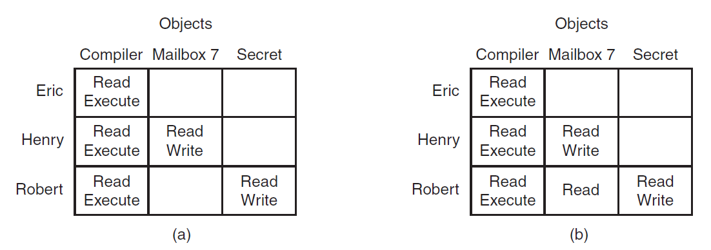
Formal Models of Secure Systems
Figure 9-10. (a) An authorized state. (b) An unauthorized state.

Slide 14
Multilevel Security: Bell-LaPadula Model
Bell-LaPadula Model rules for information flow:
The simple security property
Process running at security level k can read only objects at its level or lower
The * property
Process running at security level k can write only objects at its level or higher

Slide 15
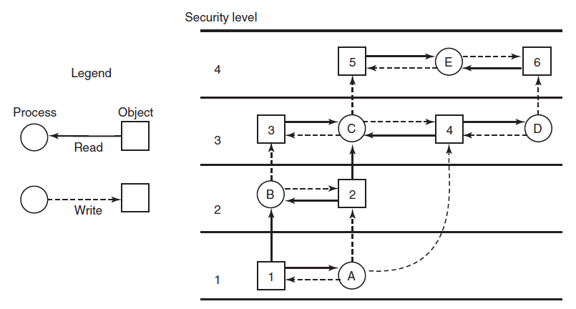
Bell- LaPadula Model
Figure 9-11. The Bell-LaPadula multilevel security model.

Slide 16
The Biba Model
To guarantee the integrity of the data:
The simple integrity principle
process running at security level k can write only objects at its level or lower (no write up).
The integrity * property
process running at security level k can read only objects at its level or higher (no read down).

Slide 17
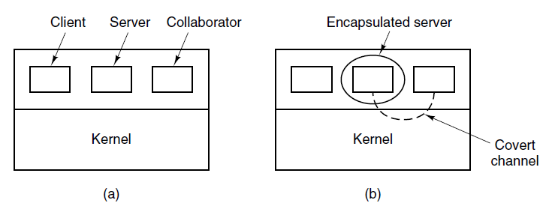
Covert Channels (1 of 2)
Figure 9-12. (a) The client, server, and collaborator processes. (b) The encapsulated server can still leak to the collaborator via covert channels.

Slide 18
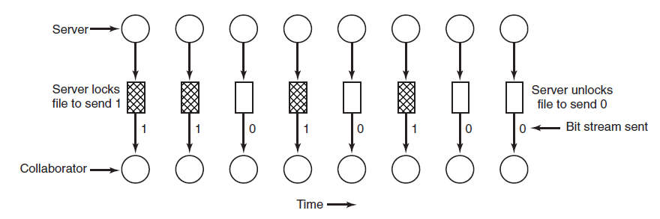
Covert Channels (2 of 2)
Figure 9-13. A covert channel using file locking.

Slide 19
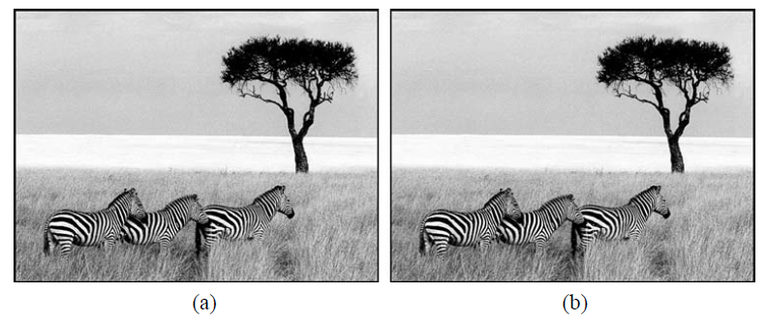
Steganography
Figure 9-14. (a) Three zebras and a tree. (b) Three zebras, a tree, and the complete text of five plays by William Shakespeare.

Slide 20
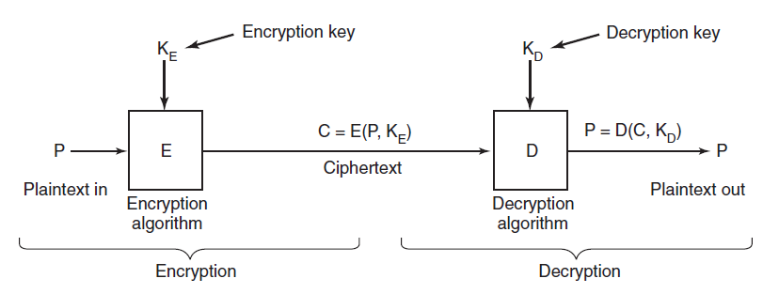
Basics of Cryptography
Figure 9-15. Relationship between the plaintext and the ciphertext.

Slide 21
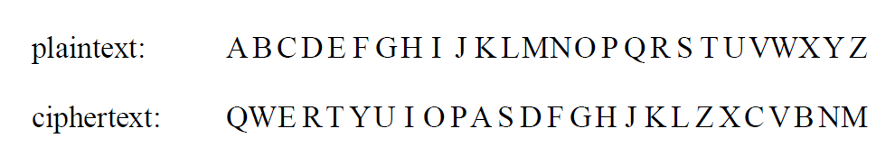
Secret-Key Cryptography
An encryption algorithm in which each letter is replaced by a different letter.

Slide 22
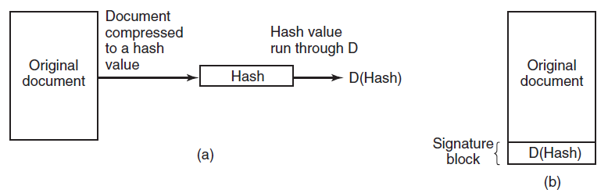
Digital Signatures
Figure 9-16. (a) Computing a signature block. (b) What the receiver gets.

Slide 23
Authentication (1 of 2)
Methods of authenticating users when they
attempt to log in based on one of three general principles:
Something the user knows.
Something the user has.
Something the user is.

Slide 24
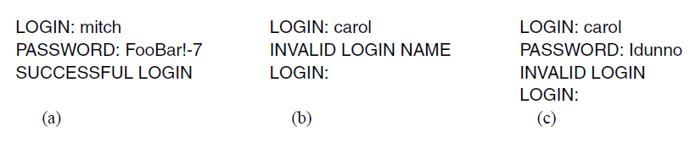
Authentication (2 of 2)
Figure 9-17. (a) A successful login. (b) Login rejected after name is entered. (c) Login rejected after name and password are typed.

Slide 25
U N I X Password Security
(a) A successful login. (b) Login rejected after name is entered. (c) Login rejected after name and password are typed.
Bobbie, 4238, e(Dog, 4238)
Tony, 2918, 2918)
Laura, 6902, e(Shakespeare, 6902)
Mark, 1694, e(XaB#Bwcz, 1694)
Deborah, 1092, e(LordByron,1092)

Slide 26
Challenge-Response Authentication
Questions should be chosen so that the user does not need to write them down. Examples:
Who is Marjolein’s sister?
On what street was your elementary school?
What did Mrs. Ellis teach?

Slide 27
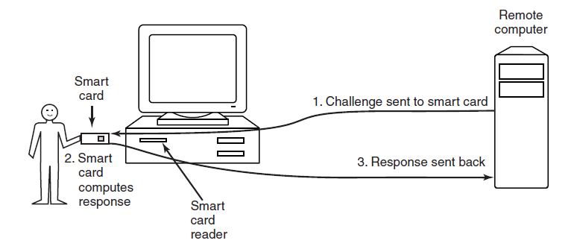
Authentication Using a Physical Object
Figure 9-19. Use of a smart card for authentication.

Slide 28
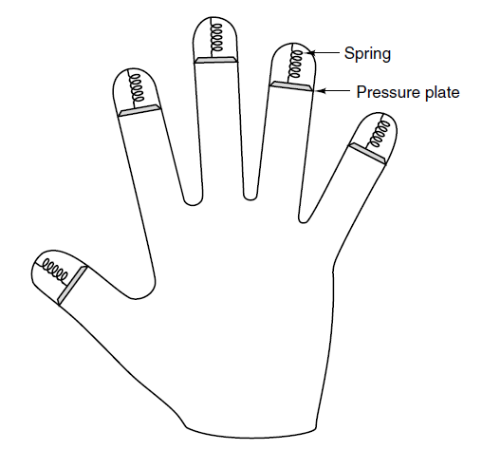
Authentication Using Biometrics
Figure 9-20. A device for measuring finger length.

Slide 29
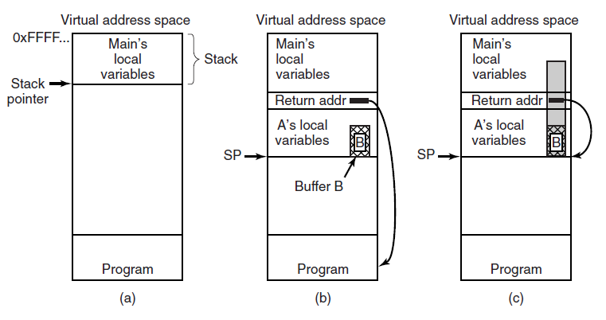
Buffer Overflow Attacks
Figure 9-21. (a) Situation when the main program is running. (b) After the procedure A has been called. (c) Buffer overflow shown in gray.

Slide 30
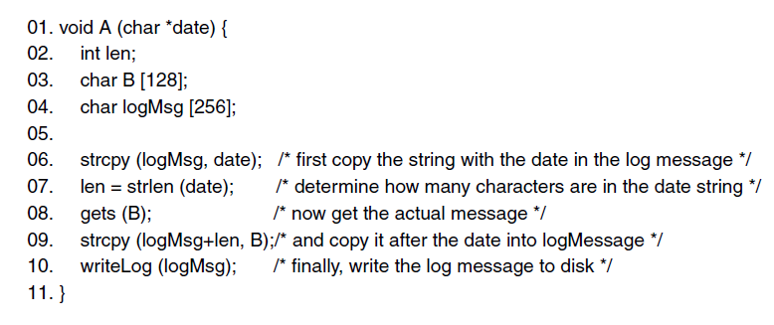
Avoiding Stack Canaries
Figure 9-22. Skipping the stack canary: by modifying len first, the attack is able to bypass the canary and modify the return address directly.

Slide 31
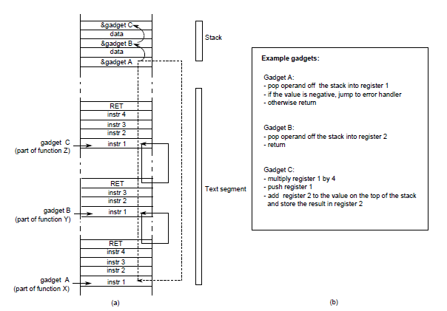
Code Reuse Attacks
Figure 9-23. Return-oriented programming: linking gadgets

Slide 32
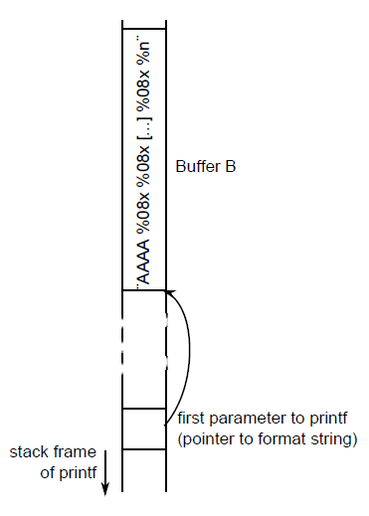
Format String Attacks
Figure 9-24. A format string attack. By using exactly the right number of %08x, the attacker can use the first four characters of the format string as an address.

Slide 33
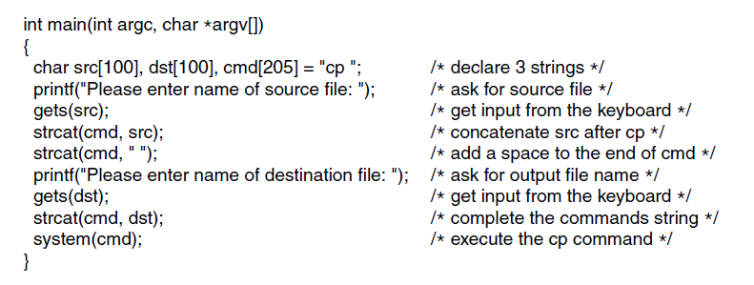
Command Injection Attacks
Figure 9-25. Code that might lead to a command injection attack.

Slide 34
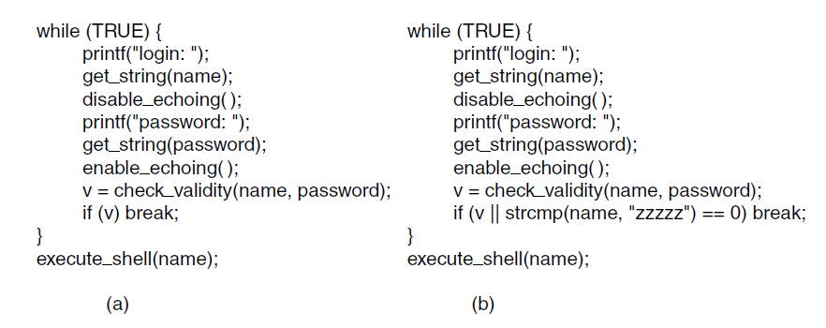
Back Doors
Figure 9-26. (a) Normal code. (b) Code with a back door inserted.

Slide 35
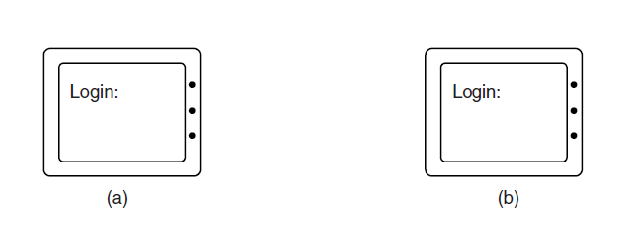
Login Spoofing
Figure 9-27. (a) Correct login screen. (b) Phony login screen.

Slide 36
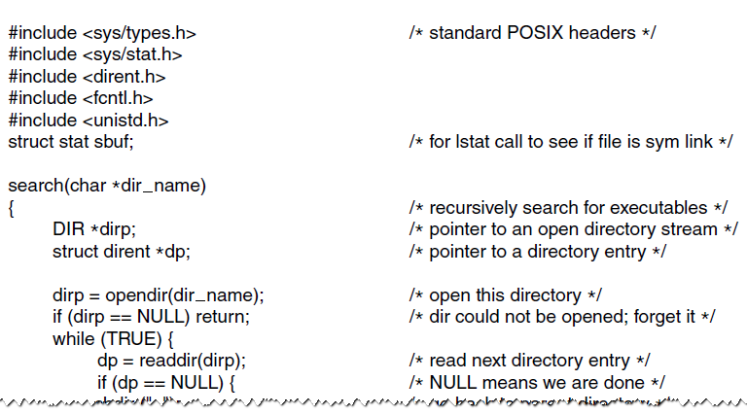
Executable Program Viruses (1 of 3)
Figure 9-28. A recursive procedure that finds executable files on a U N I X system.

Slide 37
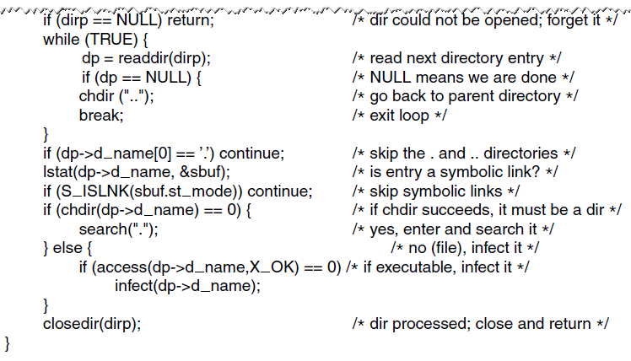
Executable Program Viruses (2 of 3)
Figure 9-28. A recursive procedure that finds executable files on a U N I X system.

Slide 38
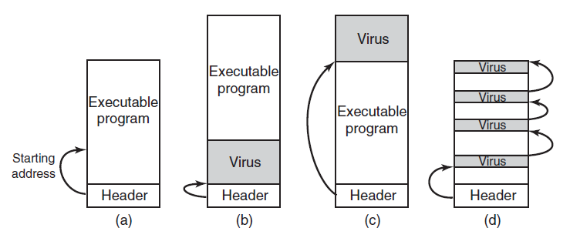
Executable Program Viruses (3 of 3)
Figure 9-29. (a) An executable program. (b) With a virus at the front. (c) With a virus at the end. (d) With a virus spread over free space within the program.

Slide 39
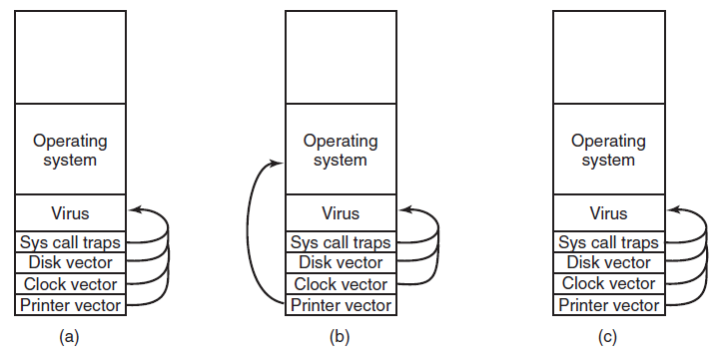
Boot Sector Viruses
Figure 9-30. (a) After the virus has captured all the interrupt and trap vectors. (b) After the operating system has retaken the printer interrupt vector. (c) After the virus has noticed the loss of the printer interrupt vector and recaptured it.

Slide 40
Actions Taken by Spyware (1 of 2)
Change the browser’s home page.
Modify the browser’s list of favorite (bookmarked) pages.
Add new toolbars to the browser.
Change the user’s default media player.
Change the user’s default search engine.

Slide 41
Actions Taken by Spyware (2 of 2)
Add new icons to the Windows desktop.
Replace banner ads on Web pages with those the spyware picks.
Put ads in the standard Windows dialog boxes
Generate a continuous and unstoppable stream of pop-up ads.

Slide 42
Types of Rootkits (1 of 2)
Five kinds of rootkits – issue is where do they hide?
Firmware rootkit
Hypervisor rootkit
Kernel rootkit
Library rootkit
Application rootkit

Slide 43
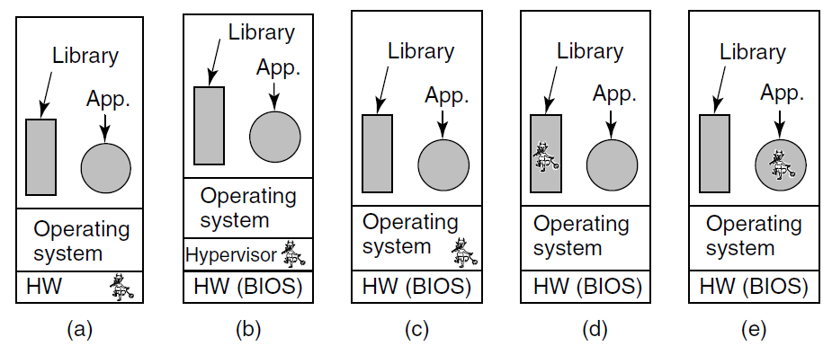
Types of Rootkits (2 of 2)
Figure 9-31. Five places a rootkit can hide.

Slide 44
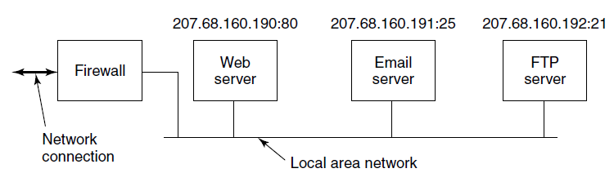
Firewalls
Figure 9-32. A simplified view of a hardware firewall protecting a LAN with three computers

Slide 45
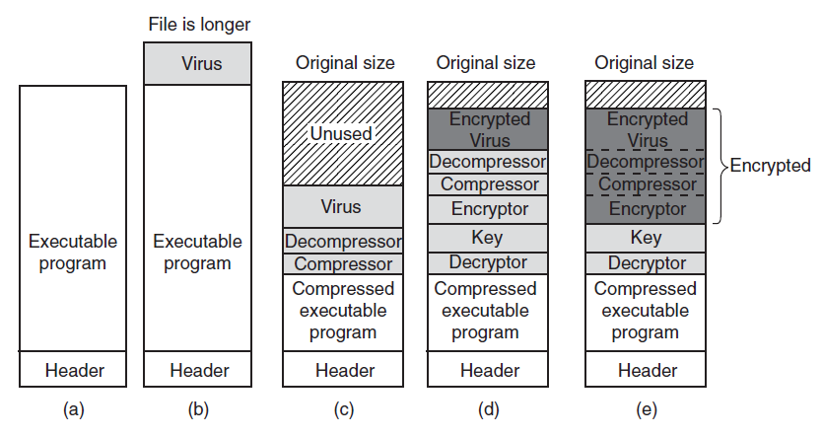
Virus Scanners (1 of 2)
Figure 9-33. (a) A program. (b) An infected program. (c) A compressed infected program. (d) An encrypted virus. (e) A compressed virus with encrypted compression code.

Slide 46
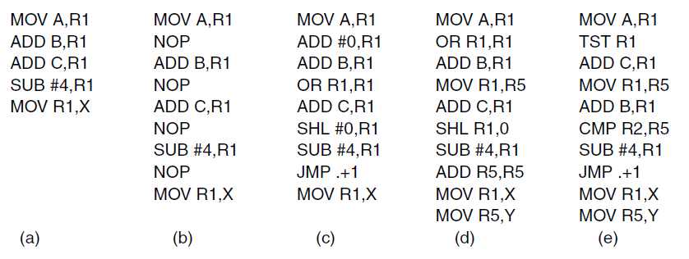
Virus Scanners (2 of 2)
Figure 9-34. Examples of a polymorphic virus.

Slide 47
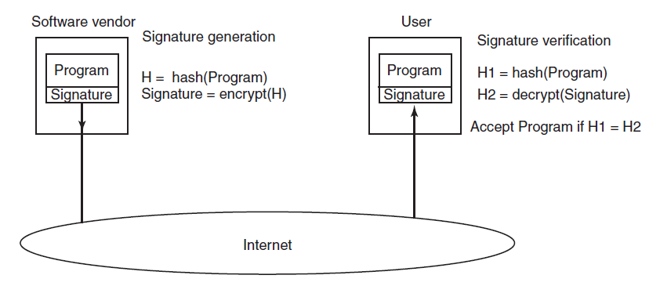
Code Signing
Figure 9-35. How code signing works.

Slide 48
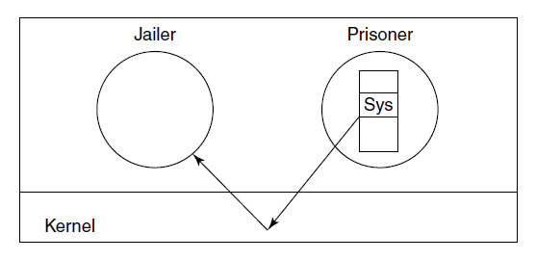
Jailing
Figure 9-36. The operation of a jail.

Slide 49
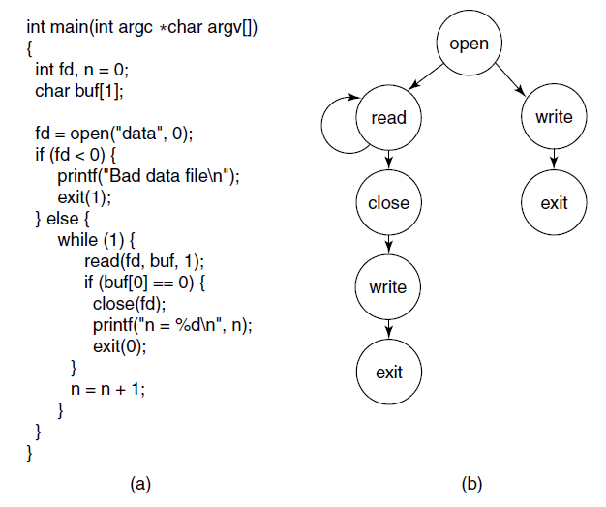
Model-Based Intrusion Detection
Figure 9-37. (a) A program. (b) System call graph for (a).

Slide 50
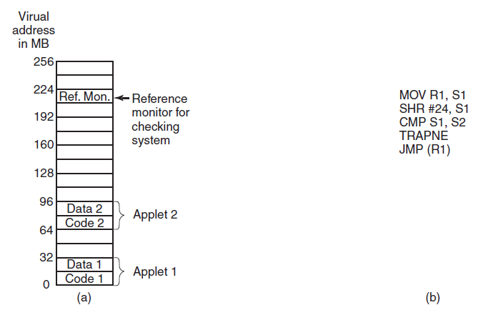
Sandboxing
Figure 9-38. (a) Memory divided into 16-MB sandboxes. (b) One way of checking an instruction for validity.

Slide 51
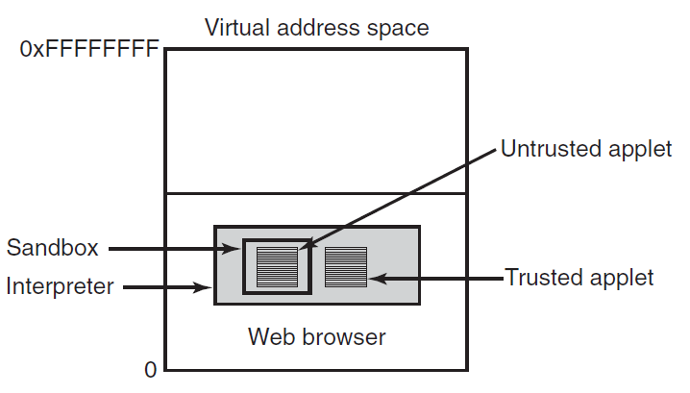
Interpretation
Figure 9-39. Applets can be interpreted by a Web browser.

Slide 52
Java Security (1 of 2)
Checks on applets include:
Does applet attempt to forge pointers?
Does it violate access restrictions on private-class members?
Does it try to use variable of one type as another?
Does it generate stack overflows or underflows?
Does it illegally convert variables of one type to another?

Slide 53
Java Security (2 of 2)
Some examples of protection that can be specified with J D K 1.2.
U R L | Signer | Object | Action
www.taxprep.com | TaxPrep | /usr/susan/1040.xIs | Read
* | Blank | /usr/tmp/* | Read, Write
www.microsoft.com | Microsoft | /usr/susan/Office/— | Read, Write, Delete

Slide 54
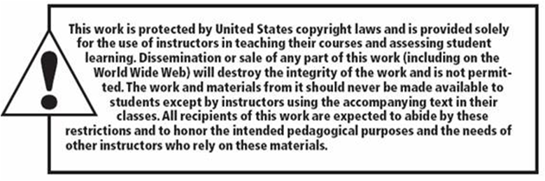
Copyright

