Slide 1
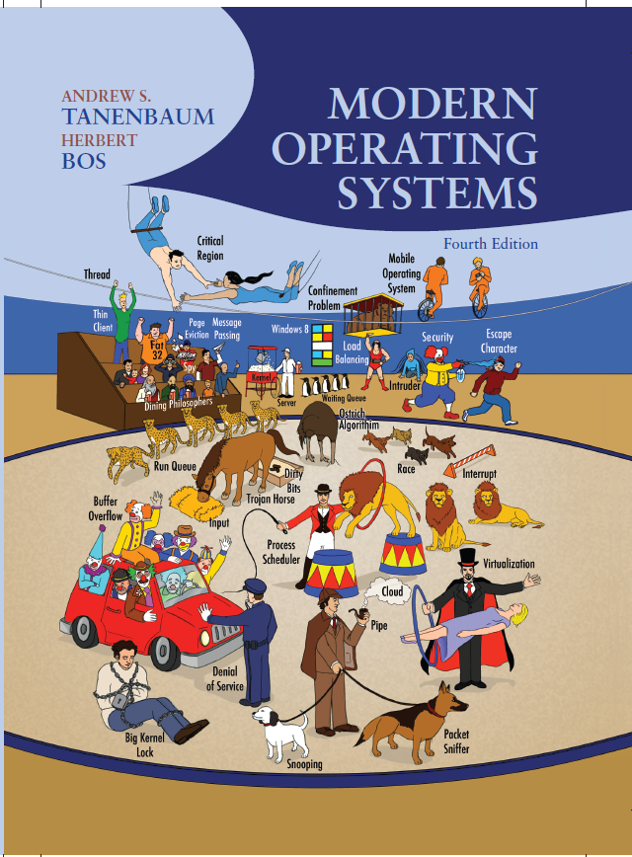
Modern Operating Systems
Fourth Edition
Chapter 11
Case Study 2: Windows 8
Copyright © 2014 Pearson Education, Inc. All Rights Reserved
Notes:
If this PowerPoint presentation contains mathematical equations, you may need to check that your computer has the following installed:
1) MathType Plugin
2) Math Player (free versions available)
3) NVDA Reader (free versions available)

Slide 2
History of Windows through Windows 8.1 (1 of 2)
Major releases in the history of Microsoft operating systems for desktop P Cs.
Year | M S−DOS | M S-DOS based Windows | N T-based Windows | Modern Windows | Notes
1981 | 1.0 | Blank | Blank | Blank | Initial release for I B M P C
1983 | 2.0 | Blank | Blank | Blank | Support for P C/X T
1984 | 3.0 | Blank | Blank | Blank | Support for P C/A T
1990 | Blank | 3.0 | Blank | Blank | Ten million copies in 2 years
1991 | 5.0 | Blank | Blank | Blank | Added memory management
1992 | Blank | 3.1 | Blank | Blank | Ran only on 286 and later
1993 | Blank | Blank | N T3.1 | Blank | Blank
1995 | 7.0 | 95 | Blank | Blank | M S-DOS embedded in Win 95
1996 | Blank | Blank | N T4.0 | Blank | Blank
1998 | Blank | 98 | Blank | Blank | Blank

Slide 3
History of Windows through Windows 8.1 (2 of 2)
Major releases in the history of Microsoft operating systems for desktop P Cs.
Year | MS−DOS | MS-DOS based Windows | NT-based Windows | Modern Windows | Notes
2000 | 8.0 | Me | 2000 | Blank | Win Me was infer ior to Win 98
2001 | Blank | Blank | X P | Blank | Replaced Win 98
2006 | Blank | Blank | Vista | Blank | Vista could not supplant X P
2009 | Blank | Blank | 7 | Blank | Significantly improved upon Vista
2012 | Blank | Blank | Blank | 8 | First Modern version
2013 | Blank | Blank | Blank | 8.1 | Microsoft moved to rapid releases

Slide 4
2000s: N T-based Windows (1 of 2)
D E C Operating Systems developed by Dave Cutler.
Year | D E C operating system | Characteristics
1973 | R S X-11M | 16-bit, multiuser, real-time, swapping
1978 | V A X/VMS | 32-bit, virtual memory
1987 | V A X E L A N | Real-time
1988 | PRISM/Mica | Canceled in favor of M I P S/Ultrix

Slide 5
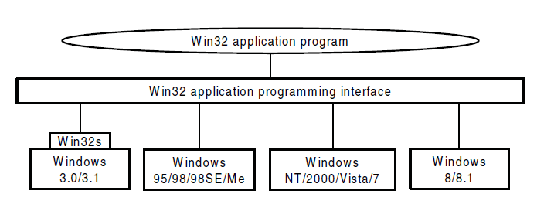
2000s: N T-based Windows (2 of 2)
Figure 11-3. The Win32 A P I allows programs to run on almost all versions of Windows.

Slide 6
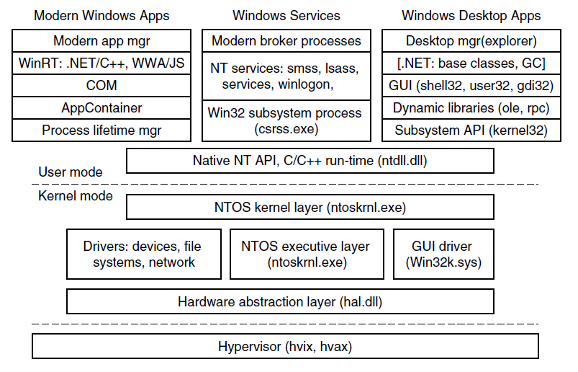
Programming Windows (1 of 2)
Figure 11-4. The programming layers in Modern Windows

Slide 7
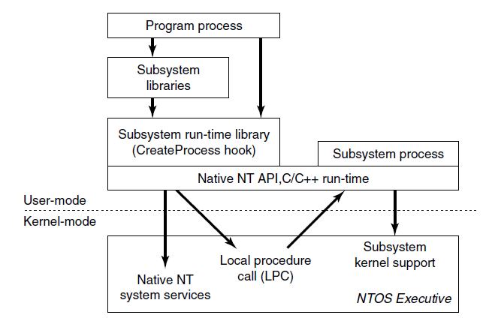
Programming Windows (2 of 2)
Figure 11-5. The components used to build N T subsystems.

Slide 8
The Native N T Application Programming Interface (1 of 2)
Common categories of kernel-mode object types.
Object category | Examples
Synchronization | Semaphores, mutexes, events, I P C ports, I/O completion queues
I/O | Files, devices, drivers, timers
Program | Jobs, processes, threads, sections, tokens
Win32 G U I | Desktops, application callbacks

Slide 9
The Native N T Application Programming Interface (2 of 2)
Examples of native N T A P I calls that use handles to manipulate objects across process boundaries.
NtCreateProcess(&ProcHandle, Access, SectionHandle, DebugPortHandle, ExceptPortHandle, ...)
NtCreateThread(&ThreadHandle, ProcHandle, Access, ThreadContext, CreateSuspended, ...)
NtAllocateVirtualMemory(ProcHandle, Addr, Size, Type, Protection, ...)
NtMapViewOfSection(SectHandle, ProcHandle, Addr, Size, Protection, ...)
NtReadVirtualMemory(ProcHandle, Addr, Size, ...)
NtWriteVirtualMemory(ProcHandle, Addr, Size, ...)
NtCreateFile(&FileHandle, FileNameDescriptor, Access, ...)
NtDuplicateObject(srcProcHandle, srcObjHandle, dstProcHandle, dstObjHandle, ...)

Slide 10
The Win32 Application Programming Interface
Examples of Win32 A P I calls and the native N T A P I calls that they wrap.
Win32 call | Native NT API call
CreateProcess | NtCreateProcess
CreateThread | NtCreateThread
SuspendThread | NtSuspendThread
CreateSemaphore | NtCreateSemaphore
ReadFile | NtReadFile
DeleteFile | NtSetInformationFile
CreateFileMapping | NtCreateSection
VirtualAlloc | NtAllocateVirtualMemory
MapViewOfFile | NtMapViewOfSection
DuplicateHandle | NtDuplicateObject
CloseHandle | NtClose

Slide 11
The Windows Registry (1 of 2)
The registry hives in Windows. H K L M is a short-hand for HKEY LOCAL MACHINE.
Hive file | Mounted name | Use
SYSTEM | H K L M\SYSTEM | OS configuration information, used by kernel
HARDWARE | H K L M\HARDWARE | In-memory hive recording hardware detected
BCD | H K L M\BCD* | Boot Configuration Database
S A M | H K L M\S A M | Local user account information
SECURITY | H K L M\SECURITY | lsass’ account and other security information
DEFAULT | H K E Y USERS \.DEFAULT | Default hive for new users
NTUSER.DAT | H K E Y USERS \<user id> | User-specific hive, kept in home directory
SOFTWARE | H K L M\SOFTWARE | Application classes registered by COM
COMPONENTS | H K L M\COMPONENTS | Manifests and dependencies for sys. components

Slide 12
The Windows Registry (2 of 2)
Some of the Win32 A P I calls for using the registry
Win32 API function | Description
RegCreateKeyEx | Create a new registry key
RegDeleteKey | Delete a registry key
RegOpenKeyEx | Open a key to get a handle to it
RegEnumKeyEx | Enumerate the subkeys subordinate to the key of the handle
RegQueryValueEx | Look up the data for a value within a key

Slide 13
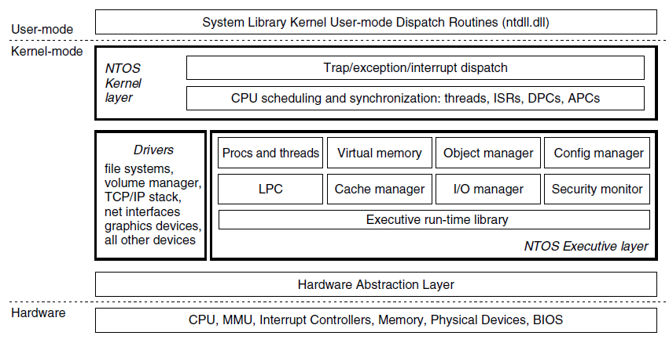
Operating System Structure
Figure 11-11. Windows kernel-mode organization.

Slide 14
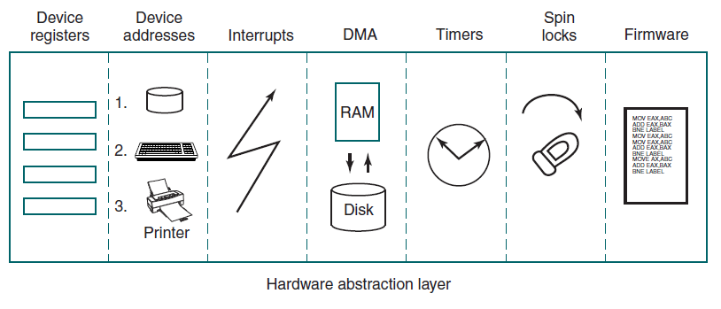
The Hardware Abstraction Layer
Figure 11-12. Some of the hardware functions the H A L manages

Slide 15
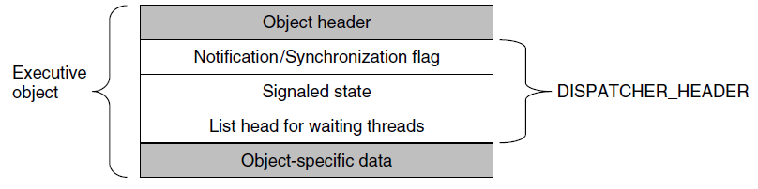
Dispatcher Objects
Figure 11-13. dispatcher_header data structure embedded in many executive objects (dispatcher objects).

Slide 16
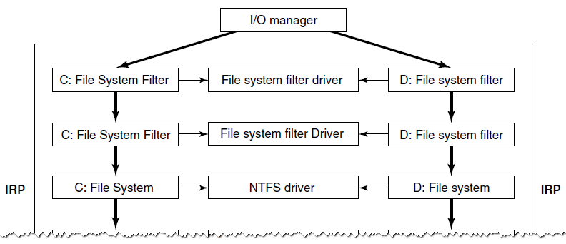
The Device Drivers (1 of 2)
Figure 11-14. Simplified depiction of device stacks for two N T F S file volumes. The I/O request packet is passed from down the stack. The appropriate routines from the associated drivers are called at each level in the stack. The device stacks themselves consist of device objects allocated specifically to each stack.

Slide 17
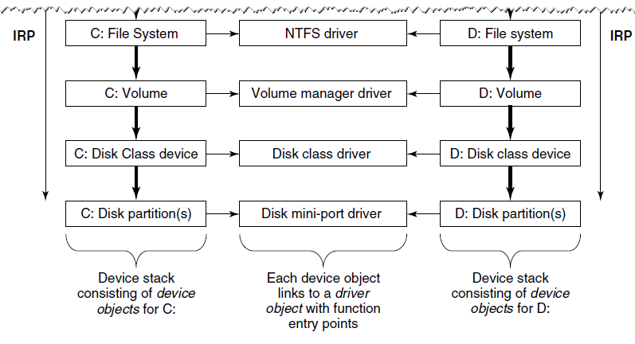
The Device Drivers (2 of 2)
Figure 11-14. Simplified depiction of device stacks for two N T F S file volumes. The I/O request packet is passed from down the stack. The appropriate routines from the associated drivers are called at each level in the stack. The device stacks themselves consist of device objects allocated specifically to each stack.

Slide 18
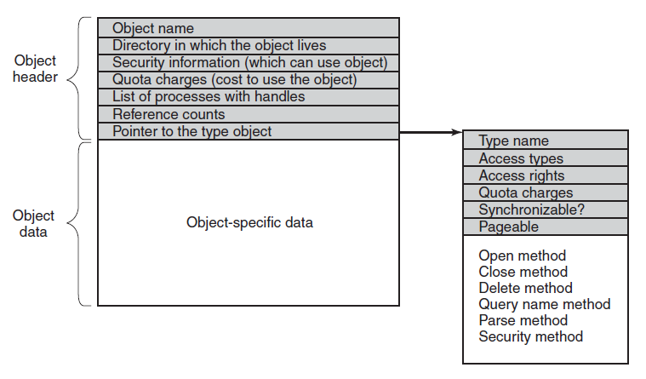
Implementation of the Object Manager
Figure 11-15. The structure of an executive object managed by the object manager

Slide 19
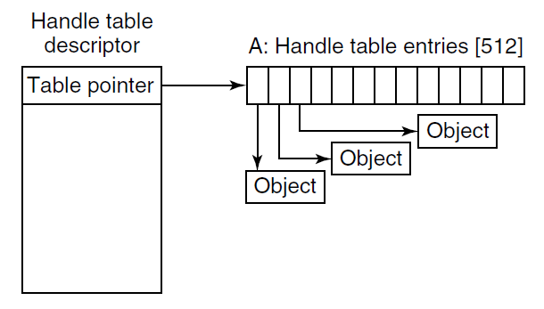
Handles (1 of 2)
Figure 11-16. Handle table data structures for a minimal table using a single page for up to 512 handles.

Slide 20
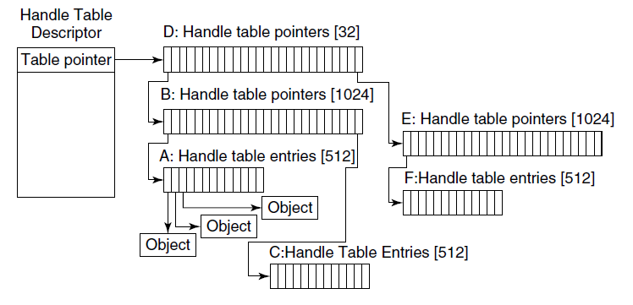
Handles (2 of 2)
Figure 11-17. Handle table data structures for a maximal table of up to 16 million handles.

Slide 21
The Object Name Space (1 of 8)
The object procedures supplied when specifying a new object type.
Procedure | When called | Notes
Open | For every new handle | Rarely used
Parse | For object types that extend the namespace | Used for files and registry keys
Close | At last handle close | Clean up visible side effects
Delete | At last pointer dereference | Object is about to be deleted
Security | Get or set object’s security descriptor | Protection
QueryName | Get object’s name | Rarely used outside kernel

Slide 22
The Object Name Space (2 of 8)
Some typical directories in the object name space
Directory | Contents
\?? | Starting place for looking up MS-DOS devices like C:
\ DosDevices | Official name of \ ??, but really just a symbolic link to \ ??
\Device | All discovered I/O devices
\Driver | Objects corresponding to each loaded device driver
\ObjectTypes | The type objects such as those listed in Fig. 11-21
\Windows | Objects for sending messages to all the Win32 GUI windows
\BaseNamedObjects | User-created Win32 objects such as semaphores, mutexes, etc.
\Arcname | Partition names discovered by the boot loader
\N L S | National Language Support objects
\FileSystem | File-systemdriver objects and file system recognizer objects
\Security | Objects belonging to the security system
\KnownDLLs | Key shared libraries that are opened early and held open

Slide 23
The Object Name Space (3 of 8)
Use of parse procedure:
Executive component passes Unicode pathname for namespace
Object manager searches through directories and symbolic links
Object manager calls the Parse procedure for object type
I/O manager creates I R P, allocate file object, send request to stack of I/O devices

Slide 24
The Object Name Space (4 of 8)
Use of parse procedure:
I R P passed down the I/O stack until it reaches device object representing the file system instance
Device objects encountered as the I R P heads toward the file system represent file system filter drivers
File system device object has a link to file system driver object

Slide 25
The Object Name Space (5 of 8)
Use of parse procedure:
N T F S fills in file object and returns it to I/O manager, which returns back up through all devices on the stack
Object manager is finished with its namespace lookup
Final step is to return back to the user-mode caller

Slide 26
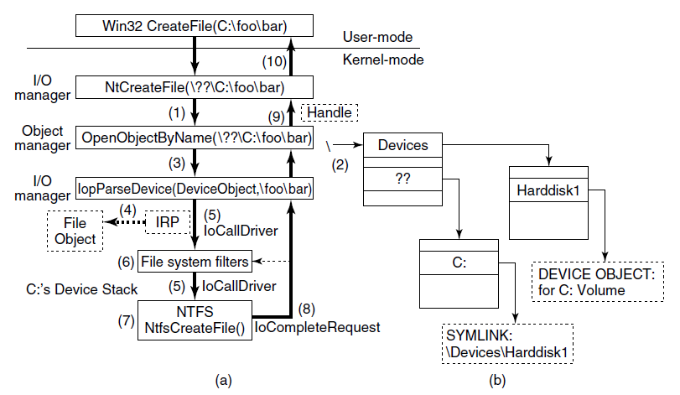
The Object Name Space (6 of 8)
Figure 11-20. I/O and object manager steps for creating/opening a file and getting back a file handle.

Slide 27
The Object Name Space (7 of 8)
Some common executive object types managed by the object manager.
Type | Description
Process | User process
Thread | Thread within a process
Semaphore | Counting semaphore used for interprocess synchronization
Mutex | Binary semaphore used to enter a critical region
Event | Synchronization object with persistent state (signaled/not)
ALPC port | Mechanism for interprocess message passing
Timer | Object allowing a thread to sleep for a fixed time interval
Queue | Object used for completion notification on asynchronous I/O
Open file | Object associated with an open file

Slide 28
The Object Name Space (8 of 8)
Some common executive object types managed by the object manager.
Type | Description
Access token | Security descriptor for some object
Profile | Datastructure used for profiling CPU usage
Section | Object used for representing mappable files
Key | Registry key, used to attach registry to object-manager namespace
Object directory | Directory for grouping objects within the object manager
Symbolic link | Refers to another object manager object by path name
Device | I/O device object for a physical device, bus, driver, or volume instance
Device driver | Each loaded device driver has its own object

Slide 29
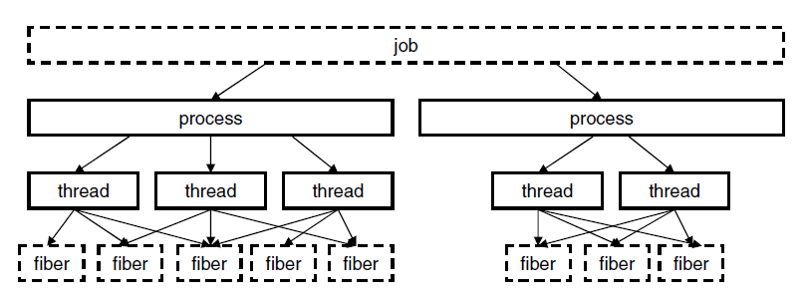
Jobs, Processes, Threads, Fibers
Figure 11-22. The relationship between jobs, processes, threads and fibers. Jobs and fibers are optional; not all processes are in jobs or contain fibers.

Slide 30
Thread Pools and User-Mode Scheduling (1 of 2)
Key elements of U M S implementation:
User-mode switching
Re-entering the user-mode scheduler
System call completion

Slide 31
Thread Pools and User-Mode Scheduling (2 of 2)
Basic concepts used for C P U and resource management.
Name | Description | Notes
Job | Collection of processes that share quotas and limits | Used in AppContainers
Process | Container for holding resources | Blank
Thread | Entity scheduled by the kernel | Blank
Fiber | Lightweight thread managed entirely in user space | Rarely used
Thread pool | Task-oriented programming model | Built on top of threads
User-mode thread | Abstraction allowing user-mode thread switching | An extension of threads

Slide 32
Job, Process, Thread, and Fiber Management A P I Calls (1 of 3)
Differences from U N I X:
Actual search path for finding program to execute buried in library code for Win32, but managed more explicitly in U N I X.
Current working directory is a kernel-mode concept in U N I X but a user-mode string in Windows.
U N I X parses command line and passes array of parameters, while Win32 leaves argument parsing up to individual program.

Slide 33
Job, Process, Thread, and Fiber Management A P I Calls (2 of 3)
Differences from U N I X :
Inheritance of file descriptors in U N I X a property the handle. In Windows is also property of handle to process creation.
New processes directly passed information about primary window in Win32. Passed as parameters to G U I applications in U N I X.
Windows does not have S E T U I D bit as property of the executable, but one process can create a process that runs as a different user (with proper token)

Slide 34
Job, Process, Thread, and Fiber Management A P I Calls (3 of 3)
Differences from U N I X:
Process and thread handle returned from Windows can be used at any time to modify new process/thread in many ways. U N I X only makes modifications to new process between fork and exec calls, and only in limited ways

Slide 35
Implementation of Processes and Threads (1 of 2)
Some of the Win32 calls for managing processes, threads, and fibers.
Win32 API Function | Description
CreateProcess | Create a new process
CreateThread | Create a new thread in an existing process
CreateFiber | Create a new fiber
ExitProcess | Terminate current process and all its threads
ExitThread | Terminate this thread
ExitFiber | Terminate this fiber
SwitchToFiber | Run a different fiber on the current thread
SetPriorityClass | Set the priority class for a process
SetThreadPriority | Set the priority for one thread
CreateSemaphore | Create a new semaphore
CreateMutex | Create a new mutex
OpenSemaphore | Open an existing semaphore
OpenMutex | Open an existing mutex

Slide 36
Implementation of Processes and Threads (2 of 2)
Some of the Win32 calls for managing processes, threads, and fibers.
Win32 API Function | Description
WaitForSingleObject | Block on a single semaphore, mutex, etc.
WaitForMultipleObjects | Block on a set of objects whose handles are given
PulseEvent | Set an event to signaled, then to nonsignaled
ReleaseMutex | Release a mutex to allow another thread to acquire it
ReleaseSemaphore | Increase the semaphore count by 1
EnterCriticalSection | Acquire the lock on a critical section
LeaveCriticalSection | Release the lock on a critical section
WaitOnAddress | Block until the memory is changed at the specified address
WakeByAddressSingle | Wake the first thread that is waiting on this address
WakeByAddressAll | Wake all threads that are waiting on this address
InitOnceExecuteOnce | Ensure that an initialize routine executes only once

Slide 37
Scheduling (1 of 4)
Conditions that invoke scheduling
A running thread blocks on a semaphore, mutex, event, I/O, etc.
Thread signals an object (e.g., does an up on a semaphore).
The quantum expires.
An I/O operation completes.
A timed wait expires.

Slide 38
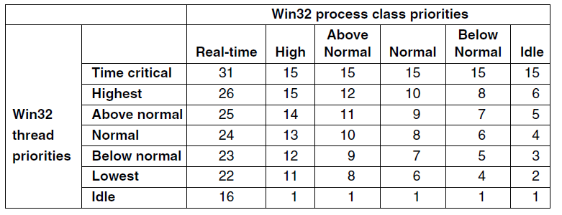
Scheduling (2 of 4)
Figure 11-25. Mapping of Win32 priorities to Windows priorities.

Slide 39
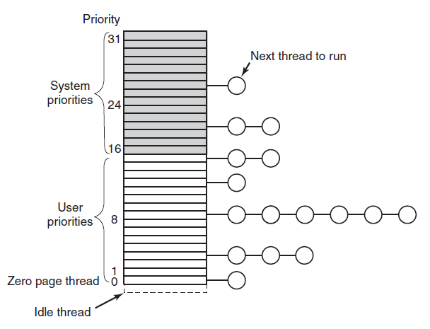
Scheduling (3 of 4)
Figure 11-26. Windows supports 32 priorities for threads.

Slide 40
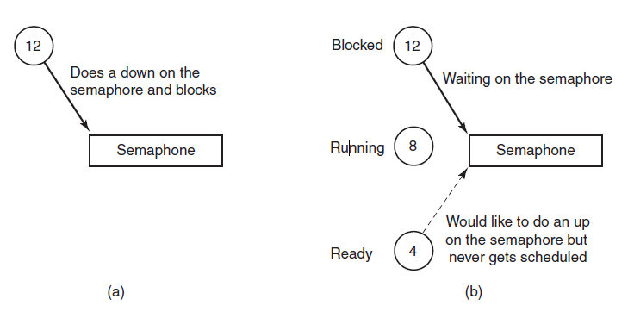
Scheduling (4 of 4)
Figure 11-27. An example of priority inversion.

Slide 41
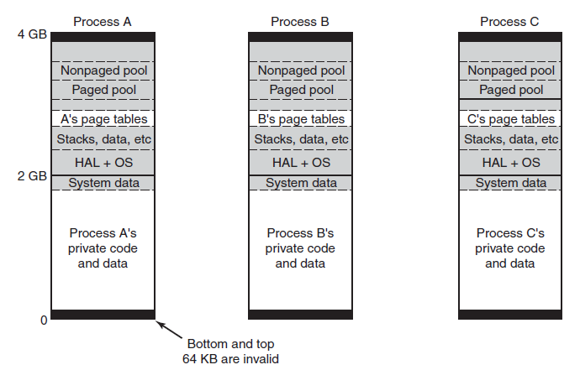
Memory Management Fundamental Concepts
Figure 11-28. Virtual address space layout for three user processes on the x86. The white areas are private per process. The shaded areas are shared among all processes.

Slide 42
Memory-Management System Calls
The principal Win32 A P I functions for managing virtual memory in Windows.
Win32 API function | Description
VirtualAlloc | Reserve or commit a region
VirtualFree | Release or decommit a region
VirtualProtect | Change the read/write/execute protection on a region
VirtualQuery | Inquire about the status of a region
VirtualLock | Make a region memory resident (i.e., disable paging for it)
VirtualUnlock | Make a region pageable in the usual way
CreateFileMapping | Create a file-mapping object and (optionally) assign it a name
MapViewOfFile | Map (part of) a file into the address space
UnmapViewOfFile | Remove a mapped file from the address space
OpenFileMapping | Open a previously created file-mapping object

Slide 43
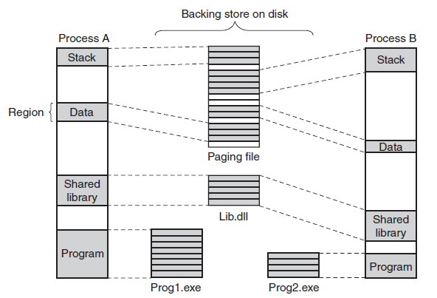
Implementation of Memory Management
Figure 11-30. Mapped regions with their shadow pages on disk. The lib.dll file is mapped into two address spaces at the same time.

Slide 44
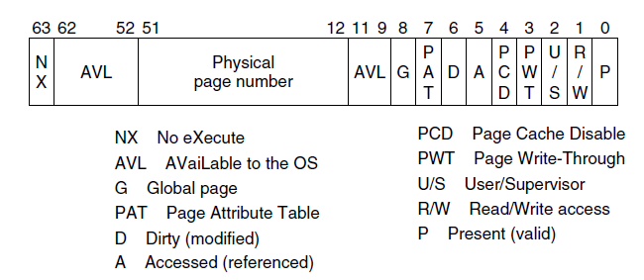
Page Fault Handling (1 of 2)
Figure 11-31. A page table entry (P T E) for a mapped page on the Intel x86 and A M D x64 architectures.

Slide 45
Page Fault Handling (2 of 2)
Categories of page faults:
The page referenced is not committed.
Attempted access to a page in violation of the permissions.
A shared copy-on-write page was about to be modified.
The stack needs to grow.
The page referenced is committed but not currently mapped in.

Slide 46
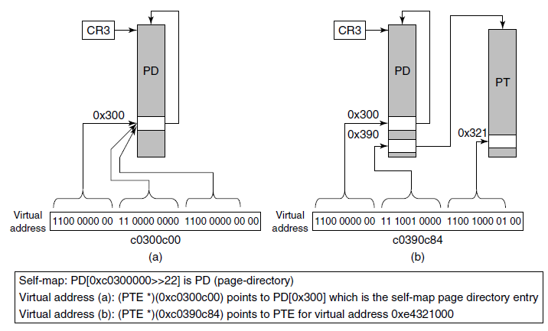
The Page Replacement Algorithm (1 of 2)
Figure 11-32. The Windows self-map entries are used to map the physical pages of the page tables and page directory into kernel virtual addresses (shown for 32-bit PTEs).

Slide 47
The Page Replacement Algorithm (2 of 2)
Three levels of activity by the working-set manager:
Lots of memory available
Memory getting tight
Memory is tight

Slide 48
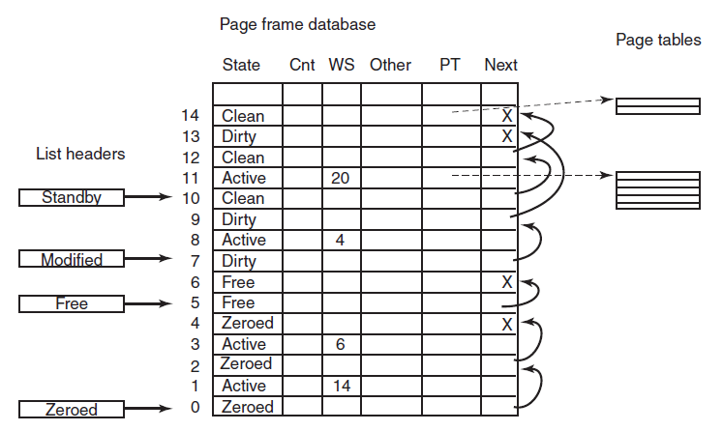
Physical Memory Management (1 of 2)
Figure 11-33. Some of the major fields in the page frame database for a valid page.

Slide 49
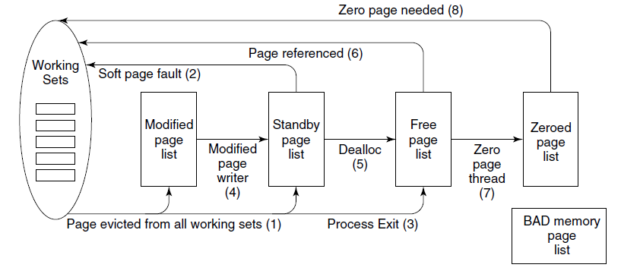
Physical Memory Management (2 of 2)
Figure 11-34. The various page lists and the transitions between them.

Slide 50
Input/Output A P I Calls
Native N T A P I calls for performing I/O.
I/O system call | Description
NtCreateFile | Open new or existing files or devices
NtReadFile | Read from a file or device
NtWriteFile | Write to a file or device
NtQueryDirectoryFile | Request information about a directory, including files
NtQueryVolumeInformationFile | Request information about a volume
NtSetVolumeInformationFile | Modify volume information
NtNotifyChangeDirectoryFile | Complete when any file in the directory or subtree is modified
NtQueryInformationFile | Request information about a file
NtSetInformationFile | Modify file information
NtLockFile | Lock a range of bytes in a file
NtUnlockFile | Remove a range lock
NtFsControlFile | Miscellaneous operations on a file
NtFlushBuffersFile | Flush in-memory file buffers to disk
NtCancelIoFile | Cancel outstanding I/O operations on a file
NtDeviceIoControlFile | Special operations on a device

Slide 51
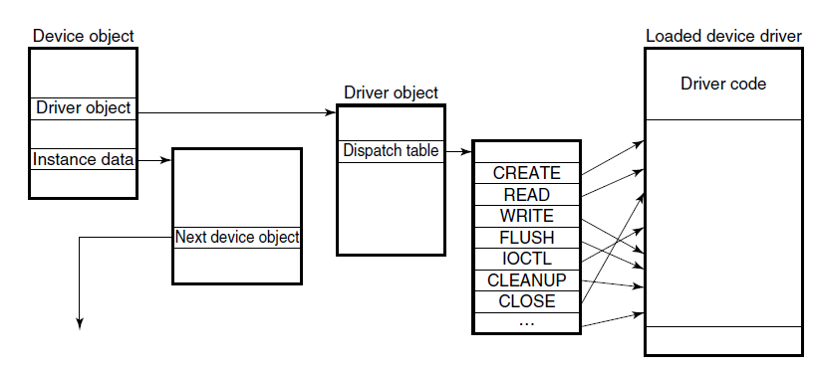
Device Drivers
Figure 11-36. A single level in a device stack.

Slide 52
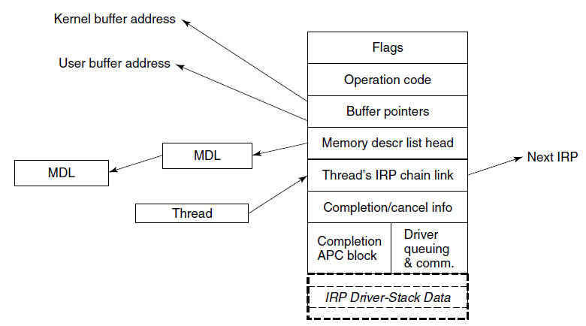
I/O Request Packets
Figure 11-37. The major fields of an I/O Request Packet.

Slide 53
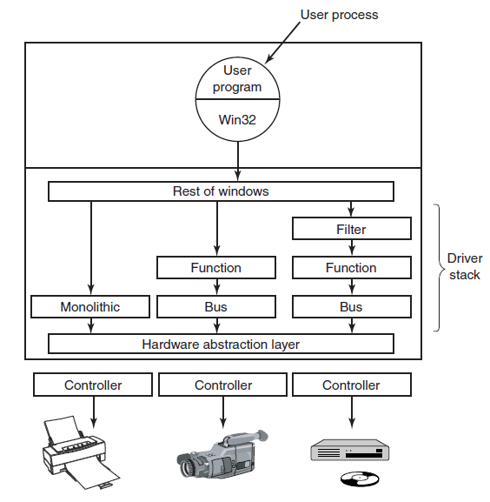
Device Stacks
Figure 11-38. Windows allows drivers to be stacked to work with a specific instance of a device. The stacking is represented by device objects.

Slide 54
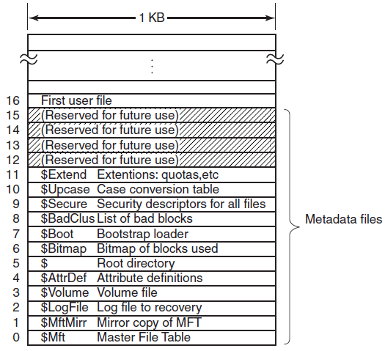
Implementation of the N T File System (1 of 2)
Figure 11-39. The N T F S master file table.

Slide 55
Implementation of the N T File System (2 of 2)
The attributes used in M F T records.
Attribute | Description
Standard information | Flag bits, timestamps, etc.
File name | File name in Unicode; may be repeated for MS-DOS name
Security descriptor | Obsolete. Security information is now in $Extend$Secure
Attribute list | Location of additional MFT records, if needed
Object ID | 64-bit file identifier unique to this volume
Reparse point | Used for mounting and symbolic links
Volume name | Name of this volume (used only in $Volume)
Volume information | Volume version (used only in $Volume)
Indexroot | Used for directories
Index allocation | Used for very large directories
Bitmap | Used for very large directories
Logged utility stream | Controls logging to $LogFile
Data | Streamdata; may be repeated

Slide 56
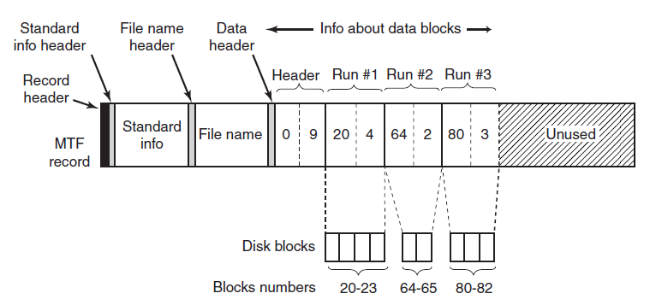
Storage Allocation (1 of 3)
Figure 11-41. An M F T record for a three-run, nine-block stream.

Slide 57
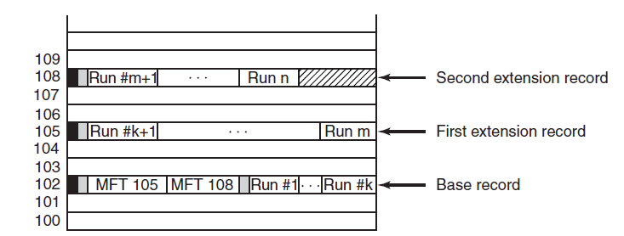
Storage Allocation (2 of 3)
Figure 11-42. A file that requires three M F T records to store all its runs.

Slide 58
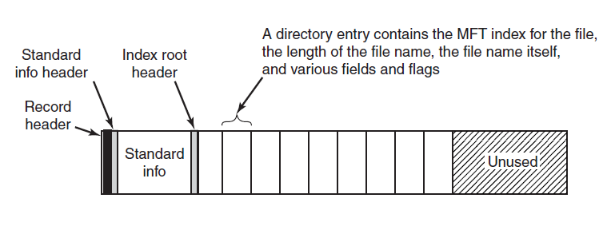
Storage Allocation (3 of 3)
Figure 11-43. The M F T record for a small directory.

Slide 59
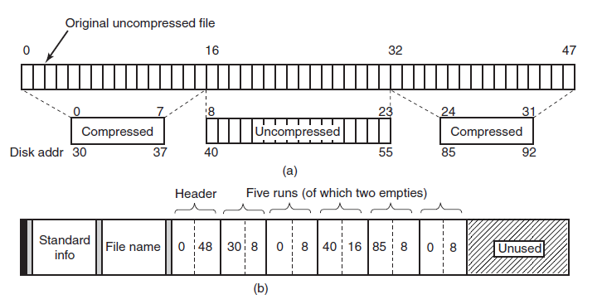
File Compression
Figure 11-44. (a) An example of a 48-block file being compressed to 32 blocks. (b) The M F T record for the file after compression.

Slide 60
Security in Windows 8
Security properties inherited from N T:
Secure login with antispoofing measures.
Discretionary access controls.
Privileged access controls.
Address space protection per process.
New pages must be zeroed before being mapped in.
Security auditing.

Slide 61
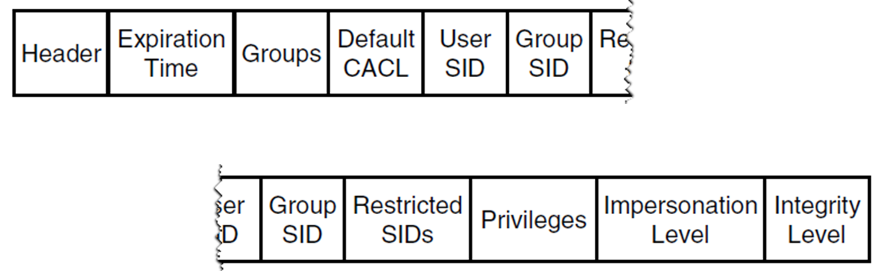
Fundamental Security Concepts
Figure 11-45. Structure of an access token.

Slide 62
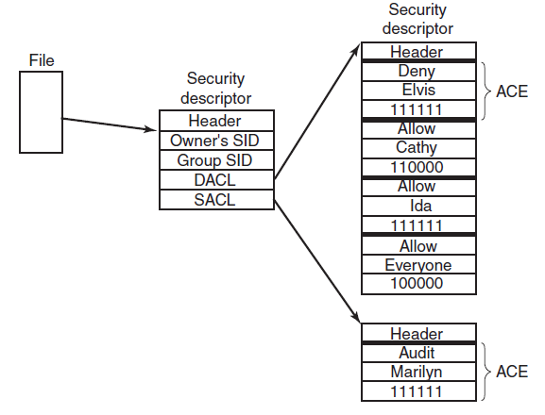
Security A P I Calls (1 of 2)
Figure 11-46. An example security descriptor for a file.

Slide 63
Security A P I Calls (2 of 2)
The principal Win32 A P I functions for security.
Win32 API function | Description
InitializeSecurityDescriptor | Prepare a new security descriptor for use
LookupAccountSid | Look up the S I D for a given user name
SetSecurityDescriptorOwner | Enter the owner S I D in the security descriptor
SetSecurityDescriptorGroup | Enter a group S I D in the security descriptor
InitializeAcl | Initialize a D A C L or S A C L
AddAccessAllowedAce | Add a new ACE to a D A C L or S A C L allowing access
AddAccessDeniedAce | Add a new ACE to a D A C L or S A C L denying access
DeleteAce | Remove an ACE from a D A C L or S A C L
SetSecurityDescriptorDacl | Attach a D A C L to a security descriptor

Slide 64
Security Mitigations
Some of the principal security mitigations in Windows.
Mitigation | Description
/GS compiler flag | Add canary to stack frames to protect branch targets
Exception hardening | Restrict what code can be invoked as exception handlers
NX MMU protection | Mark code as non-executable to hinder attack payloads
A S L R | Randomize address space to make ROP attacks difficult
Heap hardening | Check for common heap usage errors
VTGuard | Add checks to validate virtual function tables
Code Integrity | Verify that libraries and drivers are properly cryptographically signed
Patchguard | Detect attempts to modify kernel data, e.g. by rootkits
Windows Update | Provide regular security patches to remove vulnerabilities
Windows Defender | Built-in basic antivirus capability

Slide 65
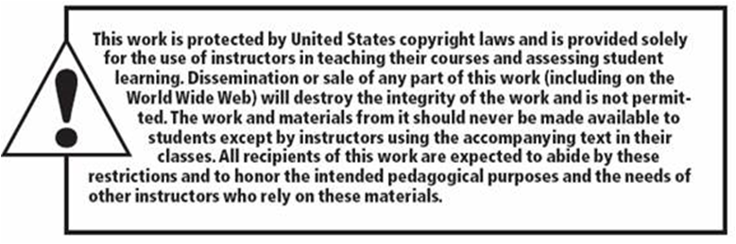
Copyright

