Slide 1

Modern Operating Systems
Fourth Edition
Chapter 12
Operating System Design
Copyright © 2014 Pearson Education, Inc. All Rights Reserved
Notes:
If this PowerPoint presentation contains mathematical equations, you may need to check that your computer has the following installed:
1) MathType Plugin
2) Math Player (free versions available)
3) NVDA Reader (free versions available)

Slide 2
Goals
Main goals of general purpose operating systems:
Define abstractions.
Provide primitive operations.
Ensure isolation.
Manage the hardware.

Slide 3
Interface Design Guiding Principles
Simplicity
Completeness
Efficiency

Slide 4
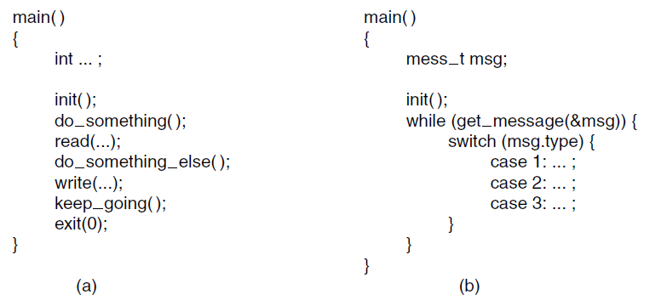
Execution Paradigms
Figure 12-1. (a) Algorithmic code. (b) Event-driven code.

Slide 5
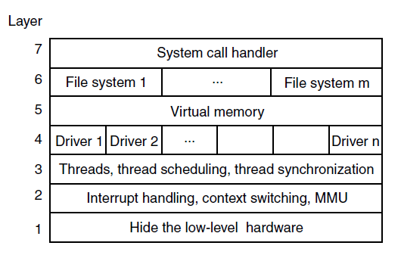
System Structure Layered Systems
Figure 12-2. One possible design for a modern layered operating system.

Slide 6
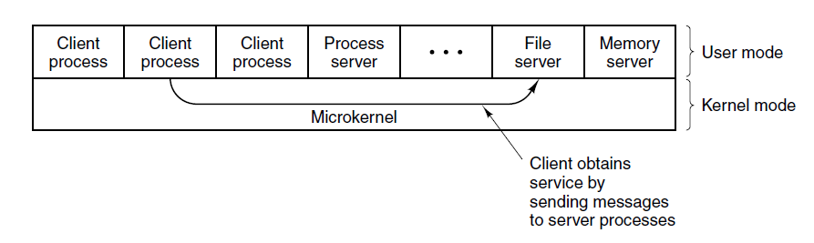
Microkernel-Based Client-Server Systems
Figure 12-3. Client-server computing based on a microkernel.

Slide 7
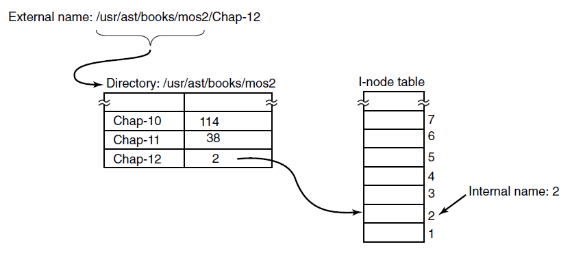
Naming
Figure 12-4. Directories are used to map external names onto internal names.

Slide 8
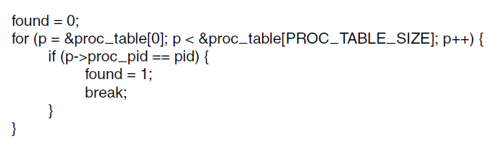
Static vs. Dynamic Structures
Figure 12-5. Code for searching the process table for a given P I D.

Slide 9
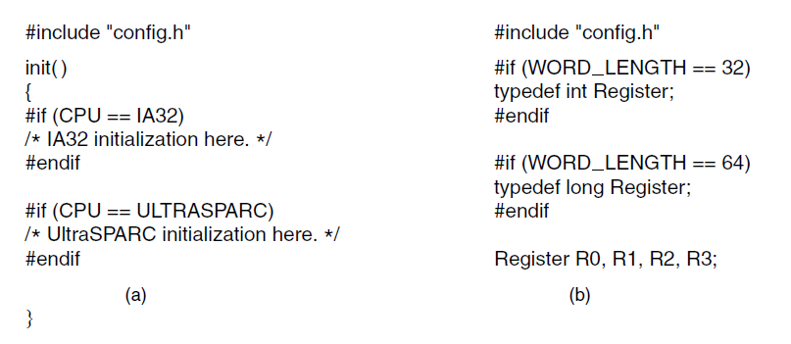
Hiding the Hardware
Figure 12-6. (a) CPU-dependent conditional compilation. (b) Word-length-dependent conditional compilation.

Slide 10
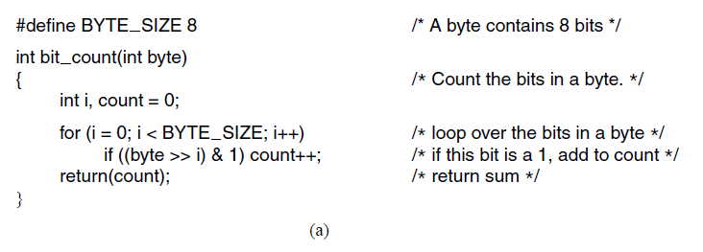
Space-Time Trade-offs (1 of 3)
Figure 12-7. (a) A procedure for counting bits in a byte.

Slide 11
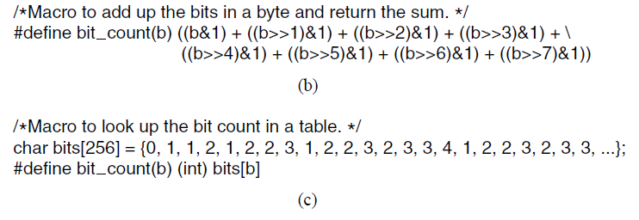
Space-Time Trade-offs (2 of 3)
Figure 12-7. (b) A macro to count the bits. (c) A macro that counts bits by table lookup.

Slide 12
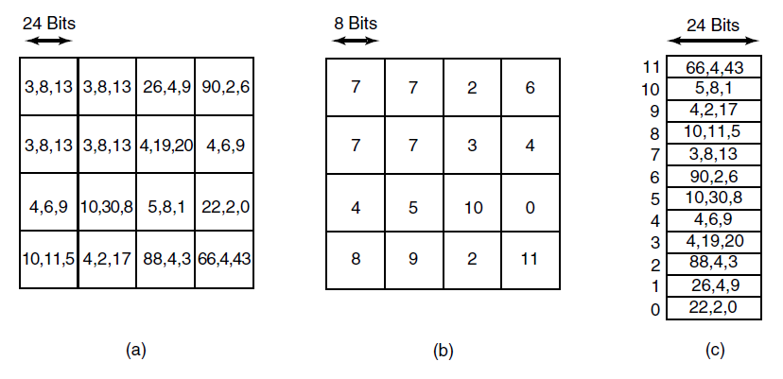
Space-Time Trade-offs (3 of 3)
Figure 12-8. (a) Part of an uncompressed image with 24 bits per pixel. (b) The same part compressed with G I F, with 8 bits per pixel. (c) The color palette.

Slide 13
Caching (1 of 2)
To look up /u s r/ast/mbox requires the following disk accesses:
Read the i-node for the root directory (i-node 1).
Read the root directory (block 1).
Read the i-node for /u s r (i-node 6).
Read the /u s r directory (block 132).
Read the i-node for /u s r/ast (i-node 26).
Read the /u s r/ast directory (block 406).

Slide 14
Caching (2 of 2)
Part of the i-node cache for Fig. 4-34
Path | I-node Number
/u s r | 6
/u s r/a s t | 26
/u s r/a s t/mbox | 60
/u s r/a s t/books | 92
/u s r/b a l | 45
/u s r/b a l/paper.ps | 85

Slide 15
Project Management Team Structure
Mills’ proposal for populating a 10-person chief programmer team.
Title | Duties
Chief programmer | Performs the architectural design and writes the code
Copilot | Helps the chief programmer and serves as a sounding board
Administrator | Manages the people, budget, space, equipment, reporting, etc.
Editor | Edits the documentation, which must be written by the chief programmer
Secretaries | The administrator and editor each need a secretary
Program clerk | Maintains the code and documentation archives
Toolsmith | Provides any tools the chief programmer needs
Tester | Tests the chief programmer's code
Language lawyer | Part timer who can advise the chief programmer on the language

Slide 16
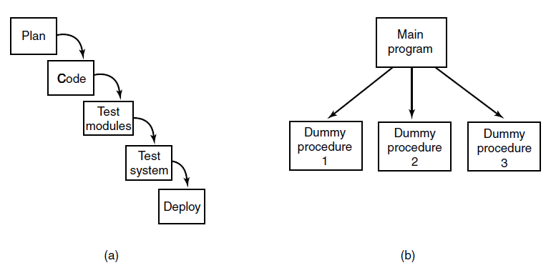
The Role of Experience
Figure 12-11. (a) Traditional software design progresses in stages. (b) Alternative design produces a working system (that does nothing) starting on day 1.

Slide 17
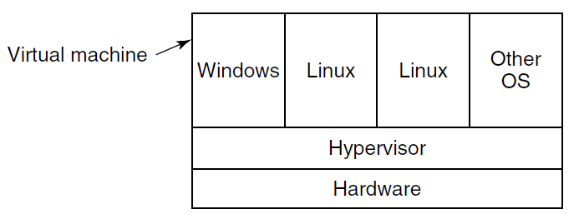
Trends In Operating System Design Virtualization and the Cloud
Figure 12-12. A hypervisor running four virtual machines.

Slide 18

Copyright

