Slide 1
Case Study 2: Windows 8
Chapter 11
Tanenbaum & Bo, Modern Operating Systems:4th ed., (c) 2013 Prentice-Hall, Inc. All rights reserved.

Slide 2
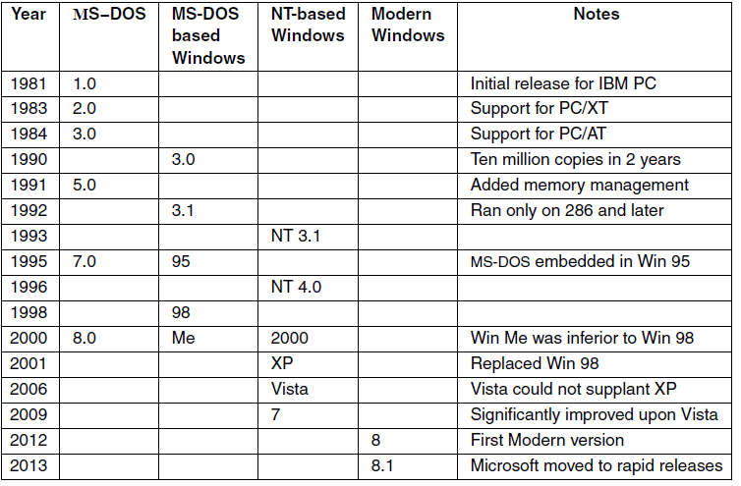
History of Windows through Windows 8.1
Figure 11-1. Major releases in the history of Microsoft operating systems for desktop PCs.
Tanenbaum & Bo, Modern Operating Systems:4th ed., (c) 2013 Prentice-Hall, Inc. All rights reserved.

Slide 3
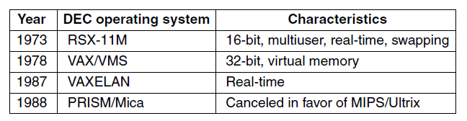
2000s: NT-based Windows (1)
Figure 11-2. DEC Operating Systems developed by Dave Cutler.
Tanenbaum & Bo, Modern Operating Systems:4th ed., (c) 2013 Prentice-Hall, Inc. All rights reserved.

Slide 4
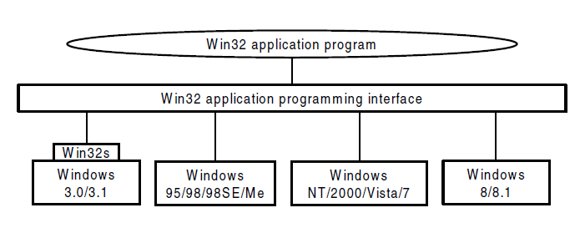
2000s: NT-based Windows (2)
Figure 11-3. The Win32 API allows programs to run
on almost all versions of Windows.
Tanenbaum & Bo, Modern Operating Systems:4th ed., (c) 2013 Prentice-Hall, Inc. All rights reserved.

Slide 5
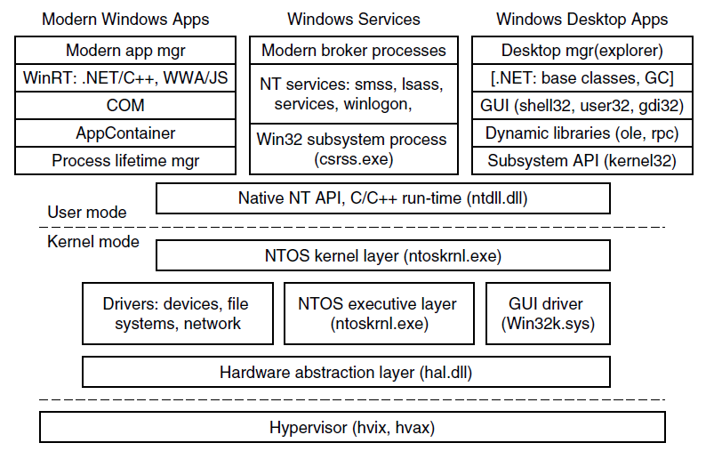
Programming Windows (1)
Figure 11-4. The programming layers in Modern Windows
Tanenbaum & Bo, Modern Operating Systems:4th ed., (c) 2013 Prentice-Hall, Inc. All rights reserved.

Slide 6
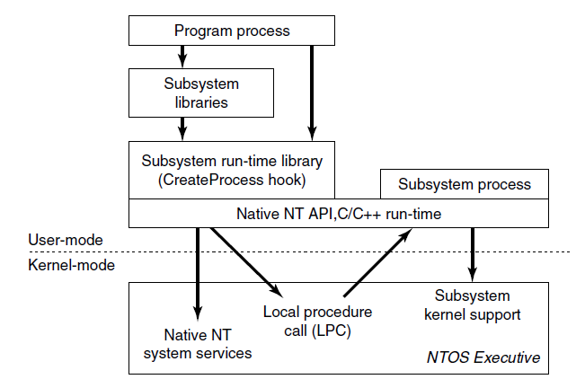
Programming Windows (2)
Figure 11-5. The components used to build NT subsystems.
Tanenbaum & Bo, Modern Operating Systems:4th ed., (c) 2013 Prentice-Hall, Inc. All rights reserved.

Slide 7
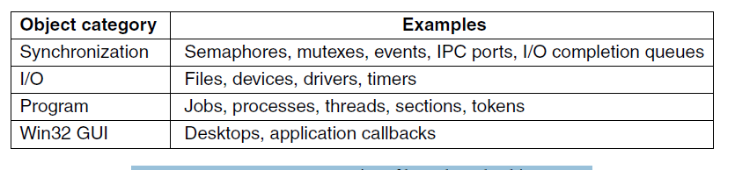
The Native NT Application Programming Interface (1)
Figure 11-6. Common categories of
kernel-mode object types.
Tanenbaum & Bo, Modern Operating Systems:4th ed., (c) 2013 Prentice-Hall, Inc. All rights reserved.

Slide 8
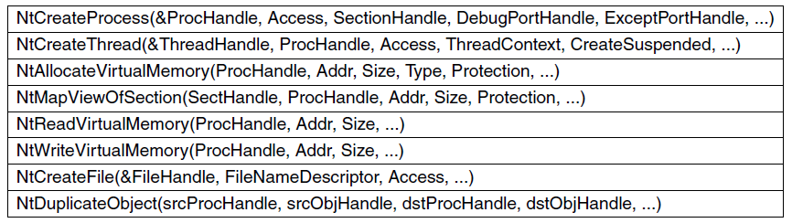
The Native NT Application Programming Interface (2)
Figure 11-7. Examples of native NT API calls that use handles to manipulate objects across process boundaries.
Tanenbaum & Bo, Modern Operating Systems:4th ed., (c) 2013 Prentice-Hall, Inc. All rights reserved.

Slide 9
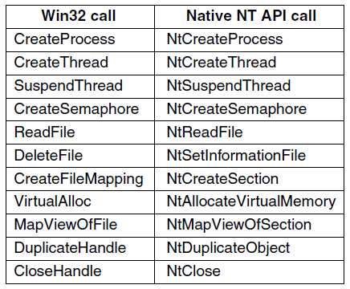
The Win32 Application Programming Interface
Figure 11-8. Examples of Win32 API calls and the
native NT API calls that they wrap.
Tanenbaum & Bo, Modern Operating Systems:4th ed., (c) 2013 Prentice-Hall, Inc. All rights reserved.

Slide 10
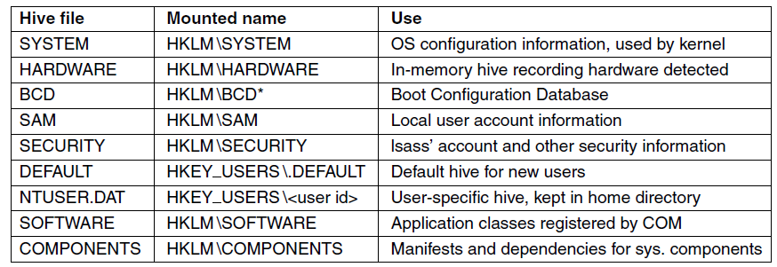
The Windows Registry (1)
Figure 11-9. The registry hives in Windows. HKLM is a
short-hand for HKEY LOCAL MACHINE.
Tanenbaum & Bo, Modern Operating Systems:4th ed., (c) 2013 Prentice-Hall, Inc. All rights reserved.

Slide 11
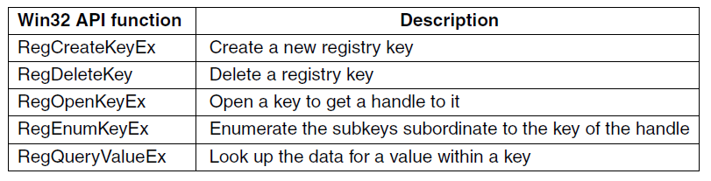
The Windows Registry (2)
Figure 11-10. Some of the Win32 API calls
for using the registry
Tanenbaum & Bo, Modern Operating Systems:4th ed., (c) 2013 Prentice-Hall, Inc. All rights reserved.

Slide 12
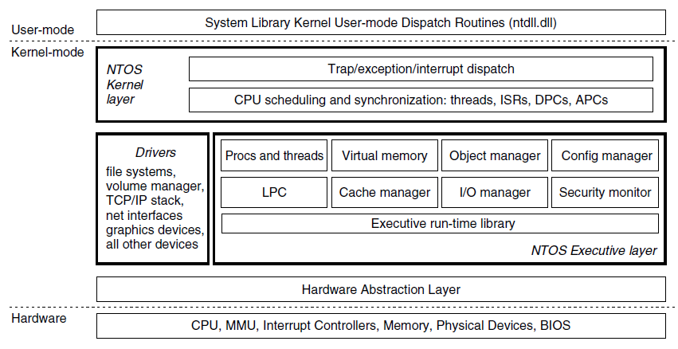
Operating System Structure
Figure 11-11. Windows kernel-mode organization.
Tanenbaum & Bo, Modern Operating Systems:4th ed., (c) 2013 Prentice-Hall, Inc. All rights reserved.

Slide 13
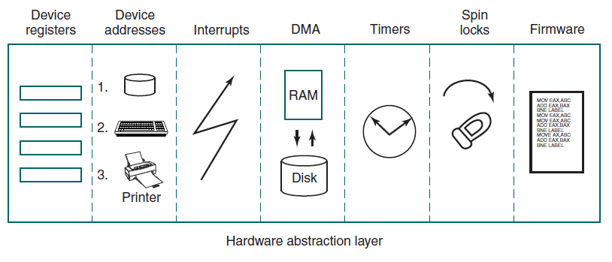
The Hardware Abstraction Layer
Figure 11-12. Some of the hardware
functions the HAL manages
Tanenbaum & Bo, Modern Operating Systems:4th ed., (c) 2013 Prentice-Hall, Inc. All rights reserved.

Slide 14
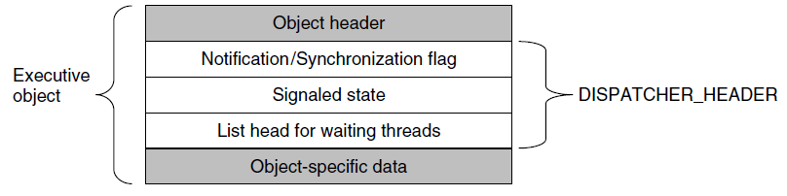
Dispatcher Objects
Figure 11-13. dispatcher_header data structure embedded in many executive objects (dispatcher objects).
Tanenbaum & Bo, Modern Operating Systems:4th ed., (c) 2013 Prentice-Hall, Inc. All rights reserved.

Slide 15
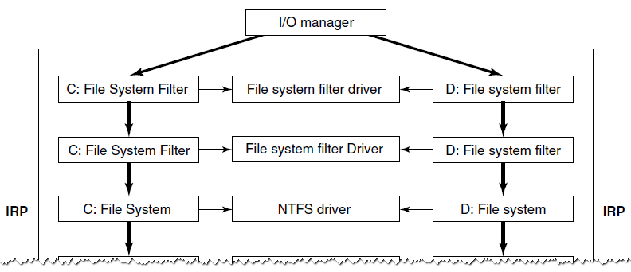
The Device Drivers (1)
Figure 11-14. Simplified depiction of device stacks for two NTFS file volumes. The I/O request packet is passed from down the stack. The appropriate routines from the associated drivers are called at each level in the stack. The device stacks themselves consist of device objects allocated specifically to each stack.
Tanenbaum & Bo, Modern Operating Systems:4th ed., (c) 2013 Prentice-Hall, Inc. All rights reserved.

Slide 16
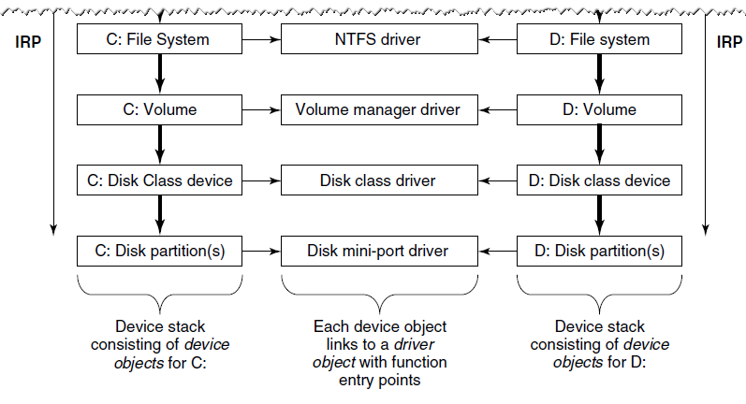
The Device Drivers (2)
Figure 11-14. Simplified depiction of device stacks for two NTFS file volumes. The I/O request packet is passed from down the stack. The appropriate routines from the associated drivers are called at each level in the stack. The device stacks themselves consist of device objects allocated specifically to each stack.
Tanenbaum & Bo, Modern Operating Systems:4th ed., (c) 2013 Prentice-Hall, Inc. All rights reserved.

Slide 17
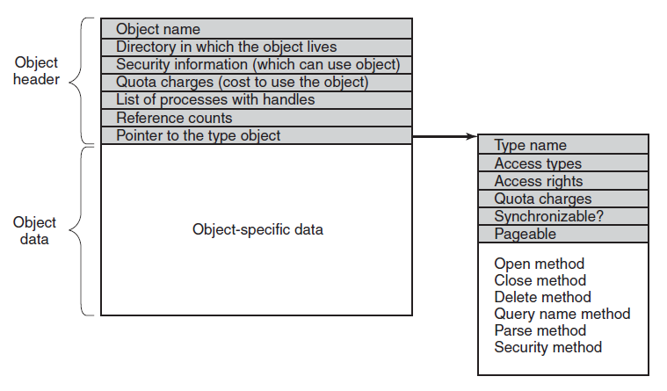
Implementation of the Object Manager
Figure 11-15. The structure of an executive object
managed by the object manager
Tanenbaum & Bo, Modern Operating Systems:4th ed., (c) 2013 Prentice-Hall, Inc. All rights reserved.

Slide 18
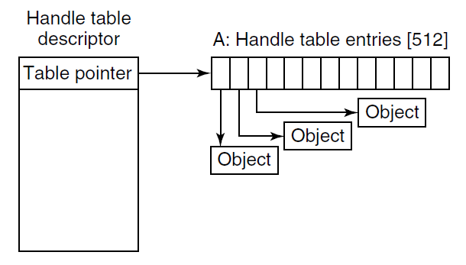
Handles (1)
Figure 11-16. Handle table data structures for a minimal table using a single page for up to 512 handles.
Tanenbaum & Bo, Modern Operating Systems:4th ed., (c) 2013 Prentice-Hall, Inc. All rights reserved.

Slide 19
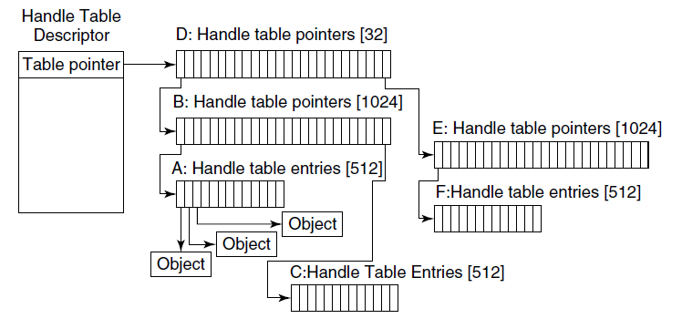
Handles (2)
Figure 11-17. Handle table data structures for a maximal table of up to 16 million handles.
Tanenbaum & Bo, Modern Operating Systems:4th ed., (c) 2013 Prentice-Hall, Inc. All rights reserved.

Slide 20
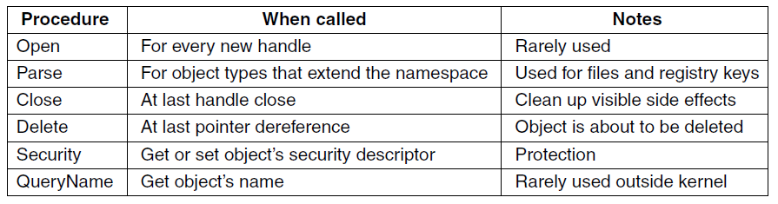
The Object Name Space (1)
Figure 11-18. The object procedures supplied when specifying a new object type.
Tanenbaum & Bo, Modern Operating Systems:4th ed., (c) 2013 Prentice-Hall, Inc. All rights reserved.

Slide 21
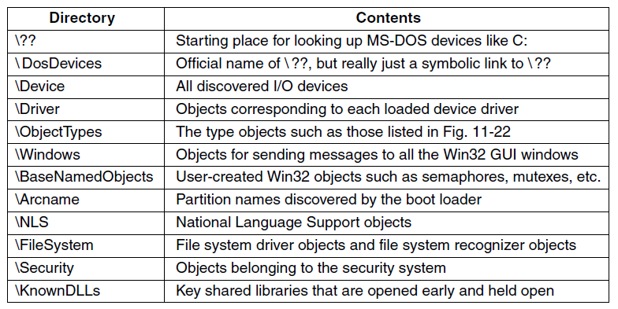
The Object Name Space (2)
Figure 11-19. Some typical directories in the object name space.
Tanenbaum & Bo, Modern Operating Systems:4th ed., (c) 2013 Prentice-Hall, Inc. All rights reserved.

Slide 22
The Object Name Space (3)
Use of parse procedure:
Executive component passes Unicode pathname for namespace
Object manager searches through directories and symbolic links
Object manager calls the Parse procedure for object type
I/O manager creates IRP, allocate file object, send request to stack of I/O devices
Tanenbaum & Bo, Modern Operating Systems:4th ed., (c) 2013 Prentice-Hall, Inc. All rights reserved.

Slide 23
The Object Name Space (4)
Use of parse procedure:
IRP passed down the I/O stack until it reaches device object representing the file system instance
Device objects encountered as the IRP heads toward the file system represent file system filter drivers
File system device object has a link to file system driver object
Tanenbaum & Bo, Modern Operating Systems:4th ed., (c) 2013 Prentice-Hall, Inc. All rights reserved.

Slide 24
The Object Name Space (5)
Use of parse procedure:
NTFS fills in file object and returns it to I/O manager, which returns back up through all devices on the stack
Object manager is finished with its namespace lookup
Final step is to return back to the user-mode caller
Tanenbaum & Bo, Modern Operating Systems:4th ed., (c) 2013 Prentice-Hall, Inc. All rights reserved.

Slide 25
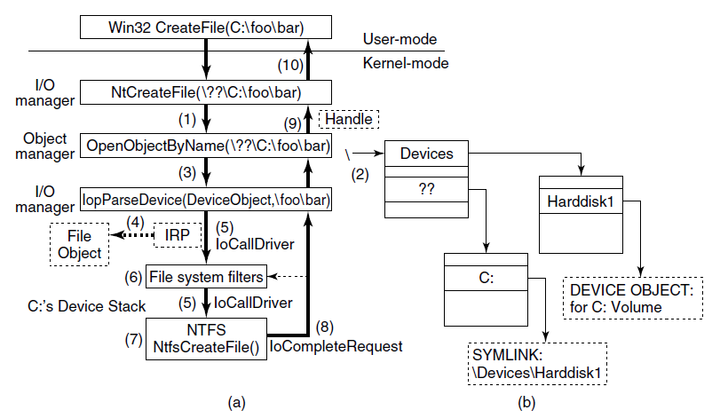
The Object Name Space (6)
Figure 11-20. I/O and object manager steps for creating/opening a file and getting back a file handle.
Tanenbaum & Bo, Modern Operating Systems:4th ed., (c) 2013 Prentice-Hall, Inc. All rights reserved.

Slide 26
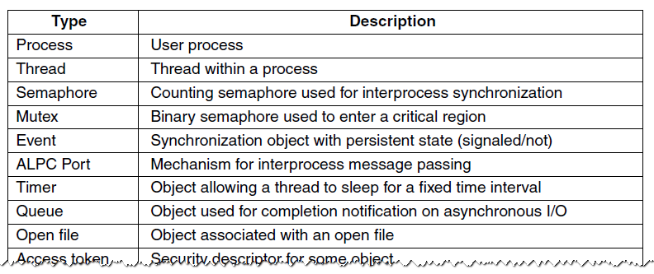
The Object Name Space (7)
Figure 11-21. Some common executive object types managed by the object manager.
Tanenbaum & Bo, Modern Operating Systems:4th ed., (c) 2013 Prentice-Hall, Inc. All rights reserved.

Slide 27
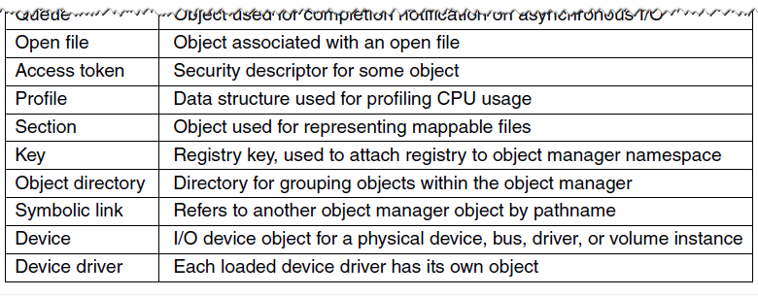
The Object Name Space (8)
Figure 11-21. Some common executive object types managed by the object manager.
Tanenbaum & Bo, Modern Operating Systems:4th ed., (c) 2013 Prentice-Hall, Inc. All rights reserved.

Slide 28
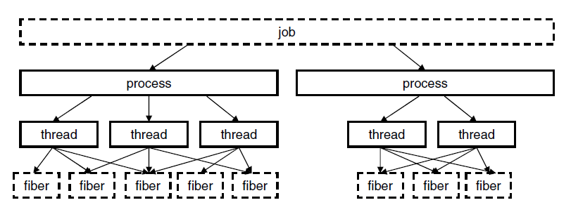
Jobs, Processes, Threads, Fibers
Figure 11-22. The relationship between jobs, processes, threads and fibers. Jobs and fibers are optional; not all processes are in jobs or contain fibers.
Tanenbaum & Bo, Modern Operating Systems:4th ed., (c) 2013 Prentice-Hall, Inc. All rights reserved.

Slide 29
Thread Pools and User-Mode Scheduling (1)
Key elements of UMS implementation:
User-mode switching
Re-entering the user-mode scheduler
System call completion
Tanenbaum & Bo, Modern Operating Systems:4th ed., (c) 2013 Prentice-Hall, Inc. All rights reserved.

Slide 30
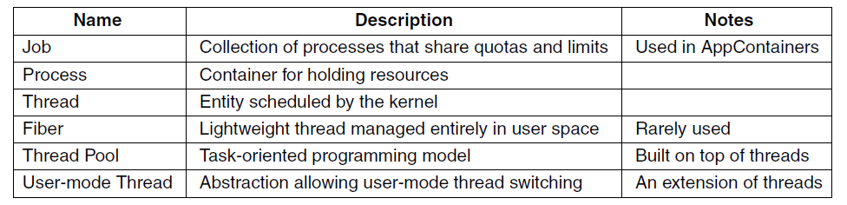
Thread Pools and User-Mode Scheduling (2)
Figure 11-23. Basic concepts used for CPU
and resource management.
Tanenbaum & Bo, Modern Operating Systems:4th ed., (c) 2013 Prentice-Hall, Inc. All rights reserved.

Slide 31
Job, Process, Thread, and Fiber Management API Calls (1)
Differences from UNIX:
Actual search path for finding program to execute buried in library code for Win32, but managed more explicitly in UNIX.
Current working directory is a kernel-mode concept in UNIX but a user-mode string in Windows.
UNIX parses command line and passes array of parameters, while Win32 leaves argument parsing up to individual program.
Tanenbaum & Bo, Modern Operating Systems:4th ed., (c) 2013 Prentice-Hall, Inc. All rights reserved.

Slide 32
Job, Process, Thread, and Fiber Management API Calls (2)
Differences from UNIX:
Inheritance of file descriptors in UNIX a property the handle. In Windows is also property of handle to process creation.
New processes directly passed information about primary window in Win32. Passed as parameters to GUI applications in UNIX.
Windows does not have SETUID bit as property of the executable, but one process can create a process that runs as a different user (with proper token)
Tanenbaum & Bo, Modern Operating Systems:4th ed., (c) 2013 Prentice-Hall, Inc. All rights reserved.

Slide 33
Job, Process, Thread, and Fiber Management API Calls (3)
Differences from UNIX:
Process and thread handle returned from Windows can be used at any time to modify new process/thread in many ways.
UNIX only makes modifications to new process between fork and exec calls, and only in limited ways
Tanenbaum & Bo, Modern Operating Systems:4th ed., (c) 2013 Prentice-Hall, Inc. All rights reserved.

Slide 34
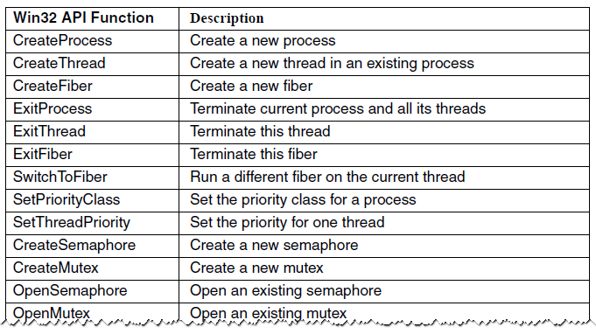
Implementation of Processes and Threads (1)
Figure 11-24. Some of the Win32 calls for managing processes, threads, and fibers.
Tanenbaum & Bo, Modern Operating Systems:4th ed., (c) 2013 Prentice-Hall, Inc. All rights reserved.

Slide 35
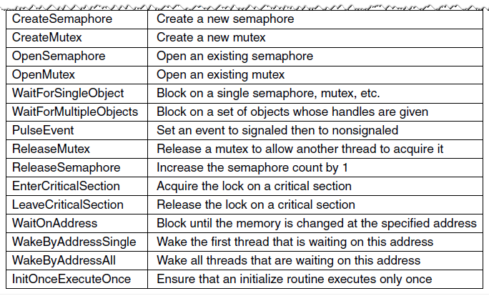
Implementation of Processes and Threads (2)
Figure 11-24. Some of the Win32 calls for managing processes, threads, and fibers.
Tanenbaum & Bo, Modern Operating Systems:4th ed., (c) 2013 Prentice-Hall, Inc. All rights reserved.

Slide 36
Scheduling (1)
Conditions that invoke scheduling
A running thread blocks on a semaphore, mutex, event, I/O, etc.
Thread signals an object (e.g., does an up on a semaphore).
The quantum expires.
An I/O operation completes.
A timed wait expires.
Tanenbaum & Bo, Modern Operating Systems:4th ed., (c) 2013 Prentice-Hall, Inc. All rights reserved.

Slide 37
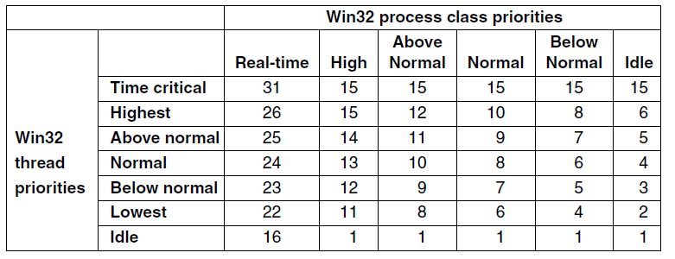
Scheduling (2)
Figure 11-25. Mapping of Win32 priorities to
Windows priorities.
Tanenbaum & Bo, Modern Operating Systems:4th ed., (c) 2013 Prentice-Hall, Inc. All rights reserved.

Slide 38
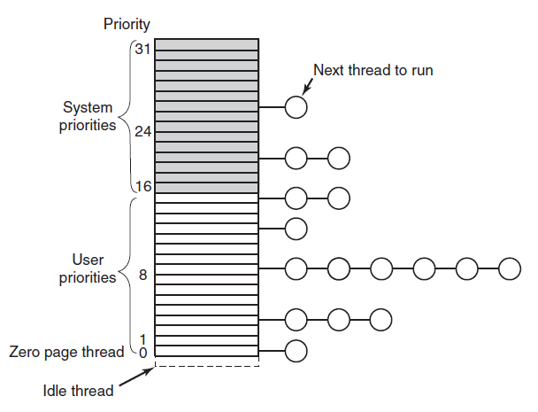
Scheduling (3)
Figure 11-26. Windows supports 32 priorities for threads.
Tanenbaum & Bo, Modern Operating Systems:4th ed., (c) 2013 Prentice-Hall, Inc. All rights reserved.

Slide 39
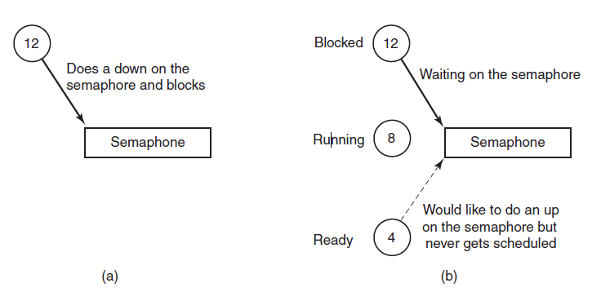
Scheduling (4)
Figure 11-27. An example of priority inversion.
Tanenbaum & Bo, Modern Operating Systems:4th ed., (c) 2013 Prentice-Hall, Inc. All rights reserved.

Slide 40
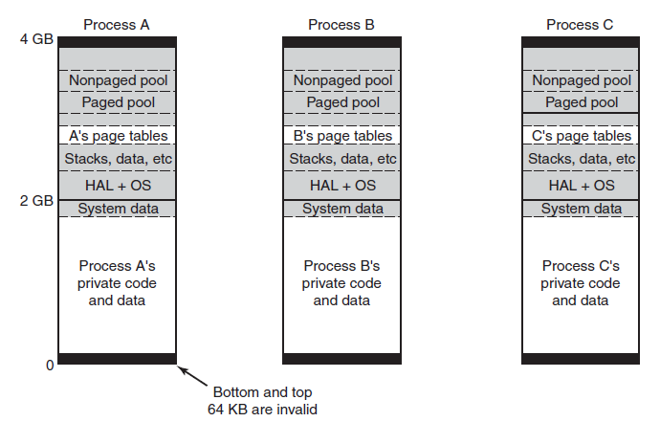
Memory Management
Fundamental Concepts
Figure 11-28. Virtual address space layout for three user processes on the x86. The white areas are private per process. The shaded areas are shared among all processes.
Tanenbaum & Bo, Modern Operating Systems:4th ed., (c) 2013 Prentice-Hall, Inc. All rights reserved.

Slide 41
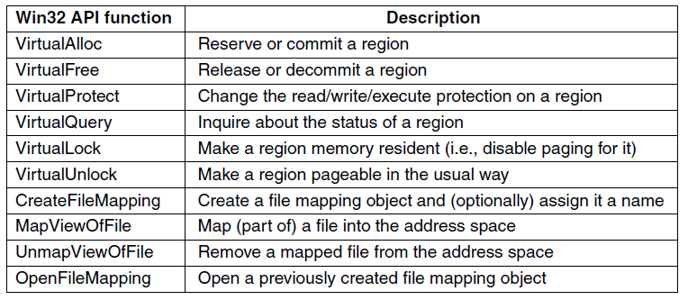
Memory-Management System Calls
Figure 11-29. The principal Win32 API functions for
managing virtual memory in Windows.
Tanenbaum & Bo, Modern Operating Systems:4th ed., (c) 2013 Prentice-Hall, Inc. All rights reserved.

Slide 42
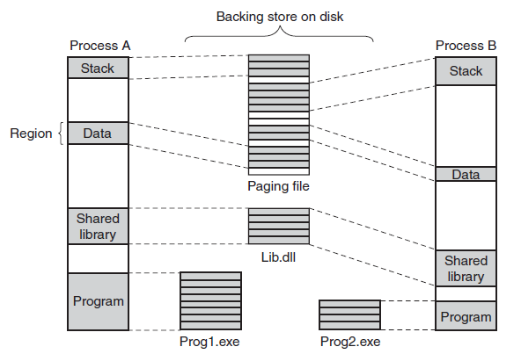
Implementation of Memory Management
Figure 11-30. Mapped regions with their shadow pages on disk. The lib.dll file is mapped into two address spaces at the same time.
Tanenbaum & Bo, Modern Operating Systems:4th ed., (c) 2013 Prentice-Hall, Inc. All rights reserved.

Slide 43
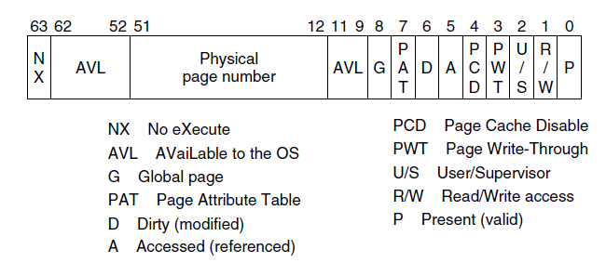
Page Fault Handling (1)
Figure 11-31. A page table entry (PTE) for a mapped page on the Intel x86 and AMD x64 architectures.
Tanenbaum & Bo, Modern Operating Systems:4th ed., (c) 2013 Prentice-Hall, Inc. All rights reserved.

Slide 44
Page Fault Handling (2)
Categories of page faults:
The page referenced is not committed.
Attempted access to a page in violation of the permissions.
A shared copy-on-write page was about to be modified.
The stack needs to grow.
The page referenced is committed but not currently mapped in.
Tanenbaum & Bo, Modern Operating Systems:4th ed., (c) 2013 Prentice-Hall, Inc. All rights reserved.

Slide 45
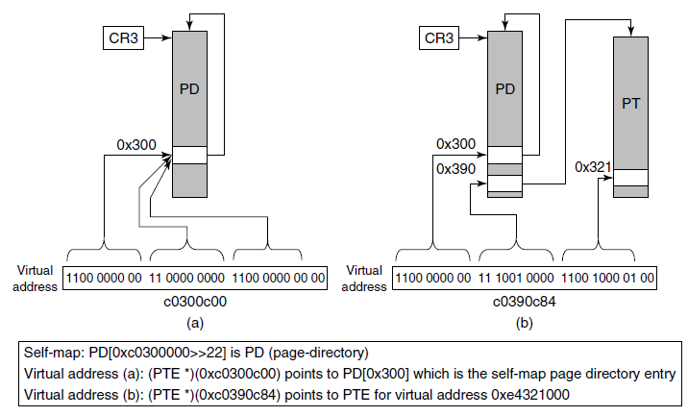
The Page Replacement Algorithm (1)
Figure 11-32. The Windows self-map entries are used to map the physical pages of the page tables and page directory into kernel virtual addresses (shown for 32-bit PTEs).
Tanenbaum & Bo, Modern Operating Systems:4th ed., (c) 2013 Prentice-Hall, Inc. All rights reserved.

Slide 46
The Page Replacement Algorithm (2)
Three levels of activity by the working-set manager:
Lots of memory available
Memory getting tight
Memory is tight
Tanenbaum & Bo, Modern Operating Systems:4th ed., (c) 2013 Prentice-Hall, Inc. All rights reserved.

Slide 47
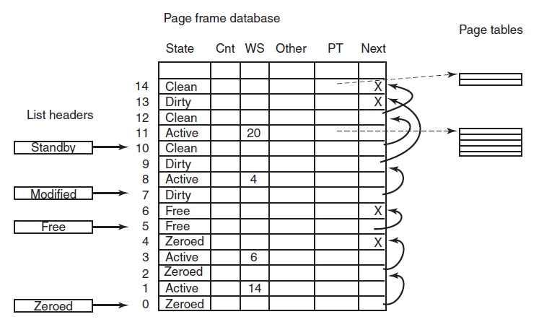
Physical Memory Management (1)
Figure 11-33. Some of the major fields in the page frame database for a valid page.
Tanenbaum & Bo, Modern Operating Systems:4th ed., (c) 2013 Prentice-Hall, Inc. All rights reserved.

Slide 48
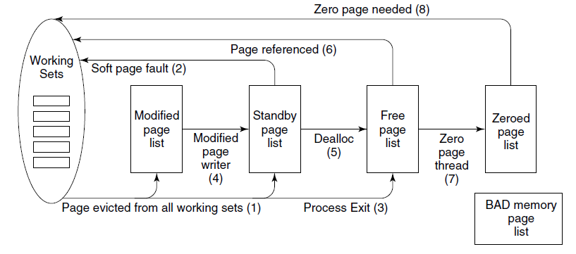
Physical Memory Management (2)
Figure 11-34. The various page lists and the
transitions between them.
Tanenbaum & Bo, Modern Operating Systems:4th ed., (c) 2013 Prentice-Hall, Inc. All rights reserved.

Slide 49
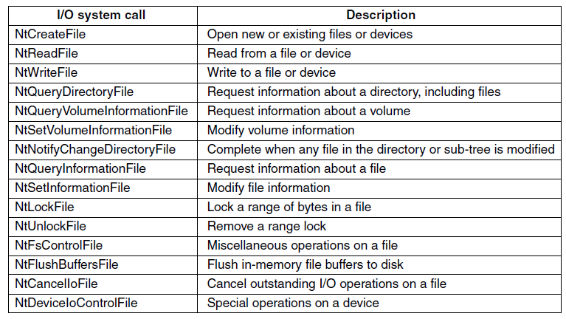
Input/Output API Calls
Figure 11-35. Native NT API calls for performing I/O.
Tanenbaum & Bo, Modern Operating Systems:4th ed., (c) 2013 Prentice-Hall, Inc. All rights reserved.

Slide 50
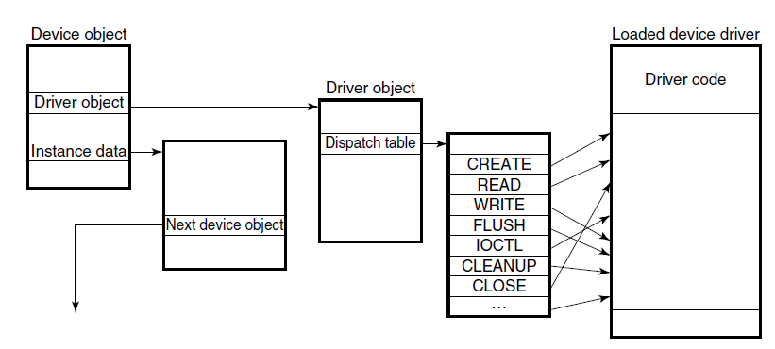
Device Drivers
Figure 11-36. A single level in a device stack.
Tanenbaum & Bo, Modern Operating Systems:4th ed., (c) 2013 Prentice-Hall, Inc. All rights reserved.

Slide 51
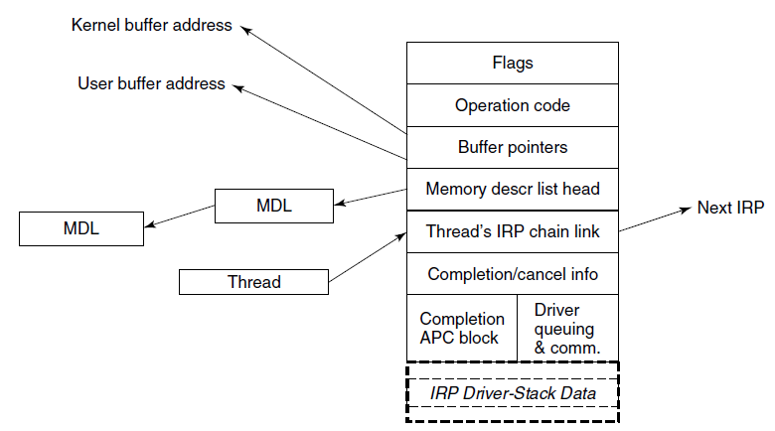
I/O Request Packets
Figure 11-37. The major fields of an I/O Request Packet.
Tanenbaum & Bo, Modern Operating Systems:4th ed., (c) 2013 Prentice-Hall, Inc. All rights reserved.

Slide 52
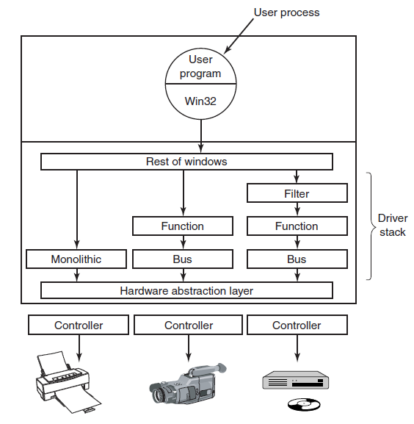
Device Stacks
Figure 11-38. Windows allows drivers to be stacked to work with a specific instance of a device. The stacking is represented by device objects.
Tanenbaum & Bo, Modern Operating Systems:4th ed., (c) 2013 Prentice-Hall, Inc. All rights reserved.

Slide 53
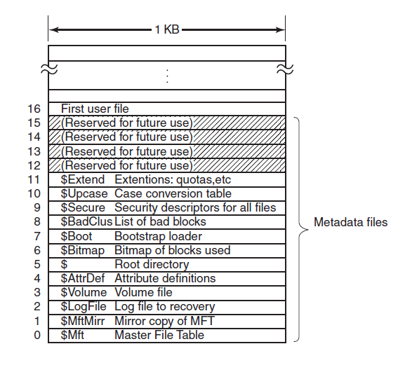
Implementation of the NT File System (1)
Figure 11-39. The NTFS master file table.
Tanenbaum & Bo, Modern Operating Systems:4th ed., (c) 2013 Prentice-Hall, Inc. All rights reserved.

Slide 54
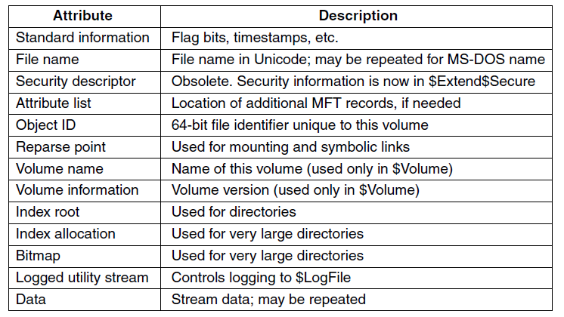
Implementation of the NT File System (2)
Figure 11-40. The attributes used in MFT records.
Tanenbaum & Bo, Modern Operating Systems:4th ed., (c) 2013 Prentice-Hall, Inc. All rights reserved.

Slide 55
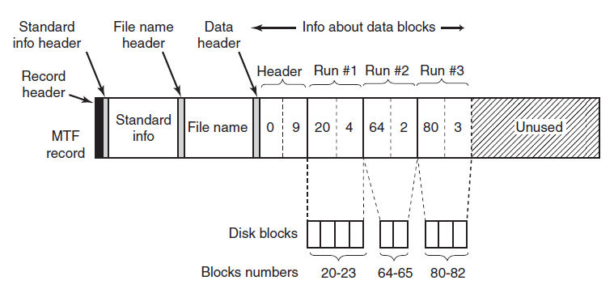
Storage Allocation (1)
Figure 11-41. An MFT record for a three-run, nine-block stream.
Tanenbaum & Bo, Modern Operating Systems:4th ed., (c) 2013 Prentice-Hall, Inc. All rights reserved.

Slide 56
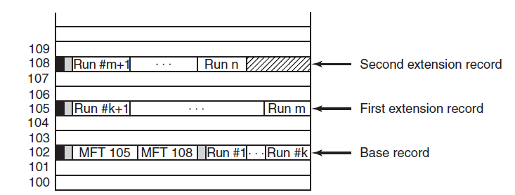
Storage Allocation (2)
Figure 11-42. A file that requires three MFT
records to store all its runs.
Tanenbaum & Bo, Modern Operating Systems:4th ed., (c) 2013 Prentice-Hall, Inc. All rights reserved.

Slide 57
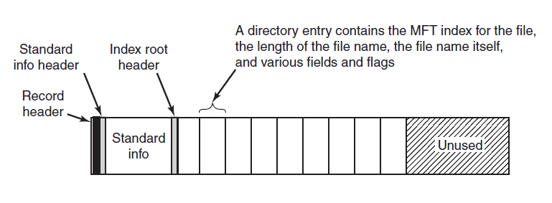
Storage Allocation (3)
Figure 11-43. The MFT record for a small directory.
Tanenbaum & Bo, Modern Operating Systems:4th ed., (c) 2013 Prentice-Hall, Inc. All rights reserved.

Slide 58
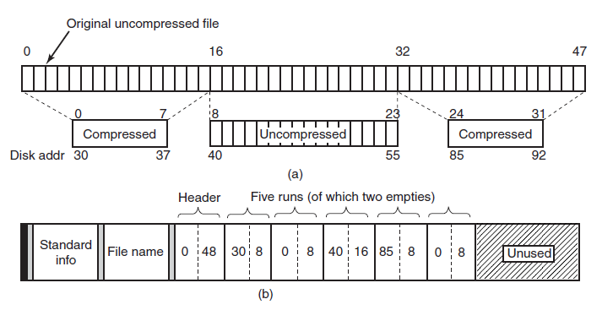
File Compression
Figure 11-44. (a) An example of a 48-block file being compressed to 32 blocks. (b) The MFT record for the
file after compression.
Tanenbaum & Bo, Modern Operating Systems:4th ed., (c) 2013 Prentice-Hall, Inc. All rights reserved.

Slide 59
Security in Windows 8
Security properties inherited from NT:
Secure login with antispoofing measures.
Discretionary access controls.
Privileged access controls.
Address space protection per process.
New pages must be zeroed before being mapped in.
Security auditing.
Tanenbaum & Bo, Modern Operating Systems:4th ed., (c) 2013 Prentice-Hall, Inc. All rights reserved.

Slide 60


Fundamental Security Concepts
Figure 11-45. Structure of an access token.
Tanenbaum & Bo, Modern Operating Systems:4th ed., (c) 2013 Prentice-Hall, Inc. All rights reserved.

Slide 61
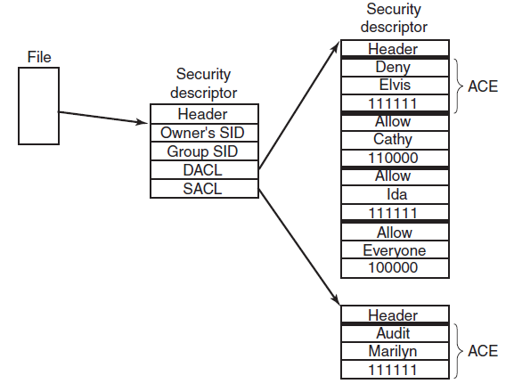
Security API Calls (1)
Figure 11-46. An example security descriptor for a file.
Tanenbaum & Bo, Modern Operating Systems:4th ed., (c) 2013 Prentice-Hall, Inc. All rights reserved.

Slide 62
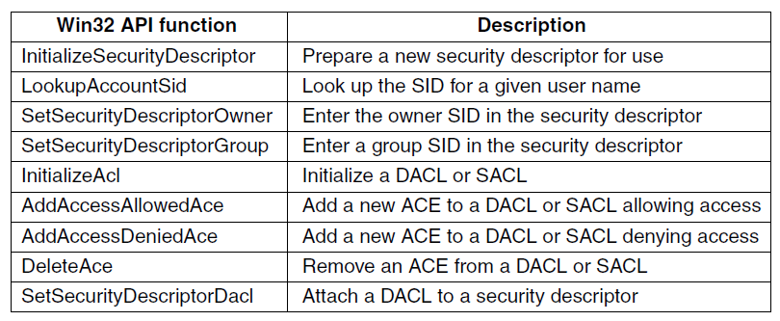
Security API Calls (2)
Figure 11-47. The principal Win32 API functions for security.
Tanenbaum & Bo, Modern Operating Systems:4th ed., (c) 2013 Prentice-Hall, Inc. All rights reserved.

Slide 63
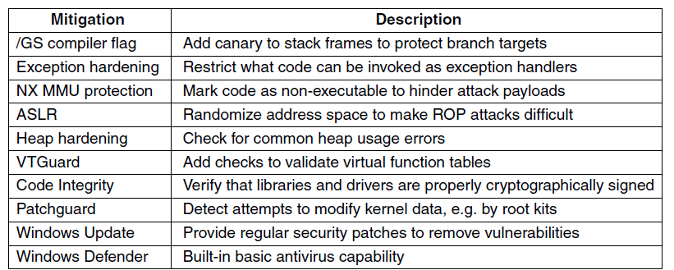
Security Mitigations
Figure 11-48. Some of the principal
security mitigations in Windows.
Tanenbaum & Bo, Modern Operating Systems:4th ed., (c) 2013 Prentice-Hall, Inc. All rights reserved.

Slide 64
End
Chapter 11
Tanenbaum & Bo, Modern Operating Systems:4th ed., (c) 2013 Prentice-Hall, Inc. All rights reserved.

