Slide 1

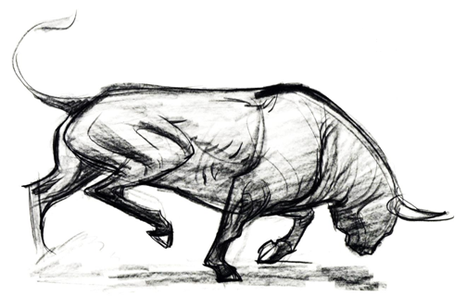
Firm Overview
Portfolio Solutions
Alternative Investments
Careers
Partner Portal
Vi tauri
[vi-tawr-ee]
Noun
Origin: Latin, 2007
Force of the bulls; derived from –
vi (vis): force, power, energy, strength
taurus (tauri): bull, ox, bison
Terms & Conditions of Use Site Map Contact Us Copyright 2013 Vitauri Group LLC. All Rights Reserved

Slide 2


Firm Overview
Portfolio Solutions
Alternative Investments
Careers
Partner Portal
Careers
Criteria
Overview
Criteria
We are seeking highly motivated, entrepreneurial and team oriented individuals with innovative ideas and solutions to join our team.
We seek individuals that strive to be future leaders and are passionate on developing and expanding the company. Candidates should also display dynamic analytical skills and possess excellent interpersonal and communication skills. Our primary goal at Vitauri is to gather talented, sharp minded individuals and expand their knowledge to tackle both global economic and social challenges.
A background in the financial services industry is not required. We believe that anyone with dedicated interest in the global markets and the financial industry has the ability to become successful within Vitauri. While the number of candidates sought each year varies, Vitauri remains committed to finding the best new talent. To submit a résumé or learn more about employment, recruiting and internship positions, please email us at careers@Vitaurigroup.com.
Terms & Conditions of Use Site Map Contact Us Copyright 2013 Vitauri Group LLC. All Rights Reserved

