Slide 1


Api-Mysql-AKS - Deployment
Release 1-2024.03.16
Rodrigo Moro

Slide 2

CheckList App- Infra - Print screen
1 - Database
1 -Discovery
Undertand the
Requirements and create
User stories and activities
I used Azer Devops Boads
Click Challenge Reposity .
2 – Build and test
Build Application, Testing, Database, IAC with Terraform , aks artefacts;
3 - Test and presentation
Presentation and Prints evidences
.

Slide 3
Introduction
Terraform Provider for AKS – Challenge
All Commits are been made On Dev Branch until validation and merge to "Main" branch
Website: terraform.io Tutorials: learn.hashicorp.com
https://registry.terraform.io/providers/hashicorp/aws/latest

Slide 4
Pre-Requirements
To create the laboratory, it is necessary to have the following Software's installed or Account:
Git Hub Actions – Deploy –CI/CD
VsCode – Create/Edit
Terraform v:1.7.4(latest),
Account Azure,
Terraform Workspace API Secrets (Terradorm Cloud)
Azure Devops – Boards –TaskList Organization
GitHub – PushCode
Api: AspNetCore 5
Database: Mysq 8

Slide 5

Architecture
internet
Architecture diagrams Envolved Services Aws
ECS – Fargate Container Services
ECR – Container Registry
RDS – Postgres Database
Cloudwatch Monitoring
Aws Backup
Public subnet
cloudwatch

Slide 6
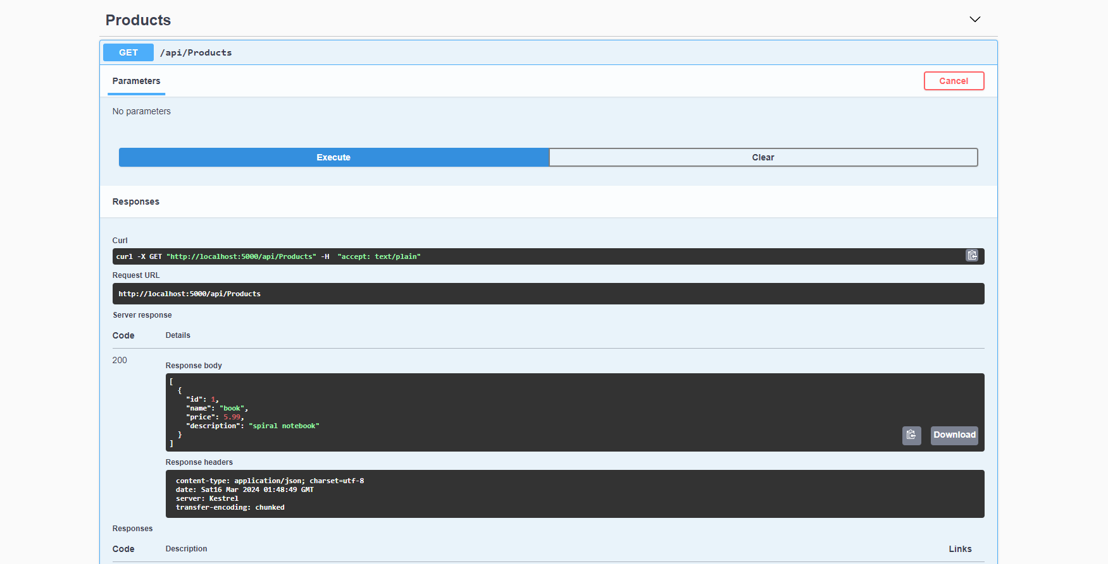
CheckList App App- Infra
https://github.com/rodrigomororodrigues/FullStackApp-Challenge
Docker API
1. Build Multi-stage Docker Application API
2.Ajustments Docker Security, Added comments, Improved small Size
3.Pushed to Docker hub (more than 13versions tested)
https://hub.docker.com/repository/docker/rodrigomoro/apimysqlrodrigomoro/general
to test and Azure Registry
CheckList Terraform
Build modules AKS
Modules ajustments (several ajustments like size disk type and Bastion Host, Log Analytics, key vault, container Registry, Private Zone, Endpoint, Storage Account, Route Table, Virtual network Peering, Deployment Script with helm, Prometheus, Ingress with NGINX, Cert Manager,

Slide 7
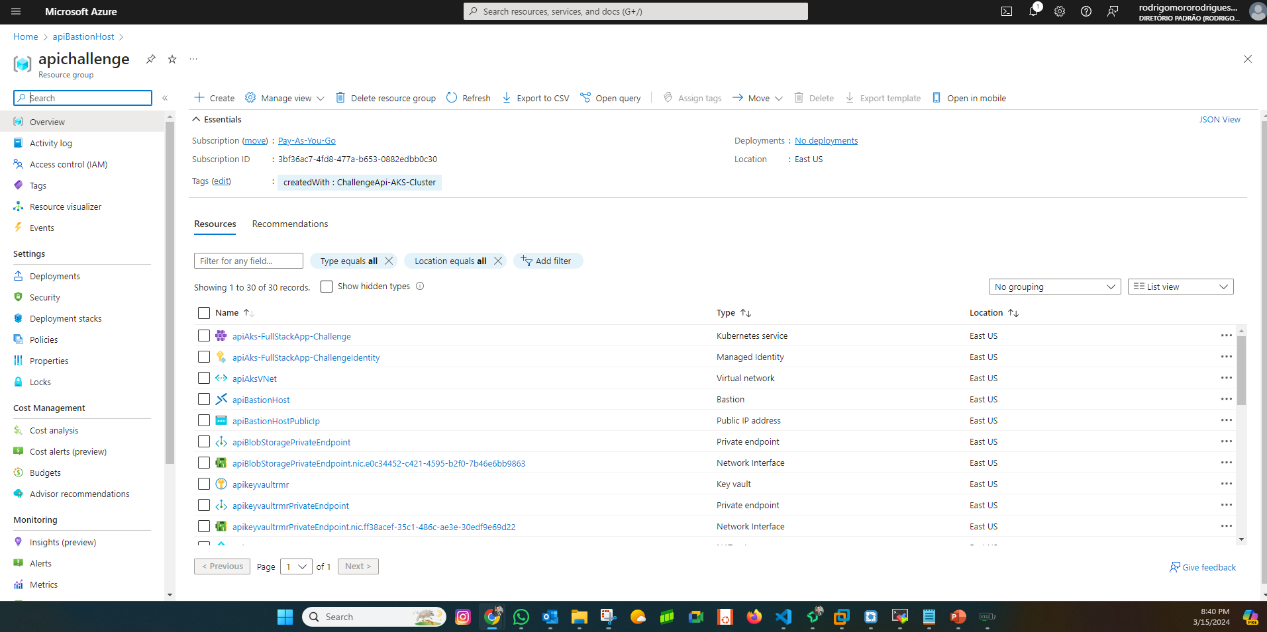
CheckList App- Infra - Print screen
1 - Database
2 - Network

Slide 8
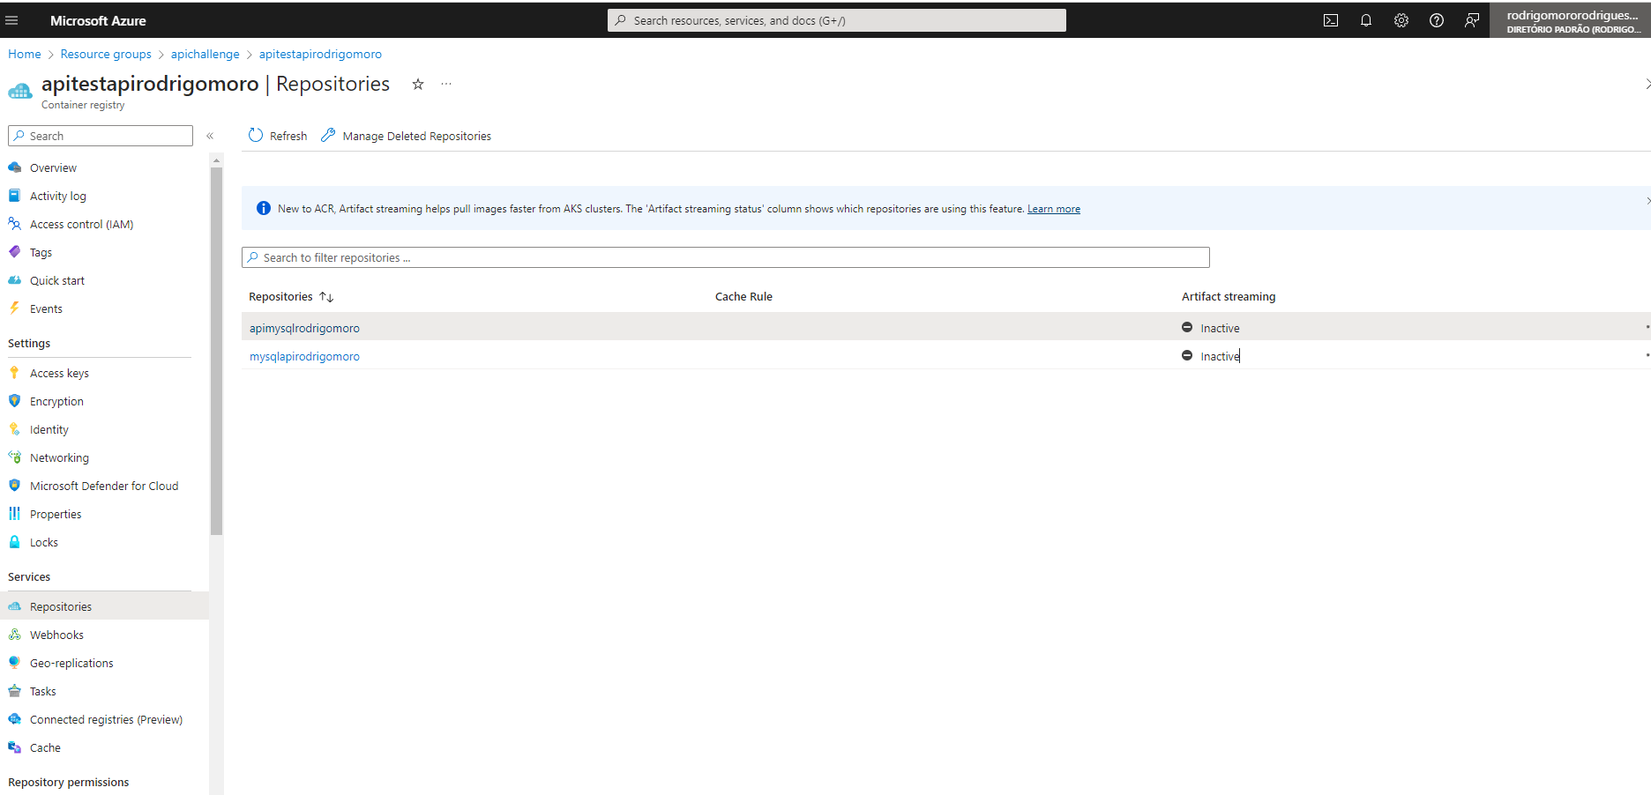
CheckList App- Infra - Print screen
1 - Database
2 - Network

Slide 9
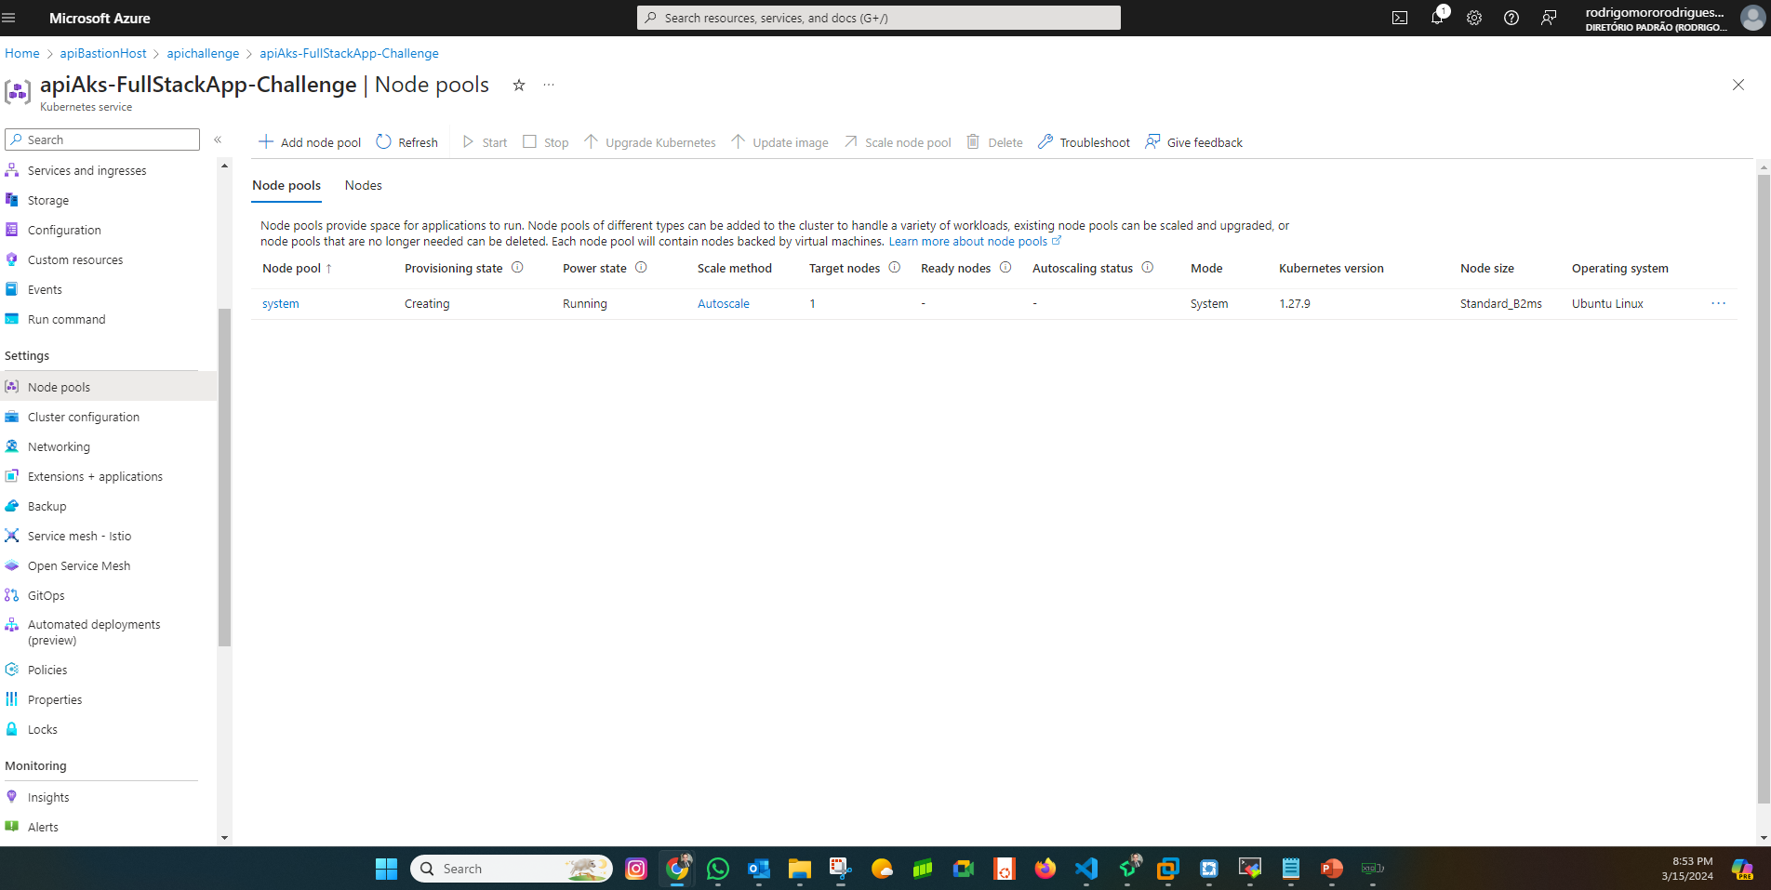
CheckList App- Infra - Print screen
1 - Database
2 - Network

Slide 10
CheckList
1
Check for the latest deck update.
Download the latest deck from the AWS Architecture Center.
3
When in doubt, see the examples.
For completed diagrams, go to the example pages. If you’re having trouble with a particular layout or object, use these as a template.
2
Read the guidelines.
For specific element guidance and best practices, see the guidelines section.

Slide 11
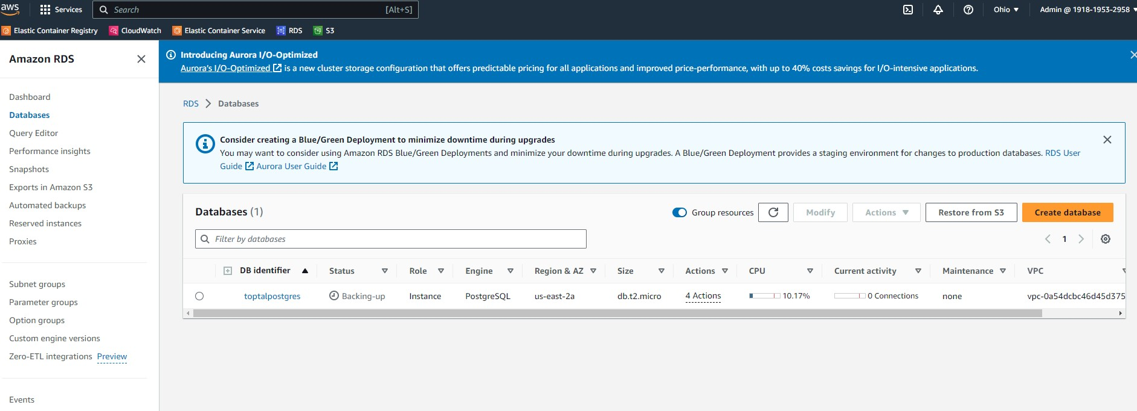
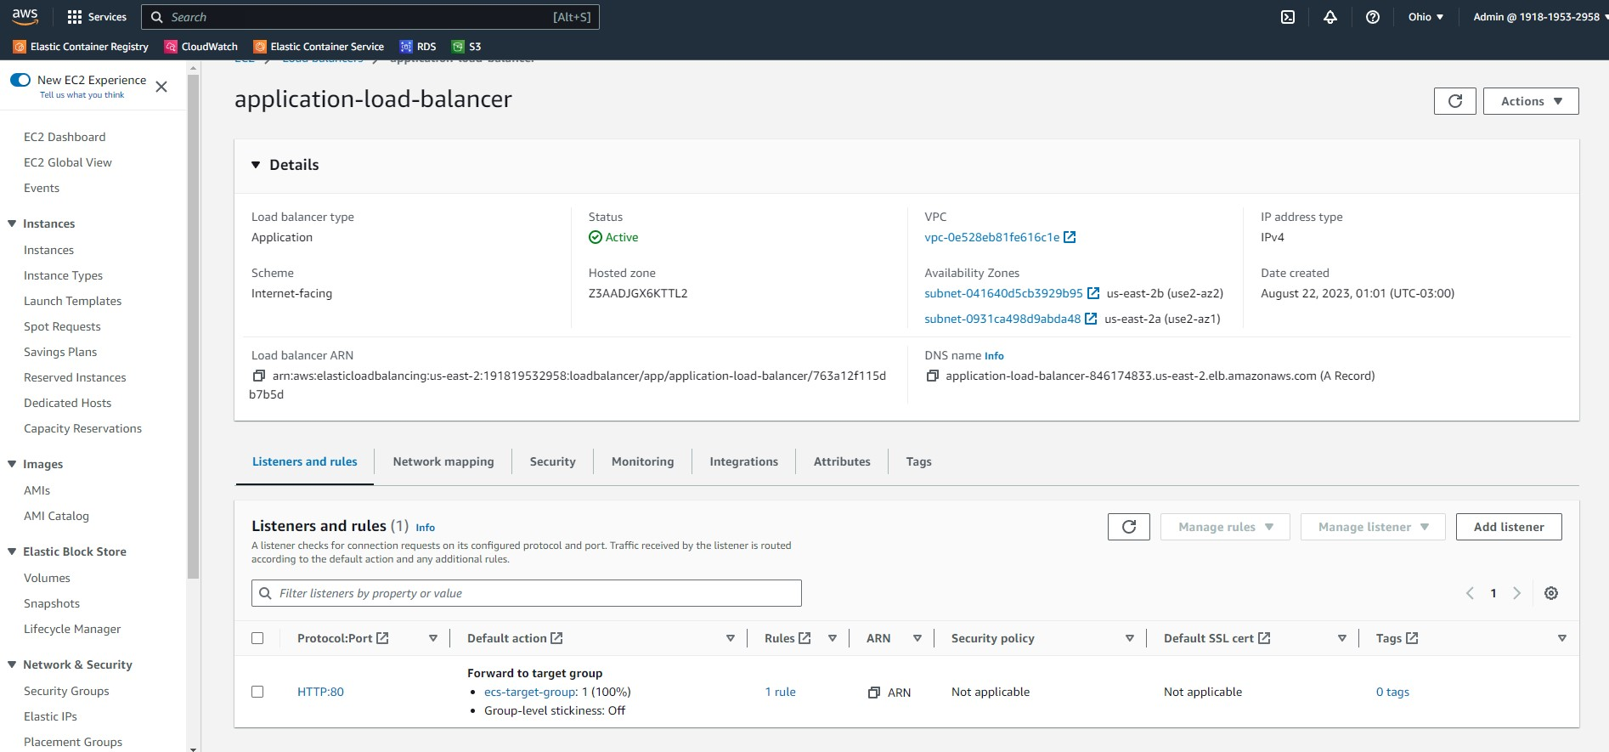
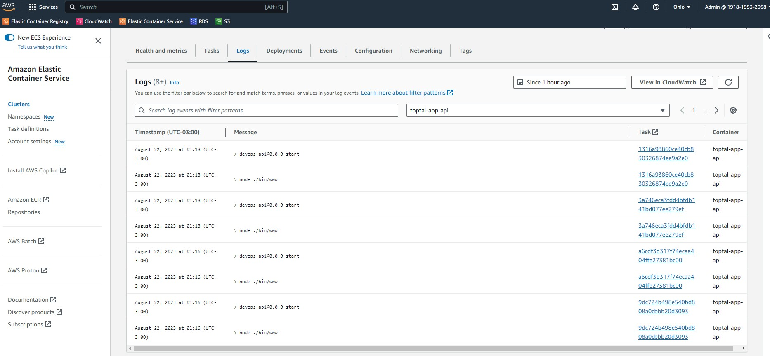
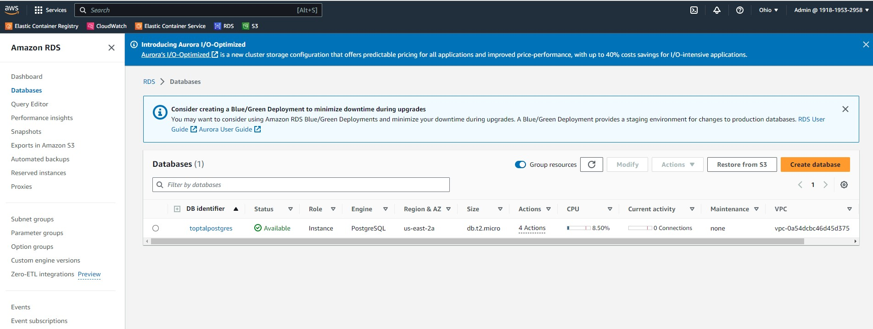
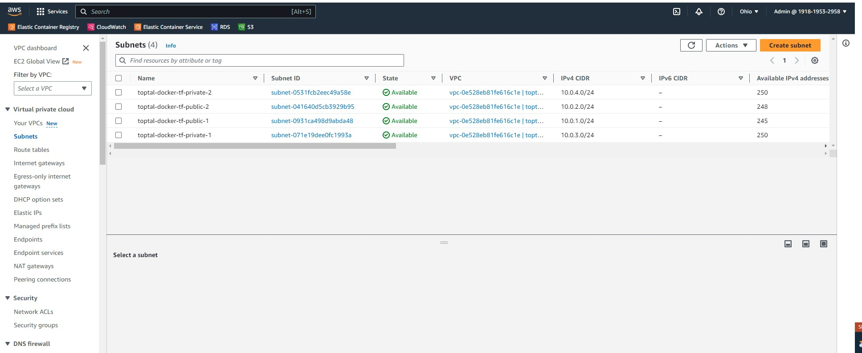
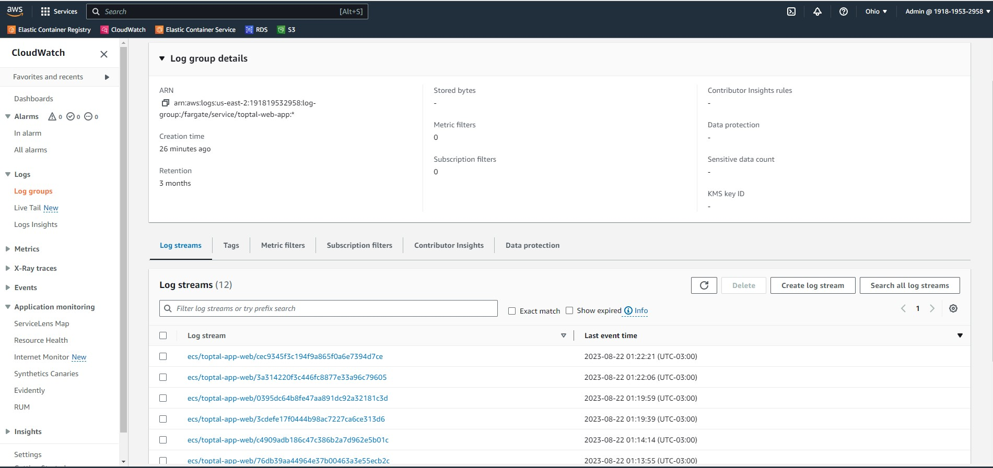
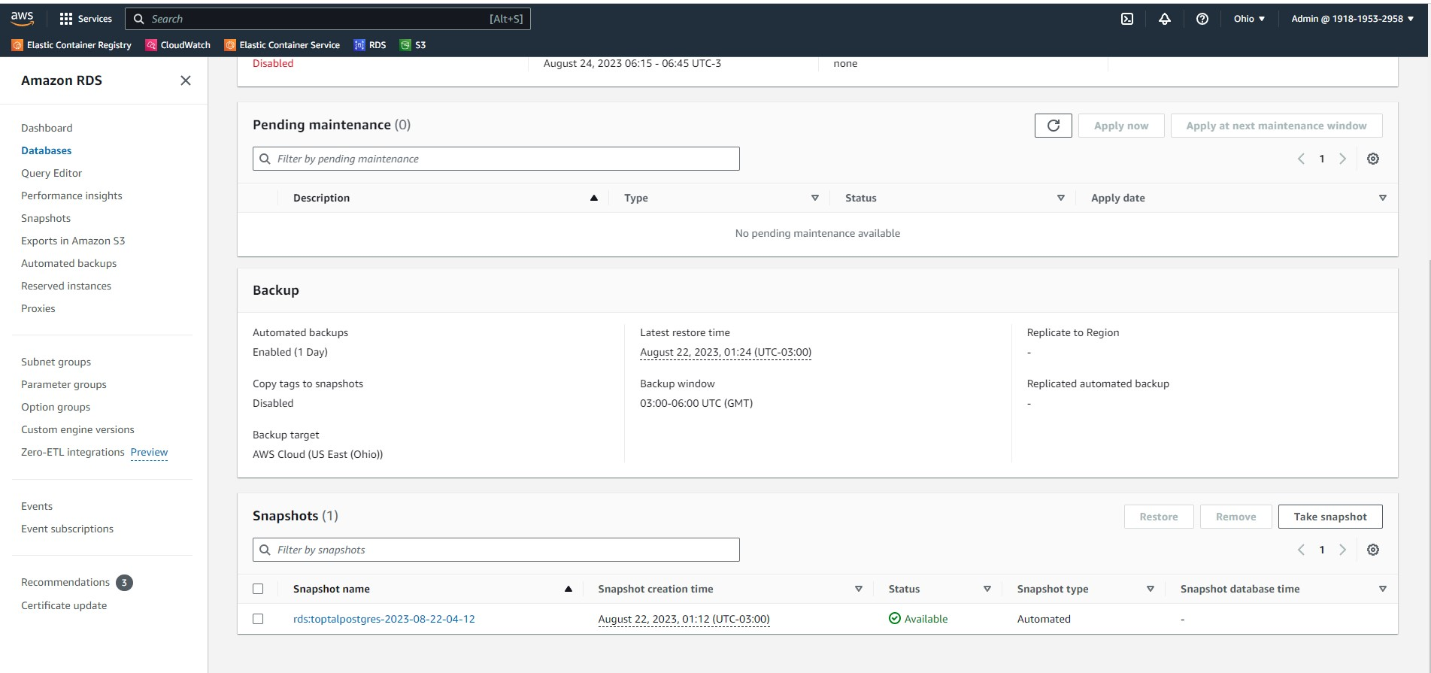
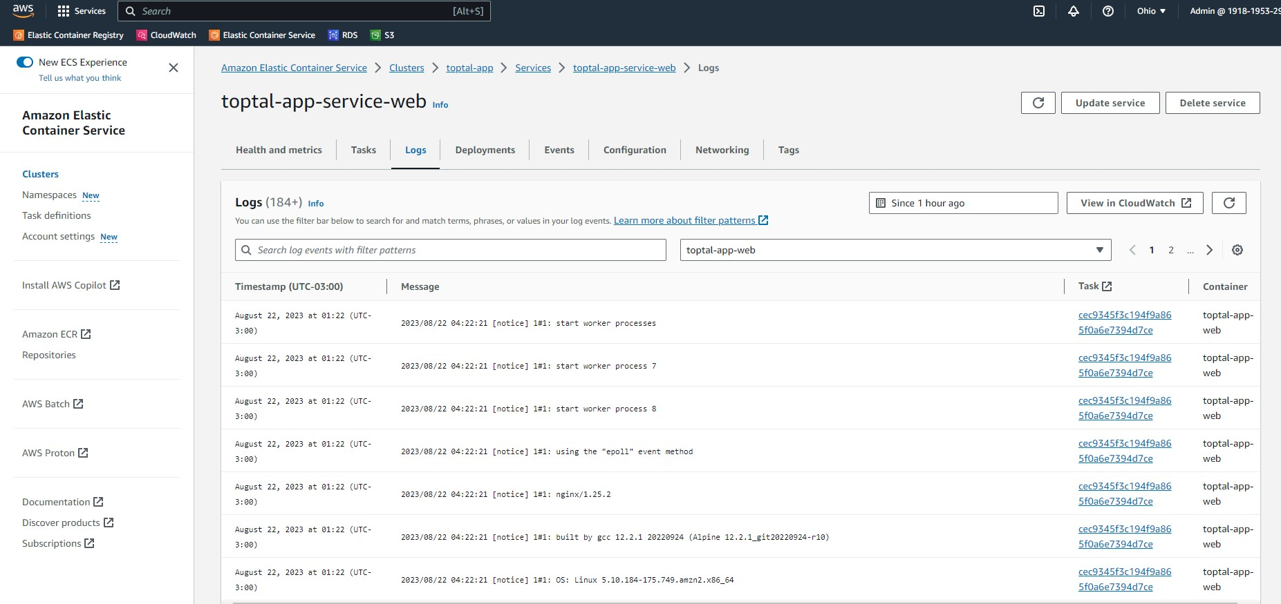
CheckList
2 - Network
3 – Application -Front/Back
1 - Database

