Slide 1
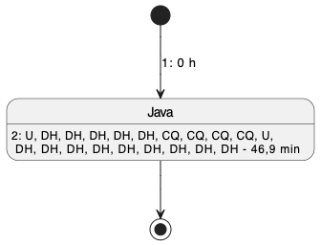
Session (without spacing)

Slide 2
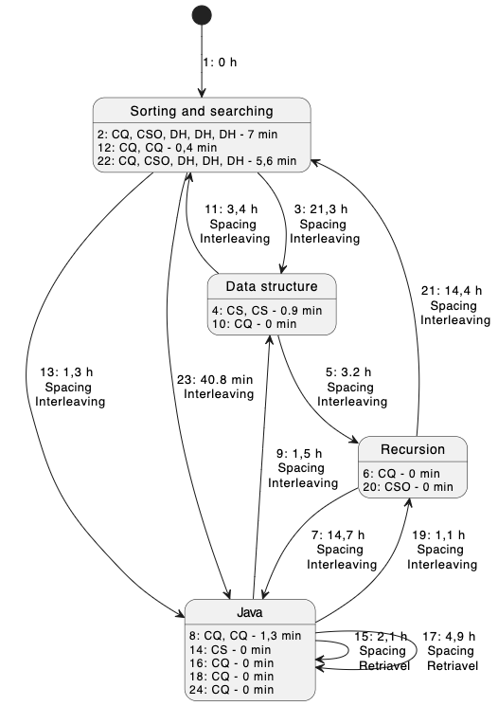
1LIlNQ39QRzunj
12
Studie
Sessions
Spacing and Interleaving
Time of 60 e minutes may be not precise
Spacing
and
Retrieval

Slide 3
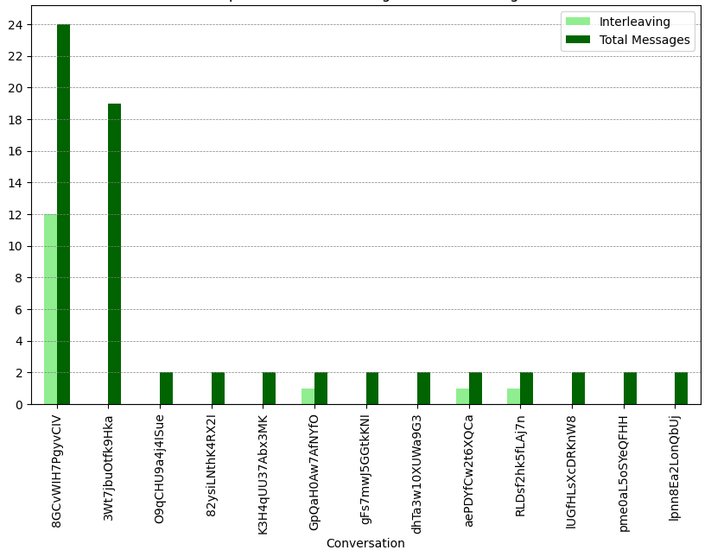
Interleaving
Inside a session

Slide 4
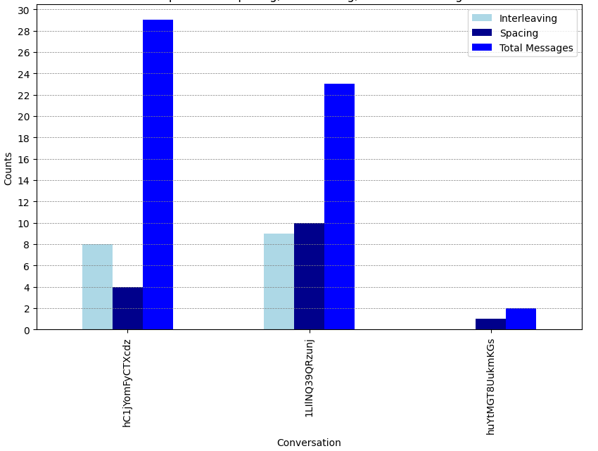
Spacing caused
Interleaving
Interleaving
Inside a session
Spacing
and
Retrieval
Spacing
and
Retrieval

