Slide 1
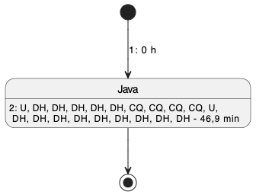
Session (without spacing)

Slide 2
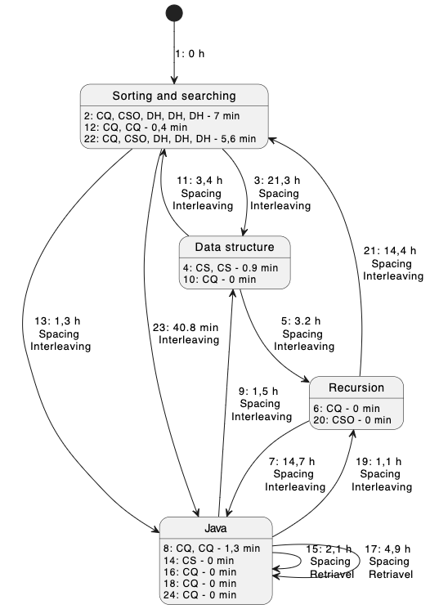
1LIlNQ39QRzunj
12
Studie
Sessions
Spacing and Interleaving
Time of 60 e minutes may be not precise
Spacing
and
Retrieval

Slide 3
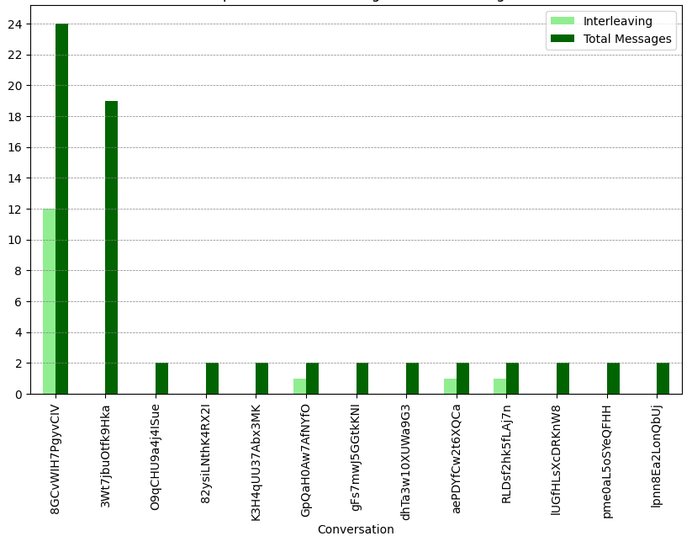
Interleaving
Blocked

Slide 4
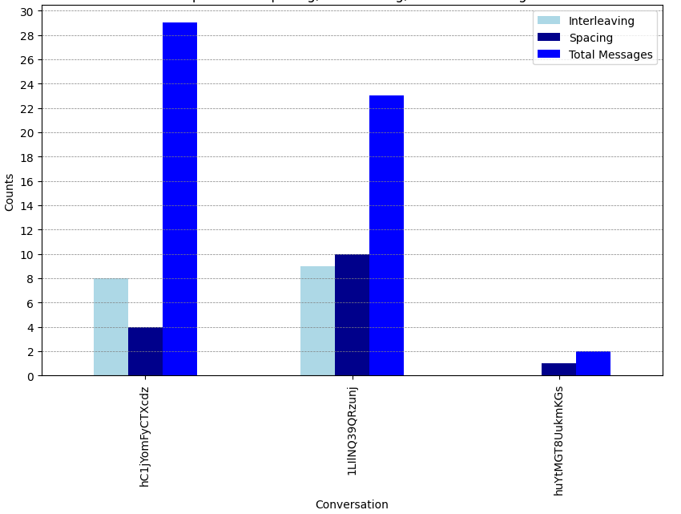
Spacing and
Interleaving
Interleaving
2x Spacing
and
Retrieval
Spacing
and
Retrieval

Slide 5
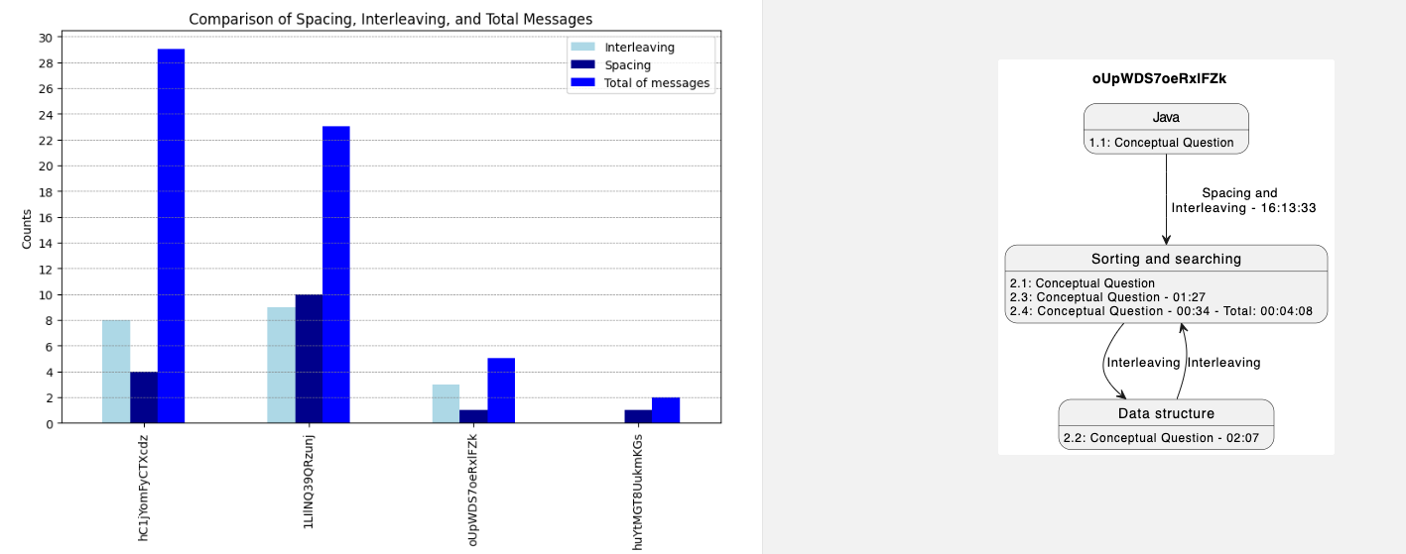
Spacing = 1 (2 sessions)
Interleaving = 3
Interleaving > Spacing => Interleaving inside a session

Slide 6
Roadmap
Chatbots development (applications)
Development of tools for visualizing students' metacognitive strategies
Development of educational microservices (Orion Services)
RAG Research and Development
Development of automatic detection of students' metacognitive patterns using statistical methods
Development of a microservices-based framework to control educational workflows
Research and development of models for identifying students' metacognitive strategies
Theoretical research on Cooperative Learning Workflows
Theoretical research on the application of metacognitive strategies in the use of GenAI

