Slide 1
Tunix - Music Search System
Information Processing and Retrieval – Milestone 1
13-10-2025
Nuno Rios (up202206272@up.pt)
Rodrigo Resende (up202108750@up.pt)
Rodrigo Ribeiro (up202206396@up.pt)
António Pereira (up202205501@up.pt)

Slide 2
Tunix - Music Search System
Main points:
Traditional systems (e.g., Shazam) rely on audio fingerprinting.
However, users often remember lyrics, not melodies.
Goal: Retrieve songs, artists, and metadata from text queries.
Tunix integrates multiple datasets:
  Tracks, artists, lyrics.
Provides contextual info such as:
  Artist biography, album details, lyrics.
Contributes to Information Retrieval by building a structured pipeline for text-based music search.
Text Query
Tunix
Artist / Song

Slide 3
Data Sources
Dataset | Attributes | Pros | Cons
Audio features and lyrics of Spotify songs | track_id, track_name, track_artist, lyrics, track_popularity, track_album_id, track_album_name, track_album_release_date, playlist_name, playlist_id, playlist_genre, playlist_subgenre, danceability, energy, key, loudness, mode, speechiness, instrumentalness, liveness, valence, tempo, duration_ms, language | A lot of information about the songs and many different tracks | Some songs don’t have lyrics and the number of songs per artist is a bit limited. Too many non-essential attributes
Spotify Million Song Dataset | song_name, artist_name, link, lyrics | Good balance of attributes, consistent number of songs per artist, and overall a well-sized dataset | Some inconsistencies in how values are obtained — description states data comes from the Spotify API, but song links are from a lyrics website
Song Lyrics Dataset | Artist, Title, Album, Date, Lyric, Year | Well-structured by artist; good complementary dataset to enrich the main dataset with lyrics information | Some songs do not have lyrics (marked consistently with the string "lyrics for this song have yet to be released please check back once the song has been released"); easy to detect and filter
Lyrics and Metadata from 1950 to 2019 | artist_name, track_name, release_date, genre, lyrics, len, dating, violence, world/life, night/time, shake the audience, family/gospel, romantic, communication, obscene, music, movement/places, light/visual perceptions, family/spiritual, like/girls, sadness, feelings, danceability, loudness, acousticness, instrumentalness, valence, energy, topic, age | Very rich dataset with a large number of songs and detailed metadata | May have too many artists with only a few songs each and includes many non-essential attributes
Artists | artist_name,artist_mbid,biography,top_10_similar_mbids,dbpedia_uri | Very rich dataset with a large number of artists and detailed metadata | Its not a raw dataSet, its a set of files that need to be conected can be harder to work

Slide 4
Exploratory Data Analysis
Attributes:
artist → Artist name
song → Song title
link → Unique song identifier
text → Lyrics
Link Structure:
Each link points to a unique song page
URL encodes artist name and song title
End number = unique song ID
Lyrics Structure:
Lyrics split by verses/paragraphs (\r\n)
Repeated lines = choruses/refrains
Variable length; may include [Chorus] or musical instructions
Keywords indicate themes (e.g., “love”, “Christmas”)
Formatting may vary (spaces, capitalization)
Same lyrics can appear for different artists (covers)
Unique Values Insights:
89 songs per artist on average
Many songs share the same title → different versions/artists
Some lyrics are repeated across artists → same song, different performer

Slide 5
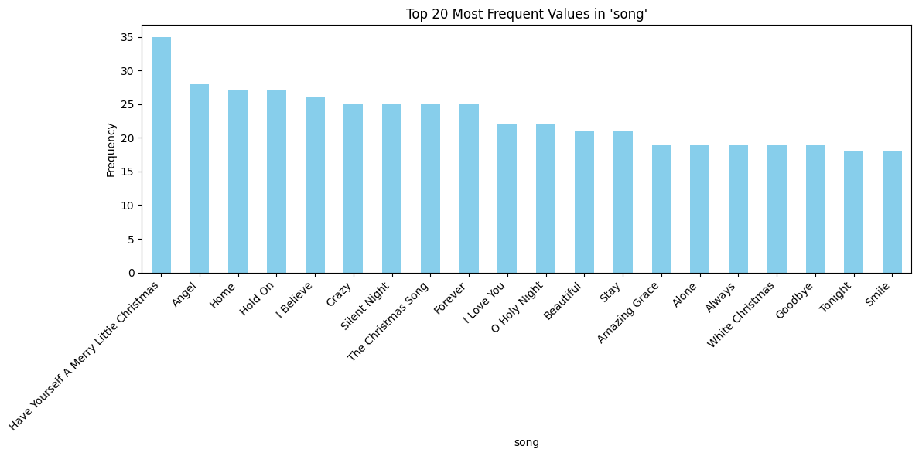
Exploratory Data Analysis

Slide 6



Data Processing Pipeline
Goal
Enhance the dataset with musical metadata retrieved from the Last.fm API:
Artist description
Album title
Release date
Track description
Main Steps
Normalize Input Rows:
  Extract clean (song, artist) pairs
  Standardize capitalization and spacing
Track SearchAPI Method: track.search
  Retrieves→ track_mbid, artist_mbid, track_name, artist_name
  Used to identify the most accurate match for each song-artist pair.
Artist MetadataAPI Method: artist.getInfo
  Extracts→ bio.content / bio.summary, name
  Cleans HTML and removes boilerplate text
  Provides background and descriptive details about the artist.
Track MetadataAPI Method: track.getInfo
  Extracts→ wiki.content / summary (track description)→ wiki.published (release date)→ album.title, album.mbid
  Adds contextual metadata such as album title and release info.
General Setup
API Root: http://ws.audioscrobbler.com/2.0/
Common Parameters: method, api_key, format=json

Slide 7
Enriched Dataset
The dataset produced by the pipeline is organized into two main tables, Musics and Artists, each containing enriched metadata collected from the Last.fm API.
1. Musics Table
Lyrics – Song lyrics
Album – lastfm_album_name
Link – Song identifier
Description – lastfm_track_description
Release Date – lastfm_release_date
2. Artists Table
Artist – Artist name
Last.fm Name – lastfm_artist_name
Bio – lastfm_artist_bio

Slide 8
Data Analysis
General Checks
Null values → Identify missing data
Duplicate rows → Detect repeated records
Unique values per column → Check data variety
Individual Checks
Short strings → Validate artist_bio and lyrics
Wrong artist bios → Remove nulls and detect invalid entries containing:
  "There are"
  "Read more on Last.fm"
Columns Removed
Songs: link, lastfm_track_description, lastfm_release_date
Artists: lastfm_artist_name
Handling Nulls
album_name → Replace nulls with "Single"
Column Renaming
lastfm_artist_bio → artist_bio
lastfm_album_name → album_name
Columns Added
Songs: artist_id (connect to Artists), id (unique song identifier)

Slide 9
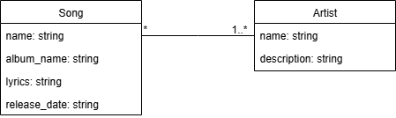
System Conceptual Model
Entities:
Artist (id, name, description)
  Has → Songs
Song (id, name, lyrics, album_name, artist_id)
  Performed by → Artist
Relationships:
One Artist → Many songs
One Song → One or more artists

Slide 10
Definition and Characterization of the Final Collection
After the data cleaning and preprocessing steps, two final datasets were obtained:
Song → Contains information about each song, including: id, artist_id, title, album_name, and lyrics.
  Each row in the Song dataset represents a unique song, including relevant metadata and a reference to its artist. In total, the dataset contains 55,185 entries.
Artist → Contains information about each artist, including: id, artist_name, and artist_bio.
  Each row in the Artist dataset represents a unique musical artist with cleaned and validated information. The dataset contains 643 entries in total.
These datasets are consistent, well-structured, and ready for analysis or integration into the Solr.
We chose to store them in CSV format because it is:
Lightweight and easy to handle
Widely supported across different tools and programming languages
Easy to visualize in tools like Excel or pandas
Ideal for data exchange and further processing

Slide 11
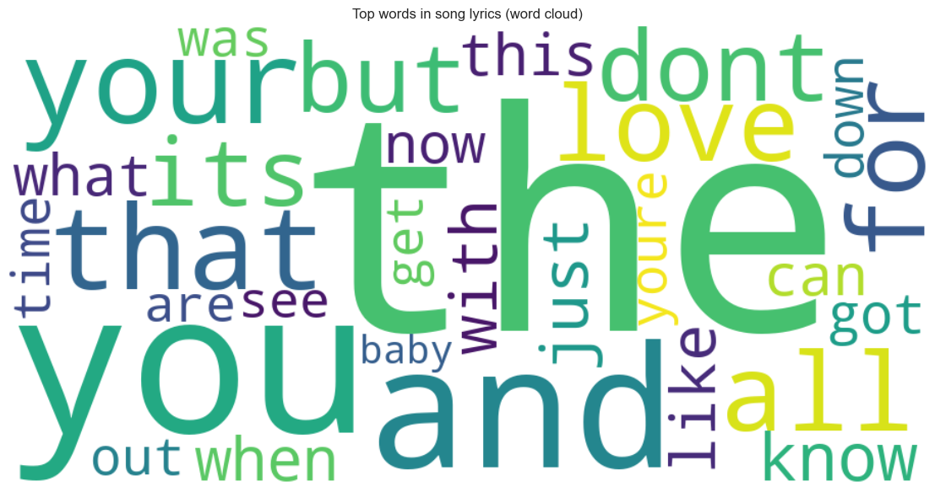
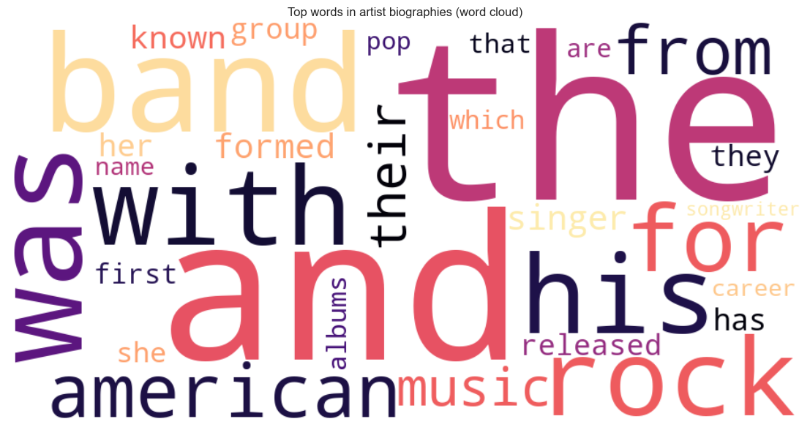
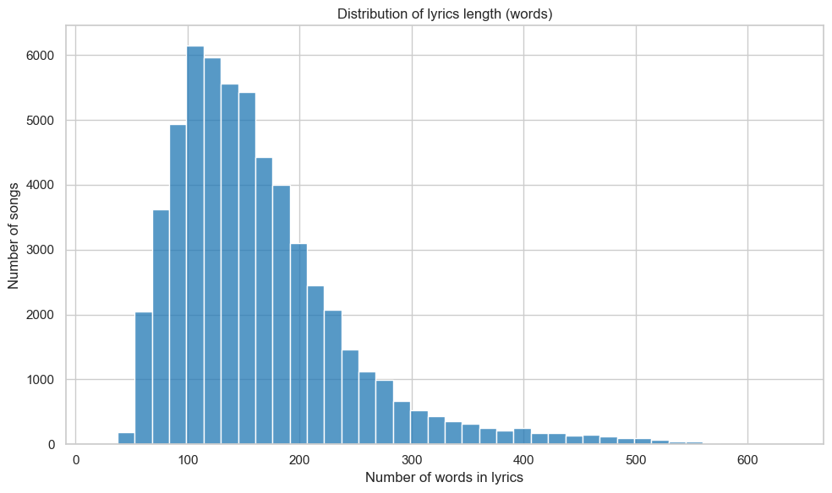
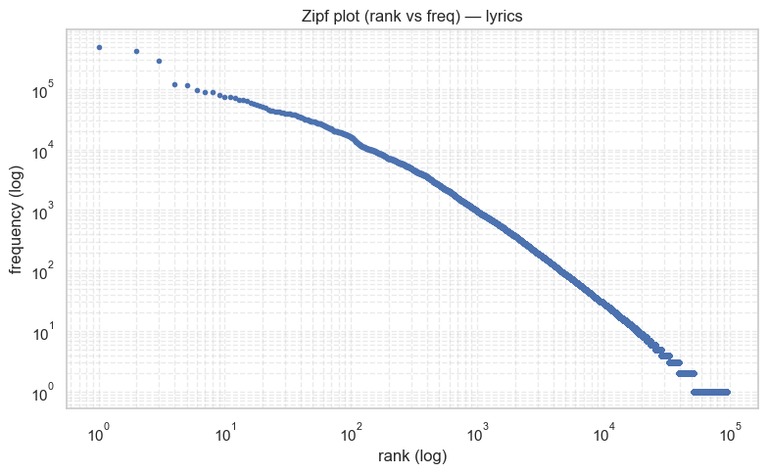
Definition and Characterization of the Final Collection

Slide 12
Information Needs
Search songs by sentiment – Ability to find songs based on emotions or mood expressed in the lyrics.
Similarity-based search – Find songs that are similar in style, theme, or lyrical content.
Filter songs by violence – Identify and exclude or focus on songs containing violent themes.
Relate artist background to lyrics – Connect the personal or professional background of an artist with the content of their songs.

